Slide 1
AquaMind: Blynk-Based Smart Irrigation System with Auto and Manual Mode for Efficient Water Management
Submitted in the partial fulfillment for the award of the degree of
BACHELOR OF ENGINEERING
IN
COMPUTER SCIENCE ENGINEERING
specialization in Internet Of Things (IoT)
Submitted by:
Aman Jha (22BIT70031)
Raunak Kumar (22BIT70008)
Rishabh Kumar (22BIT70062)
Vedant Sharma(22BIT70045)
Under the Supervision of:
Er. Abhishek Tiwari (E15792)
Department of AIT-CSE
DISCOVER . LEARN . EMPOWER

Slide 2
Outline
Introduction to Project
Problem Formulation
Objectives of the work
Hardware requirement
Methodology to be used
Literature Review
Conclusion
Future Scope
References

Slide 3
Introduction to AquaMind
AquaMind is an innovative IoT-based smart irrigation system designed to automate and optimize the process of watering plants using real-time soil moisture data and intelligent control mechanisms. The primary objective of AquaMind is to conserve water, reduce human effort, and ensure that crops receive the right amount of water at the right time.
Its Need?
  Water Scarcity and Over-Irrigation:
  System Safety and Reliability:
  Sustainable Agriculture:
  Why AquaMind?
  The system “thinks before watering” by analysing real-time soil moisture data and making automatic decisions.​
  Offers both automatic and manual control via IoT (Blynk app), ensuring flexibility and user control.
  Includes a safety override to protect against Wi-Fi disconnection, sensor failure, or abnormal readings.

Slide 4
Problem Formulation
Challenges in Traditional Irrigation System:​
Manual Operation & Human Dependency: Farmers had to turn pumps on/off manually, leading to irregular watering and water wastage.
No Real-Time Monitoring: Earlier systems lacked soil moisture sensing, causing over- or under-irrigation.
No Safety Mechanism: Systems failed to stop automatically during sensor faults or network loss.
No Data Insight: Older systems provided no data visualization or control analytics for optimization.
No Adaptive Feedback: There was no hysteresis or feedback logic to stabilize pump operation.

Slide 5
Objectives of the Work
Automatic Irrigation Control: To design a smart system that automatically regulates water flow based on real-time soil moisture levels.
Dual-Mode Operation: To provide both automatic and manual modes for flexible and user-friendly irrigation control.
IoT-Based Monitoring: To integrate the Blynk IoT platform for real-time monitoring, data visualization, and remote pump operation.
Adaptive Feedback Mechanism: To implement hysteresis logic for stable pump control and reduced switching frequency.
Interactive Dashboard: Develop visualization tools with real-time notifications for stakeholders​
Safety and Reliability: To add a safety override mechanism for protection during sensor failure or WiFi disconnection.

Slide 6
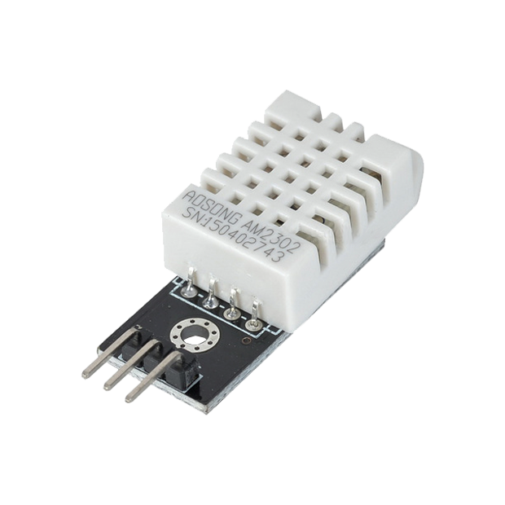
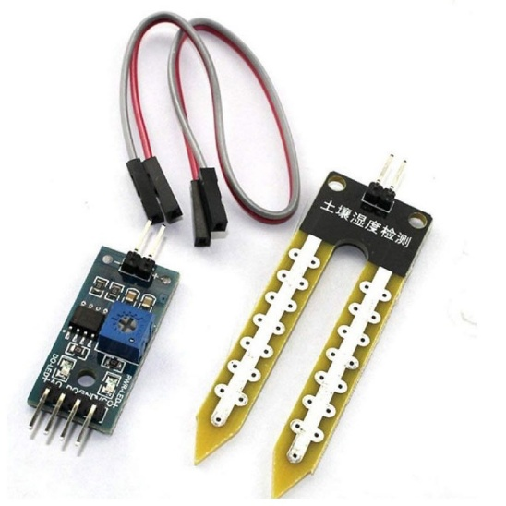
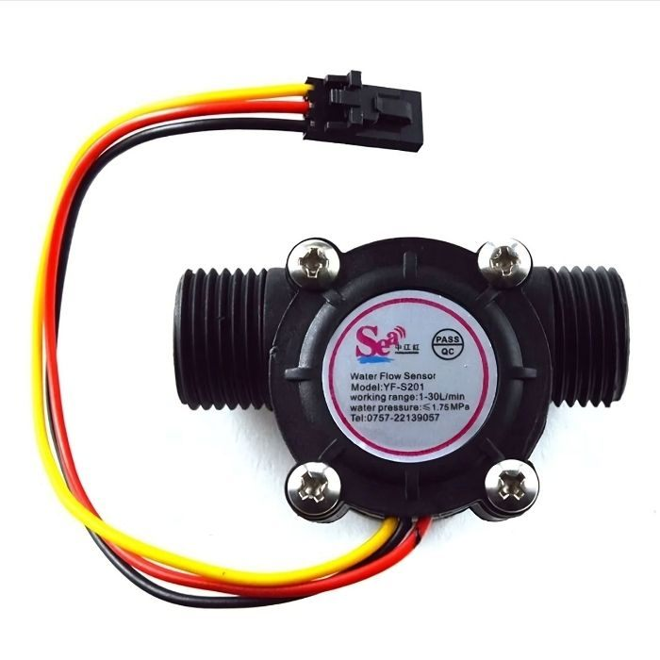
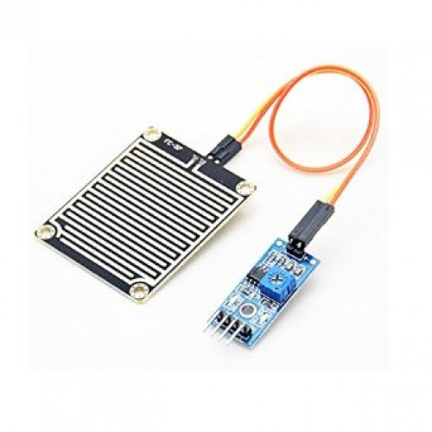
Hardware requirement
Sensors:​
Soil Moisture Sensor: Detects the water content in the soil and helps determine when irrigation is needed.
DHT11 / DHT22 Sensor : Measures ambient temperature and humidity to enhance irrigation decisions.
Water Flow Sensor : Monitors the rate of water flow through the pipeline to prevent overuse or leakage.
Rain Sensor : Detects rainfall to automatically stop irrigation during wet conditions.
Soil Moisture Sensor
DHT22 Sensor
Water Flow Sensor
Rain Sensor

Slide 7
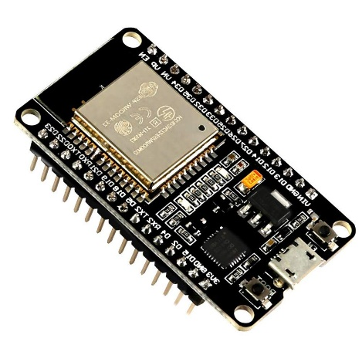
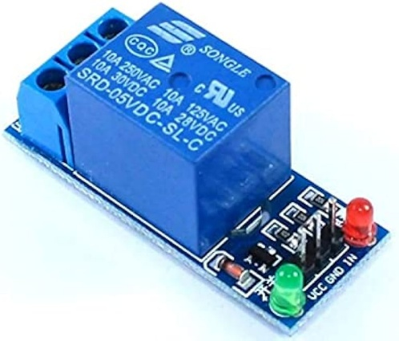
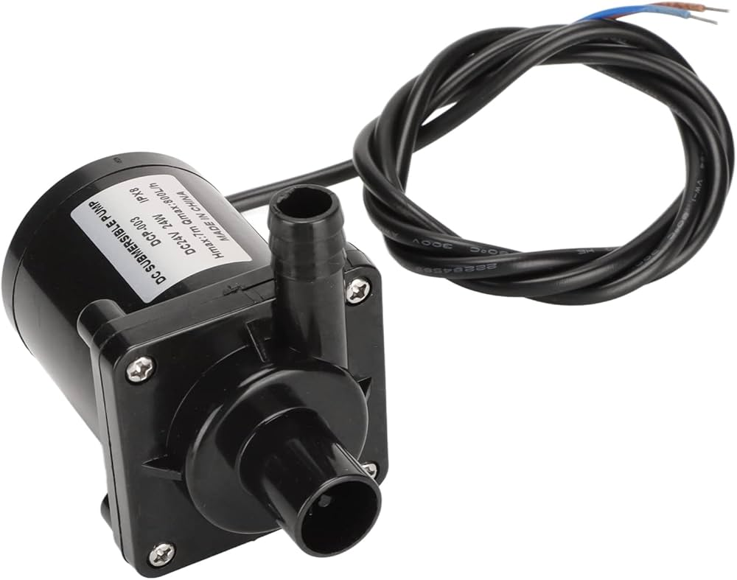
Hardware requirement
ESP32 Microcontroller: Serves as the central control unit, handling sensor input, relay output, and IoT communication.
Relay Module (5V): Acts as a switch to control the water pump based on signals from the ESP32.
Water Pump / Motor Valve: Pumps water to the plants when activated by the relay in auto or manual mode.
ESP 32 Microcontroller
Relay Module (5V)
Water Pump / Motor Valve

Slide 8
Software requirement
Blynk IoT Platform: Provides the mobile and web interface for real-time monitoring, control, and data visualization.
Arduino IDE: Used to write, compile, and upload the program code to the ESP32 microcontroller.
Wi-Fi Connectivity: Allows the ESP32 to connect to the internet for remote monitoring and operation.
Cloud Data Storage / Blynk Dashboard: For logging sensor data and analysing irrigation trends.

Slide 9
Methodology to be used
System Design and Planning: Designing the architecture integrating ESP32, sensors, relay, and IoT platform.
Hardware Integration: Connecting the soil moisture sensor, relay, and pump to the ESP32 with proper wiring.
Software Development: Programming the ESP32 in Arduino IDE for dual-mode operation and safety features.
​IoT Configuration: Setting up the Blynk IoT platform with virtual pins for monitoring and remote control.

Slide 10
Methodology to be used
Testing and Calibration: Verifying sensor accuracy and adjusting threshold values for reliable irrigation.
Performance Evaluation: Assessing system efficiency, response time, and reliability under different conditions.
Implementation and Monitoring: Deploying the system in the field and observing real-time performance via the app.
AI-Based Decision Making: Implementing machine learning algorithms to predict irrigation needs based on soil and weather data.

Slide 11
Literature Review
Evolution of Smart Irrigation Systems:​
Traditional Irrigation Methods: Early irrigation systems relied entirely on manual watering using canals or pumps, leading to water wastage, uneven distribution, and low efficiency.
Timer-Based Irrigation Systems: The next evolution introduced electric or mechanical timers to control pump operation, but these systems lacked soil feedback and adaptability to weather conditions.
Sensor-Based Automation: Later systems integrated soil moisture sensors to automate watering; however, most lacked IoT connectivity and real-time monitoring capabilities.
Microcontroller-Based Control: With the rise of microcontrollers like Arduino and ESP8266, systems became programmable, allowing automation based on sensor data, but remote access was still limited.

Slide 12
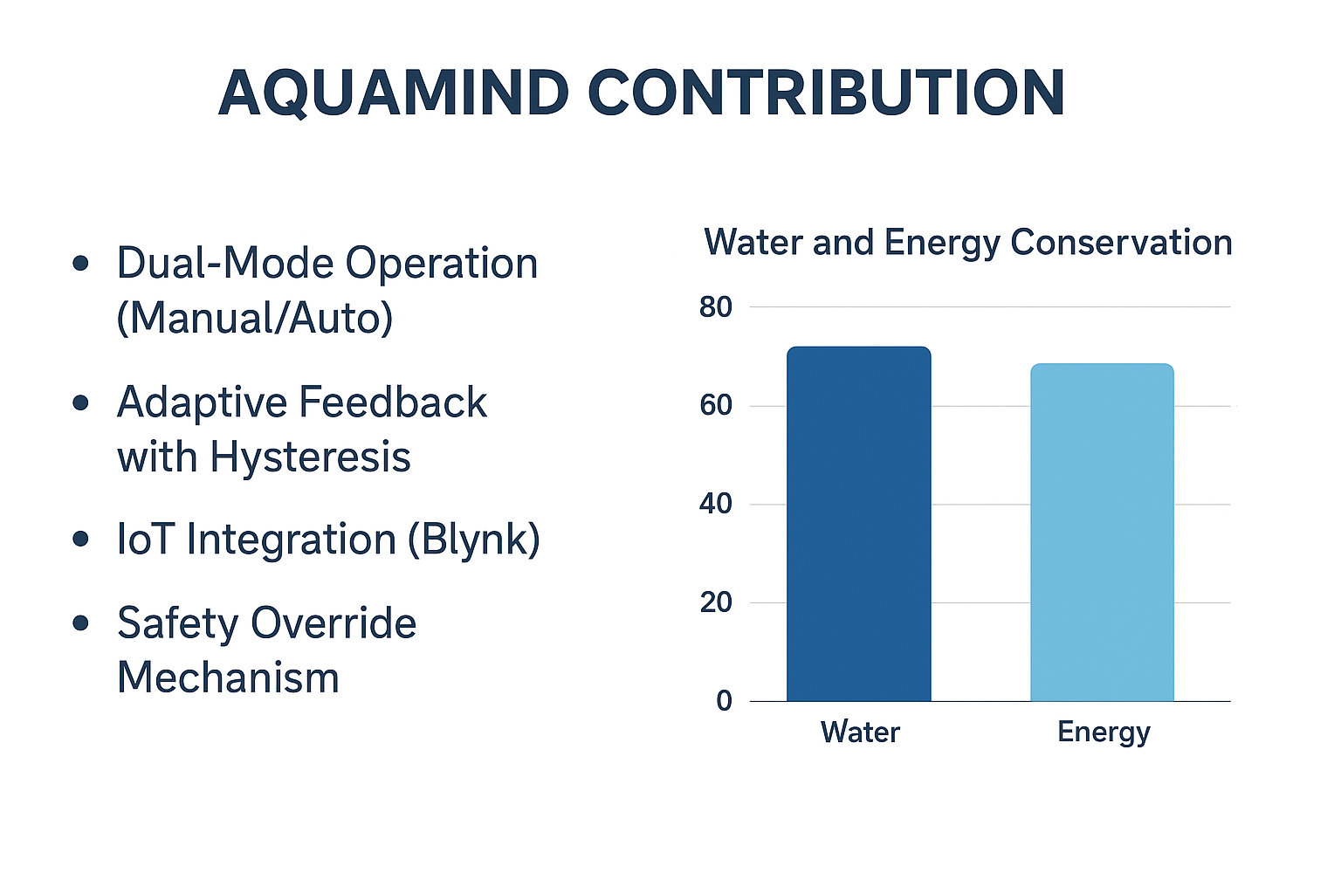
Literature Review
IoT-Enabled Smart Irrigation: Modern systems connected via IoT platforms (like Blynk and Thingspeak) enabled farmers to monitor and control irrigation remotely using smartphones.
AquaMind Evolution: The proposed AquaMind System advances this evolution by combining dual-mode operation, adaptive feedback, and a safety override mechanism, ensuring both automation and user control with high reliability.

Slide 13
Conclusion
The AquaMind system successfully demonstrates how IoT, automation, and adaptive feedback can revolutionize modern irrigation practices. By combining dual-mode operation, real-time monitoring, and a safety override mechanism, the system ensures precise water management, energy efficiency, and reliable operation even under network failures. It intelligently adjusts irrigation based on soil moisture conditions, minimizing human intervention and resource wastage. The integration of the Blynk IoT platform enables seamless remote control and data visualization, empowering users to make informed decisions.
Furthermore, the system’s scalable design makes it adaptable to various farm sizes, from small gardens to large agricultural fields. Its low-cost and eco-friendly implementation promotes sustainable agriculture and supports the global goal of efficient resource utilization. Overall, AquaMind provides a sustainable, efficient, and intelligent irrigation solution, paving the way for smarter, data-driven, and greener farming practices of the future.

Slide 14
Future Scope
AI-Based Predictive Irrigation: Integration of machine learning models to forecast irrigation needs based on weather, soil, and crop data for even higher accuracy.
Solar-Powered Operation: Incorporating renewable solar energy to make the system completely self-sustaining and suitable for remote areas.
Mobile App Enhancement: Developing a dedicated mobile application with analytics, alerts, and scheduling features for better user interaction.
Multi-Sensor Expansion: Adding sensors for temperature, humidity, pH, and nutrient levels to provide comprehensive soil health monitoring.
Cloud Data Analytics: Utilizing cloud platforms for long-term data storage and analysis to improve water usage efficiency and crop yield predictions.
Integration with Smart Farming Networks: Connecting AquaMind with other IoT-based smart devices (like drones and weather stations) for a unified smart agriculture ecosystem.

Slide 15
References
Key Research Citations:​
Patil, V. C., et al. (2018). “IoT Based Smart Irrigation System Using Soil Moisture Sensor and Automation.” International Journal of Scientific Research in Computer Science, Engineering and Information Technology (IJSRCSEIT), Vol. 3, Issue 6.
Narale, D. D., et al. (2018). “Automation in Irrigation System using IoT and Cloud Computing.” International Research Journal of Engineering and Technology (IRJET), Vol. 5, Issue 4.
– Discusses automation through cloud-based data logging and control for water-efficient irrigation.
Raut, R., & Kolekar, M. (2019). “Adaptive Smart Irrigation System Using IoT and Machine Learning.”
Reddy, P. S., & Kumar, P. (2020). “Dual Mode IoT Enabled Smart Irrigation System.”
International Journal of Innovative Technology and Exploring Engineering (IJITEE), Vol. 9, Issue 4.
Kumar, S., & Rajasekaran, M. P. (2017). “IoT based smart irrigation monitoring and controlling system.” IEEE International Conference on Innovations in Electrical, Electronics, Instrumentation and Media Technology (ICEEIMT).

