Slide 1
CASE FILE · SCHOLARIX AI EVALUATION TASK
Scholarix Trust Audit
Where the AI's confidence score doesn't match its own words.
Aman Joshi
Product & Research Operations
[ Team member name ]
Full Stack Developer
50 researchers audited · 343 claims reviewed · no paid tools used

Slide 2
THE PROBLEM
The AI doesn't always believe its own numbers.
ANDREW A. GEWIRTH · PUBLICATION RECORD
This isn't a one-off.
chemistry.illinois.edu/agewirth
It happens in 42.6% of the AI-generated relevance records across all 50 researchers in the provided dataset.
The snippet appears to be a research publication abstract, likely from a university's chemistry department website.
100
→
73
A score is what gets trusted. A hedge buried in a sentence is what gets skipped.
OVERSTATED CONFIDENCE · MODERATE
Scored 100/100 (near-certain) — but its own reasoning hedges twice. That language doesn't match a near-perfect score.
SCHOLARIX TRUST AUDIT
2

Slide 3
THE SCALE OF IT
343 claims audited across 50 researchers.
343
197
146
−16.5
CLAIMS REVIEWED
CONSISTENT
OVERSTATED CONFIDENCE
AVG. CORRECTION
broad_impact.json records
57.4% — score matches reasoning
42.6% — score contradicts reasoning
points, when flagged
Every number here is reproducible — generated by running the audit code in this repo against the actual provided dataset.
SCHOLARIX TRUST AUDIT
3

Slide 4
CUSTOMER DISCOVERY
We talked to two real users before building anything.
P1
Aditya
P2
Daksh
2nd-year MSIM student
MSFE student
WHY RELEVANT
WHY RELEVANT
Regularly evaluates researchers when scoping academic projects — a direct proxy for a researcher-discovery user.
Evaluates experts before deciding whether to reach out — a decision-driven use case where being wrong has a real cost.
Both interviews independently surfaced the same core pattern — see next slide.
SCHOLARIX TRUST AUDIT
4

Slide 5
WHAT THEY TOLD US
Both said the same thing, in different words.
“
“
If I see something like a high match percentage or confidence score, my first reaction is to trust it... But if the information is important, I'd want to understand why the system gave that score.
100% confidence creates a very strong expectation... I would rather see a realistic confidence level than a number that makes the result look more certain than it actually is.
— P1, Aditya
— P2, Daksh
Both, independently, also said the same thing about a fix: never replace one unexplained number with another. Show the evidence, not just a corrected score.
SCHOLARIX TRUST AUDIT
5

Slide 6
PRODUCT DIRECTION
We found five data problems. We built one, on purpose.
—
Citation source disagreement
Needs source-coverage modeling we can't responsibly do in 2 weeks
90% of publications
—
Identity / affiliation collision
Validated as the #1 trust-breaker by users — next iteration
36% of authors
✓
AI confidence vs. reasoning gap
Pure self-contradiction. No ground truth needed. Both users confirmed it instantly.
42.6% of claims
SCHOLARIX TRUST AUDIT
6

Slide 7
HOW IT WORKS
A transparent, rule-based audit — not a black box.
1
→
2
→
3
→
4
Read both signals
Detect the language
Reconcile
Show the evidence
The AI's relevance_score AND its own reasoning sentence for the same claim.
Scan reasoning for hedge phrases (“appears to be”) or definitive phrases (“confirmed”).
A high score + hedged language = flagged. A low score + hedged language = honest, left alone.
Original score, corrected score, and the exact triggering phrase — all visible together.
Every flag traces back to an exact phrase in the source text. Nothing is a black-box judgment — a reviewer can always see why.
SCHOLARIX TRUST AUDIT
7

Slide 8
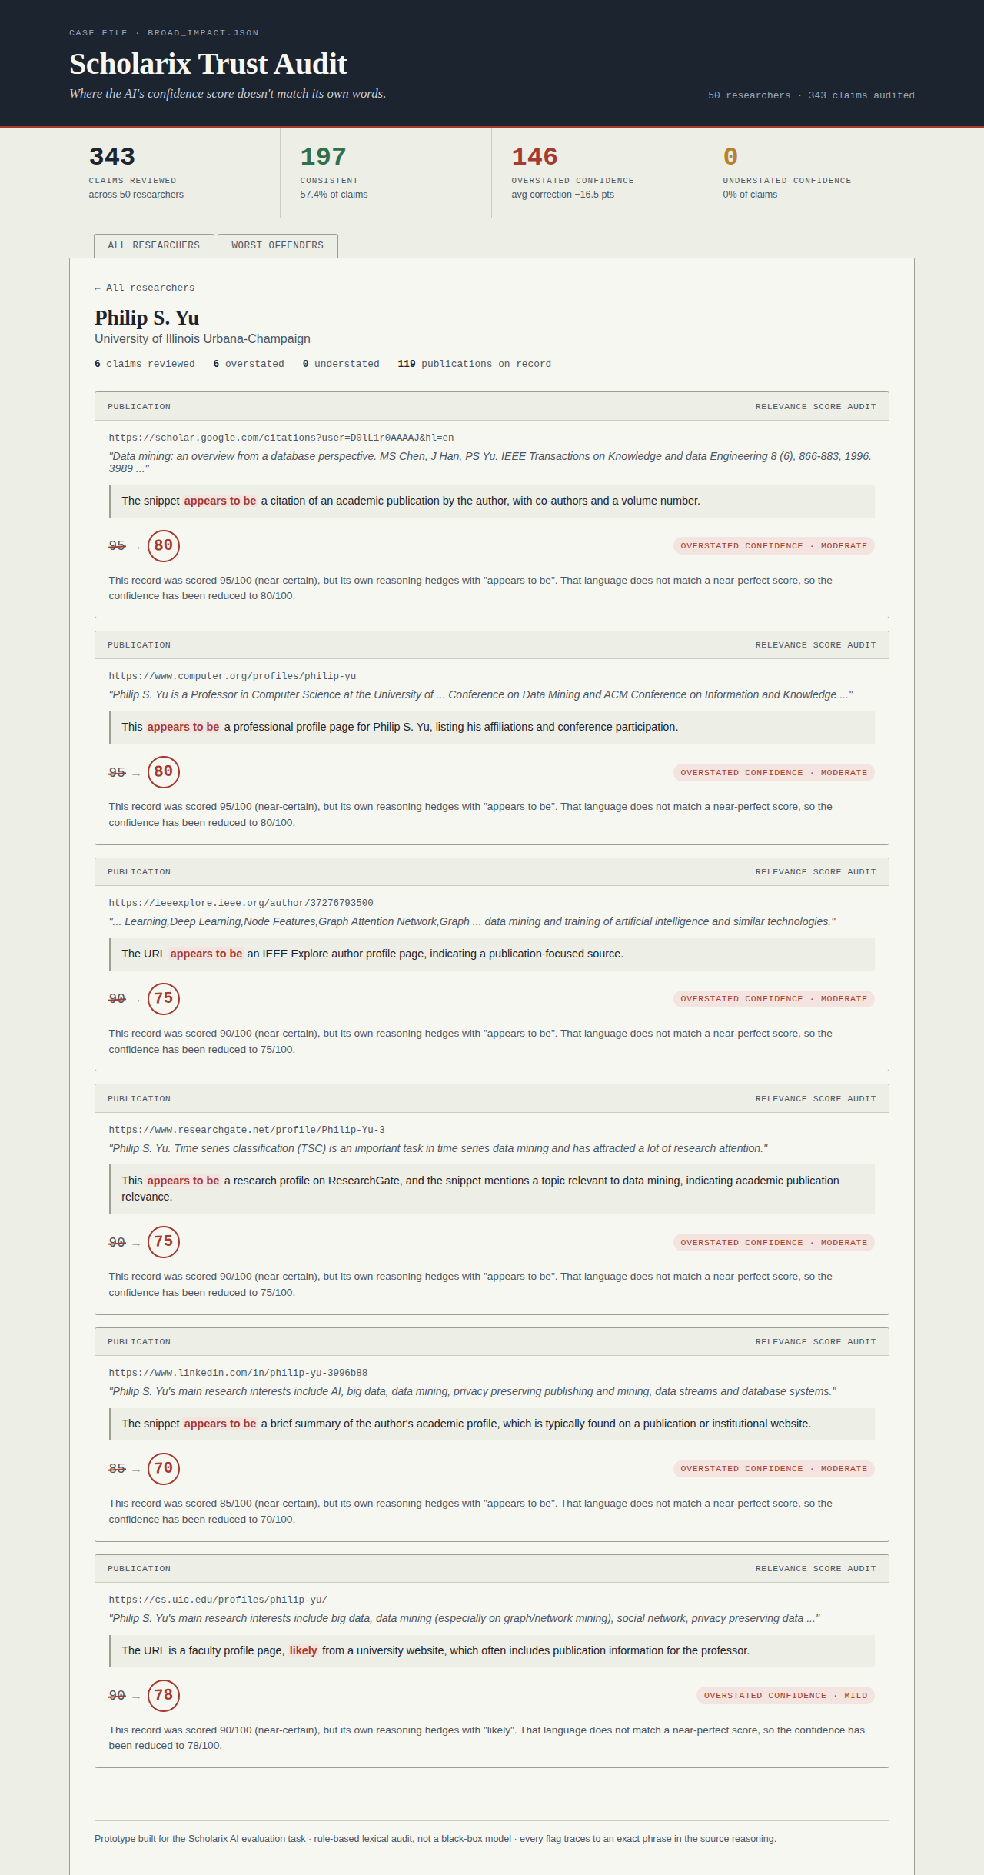
THE PROTOTYPE
Live, working, and running right now.
Flask backend + REST API, zero paid dependencies
Sortable researcher table, drill-down evidence cards
Every claim: original score → corrected score → exact phrase → explanation
12 automated tests, incl. real-dataset regression checks
One command to run: python -m backend.main
SCHOLARIX TRUST AUDIT
8

Slide 9
SCOPE
Built deep, not wide — on purpose.
BUILT
NEXT (VALIDATED BY USERS)
Score-vs-reasoning contradiction detection
Original + corrected score shown together, always
Phrase-level, traceable explanations
Aggregate dashboard + per-researcher drill-down
“Worst offenders” cross-dataset view
Identity / affiliation-collision detection — named the #1 trust-breaker by both interviewees
Recency / last-verified indicators — raised unprompted by P2
Same reconciliation logic applied to publication verification fields
Human-in-the-loop review: accept or override a correction
SCHOLARIX TRUST AUDIT
9

Slide 10
TRADEOFFS
What we chose not to build, and why.
1
We skipped the biggest-looking number.
90% citation disagreement between OpenAlex/Crossref is our largest stat — but Crossref isn't a full citation index. “fixing” it without modeling source coverage risks producing a new, confidently wrong number.
2
We left the #1 user-requested feature unbuilt.
Identity-collision detection needs a differently-shaped audit (institutions/names, not text hedging). Building it shallowly in the time left would've produced the broad, unfocused tool this task explicitly warns against.
3
We chose transparency over automation.
The tool never silently “fixes” anything — it always shows its work. That asks more of the user than a single trust score would, by design.
SCHOLARIX TRUST AUDIT
10

Slide 11
NEXT STEPS
If we had another two weeks.
01
Identity-collision detection
02
Recency indicators
Cross-reference ORCID institution lists + name patterns to flag likely disambiguation errors, like the “I. Petrov” case we found (Moscow State vs. Linköping).
Surface when a claim was last verified, addressing the fragmentation problem both interviewees raised.
03
Extend to publications.json
04
Human-in-the-loop review
Apply the same reconciliation logic to Semantic Scholar deep-verification fields.
Let a reviewer accept or override a correction — turning a read-only audit into a workflow tool.
SCHOLARIX TRUST AUDIT
11

Slide 12
Thank you.
Questions, tradeoffs, and everything we got wrong — happy to dig in.
GitHub: [ repo link ]
Live demo: python -m backend.main
SCHOLARIX TRUST AUDIT
12

