Slide 1

18CSC202J - OBJECT ORIENTED DESIGN AND PROGRAMMING
Session 1
Topic :Generic - Templates : Introduction

Slide 2
Templates-Introduction
Allows functions and classes to operate with generic types.
Allows a function or class to work on many different data types without being rewritten for each one.
Great utility when combined with multiple inheritance and operator overloading
The C++ Standard Library is based upon conventions introduced by the Standard Template Library (STL)

Slide 3
Types of Templates
Function Template
A function template behaves like a function except that the template can have arguments of many different types
Class Template
A class template provides a specification for generating classes based on parameters.
Class templates are generally used to implement containers.

Slide 4
Function Template
A function templates work in similar manner as function but with one key difference.
A single function template can work on different types at once but, different functions are needed to perform identical task on different data types.
If you need to perform identical operations on two or more types of data then, you can use function overloading. But better approach would be to use function templates because you can perform this task by writing less code and code is easier to maintain.

Slide 5
Cont.
A generic function that represents several functions performing same task but on different data types is called function template.
For example, a function to add two integer and float numbers requires two functions. One function accept integer types and the other accept float types as parameters even though the functionality is the same. Using a function template, a single function can be used to perform both additions.
It avoids unnecessary repetition of code for doing same task on various data types.

Slide 6
Cont.
Why Function Templates?
Templates are instantiated at compile-time with the source code.
Templates are used less code than overloaded C++ functions.
Templates are type safe.
Templates allow user-defined specialization.
Templates allow non-type parameters.

Slide 7
Function Template
A function template starts with keyword template followed by template parameter/s inside <> which is followed by function declaration.
T is a template argument and class is a keyword.
We can also use keyword typename instead of class.
When, an argument is passed to some_function( ), compiler generates new version of some_function() to work on argument of that type.

Slide 8
Template Syntax
template <class T>
T some_function(T argument)
{
.... ... ....
}
The template type keyword specified can be either "class" or " typename":
template<class T>
or
template<typename T>
Both are valid and behave exactly the same.

Slide 9
Session 2
Topic :Example Program Function Template, Class Template

Slide 10
Example program Function Templates
#include<iostream.h>
template <typename T>
T Sum(T n1, T n2) // Template function
{
T rs;
rs = n1 + n2;
return rs;
}
int main()
{
int A=10,B=20,C;
long I=11,J=22,K;
C = Sum(A,B);
cout<<"nThe sum of integer values : "<<C;
K = Sum(I,J);
cout<<"nThe sum of long values : "<<K;
}

Slide 11
More than One Template Argument
template<class T , class U>
void multiply(T a , U b)
{
cout<<"Multiplication= "<<a*b<<endl;
}
int main()
{
int a, b;
float x, y;
cin>>a>>b;
cin>>x>>y;
multiply(a,b); // Multiply two integer type data
multiply(x,y); // Multiply two float type data
multiply(a,x); // Multiply a float and integer type data
return 0;
}

Slide 12
Class Template
Like function template, a class template is a common class that can represent various similar classes operating on data of different types.
Once a class template is defined, we can create an object of that class using a specific basic or user-defined data types to replace the generic data types used during class definition.

Slide 13
Syntax for Class Template
template <class T1, class T2, ...>
class classname
{
attributes;
methods;
};

Slide 14
Example Program
#include <iostream.h>
using namespace std;
const int MAX = 100; //size of array
template <class Type>
class Stack
{
private:
Type st[MAX]; //stack: array of any type
int top; //number of top of stack
public:
Stack() //constructor
{ top = -1; }
void push(Type var) //put number on stack
{ st[++top] = var; }
Type pop() //take number off stack
{ return st[top--]; }
};

Slide 15
Cont.
int main()
{
Stack<float> s1; //s1 is object of class Stack<float>
s1.push(1111.1F); //push 3 floats, pop 3 floats
s1.push(2222.2F);
s1.push(3333.3F);
cout << “1: “ << s1.pop() << endl;
cout << “2: “ << s1.pop() << endl;
cout << “3: “ << s1.pop() << endl;
Stack<long> s2; //s2 is object of class Stack<long>
s2.push(123123123L); //push 3 longs, pop 3 longs
s2.push(234234234L);
s2.push(345345345L);
cout << “1: “ << s2.pop() << endl;
cout << “2: “ << s2.pop() << endl;
cout << “3: “ << s2.pop() << endl;
return 0;
}

Slide 16
Session 3
Topic :Class Template, Example Program for Class and Function Template

Slide 17
Class Templates with Multiple parameter
We can use more than one generic data type in a class template.
Syntax:
template<class T1, class T2>
class classname
{
……
……
};

Slide 18
Example Program
int main()
{
test<float, int> test1(1.23, 123);
test<int, char> test2(100,’w’);
test1.show();
test2.show();
return 0;
}
Output:
1.23
123
100
w
template<class T1, classT2>
class Test
{
T1 a;
T2 b;
}
void show()
{
cout<<a;
cout<<b;
}
};

Slide 19
Class Template Object
To create a class template object, you need to define the data type inside a < > when creation.
Syntax:
className<dataType> classObject;
Example:
className<int> classObject;
className<float> classObject;
className<string> classObject;

Slide 20
Program
Program to display largest among two numbers using function templates.
Program to swap data using function templates.
Program to add, subtract, multiply and divide two numbers using class template.

Slide 21
Solution:1
#include <iostream>
using namespace std;
template <class T>
T Large(T n1, T n2)
{
return (n1 > n2) ? n1 : n2;
}
int main()
{
int i1, i2;
float f1, f2;
char c1, c2;
cout << "Enter two integers:\n";
cin >> i1 >> i2;
cout << Large(i1, i2) <<" is larger." << endl;
cout << "\nEnter two floating-point numbers:\n";
cin >> f1 >> f2;
cout << Large(f1, f2) <<" is larger." << endl;
cout << "\nEnter two characters:\n";
cin >> c1 >> c2;
cout << Large(c1, c2) << " has larger ASCII value.";
return 0;
}

Slide 22
Output
Enter two integers:
5
10
10 is larger.
Enter two floating-point numbers:
12.4
10.2
12.4 is larger.
Enter two characters:
z
Z
z has larger ASCII value.

Slide 23
Solution: 2
#include <iostream>
using namespace std;
template <typename T>
void Swap(T &n1, T &n2)
{
T temp;
temp = n1;
n1 = n2;
n2 = temp;
}
int main()
{
int i1 = 1, i2 = 2;
float f1 = 1.1, f2 = 2.2;
char c1 = 'a', c2 = 'b';
cout << "Before passing data to function template.\n";
cout << "i1 = " << i1 << "\ni2 = " << i2;
cout << "\nf1 = " << f1 << "\nf2 = " << f2;
cout << "\nc1 = " << c1 << "\nc2 = " << c2;
Swap(i1, i2);
Swap(f1, f2);
Swap(c1, c2);
cout << "\nAfter passing data to function template.\n";
cout << "i1 = " << i1 << "\ni2 = " << i2;
cout << "\nf1 = " << f1 << "\nf2 = " << f2;
cout << "\nc1 = " << c1 << "\nc2 = " << c2;
return 0;
}

Slide 24
Output
Before passing data to function template.
i1 = 1
i2 = 2
f1 = 1.1
f2 = 2.2
c1 = a
c2 = b
After passing data to function template.
i1 = 2
i2 = 1
f1 = 2.2
f2 = 1.1
c1 = b
c2 = a

Slide 25
Solution: 3
T subtract()
{
return num1 - num2;
}
T multiply()
{
return num1 * num2;
}
T divide()
{
return num1 / num2;
}
};
int main()
{
Calculator<int> intCalc(2, 1);
Calculator<float> floatCalc(2.4, 1.2);
cout << "Int results:" << endl;
intCalc.displayResult();
cout << endl << "Float results:" << endl;
floatCalc.displayResult();
return 0;
}
#include <iostream>
using namespace std;
template <class T>
class Calculator
{
private: T num1, num2;
public: Calculator(T n1, T n2)
{
num1 = n1;
num2 = n2;
}
void displayResult()
{
cout << "Numbers are: " << num1 << " and " << num2 << "." ;
cout << "Addition is: " << add() << endl;
cout << "Subtraction is: " << subtract() << endl;
cout << "Product is: " << multiply() << endl;
cout << "Division is: " << divide() << endl;
}
T add()
{
return num1 + num2;
}

Slide 26
Output
Int results:
Numbers are: 2 and 1.
Addition is: 3
Subtraction is: 1
Product is: 2
Division is: 2
Float results:
Numbers are: 2.4 and 1.2.
Addition is: 3.6
Subtraction is: 1.2
Product is: 2.88
Division is: 2

Slide 27
Session 6
Topic :Exceptional Handling: try and catch, multilevel exceptional

Slide 28
Introduction
It is normal to commit mistakes in programming that prompts unusual conditions called errors. These errors are classified as:
Syntax Errors - Errors that occur when you violate the rules of writing C++ syntax, e.g, missing paranthesis
Logical Errors - These errors solely depend on the logical thinking of the programmers.
Runtime Errors - Errors which occur during program execution(run-time) after successful compilation are called run-time errors, e.g, division by zero
Semantic errors - Errors due to an improper use of program statements

Slide 29
Introduction
The errors that occur at run-time are known as exceptions.
They occur due to different conditions such as division by zero, accessing an element out of bounds of an array, unable to open a file, running out of memory and so on
Exception Handling in C++ is defined as a method that takes care of a surprising condition like runtime errors.
At whatever point a sudden situation happens, there is a movement of the program control to a unique function known as Handlers.

Slide 30
Exceptions
Indicate problems that occur during a program’s execution
Occur infrequently
Exceptions provide a way to transfer control from one part of a program to another.
A C++ exception is a response to an exceptional circumstance that arises while a program is running, such as an attempt to divide by zero.

Slide 31
Exception Handling
Can resolve exceptions
Allow a program to continue executing or
Notify the user of the problem and
Terminate the program in a controlled manner
Makes programs robust and fault-tolerant
Types
Synchronous exception (out-of-range index, overflow)
Asynchronous exception (keyboard interrupts)

Slide 32
Types of Exception
Two types of exception:
Synchronous Exceptions
Asynchronous Exceptions

Slide 33
Synchronous Exceptions
Occur during the program execution due to some fault in the input data or technique that is not suitable to handle the current class of data, within the program .
For example:
Errors such as out of range
Overflow
Underflow and so on

Slide 34
Asynchronous Exceptions
Caused by events or faults unrelated (external) to the program and beyond the control of the program.
For example
errors such as keyboard interrupts
hardware malfunctions
disk failure and so on
The exception handling mechanism of C++ is designed to handle only synchronous exceptions within a program.

Slide 35
Exception levels
Exceptions can occur at many levels:
Hardware/operating system level.
• Arithmetic exceptions; divide by 0.
• Memory access violations; stack over/underflow.
Language level.
• Type conversion; illegal values, improper casts.
• Bounds violations; illegal array indices.
• Bad references; null pointers.
3. Program level.
• User defined exceptions.

Slide 36
Need of Exceptions
Detect and report an “exceptional circumstance”
Separation of error handling code from normal code
That is, you will isolate your error handling code from your ordinary code. The code will be more coherent and simpler to keep up with.
Functions/ Methods can handle any exception they choose
Grouping of Error types

Slide 37
Basic Keywords in Exception Handling
Exception Handling in C++ falls around these three keywords:
Throw: when a program experiences an issue, it throws an Exception. The throw keyword assists the program by performing throw
Catch: a program that utilises an exception handler to catch an Exception. It is added to the part of a program where you need to deal with the error
Try: the try block recognises the code block for which certain exceptions will be enacted. It ought to be followed by one/more catch blocks

Slide 38
Exception Handling Mechanism
Find the problem (Hit the exception)
Inform that an error has occurred (Throw the exception)
Receive the error information (Catch the exception)
Take corrective actions (Handle the exception)

Slide 39
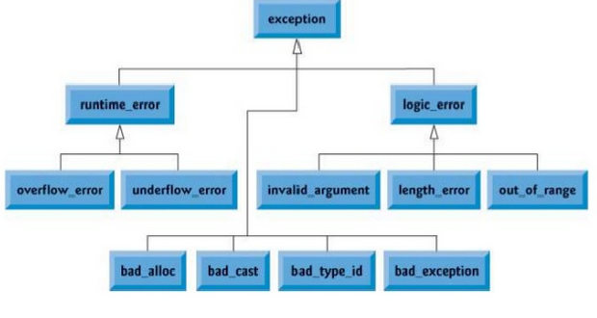
C++ Standard Exceptions

Slide 40
C++ Standard Exceptions
Exception | Description
std::exception | An exception and parent class of all the standard C++ exceptions.
std::bad_alloc | This can be thrown by new.
std::bad_cast | This can be thrown by dynamic_cast.
std::bad_exception | This is useful device to handle unexpected exceptions in a C++ program
std::bad_typeid | This can be thrown by typeid.

Slide 41
C++ Standard Exceptions
Exception | Description
std::logic_error | An exception that theoretically can be detected by reading the code.
std::domain_error | This is an exception thrown when a mathematically invalid domain is used
std::invalid_argument | This is thrown due to invalid arguments.
std::length_error | This is thrown when a too big std::string is created
std::out_of_range | This can be thrown by the at method from for example a std::vector and std::bitset<>::operator[]().

Slide 42
C++ Standard Exceptions
Exception | Description
std::runtime_error | An exception that theoretically can not be detected by reading the code.
std::overflow_error | This is thrown if a mathematical overflow occurs.
std::range_error | This is occured when you try to store a value which is out of range.
std::underflow_error | This is thrown if a mathematical underflow occurs.

Slide 43
Exceptions : syntax
try {
// the protected code
} catch( Exception_Name exception1 ) {
// catch block
} catch( Exception_Name exception2 ) {
// catch block
} catch( Exception_Name exceptionN ) {
// catch block
}
We have one try statement with many catch statement.
The ‘ExceptionName’ is the name of the Exception for being caught.
The exception1, exception2, exception3 and exceptionN are your defined names for referring to the exceptions.

Slide 44
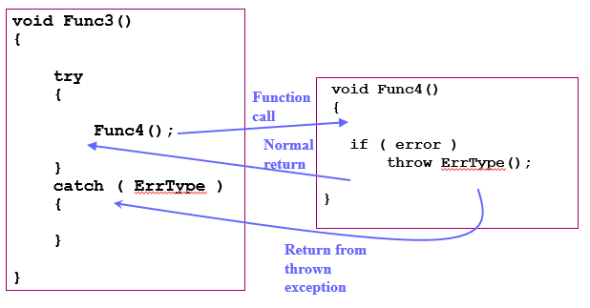
Exceptions

Slide 45
Simple Exceptions : Example
#include<iostream>
using namespace std;
int main()
{
int a,b;
cin >> a>> b;
try
{
if (b!=0)
{
cout<<“result (a/b)=”<<a/b;
}
else
{
throw(b);
}
}
catch(int i)
{
cout <<“exception
caught”;
}
}

Slide 46
Nested try blocks
try
{ ……..
try
{
………
}
catch (type arg)
{
………
}
}
catch(type arg)
{ ……….
………..
}

Slide 47
Multiple Catch Exception
Used when a user wants to handle different exceptions differently.
For this, a user must include catch statements with different declaration.

Slide 48
Multiple Catch Exception
It is possible to design a separate catch block for each kind of exception
Single catch statement that catches all kind of exceptions
Syntax
catch(…)
{
…….
}
Note :
A better way to use this as a default statement along with other catch statement so that it can catch all those exception which are not handle by other catch statement

Slide 49
Multiple catch statement : Syntax
try {
……..
}
catch (type1 arg) {
………
}
catch (type2 arg) {
………
}
……..
catch(typeN arg) {
………..
}

Slide 50
Multiple Exceptions : Example
#include<iostream>
using namespace std;
int main() {
int a,b;
cin >> a>> b;
try {
if (b!=a)
{
float div = (float) a/b;
if(div <0)
throw ‘e’;
cout<<div;
}
else
throw b;
}
catch(int i)
{cout <<“exception caught”;
}
catch(int i)
{
cout <<“exception caught : Division by zero”;
}
catch (char st)
{
cout << “exception caught : Division is less than 1”;
}
catch(…)
{
cout << “Exception : unknown”;
}
}

Slide 51
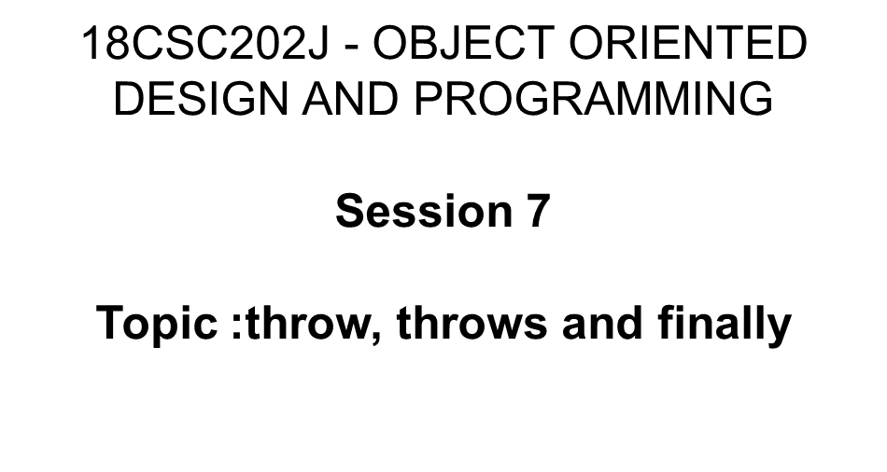
Exceptions

Slide 52
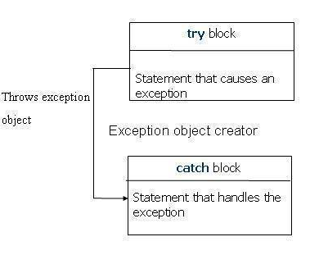
throwing Exception

Slide 53
throwing Exception
When an exception is detected, it is thrown using throw statement in the try block
It is also possible to have nested try-catch statement
It cause the current exception to be thrown to the next enclosing try/catch sequence and is caught by a catch statement listed after that enclosing try block.

Slide 54
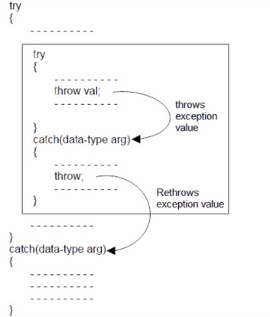
Re-throwing Exception

Slide 55
Throw Example
try
{
if(denominator == 0)
{
throw denominator;
}
result = numerator/denominator;
cout<<"\nThe result of division is:" <<result;
}

Slide 56
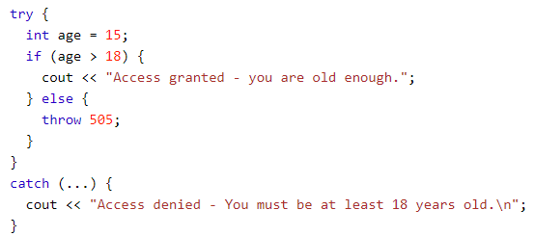
Handle Any Type of Exceptions (...)
If you do not know the throw type used in the try block, you can use the "three dots" syntax (...) inside the catch block, which will handle any type of exception.

Slide 57
Finally
The application always executes any statements in the finally part, even if an exception occurs in the try block.
When any code in the try block raises an exception, execution halts at that point.
Once an exception handler is found, execution jumps to the finally part.
After the finally part executes, the exception handler is called.
If no exception occurs, the code in the finally block executes in the normal order, after all the statements in the try block.

Slide 58
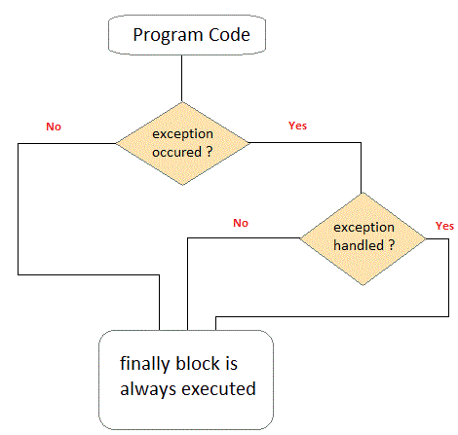
Finally

Slide 59
Finally - Syntax
try
{
// statements that may raise an exception
}
__finally
{
// statements that are called even
//if there is an exception in the try block
}

Slide 60
Finally - Example
#include<iostream>
using namespace std;
int main()
{
int a,b;
cin >> a>> b;
try{
if (b!=0) {
cout<<“result
(a/b)=”<<a/b;
}
Else {
throw(b);
}
}
catch(int i) {
cout <<“exception caught”;
}
__finally {
cout<<“Division”;
}
}

Slide 61
Exception Handling
Session 8
Topic : Exceptional Handling:
User defined exception

Slide 62
User Defined Exceptions
We can define your own exceptions by inheriting and overriding exception class functionality.
User defined exception classes inherit exception class provided by C++ and overrides it’s functionality according to our needs.
To use class exception, we must include exception header using the pre-processor directive.
#include <exception>

Slide 63
Rules for User Defined Exceptions
Always include exception header using pre-processor directive at the very first step.
The function which will return an exception string should have a return type of char followed by *,
char* what()
{
// codes here
}
char is as return type because we will return a
string
Should have a try and catch block.

Slide 64
User Defined Exceptions- Example
class MyCustomException : public std::exception {
public:
char * what () {
return "Custom C++ Exception";
}
};
int main() {
try {
throw MyCustomException();
} catch (MyCustomException mce) {
cout << "Caught MyCustomException" << endl;
cout << mce.what();
}
}

Slide 65
User Defined Exceptions
Example
Let’s say that the password must consists of at least 6 characters.
If we write a exception for this case, when the program receives a password in length of 5 characters it will throw an exception so that we could know the password is not valid

Slide 66
User Defined Exceptions
Example
class BadLengthException : public exception {
public:
int N;
BadLengthException(N) {
this->N=N;
};
int what() {
return this->N;
}
}

Slide 67
User Defined Exceptions
The BadLengthException inherited all properties from the exception class.
When this class is initialized, it takes the username length and stores it in public variable N.
When the catch block detected exception, it will dial with the function what of our exception class to get what is happened.

Slide 68
User Defined Exceptions
int main() {
int usernameLength;
cin>>usernameLength;
try {
if(usernameLength<5)
throw BadLengthException(usernameLength);
else
cout<<"Valid";
} catch(BadLengthException e) {
cout<<"Too short: "<<e.what();
}
return 0;
}

Slide 69
Passing Parameters to Custom Exceptions
Custom exceptions can include parameters to provide relevant information about the exception and customize the error message. This can help programmers to better handle the exception.
class MyCustomException : public std::exception {
private:
char * message;
public:
MyCustomException(char * msg) : message(msg) {}
char * what () {
return message; }
};

Slide 70
Passing Parameters to Custom Exceptions
int main() {
try {
throw MyCustomException("Custom C++
Exception");
} catch (MyCustomException mce) {
cout << "Caught MyCustomException" << endl;
cout << mce.what();
}
}
Output
Caught MyCustomException
Custom C++ Exception

Slide 71
Questions in Exceptions
What is the advantage of exception handling ?
1. Remove error-handling code from the software’s main line of code.
2. A method writer can choose to handle certain exceptions and delegate others to the caller.
3. An exception that occurs in a function can be handled anywhere in the function call stack.
(A) Only 1
(B) 1, 2 and 3
(C) 1 and 3
(D) 1 and 2

Slide 72
Questions in Exceptions
Predict the output of the code?
class Base {};
class Derived: public Base {};
int main() {
Derived d;
try {
throw d;
} catch(Base b) {
cout<<"Caught Base Exception";
} catch(Derived d) {
cout<<"Caught Derived Exception";
}
return 0;
}
(A) Caught Derived Exception
(B) Caught Base Exception
(C) Compiler Error
(D) Run Time Error

Slide 73
Questions in Exceptions
Predict the output of the code?
int main()
{
try
{
throw 'a';
}
catch (int param)
{
cout << "int exception\n";
}
catch (...)
{
cout << "default exception\n";
}
cout << "After Exception";
return 0;
}
(A) default exception
After Exception
(B) int exception
After Exception
(C) int exception
(D) default exception

Slide 74
Questions in Exceptions
Predict the output of the code?
int main()
{ try {
throw 10;
}
catch (...) {
cout << "default exception\n";
}
catch (int param) {
cout << "int exception\n";
}
return 0;
}
((A) default exception
(B) int exception
(C) Compiler Error
(D) Run Time Error
Reason: The catch(…) must be the last catch block.

Slide 75
Questions in Exceptions
Predict the output of the code?
int main() {
try {
try {
throw 20;
}
catch (int n) {
cout << "Inner Catch\n";
throw; }
}
catch (int x){
cout << "Outer Catch\n";
}
return 0;
}
((A) Outer Catch
(B) Inner Catch
(C) Inner Catch
Outer Catch
(D) Compiler Error
Reason: The statement ‘throw;’ is used to re-throw an exception.

Slide 76
Questions in Exceptions
Which of the following is true about exception handling in C++?
1) There is a standard exception class like Exception class in Java.
2) All exceptions are unchecked in C++, i.e., compiler doesn’t check if the exceptions are caught or not.
3) In C++, a function can specify the list of exceptions that it can throw using comma separated list like following.
void fun(int a, char b) throw (Exception1, Exception2, ..)
(A) 1 and 3
(B) 1, 2 and 3
(C) 1 and 2
(D) 2 and 3

Slide 77
Package and Component Diagram

Slide 78
Dynamic Modelling
The dynamic model is used to express and model the behaviour of the system over time. It includes support for activity diagrams, state diagrams, sequence diagrams and extensions including business process modelling.

Slide 79
Package Diagram
All the interrelated classes and interfaces of the system when grouped together form a package.
To represent all these interrelated classes and interface UML provides package diagram.
Package diagram helps in representing the various packages of a software system and the dependencies between them.
It also gives a high-level impression of use case and class diagram.

Slide 80
Package Diagram: purpose
To provide static models of modules, their parts and their relationships
To present the architectural modelling of the system
To group any UML elements
To specify the logical distribution of classes
To emphasize the logical structure of the system
To offer the logical distribution of classes which is inferred from the logical architecture of the system

Slide 81
Package Diagram: Uses
To illustrate the functionality of a software system.
To illustrate the layered architecture of a software system.
The dependencies between these packages can be adorned with labels / stereotypes to indicate the communication mechanism between the layers.

Slide 82
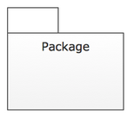
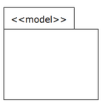
Notations
S.NO | NAME | SYMBOL | DESCRIPTION
1 | Package |  | organize elements into groups to provide better structure for system model.
2 | Mode |  | show only a subset of the contained elements according to some criterion.

Slide 83
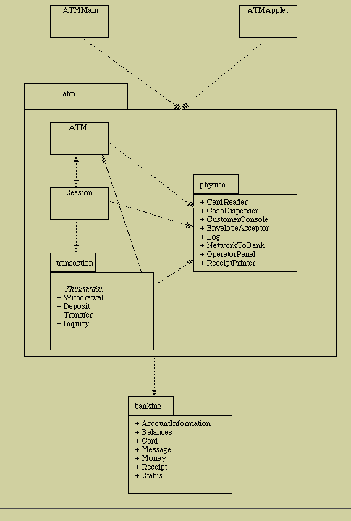
Example

Slide 84
18CSC202J - OBJECT ORIENTED DESIGN AND PROGRAMMING
Session 12
Topic : UML Component Diagram

Slide 85
Guidelines to Draw: Component Diagram
Based on the analysis of the problem description of the system, identify the major subsystem.
Group the individual packages and other logical entities in the system to provide as separate components.
Then identify the interfaces needed for components interaction.
If needed, identify the subprograms which are part of each of the components and draw them along with their associated components.
Use appropriate notations to draw the complete component diagram.

Slide 86


Notations
S.NO | NAME | SYMBOL | DESCRIPTION
1 | Component |  | Component is used to represent any part of a system for which UML diagrams are made.
2 | Association |  | A structural relationship describing a set of links connected between objects.

Slide 87
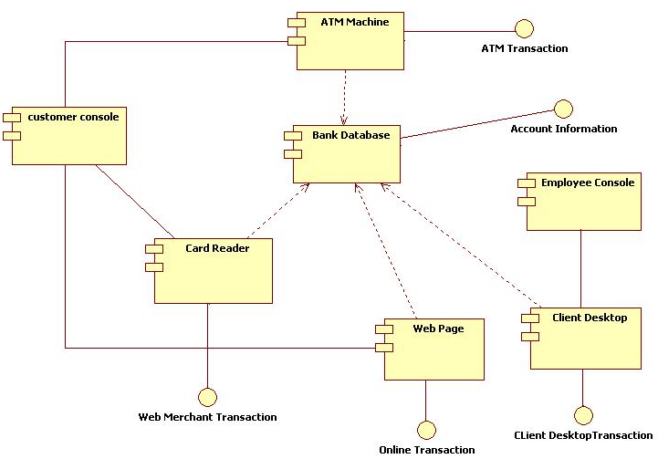
Example

Slide 88
MCQs
Which of the following diagram displays the structural relationship of components of a software?
(A). Component Diagram
(B). class diagram
(C). use case diagram
(D). sequence diagram
Answer: Component Diagram
Which of the following diagram is required when working with big and complex systems with many components?
(A). Component Diagram
(B). class diagram
(C). use case diagram
(D). sequence diagram
MCQ Answer: Component Diagram

Slide 89
MCQs
In Component Diagram, Components communicate with each other using which of the following?
(A). Components
(B). interfaces
(C). Use cases
(D). attributes
MCQ Answer: interfaces
The interfaces in component diagrams are linked using which of the following?
(A). connectors
(B). interfaces
(C). Components
(D). None of these
MCQ Answer: connectors

Slide 90
MCQs
A package diagram consists of the following? (A). Package symbols (B). Groupings of Use cases, classes, components (C). Interface (D). Package symbols, Groupings of Use cases, classes & components
MCQ Answer: Package symbols, Groupings of Use cases, classes & components
Which one of the following is not a structural thing?
(A). Class
(B). Package
(C). Use case
(D). Node
MCQ Answer: Package

Slide 91
18CSC202J - OBJECT ORIENTED DESIGN AND PROGRAMMING
Session 13
Topic : UML Deployment Diagram, Examples

Slide 92
Guidelines to Draw: Deployment Diagram
Identify the hardware components and processing units in the target system.
Analyze the software and find out the subsystem, parallel execution of modules, server side components, client side components, business logic components, backend database servers and software and hardware mapping mechanism to map the software components to be mapped with appropriate hardware devices.
Draw the hardware components and show the software components inside them and also show the connectivity between them.

Slide 93

Notations
S.NO | NAME | SYMBOL | DESCRIPTION
1 | Node |  | A node represents a physical component of the system. Node is used to represent physical part of a system like server, network etc.
2 | Association |  | A structural relationship describing a set of links connected between objects.

Slide 94
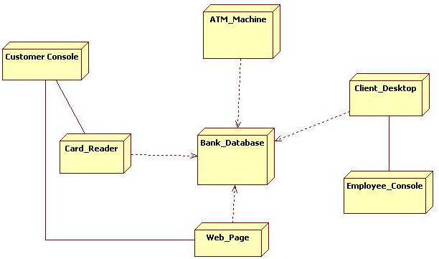
Example

Slide 95
Example
online shopping UML diagrams
Ticket vending machine UML diagrams
Bank ATM UML diagrams
Hospital management UML diagrams
Digital imaging and communications in medicine (DICOM) UML diagrams
Java technology UML diagrams
Application development for Android UML diagrams

Slide 96
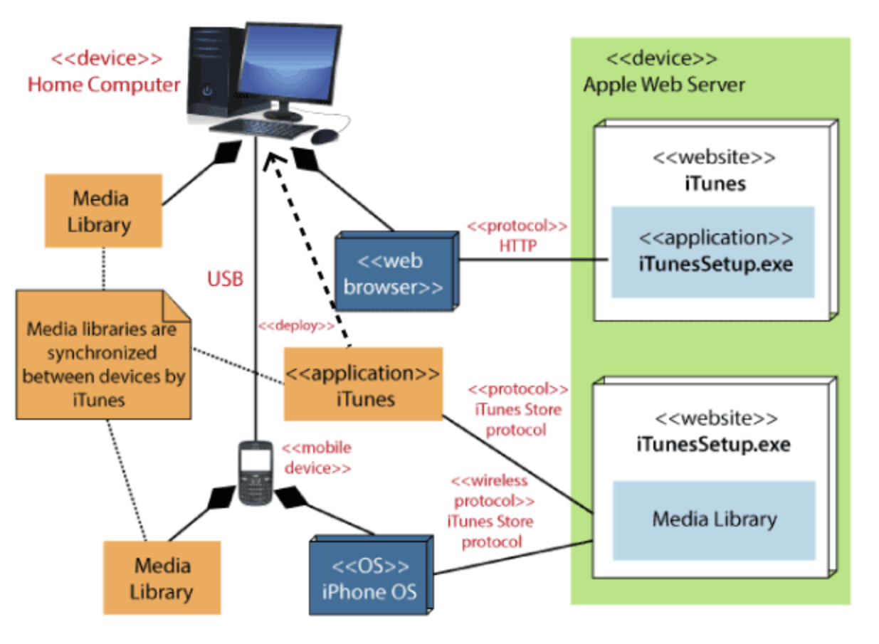
Deployment Diagram

Slide 97
Applications of Deployment Diagram
To model the network and hardware topology of a system
To model the distributed networks and systems
Implement forwarding and reverse engineering processes
To model the hardware details for a client/server system
For modelling the embedded system

