Slide 1

-sharing moments ~by Aman Kansal 1802913023

Slide 2
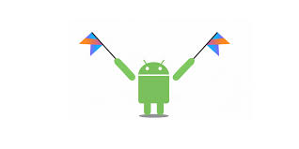
Description: An android based application through which we can share our posts with captions and user’s curlpux handle displayed above it.

Slide 3

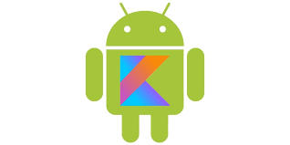
Software used:
*I have used android studio for this project.
*The code is written in kotlin language.
*And I have used the FIREBASE as the backened service for authentication , real-time database and storage for my application on the server side.

Slide 4
Motivation for this project:
I was self motivated to learn android development and to make some simple and interesting projects.
I have chosen this project so that I can learn many things from the single project such UI design,Backened services,Kotlin language ,Picasso and many more things.

Slide 5

Android Studio:
Android Studio is the official integrated development environment (IDE) for Google's Android operating system, built on JetBrains' IntelliJ IDEA software and designed specifically for Android development. It is available for download on Windows, MacOS and Linux based operating systems

Slide 6

Kotlin:
Kotlin is officially supported by Google for mobile development on Android. Since the release of Android Studio 3.0 in October 2017, Kotlin is included as an alternative to the standard Java compiler. The Android Kotlin compiler lets the user choose between targeting Java 6 or Java 8 compatible bytecode.
Kotlin has been Google’s preferred language for Android app development since May 7th 2019.
Kotlin is sponsored by JetBrains and Google through the Kotlin Foundation.

Slide 7


Firebase:
Firebase is a mobile and web application development platform developed by Firebase, Inc. in 2011, then acquired by Google in 2014. As of October 2018, the Firebase platform has 18 products, which are used by 1.5 million apps.
Firebase is a Backend-as-a-Service (BaaS) app development platform that provides hosted backend services such as a realtime database, cloud storage, authentication, crash reporting, machine learning, remote configuration, and hosting for your static files.

Slide 8
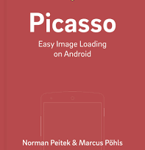
Picasso:
A powerful image downloading and caching library for Android
Images add much-needed context and visual flair to Android applications. Picasso allows for hassle-free image loading in your application—often in one line of code!

Slide 9
Application Design:
My app consists of mainly 4 screens i.e.,
1. Splash screen.
2. Authentication screen.
3.Feed screen.
4.Upload screen.
*it also contains a menu bar at the right corner of the feed screen which serves the purpose of adding posts.

Slide 10
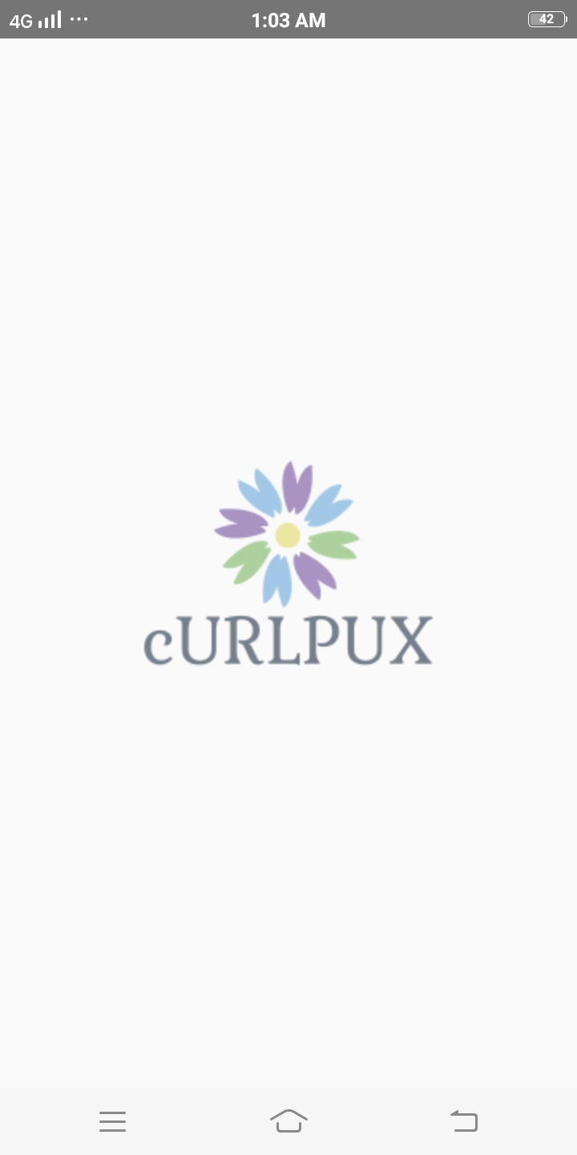
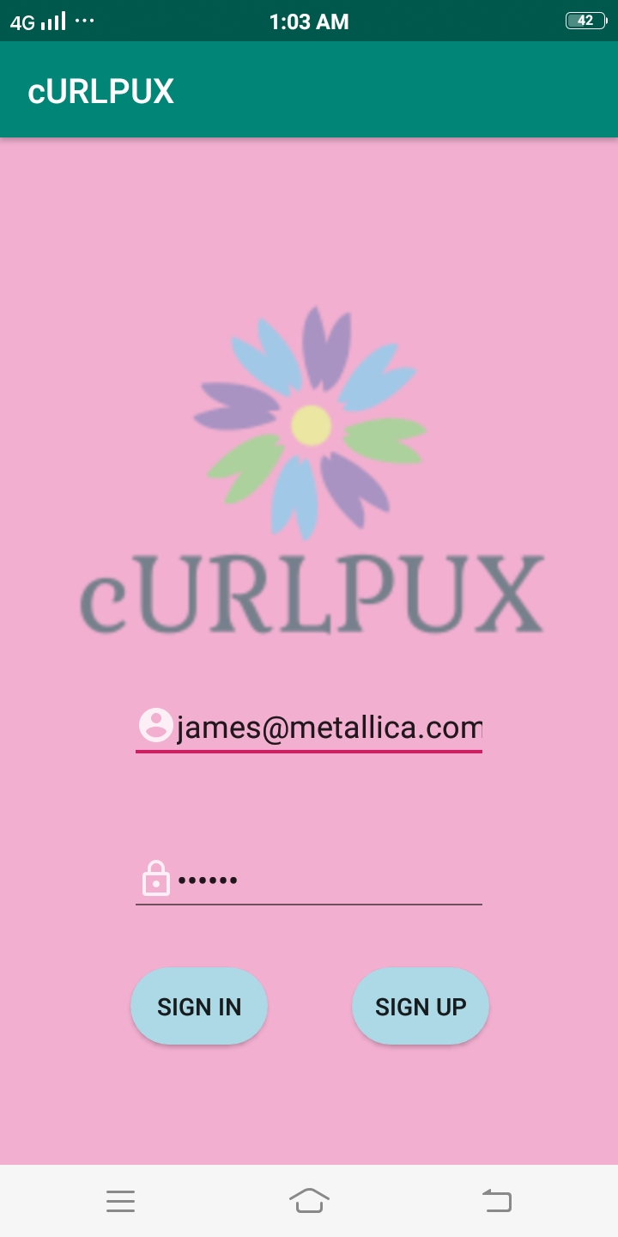
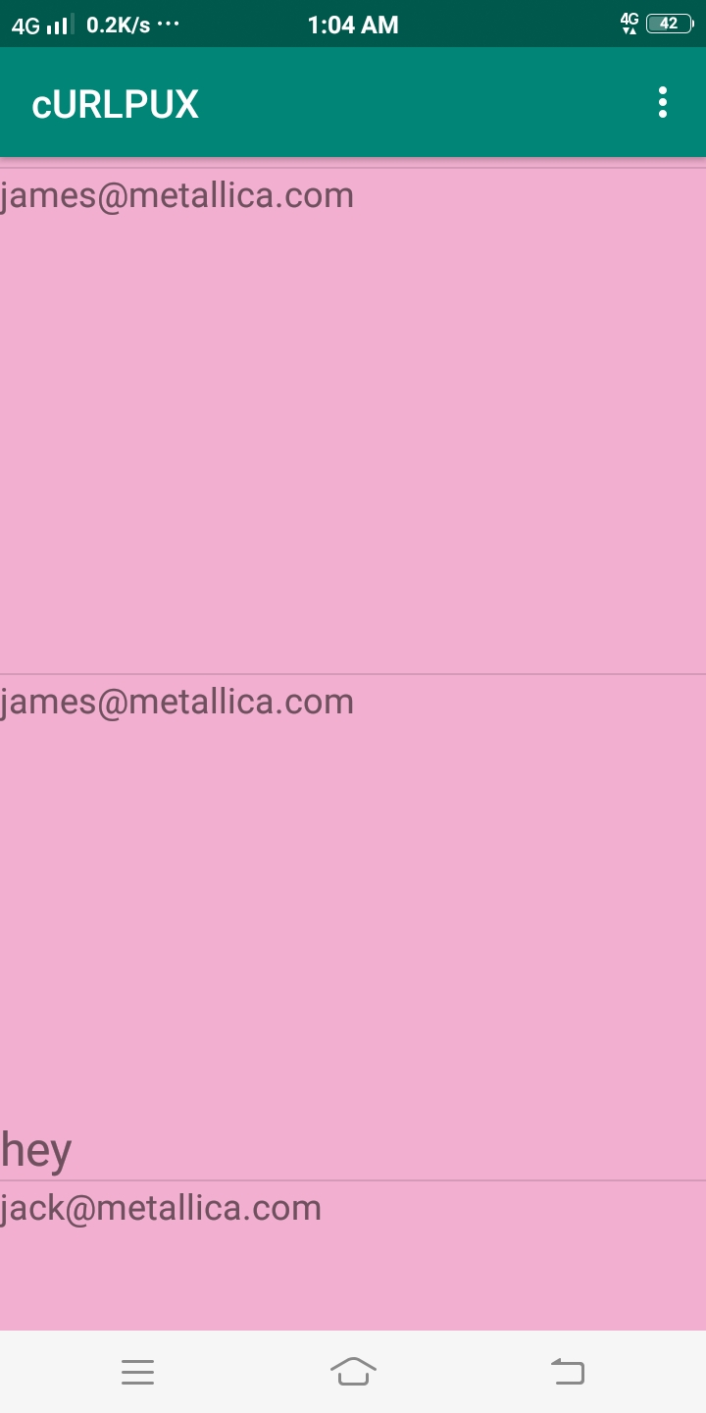
1.Splash screen.
2. Authentication screen.
3. Feed screen.

Slide 11
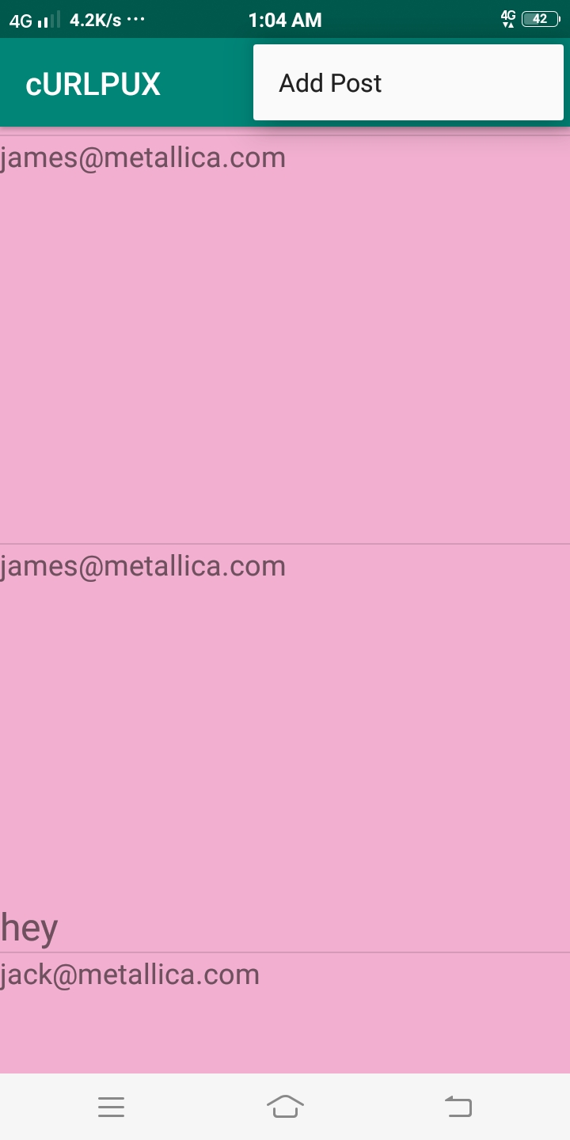
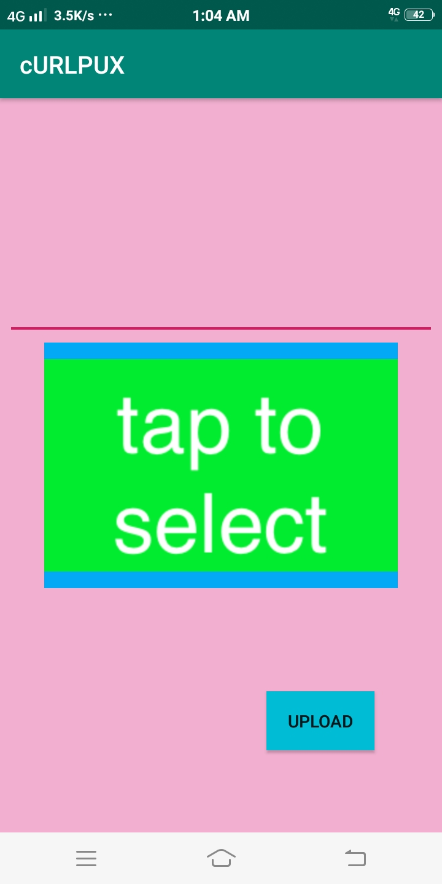
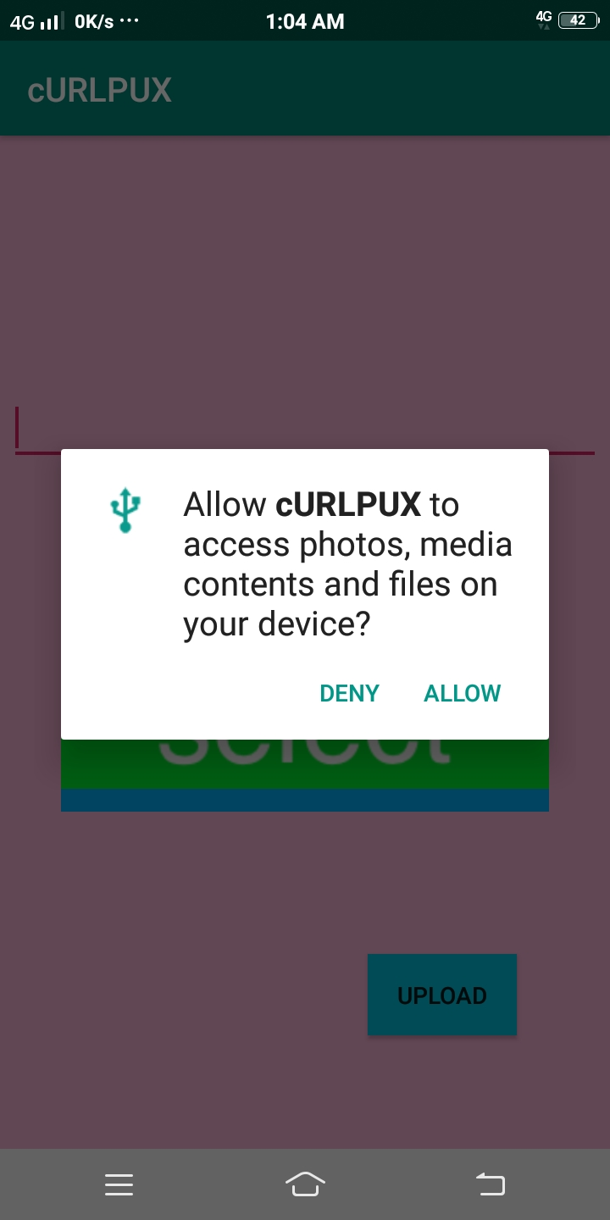
##Asking permission to access mobile internal storage.
*Menu bar to add post.
4.Upload screen.

Slide 12
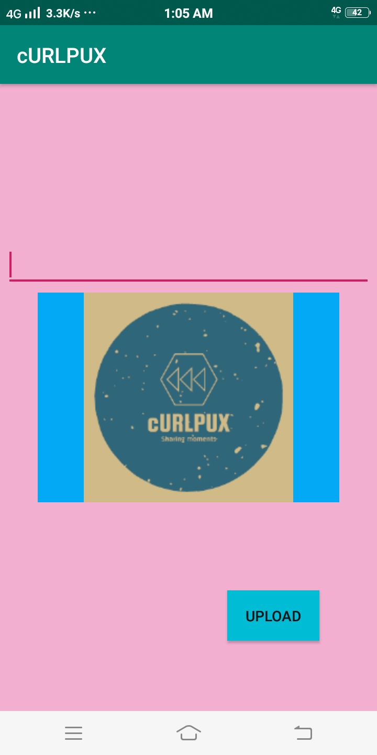
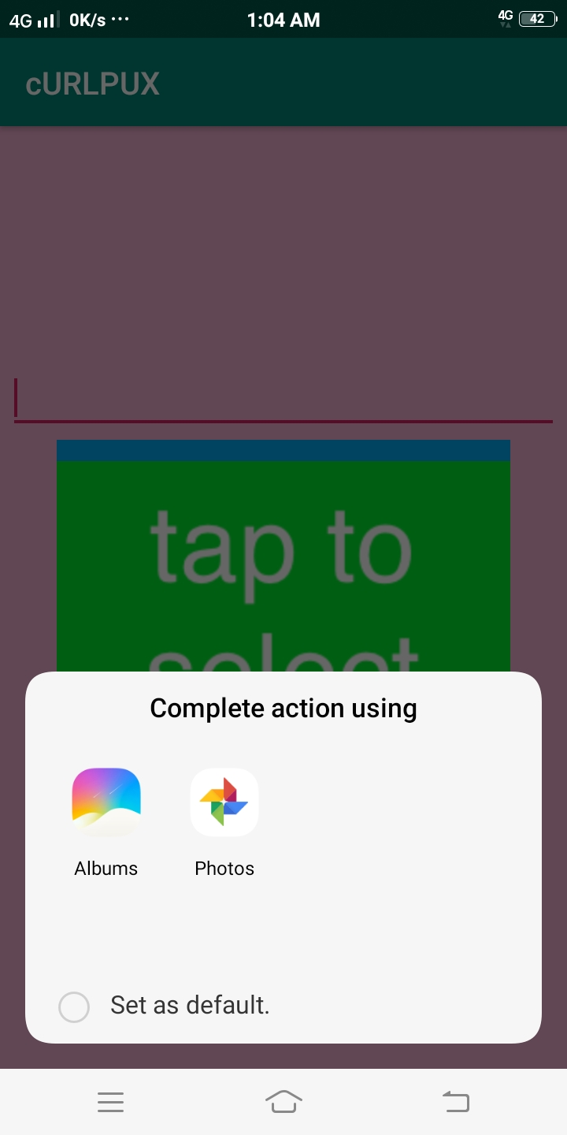

Slide 13
Conclusion:
cURLPUX : A social media application through which we can share our best moments describing them in brief using curlpux handle.
As I am just a beginner in Android development ,there are many new features remaining which the application needs.
I will keep updating this application as I move ahead in learning Android Development using kotlin.

Slide 14
Thank You

