Slide 1
MagnusCI
Ephemeral Container-Based CI/CD Orchestration Engine
Node.js
Express
BullMQ
Redis
PostgreSQL
Docker
Kubernetes (K3s)
MinIO

Slide 2
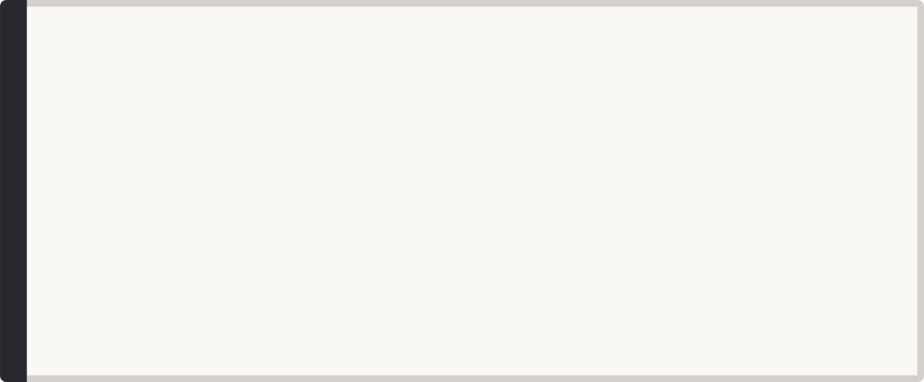
Three CI/CD Infrastructure Problems
Bursty Webhook Traffic
Pipeline Deadlocks
Untrusted Code Execution
A single push triggers dozens of concurrent builds.
Multi-stage builds need real dependency graphs.
Arbitrary scripts must run isolated from the host.

Slide 3






The Mandate: Ephemeral, Zero Host Pollution
Webhook
HMAC Verify
Queue
Scheduler
Sandbox
Log Stream
Signed Webhooks
Deadlock-Free Scheduling
Isolated Execution
Real-Time Logs

Slide 4
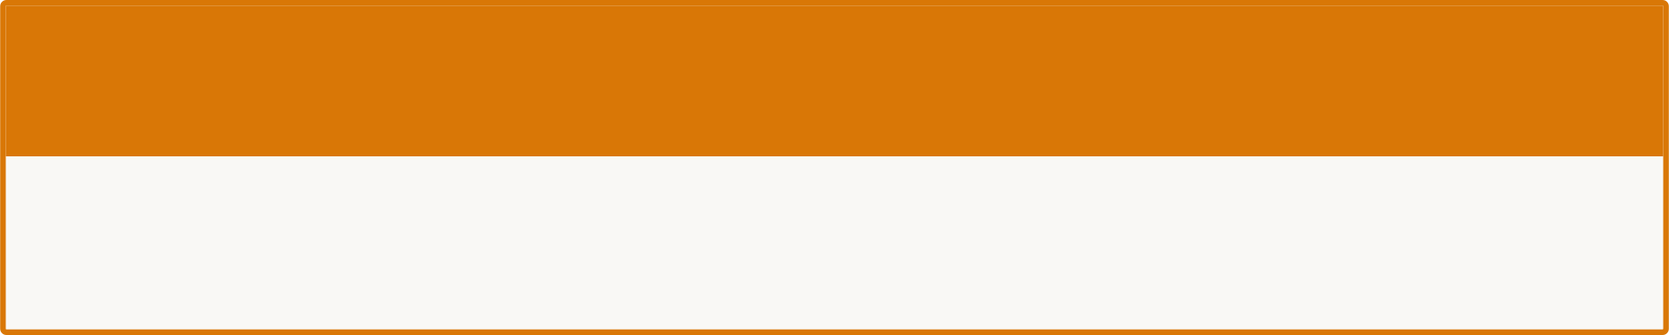
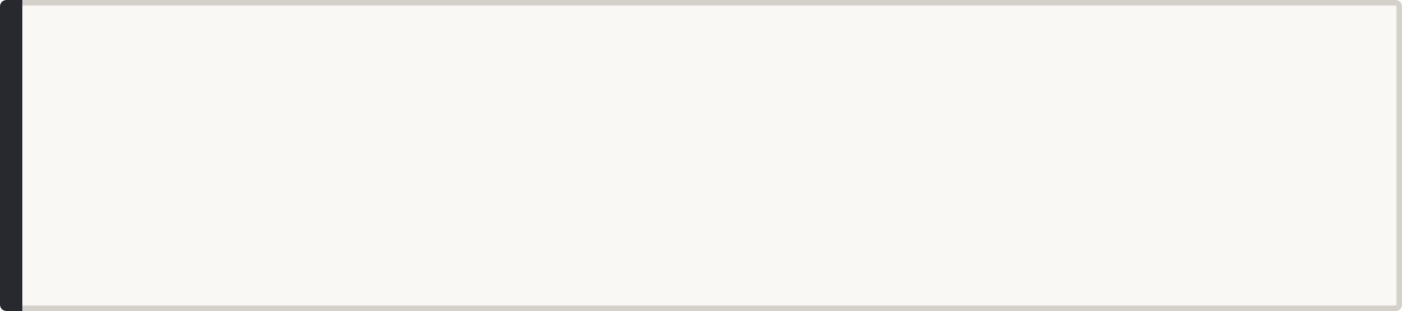


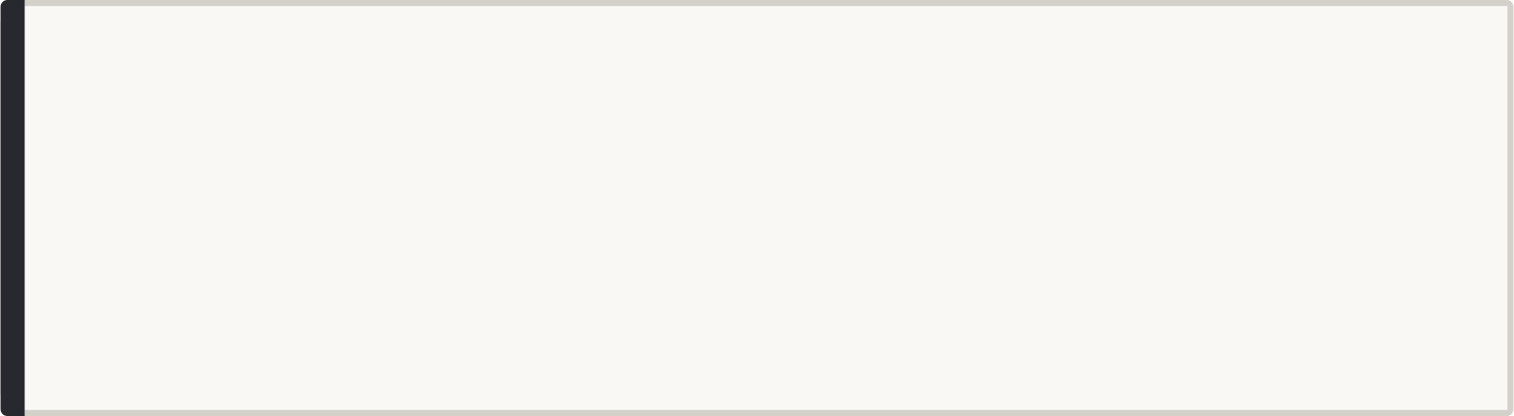

Webhook Verification & BullMQ Backpressure
Decoupled Ingestion
GitHub Webhook Arrives
Ingestion and execution are fully independent layers.
Stalled-Job Reclaim
Auto-reclaim triggered if a worker dies mid-build.
HMAC-SHA256 Verify (raw body)
Worker Pool Isolation
Each job runs in a controlled worker pool, protecting the host from noisy or long-running tasks.
BullMQ Queue → Worker Pool

Slide 5

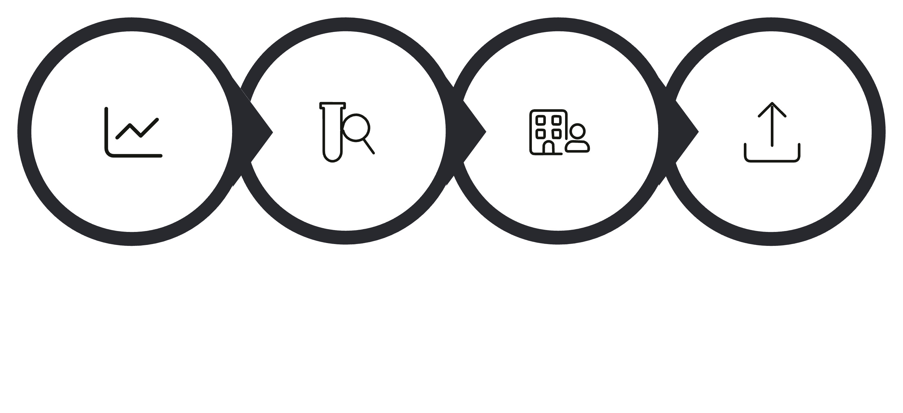
Deadlock-Free Scheduling, Isolated Execution
Sandbox Isolation
DAG Scheduling
cgroup Limits
Memory, CPU, and PID caps enforced per container.
Socket Never Mounted
docker.sock withheld from user sandboxes.
Lint
Test
Build
Deploy
Path Traversal Blocked
Cycle check via DFS. Parallel stages via Kahn's algorithm.
Workspace locked to build ID — no escape possible.

Slide 6

War Story: The Bot That Reverted Itself Forever
1
Symptom
2
Suspected
Build count climbing — no new human commits.
Flaky test causing repeated re-triggers.
3
Ruled Out
4
Root Cause
Logs showed unrelated, inconsistent failures each time.
Auto-revert bot's own commit re-triggered the webhook — infinite loop.
Any self-triggering automation needs a self-recognition check.

Slide 7
Measured Impact
4
Zero
Test Suites
Unit, integration, chaos, E2E
Pool Exhaustion
Fail-fast Postgres connection limits
zstd
K3s
Compression
Multi-threaded vs single-threaded gzip
Live Deployment
Rolling updates, continuous health checks

Slide 8

Trade-offs & Design Decisions
1
2
3
4
BullMQ vs Kafka
Socket.IO vs SSE
Zstandard vs gzip
Docker Socket Isolation
Redis-native. Not built for durable event replay at scale.
Bidirectional streaming required. SSE is one-directional only.
Multi-threaded compression — cache hydration is the real bottleneck.
Mounted to trusted worker pod only. Never the user sandbox.

Slide 9





What's Next
Any self-triggering system needs a self-recognition check from day one.
Long-Lived Worker Pods
Ephemeral Kubernetes Jobs
Idle Resource Cost
Current: persistent workers handle all builds.
Next: one job per build. Further reduces idle cost.
Ephemeral jobs eliminate persistent overhead entirely.
Blast Radius Reduction
Scale to Zero
Pod-per-build enforces stronger isolation boundaries.
Kubernetes native scheduling handles burst and idle equally.

