Slide 1
NexusIDE
Production-Ready Collaborative Cloud IDE
Frontend & UI Layer: React · TypeScript · Tailwind CSS · Monaco Editor · Vite
Backend & Real-Time Gateway: Node.js · Express · Socket.io
Database & State Mesh: PostgreSQL · Redis
Infrastructure, Sandboxing & Observability: Docker · Linux · Nginx · PM2 · Prometheus
Testing & Quality Assurance: Vitest · Playwright
Live demo: http://129.154.39.198/ide/login · GitHub

Slide 2
Three Distributed Systems Bottlenecks
⇄ State Synchronization
⬚ Compute Density
⚡ Write Amplification
Concurrent edits across pods with no shared memory
CPU-heavy ops blocking the Node.js event loop; 300ms+ event loop lag
Every keystroke writes to Postgres — disk I/O saturates in seconds

Slide 3



The Mandate: Fully Stateless Backend
Real-time Collab
Node.js Pod
Any pod serves any user
Load Balancer
Routes requests without sticky sessions to any pod.
Stateless app instances; three identical pods handle requests.
Sandboxed Terminals
Session state in Redis, not RAM
LSP + Snapshots
Redis
PostgreSQL
Persisted to PostgreSQL
Session state and real-time collab data shared across pods.
Persistent snapshots and LSP data stored reliably.
Horizontal Scale
✗ no sticky sessions
No sticky sessions — any pod can serve any request.

Slide 4
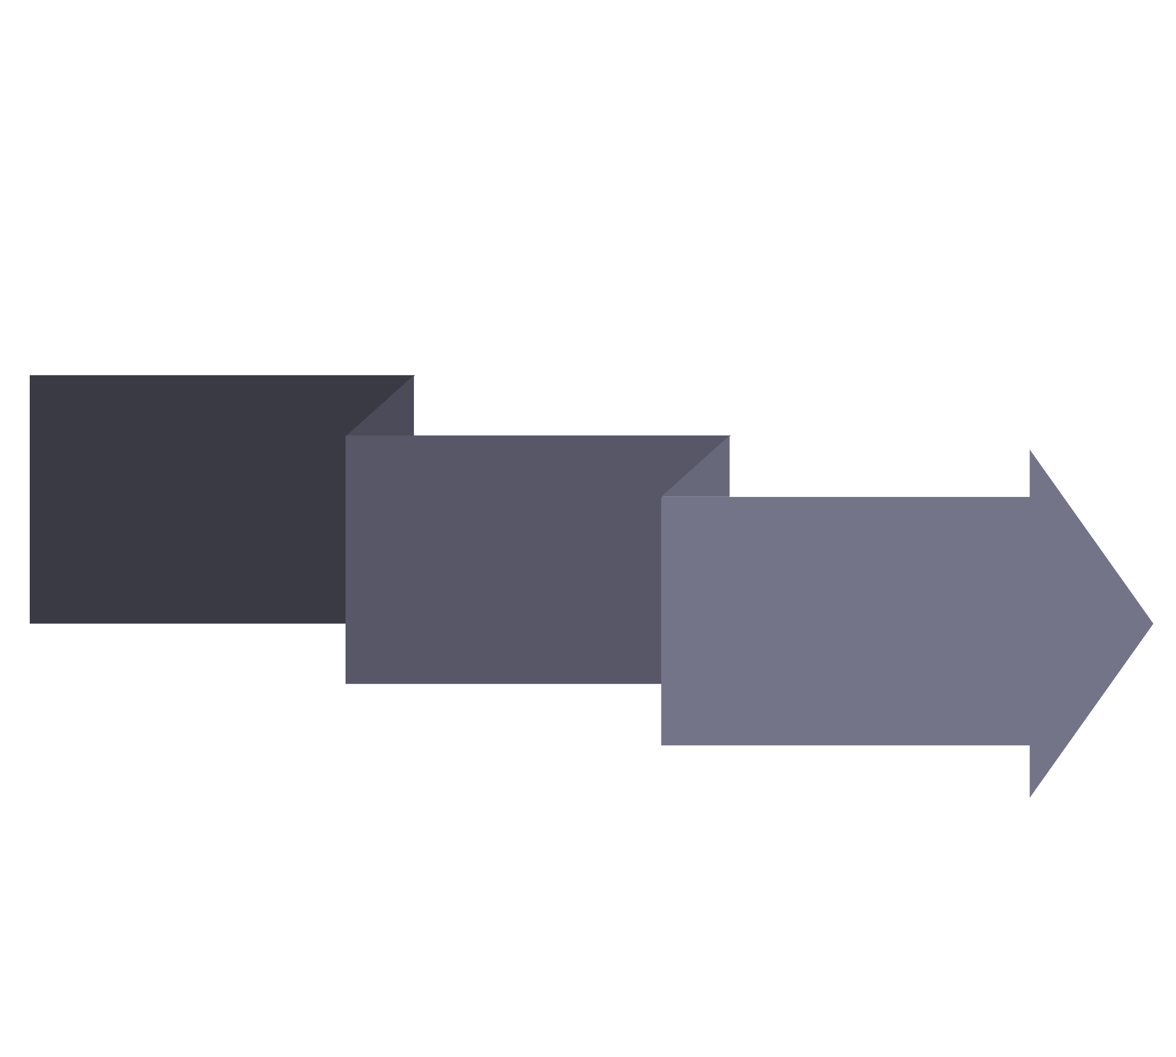
CRDT LAYER
CRDT State Mesh & Redis Pub/Sub
User A → Pod 1
Pod 2 → User B
Redis Pub/Sub
origin-tag prevents rebroadcast loop
Yjs CRDTs — Strong Eventual Consistency

Slide 5

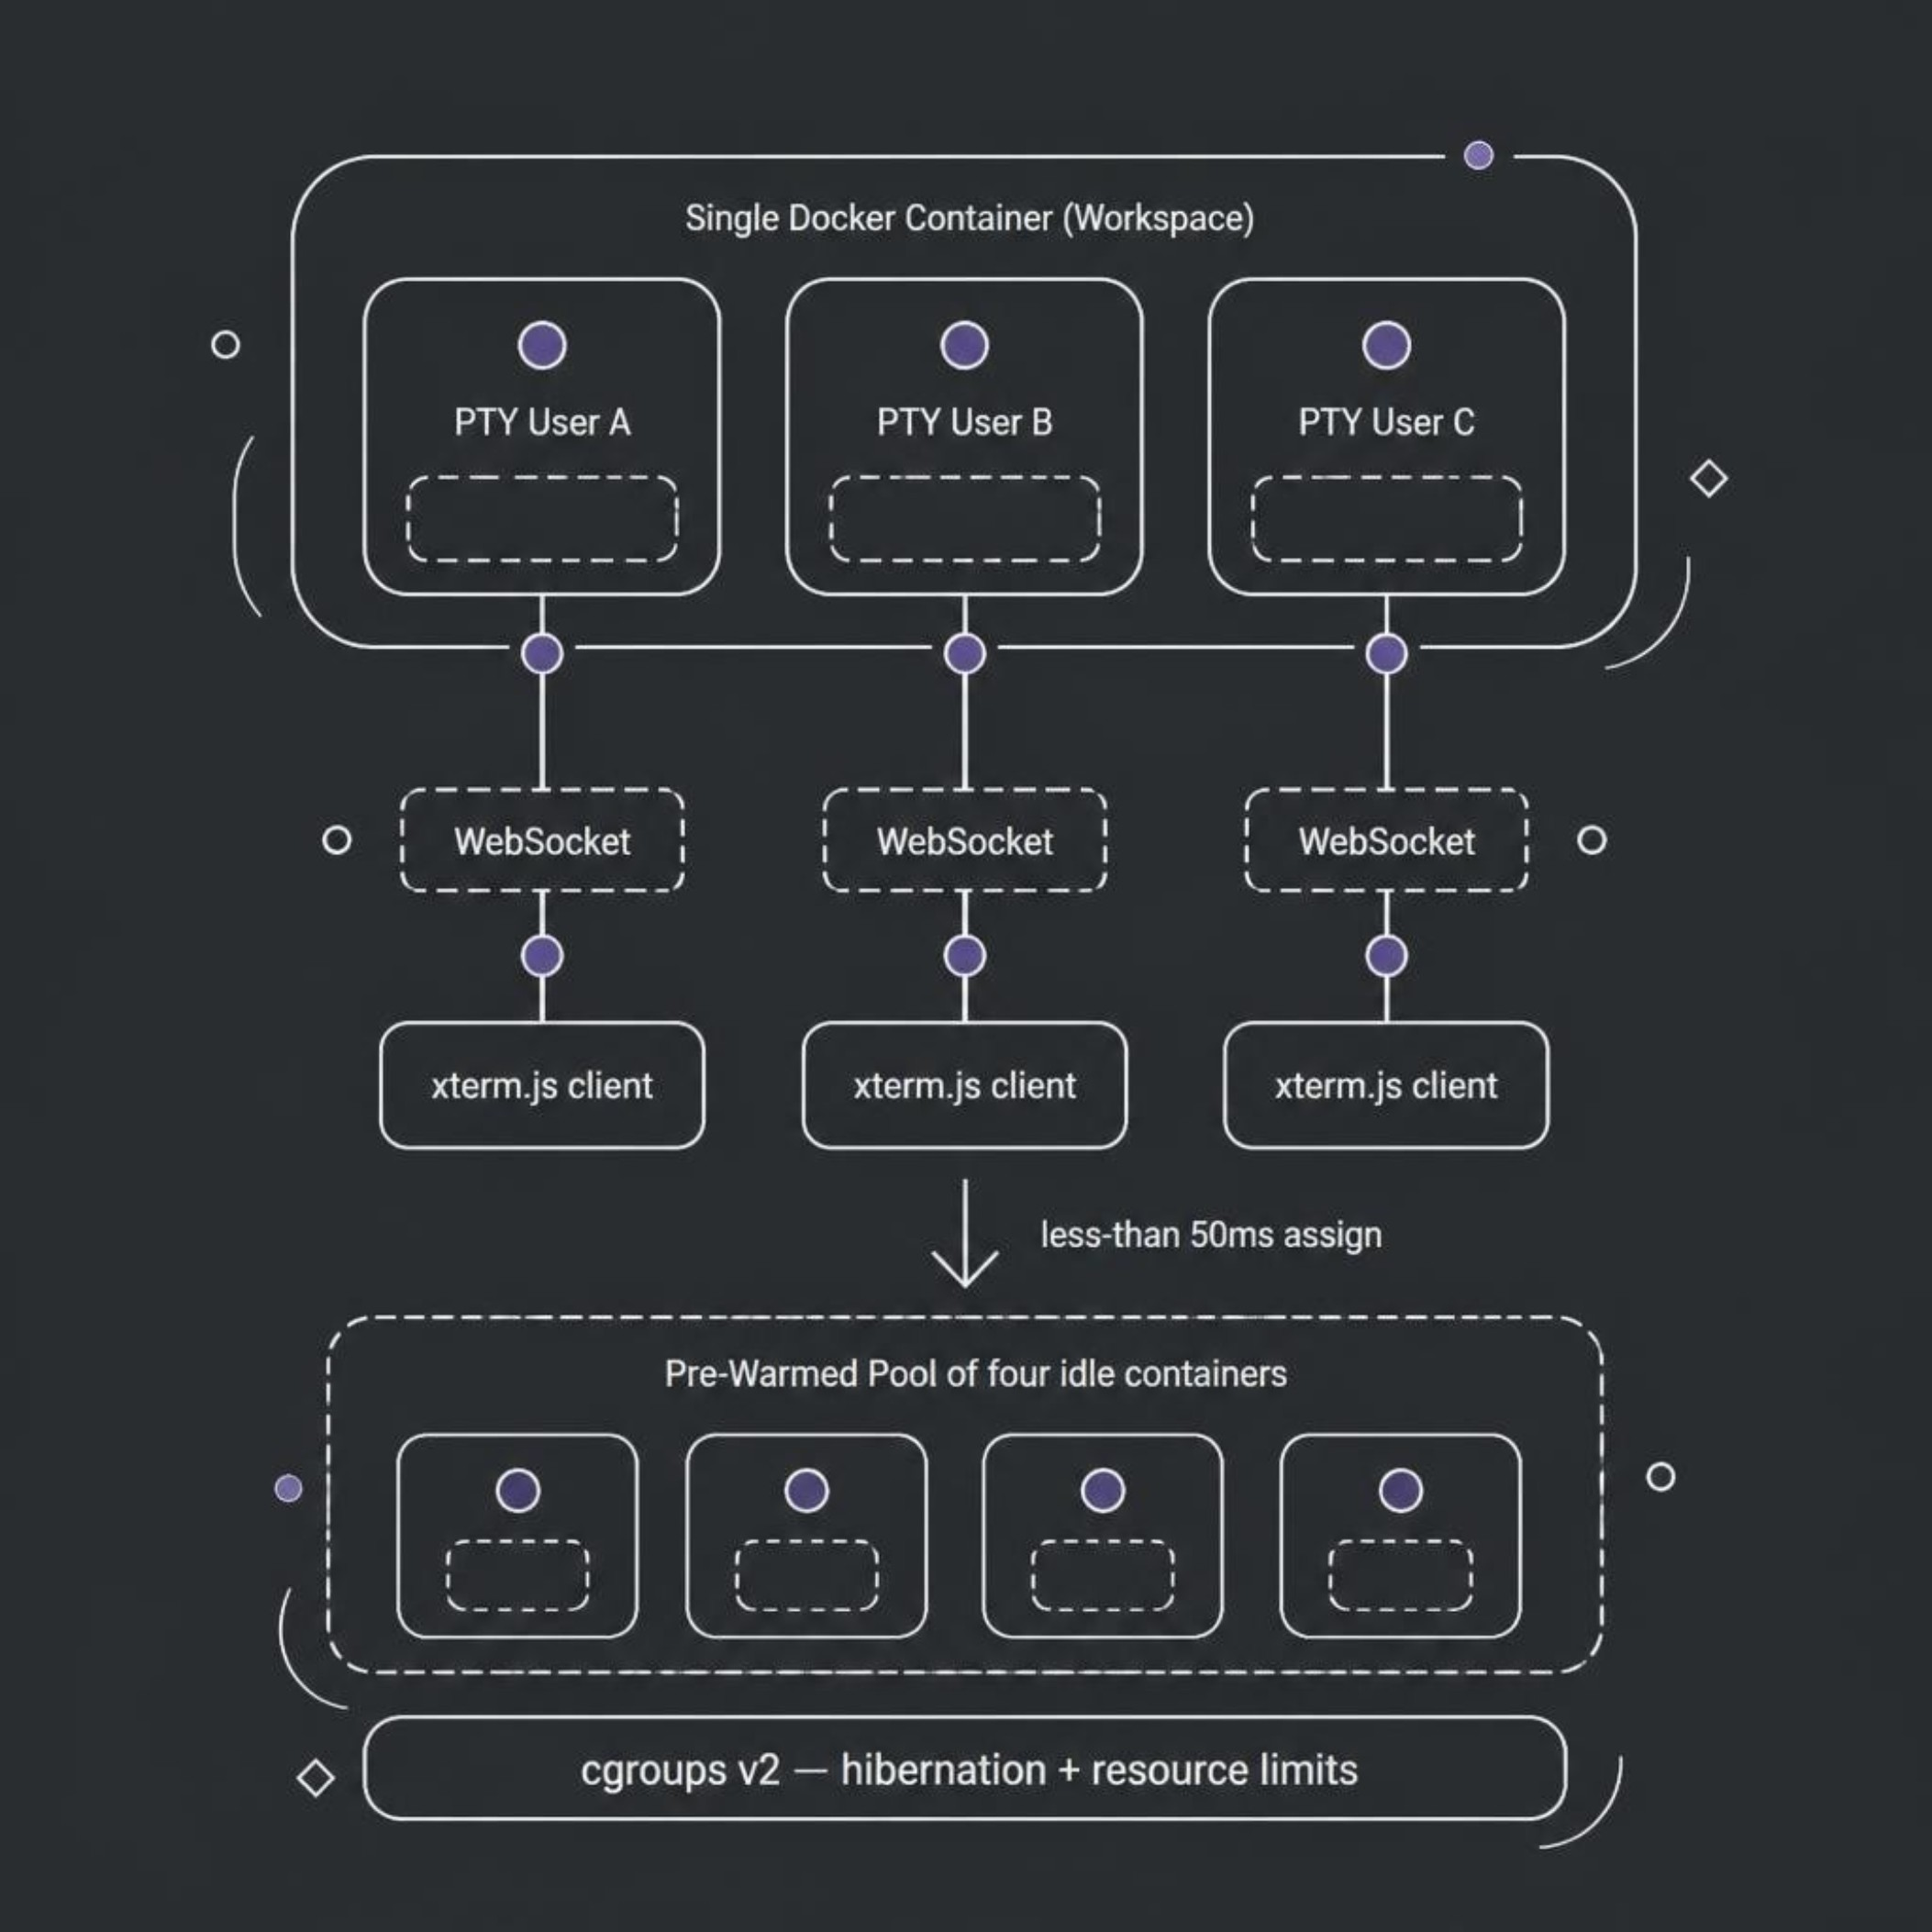
CONTAINER LAYER
Shared Container, Isolated PTYs
One container per workspace
Multiple users share the same filesystem namespace
Isolated PTY per user
Independent shell sessions, no cross-user leakage
<50ms assignment
Pre-warmed pool eliminates cold-start latency
cgroups v2
Hibernation + hard resource limits per container

Slide 6




THREADING
Offloading the Main Thread
Main Thread
Offload
Worker Threads
300ms+ lag
Merkle hashing + CRDT compaction blocking I/O
Move CPU-bound work to Worker Threads
<5ms latency
Merkle Hashing · CRDT Compaction
Result: 60x latency improvement (300ms → 5ms)

Slide 7

WAR STORY
The Race Condition That Doubled a Workspace
1. Symptom
2. Suspected
Two users landed in the same terminal, mid-typing
WebSocket room mix-up on the frontend
3. Ruled Out
4. Root Cause
Room routing logs showed correct per-user rooms
Pool checkout wasn't atomic — two requests read the same 'ready' container before either marked it claimed
❌ BEFORE
Pre-Warmed Pool
const container = pool.find(c => c.status === 'ready');
await verifyContainer(container); // async gap
container.status = 'claimed';
Checkout involved a read, then an async gap, then a write.
Bug: two concurrent requests could both pass the read before either completed the write — a classic check-then-act race.
Fix: wrap the entire checkout in a Redis-backed distributed lock (Redlock), so no second request can read the pool until the first claim finishes.
Two requests can both read 'ready' before either writes 'claimed'.
✅ AFTER
const container = await redlock.acquire('pool-checkout');
const c = pool.find(c => c.status === 'ready');
c.status = 'claimed';
redlock.release();
Read-then-claim happens as one atomic, lock-protected step.

Slide 8




RELIABILITY
Resilience: Failure Modes & Recovery
Redlock Distributed Locking
cgroup Resource Limits
Prevents split-brain writes and race conditions on shared resources (Postgres debounce, container pool checkout)
Hard memory/CPU/PID ceilings prevent one workspace from starving the host
Pre-Warmed Container Pool
Worker Thread Isolation
Standing reserve of ready containers absorbs load spikes without cold-start delay
CPU-heavy work offloaded from the main thread so one heavy operation can't freeze the whole event loop

Slide 9

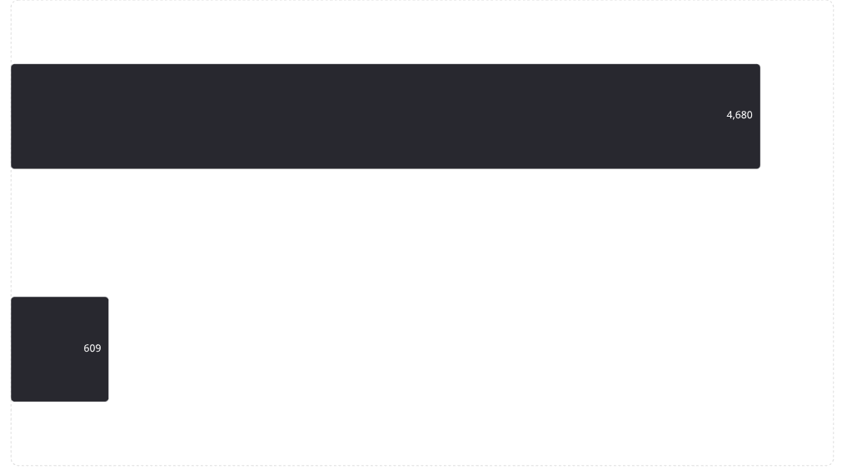
RESULTS
Measured Impact
609KB
<5ms
<50ms
20-Tier
Bundle Size
Event Loop Latency
After worker thread offload
Container Assignment
Pre-warmed pool cold-start
Automated Test Suite
Full coverage: unit, chaos, fuzzing
Down from 4.68MB

Slide 10
PERFORMANCE
Key Metrics at Scale
Bundle Size
Event Loop Latency
Container Assignment
Measured via Vite build output and gzip compression analysis
Sampled via perf_hooks.monitorEventLoopDelay (p50/p90/p99)
Timed from pool.acquire() to container.exec() ready
Automated Test Tiers
20-tier suite: unit, integration, chaos, security, E2E

Slide 11
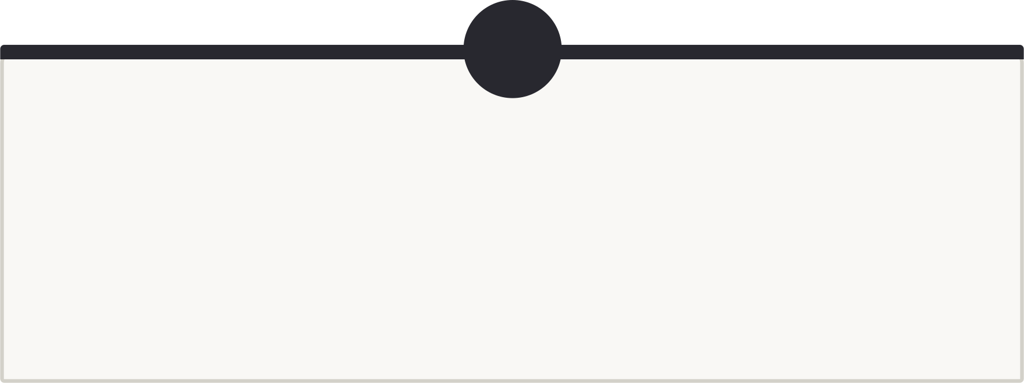
Trade-offs & Design Decisions
1
2
Docker vs Firecracker
PM2 vs Kubernetes
Namespace isolation chosen for faster initial development; kernel-level isolation is the acknowledged next step, not yet built.
PM2 was right-sized for this single-VM deployment; would move to an orchestrator only at multi-node scale.
3
4
BYTEA vs JSONB for CRDT Storage
Redlock's Known Limitation
BYTEA chosen since Yjs updates are already compact binary — JSONB would add serialization overhead for no benefit.
Redlock's correctness under Redis failover is debated in the distributed systems community; acceptable here because CRDT state is self-healing on reconnect.

Slide 12

What's Next
"Simplicity in state boundaries beats complexity in sync logic."
1
2
3
4
High-Density Sandboxing
WASM Client Extension Runtime
WebRTC Spatial Audio & Video Mesh
AI Context-Aware Autocompletion
MicroVMs like AWS Firecracker will harden host Linux kernels against container-escape risks during arbitrary untrusted user code execution.
A lightweight browser-side runtime for custom linters, formatters, and language analyzers — no server compute overhead or security exposure.
Peer-to-peer workspace channels for zero-dependency spatial audio, screen sharing, and developer huddles alongside live Monaco editing.
Low-latency inline ghost text, multi-token completions, and smart code fill powered by code LLMs like Codestral / Mistral AI.

