Slide 1

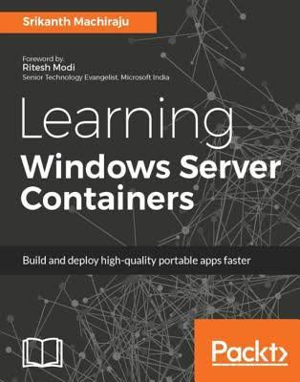
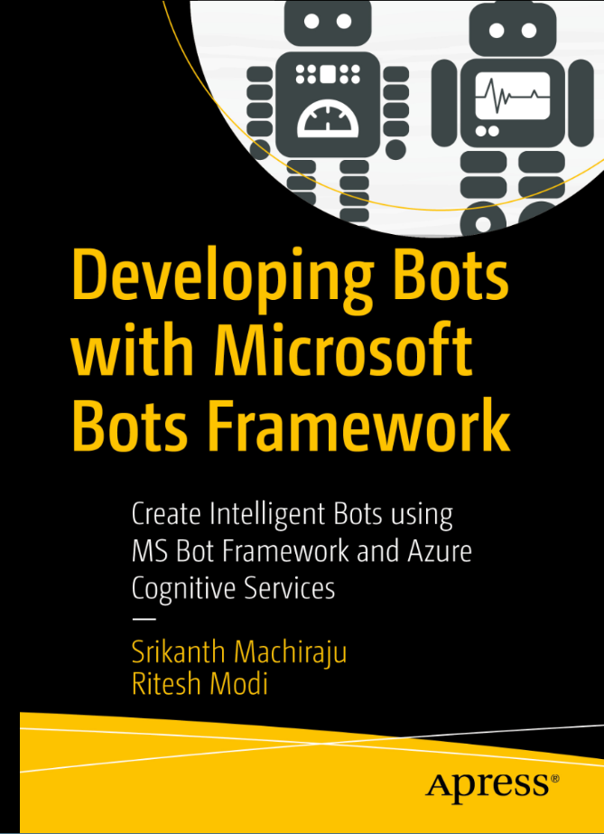
Srikanth Machiraju
www.linkedin.com/in/vishsrik
Containerize And Deploy Stateful Nodejs On K8s
git clone https://github.com/vishwanathsrikanth/nodejs-docker-k8s-training.git
Senior Consultant | Author | Blogger
Microsoft, Hyderabad

Slide 2
Why Kubernetes
How do you deploy an app with multiple containers?
How do we ensure Fault Tolerance across containers?
How do we do Canary Deployments / Blue green ?
How do we manage dependencies like App connecting to SQL container ?

Slide 3
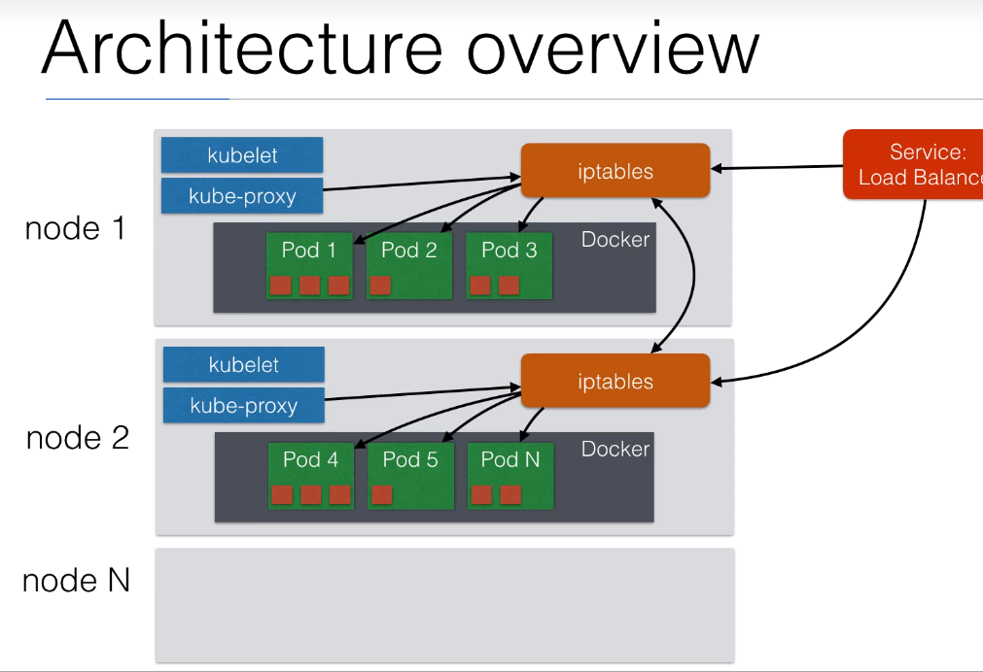
Introduction
Kubernetes is an open source orchestration system for Containers
Schedule containers on a cluster of machines
Manage containerized Applications as a unit
Move containers between nodes
Highly Modular
Great Community
Backed by Google

Slide 4
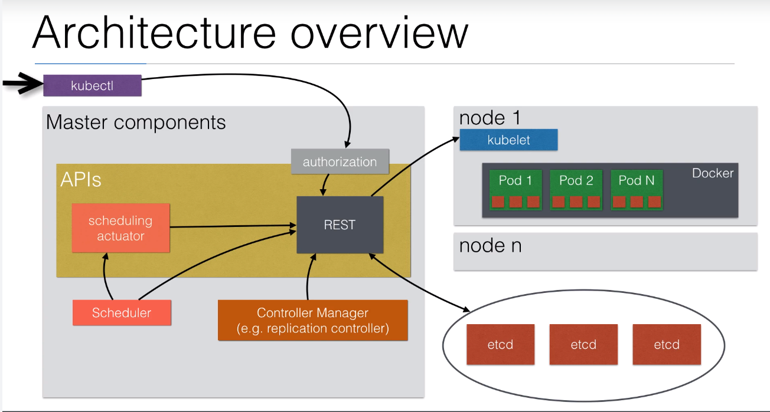
K8s Architecture

Slide 5
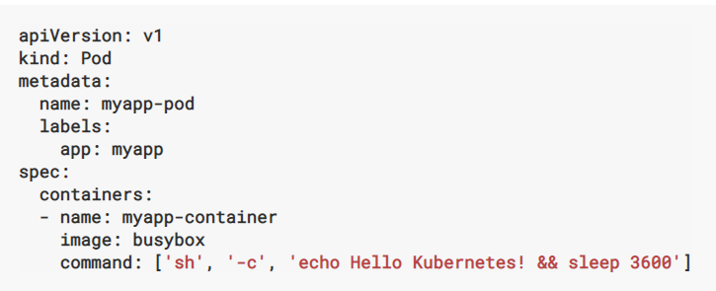
Pod
IP
Cluster
IP
IP
Node
Node
Basic Unit of deployment.
A Pod can contain one or more containers
Containers in a Pod share one IP address
Pods are scalable, fault tolerant
Containers within Pod can communicate using localhost
IP
IP
IP
Volume
Volume
Volume
Network
Network
Network
c
c
c
c
c
c
Pod
Pod
Pod

Slide 6
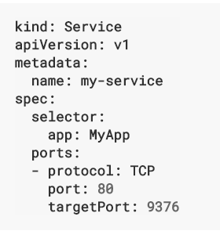
Service
Cluster
Pods are mortal
Pod IPs are not static
Service is an abstraction which defines logical set of pods
Node
Service
Pod
Pod
Service
Pod
Pod
Pod

Slide 7
Deployment
Cluster
A deployment is used to define a desired state of an application
Deployments can be upgraded or rolled back
Deployments can be scaled manually or auto-scaled using CPU %, Memory %
Deployments can be paused
If you want to roll out releases to a subset of users or servers using the Deployment, you can create multiple Deployments, one for each release, following the canary pattern
Node
Service
Pod
Pod
Deployment
Service
Pod
Pod
Pod
Volumes
Secrets
Config

Slide 8
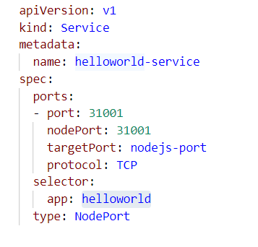
Port Mapping aka. Service Types
Request
Cluster IP
Default K8s Service Type
The service by default is internal to cluster
Node Port
A Service of type node port is exposed over Node’s IP.
You will be able to contact the Port by using <NodeIP>:<NodePort>
If you have multiple nodes same ports are opened on all IPs
Not supported by AKS
Load Balancer Port [Most Common]
Leverages cloud provider’s load balancer
External Name
Ingress
Cluster
IP, 31001
Node
Service, 31001
Pod
3030
container
3030
App
3000
Cluster
IP
Node
External Load Balancer
IP, 80
Service, <random>
Pod
3030
container
3030
App
3000
Request

Slide 9
Further Reading
Kubernetes Custom Resource Definition (CRD)
Kubeless
HELM
ISTIO

Slide 10
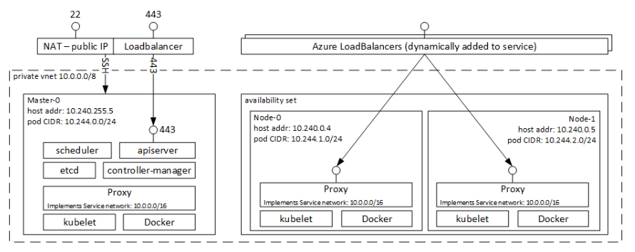
AKS Networking Architecture

