Slide 1
Asynchronous Programming & ES6 Features in NodeJS
git clone https://github.com/vishwanathsrikanth/nodejs-trainingmaterial
Srikanth Machiraju
Senior consultant | Author | blogger

Slide 2
Functional Programming
Definition of a function
A function must always take an argument.
A function must always return a value.
A function should act only on its receiving arguments (i.e., X) not the outside world.
For a given X, there will be only one Y.
Functions vs. Methods.
ECMA Script
Transpilers
Notes:
https://es6console.com/

Slide 3
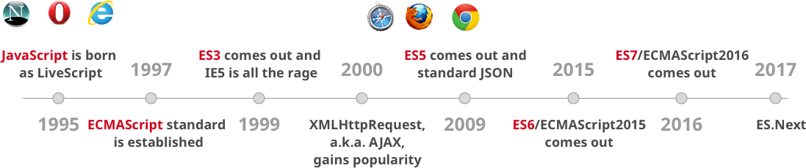
ES6
Browser Support
ECMA Script

Slide 4
Asynchronous Programming / ES8
Callback
Callback hell
Promises
Async and Await

Slide 5
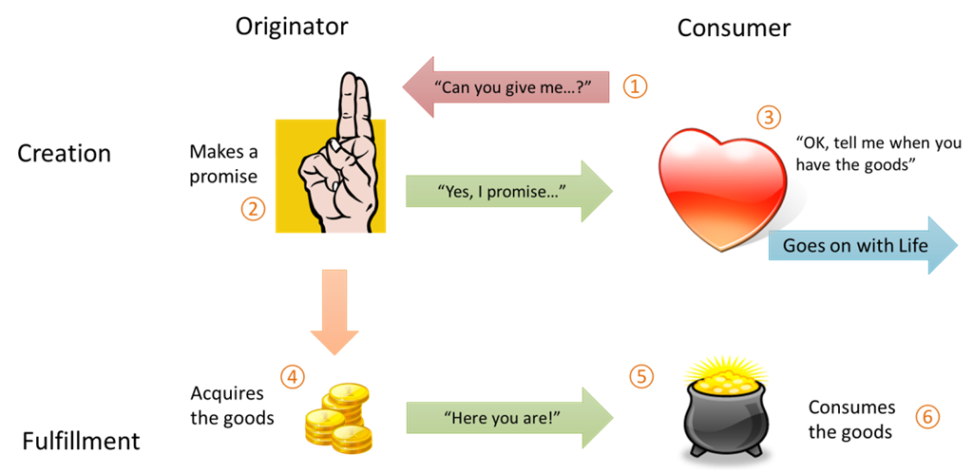
Promise
A promise in JavaScript world is piece of work which is expected to complete (or fail) at some point in future.
A Promise can be in any of three states: Pending, Resolved and Rejected

Slide 6
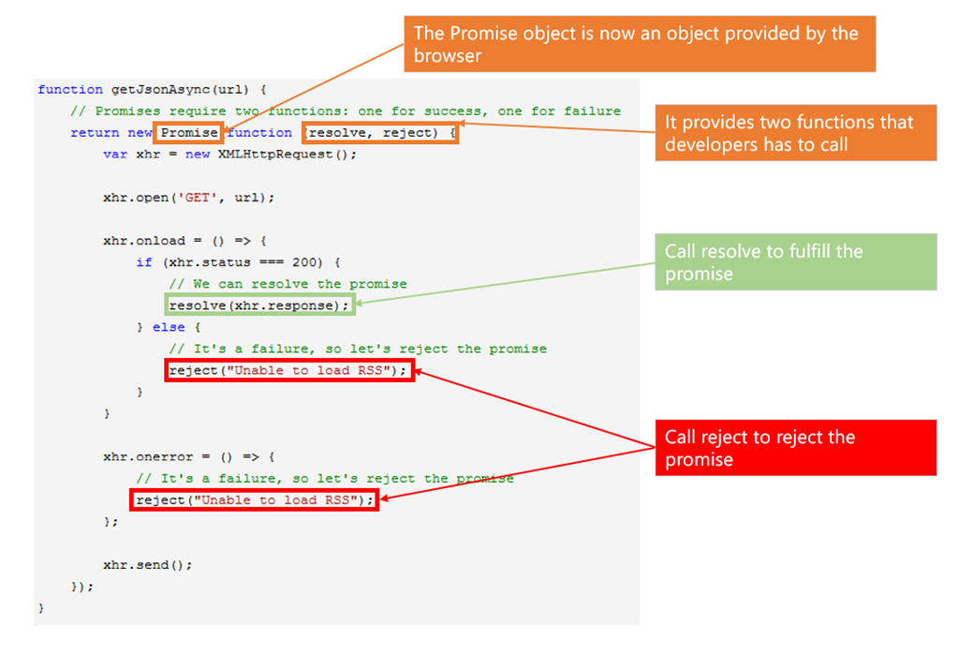
Async & Await

Slide 7
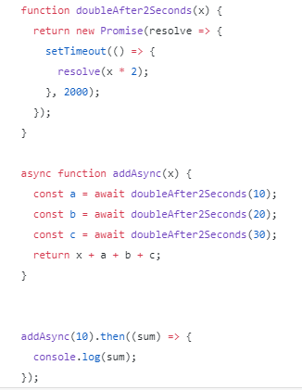
Async & Await
ES 2017 introduced Asynchronous functions
It is non-blocking (just like promises and callbacks).
Async/Await was created to simplify the process of working with and writing chained promises.
Async functions return a Promise. If the function throws an error, the Promise will be rejected. If the function returns a value, the Promise will be resolved.

Slide 8
ES 6 Features
Constants, Var/let/const Hoisting, object.freeze
Scoping
Arrow functions
Template literals
Default parameters
Spread operator
Enhanced object properties (computed property names, property shorthand, method properties)
Destructuring assignment
Modules
Classes
Iterators
Generators
Notes:
var hoisting:
var is function scoped. It is available in the whole function even before being declared.
Declarations are Hoisted. So you can use a variable before it has been declared.
Initializations are NOT hoisted. If you are using var ALWAYS declare your variables at the top.
--------------------------------------------------------------------------------------------------------------
Let hoisting and “temporal dead zone”
In ES6, let will hoist the variable to the top of the block (NOT at the top of function like ES5).
However, referencing the variable in the block before the variable declaration results in a ReferenceError.
let is blocked scoped. You cannot use it before it is declared.
“Temporal dead zone” is the zone from the start of the block until the variable is declared.
-----------------------------------------------------------------------------------------------------------------
Use const for all your references; avoid using var.
If you must reassign references, use let instead of const.
----------------------------------------------------------------------------------------------
Object.freeze
---------------------------------------------------

Slide 9
Further reading: Functional JS
Higher Order Functions
Closures
Currying and Partial Functions
Composition
Pipelines
Monads
Functors

