Slide 1
Face Detection: Using Local Binary Pattern
CSE504 | SPRING 2019
By Aman krishna, gyanshu azad singh, smriti bhati
iiit hyderabad
PROJECT PRESENTATION 5 MAY 2019
<number>

Slide 2
Method
This project is an implementation of the face detection for a given database using the Local Binary Pattern:
Title: Face Recognition using Local Binary Patterns (LBP)
Author: Md. Abdur Rahim, Md. Najmul Hossain, Tanzillah Wahid & Md. Shafiul Azam
<number>

Slide 3
Problem Statement
Proposed Solution
Data Preprocessing
Histogram
Distance
Matching
Parallelism
Flow of presentation
Intro
Module
Project
<number>

Slide 4
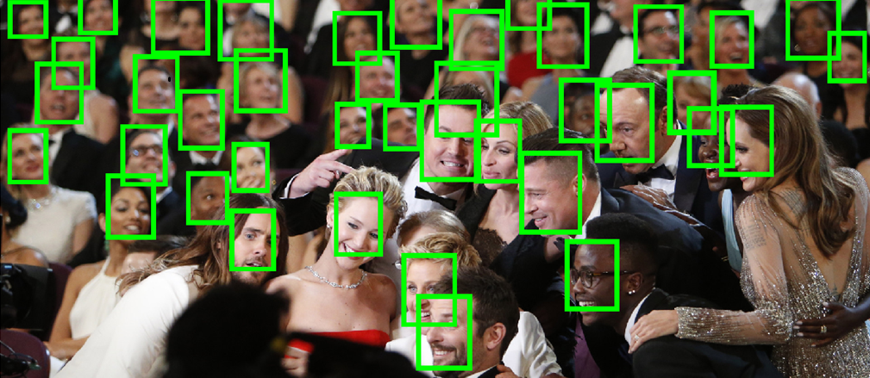
Introduction
Face detection is one of the major problems in Computer Vision
We wanted to train our database on a given set of images and later test out it on a new query image
<number>

Slide 5
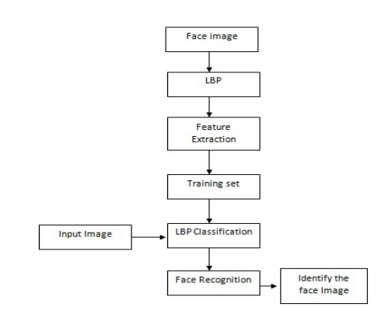
Proposed Solution
Using Local Binary Patterns which is robust against illumination, orientation, facial expression and aging of a person to recognize faces
<number>

Slide 6
Steps
Data Pre-
Processing
Histogram
Steps
Distance
Parallelism
Matching
<number>

Slide 7
Data Processing
→ Converting image into a text file containing the intensity values for a given pixel
→ We have considered images of 18 people
→ And 27 expressions of each person
Matrix factorization
Biased
MF
New
Method
Song2Vec
<number>

Slide 8
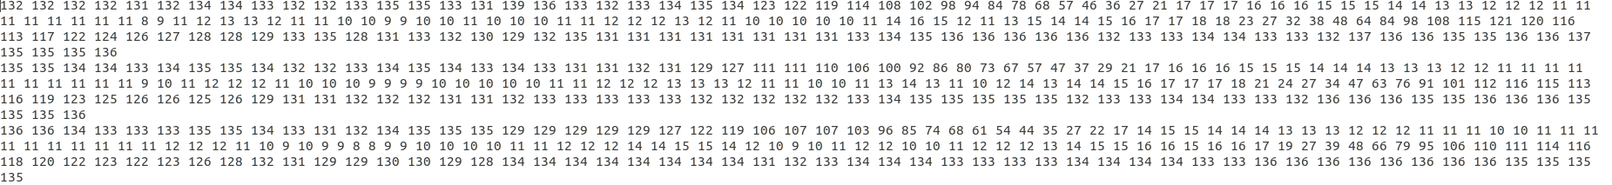
Snapshot of Raw Data
Matrix factorization
Biased
MF
New
Method
Song2Vec
<number>

Slide 9
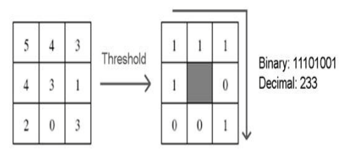
Local Binary Pattern
-> This operator works with the eight neighbors of a pixel, using the value of this center pixel as a threshold
-> If a neighbor pixel has a higher gray value than the center pixel (or the the same gray value) than a one is assigned to that pixel, else it gets a zero
-> The LBP code for the center pixel is then produced by concatenating the eight ones or zeros to a binary code
Matrix factorization
New
Method
Song2Vec
<number>

Slide 10
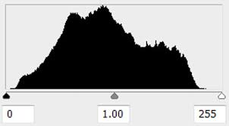
Histogram
-> There are 256 histogram bins which are initialized to 0
-> The decimal value generated by the string of zeros and ones is used to increament the bin correponding to the decimal value by one
-> We have used stride of 1
-> The window is moved across the complete image and the historgram of the image is created
-> We carried out this step for all the images in training data
Matrix factorization
New
Method
Song2Vec
<number>

Slide 11

Distance
-> Once we have the set of histogram for all the images
-> We calculate the histogram for the query image
-> The distance between two histograms is calculated as shown
Matrix factorization
New
Method
Song2Vec
<number>

Slide 12
Finding Match
-> We compare the query image with the set of all training histograms
-> The one with the minimum distance is taken as the matched face
Matrix factorization
New
Method
Song2Vec
<number>

Slide 13
Parallelism
-> We have parallelized the Histogram contructing step of the LBP such that multiple bins are constructed simultaneously
-> We have introduced parallelism such that histograms are constructed for multiple faces in parallel
-> For distance calculation as well we have introduced parallelism to speed up the process
Matrix factorization
New
Method
Song2Vec
<number>

Slide 14
Thank You !

