Slide 1
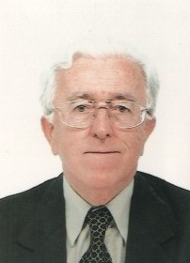
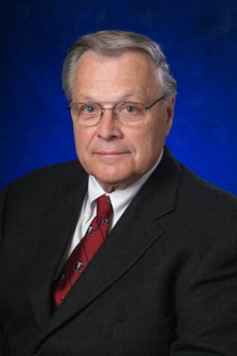
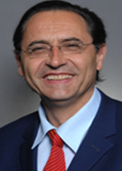
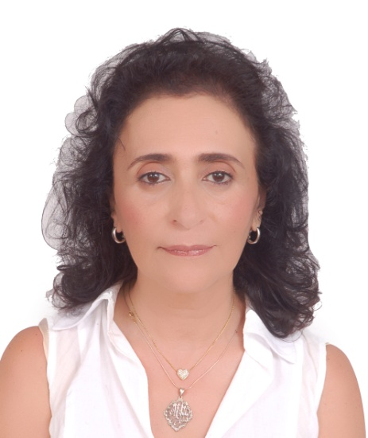
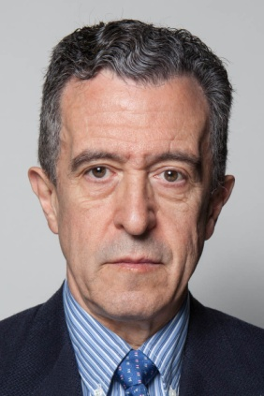
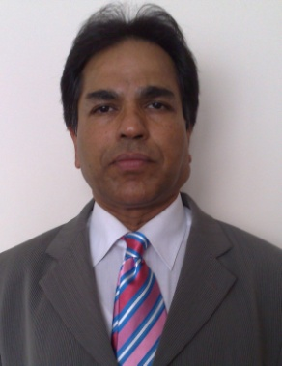
Michel Henry
Interventional Cardiologist,
France
Course Chairman, APVIC
Clifford J. Buckley
Professor of Surgery, Texas A&M University Health Science Center, Texas
President Elect, ISES
USA
Jacques Busquet
Ambassador, International Society of Endovascular Specialists
Ex President, ISES
France
Amira Benjelloun
Vascular Surgeon
President of SMSE (Moroccan Society of Endovascular Specialists)
President of SSEM (Maghrebin Society of Endovascular Specialists)
Frank J. Criado
Endovascular Specialist
MedStar Union Memorial Hospital
Baltimore, USA
Saroj Das
Vascular Surgeon
Honorary Professor, Brunel Institute of Bioengineering
Director of Clinical Studies, Imperial College London, UK

Slide 2
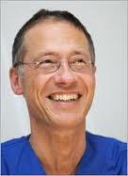
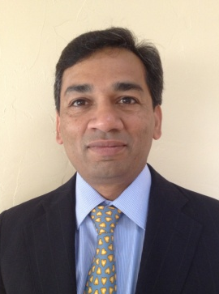
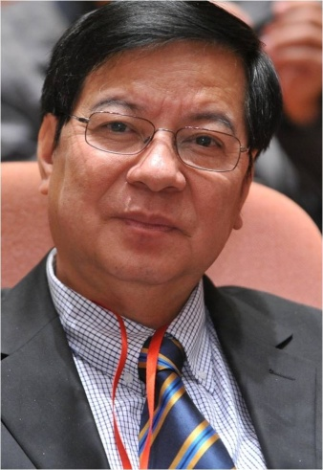
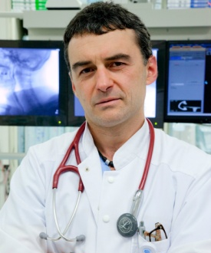
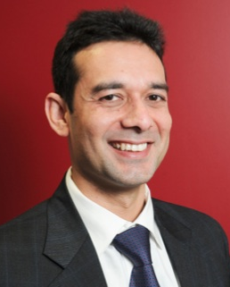
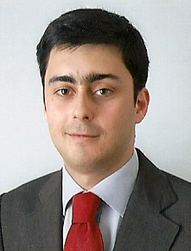
Horst Sievert
Specialist in Internal Medicine, Cardiology & Angiology, Intensive Care
Director and Founder, CardioVascular Centre Frankfurt, Germany
Ramesh Adiraju
RENU-CA Research Institute
Philadelphia, USA
Dai-Do DO
Associate Professor & Vice-Chairman
Director, Peripheral Vascular Interventions
Clinical and Interventional Angiology
Cardiovascular Department Inselspital,
Bern University Hospital, Switzerland
Ivo Petrov
President, Bulgarian Society of Endovascular Therapy
Head of Cardiology and Angiology Department, City Clinic, Sofia
Bulgaria
Akshay Mishra
Consultant, Interventional Cardiology
Prince Charles Hospital
Brisbane, Australia
Hugo Rio Tinto
Interventional Radiologist
Hospital de Saint Louis, Lisbon, Hepatobiliary and Transplant Centre, Lisbon, Portugal

Slide 3
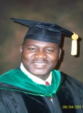
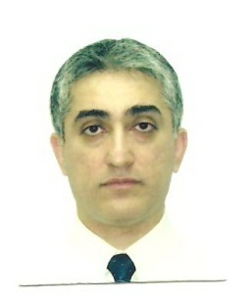
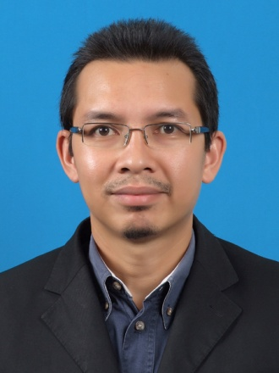
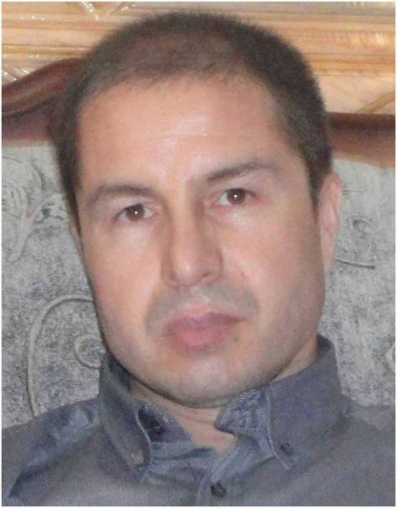
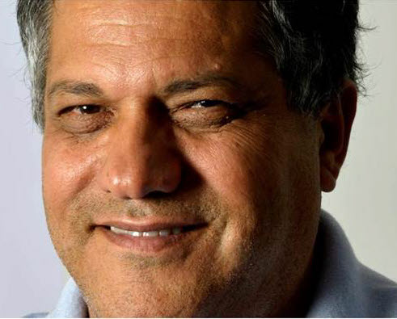
Balarabe Sani Garko
Professor of Internal Medicine/Cardiology,
Ahmadu Bello University, Zaria
Nigeria
Varin Arora
Consultant Cardiologist
Phetcharat Hospital, Thailand
Bangkok
Shaiful Azmi bin Yahaya
Consultant Cardiologist,
Institut Jantung Negara
Kuala Lumpur, Malaysia
M. Hussain Hamdard Consultant, Cardiology ARIA Medical University Chief, Cardiology Ward, Umulbelad Diagnostic Clinic
Afghanistan
Noureddine Frid
CEO of Cardiatis
Belgium

