Slide 1


NEXT GEN EMPLOYABILITY PROGRAM
CREATING A FUTURE-READY WORKFORCE
Student Name :
Aman Kumar
Student ID :
STU650b3cbe727ee1695235262
Mobile No:
9466296536
Mail ID:
ak3018258103@gmail.com
College Name :
Kurukshetra University, Kurukshetra

Slide 2
CAPSTONE PROJECT SHOWCASE
Project Title
Health Care Data Driven Decisions
Abstract | Problem Statement | Project Overview | Proposed Solution | Technology Used | Modelling & Results | Conclusion | Q&A

Slide 3
Abstract
1
Data Collection and Processing for Healthcare Decision Making
2
Harnessing the Power of DAX Functions in Healthcare Analytics
3
Visualizing Healthcare Trends and Insights with Power BI Dashboards
4
Optimizing Healthcare Data Presentation and Communication

Slide 4


Problem Statement
Data Cleaning
Data Importing
Data Processing and DAX Functions
Visualization and Dashboard Design
Formatting and Layout

Slide 5

Project Overview
First we have collected, cleaned, and imported healthcare data for analysis, leveraging DAX functions to create new columns and measures. Through data processing and visualization in Power BI, we have developed comprehensive dashboards and applied formatting for effective data communication and decision-making in healthcare contexts.

Slide 6
Proposed Solution
Implement robust data cleaning techniques such as handling missing values, outlier detection, and standardizing data formats to ensure data integrity and reliability.
Utilize Power BI's data connectors and ETL (Extract, Transform, Load) processes to streamline data importing and maintain data consistency.
Develop optimized DAX expressions for creating new columns, measures, and calculated fields to perform advanced analytics, aggregations, and statistical computations accurately.
Design intuitive and interactive visualizations using appropriate charts, graphs, and slicers in Power BI to present actionable insights .
Implement standardized formatting templates, color schemes, and layout guidelines for reports and dashboards to enhance readability, aesthetics, and user engagement.

Slide 7
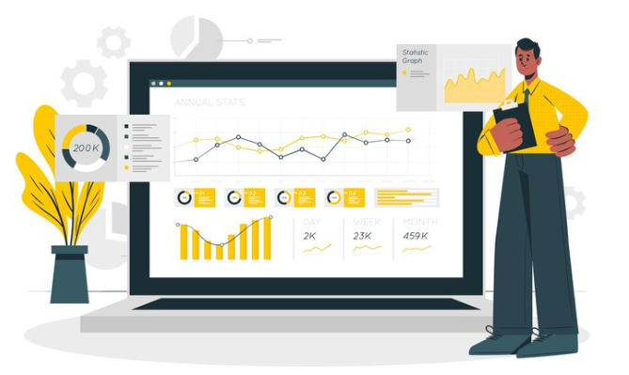
Technology used
Power BI

Slide 8
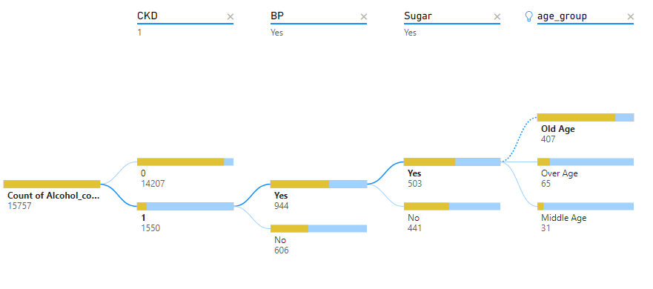
Modelling & Result
Consumer

Slide 9
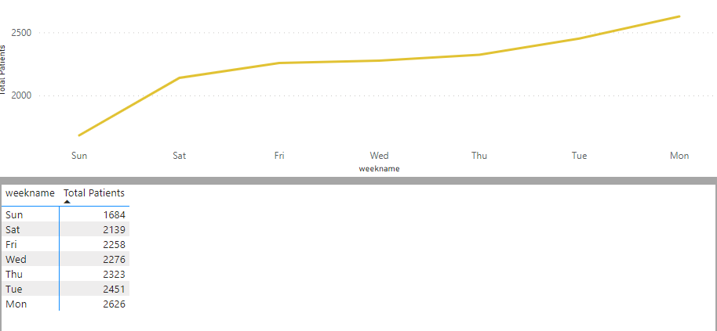
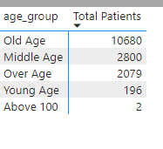
Modelling & Result

Slide 10
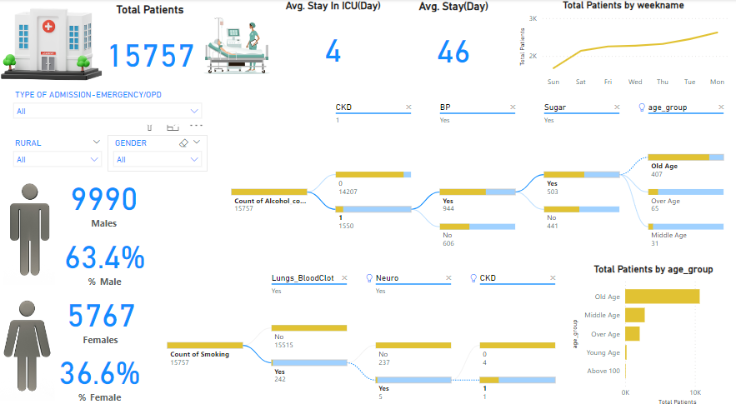
Modelling & Result

Slide 11

Conclusion
Through comprehensive data collection, cleaning, and analysis using Power BI, we gained insights into a healthcare dataset comprising 15,000 patients. The majority were male (66.6%) compared to female (38.4%). The average ICU stay was 4 days, while patients spent an average of 46 days in the hospital. Interestingly, Mondays and Tuesdays saw the highest patient admissions, indicating potential patterns for resource allocation and scheduling optimization in healthcare facilities.

Slide 12


Notes:
Thank You !!

