Slide 1

MAJOR PROJECT PRESENTATION
Presented by-
Aman Kumar
Anurag Singh
Deepali Sharma
Nitish Kumar Tiwari
Supervised by-
Dr. Ankur rai
(Assistant Professor)

Slide 2


Sentiment Analysis using Machine Learning and Information Retrieval

Slide 3
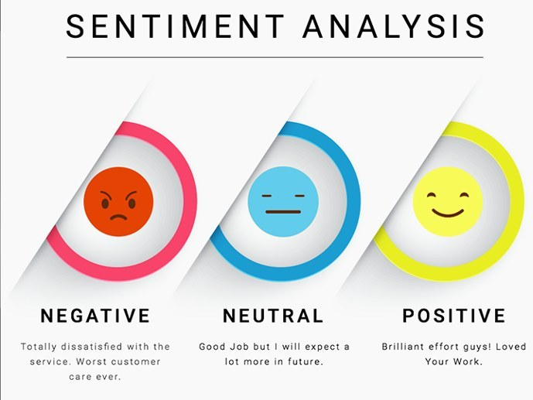
What is Sentiment Analysis?
Sentiment Analysis is a computational technique that involves using algorithms to determine the sentiment or emotional tone expressed in a piece of text. It aims to categorize the sentiment as positive, negative, or neutral, providing valuable insights into people's opinions and emotions.

Slide 4
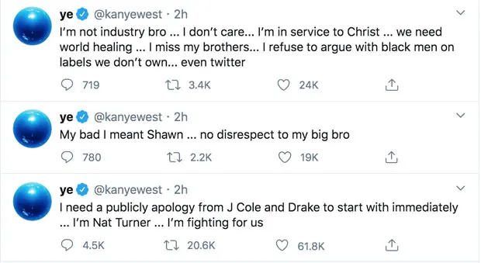
Why Twitter Data?
Twitter as a rich source of real-time public opinions: Twitter is a microblogging platform with millions of active users sharing their opinions and reactions in real-time. This makes it an invaluable resource for sentiment analysis as it provides a continuous stream of diverse and up-to-date textual data.

Slide 5
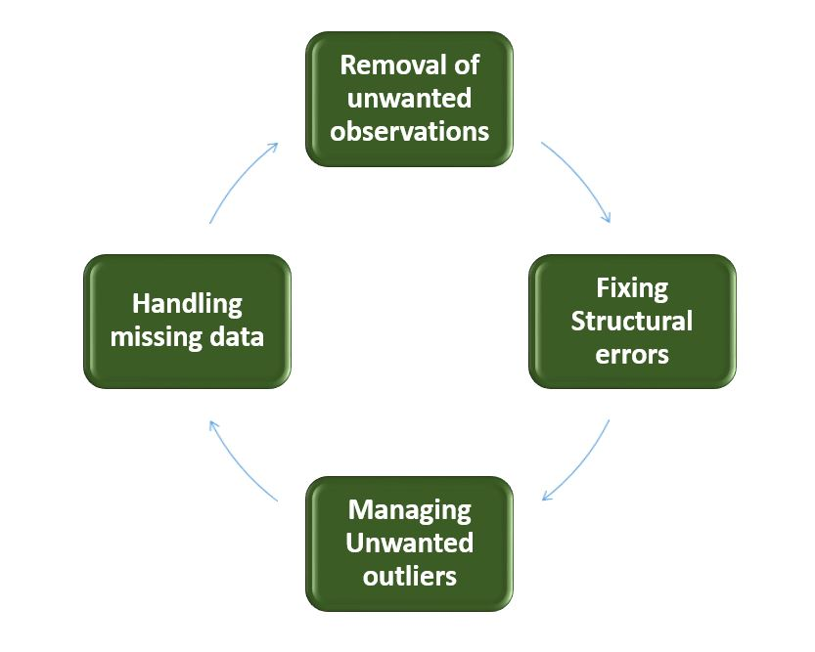
Data Collection
Kaggle for data retrieval: To collect data from Twitter, we will utilize the Kaggle dataset.
Data cleaning and preprocessing: Raw Twitter data may contain noise, including irrelevant information, special characters, and URLs.

Slide 6
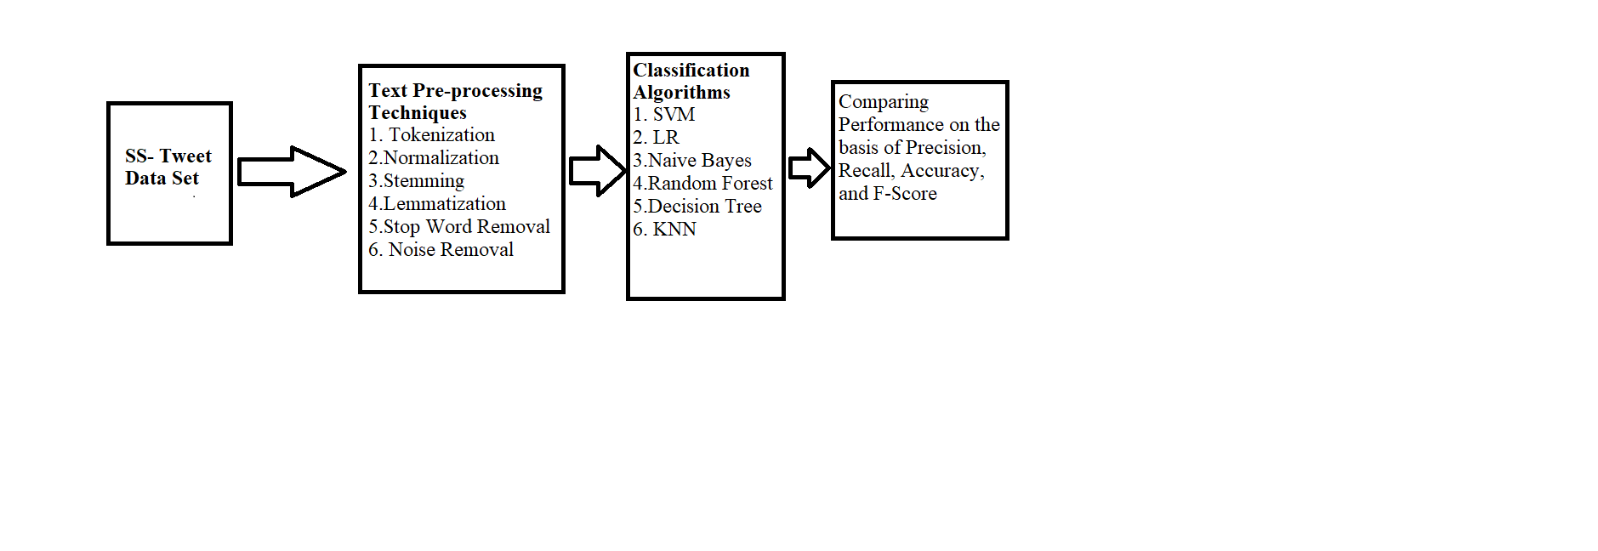
PROPOSED APPROACH

Slide 7
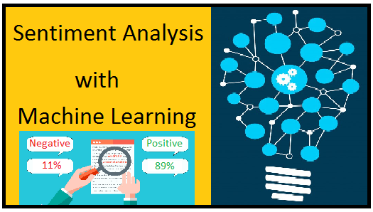
Machine Learning for Sentiment Analysis
We will employ various machine learning algorithms, such as Naive Bayes, Support Vector Machines, K-Nearest Neighbor (KNN), Decision Tree Classifier and Logistic Regression, to train our sentiment analysis model.

Slide 8
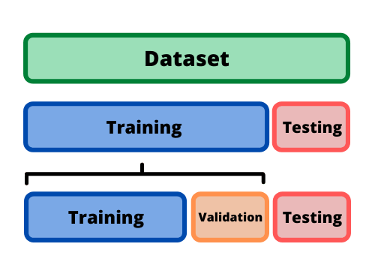
Training and Testing
Splitting data into training and testing sets: To evaluate the performance of our sentiment analysis model, we will partition the dataset into two subsets: a training set used to train the model and a testing set used to assess its accuracy.

Slide 9

Feature Extraction
Feature extraction is a critical step in sentiment analysis. We will employ techniques like Term Frequency-Inverse Document Frequency (TF-IDF) and Word Embeddings to convert text into numerical vectors.
Feature selection helps in identifying the most informative aspects of the text that contribute to sentiment.

Slide 10
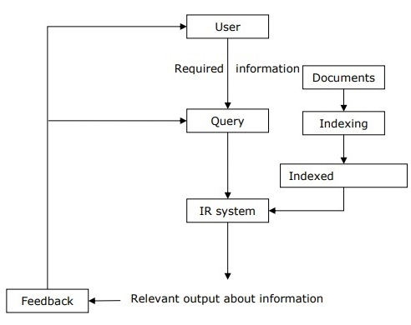
Integration of Machine Learning and IR
The machine learning model provides accurate sentiment classification, while the IR system enriches the analysis by retrieving contextually relevant information. This combined approach leads to more nuanced and accurate sentiment insights.

Slide 11

Tools and Hardware
For the implementation of this project, we will primarily use Python
Key libraries that will be utilized include NLTK (Natural Language Toolkit) for text processing and Scikit-learn for machine learning tasks.

Slide 12
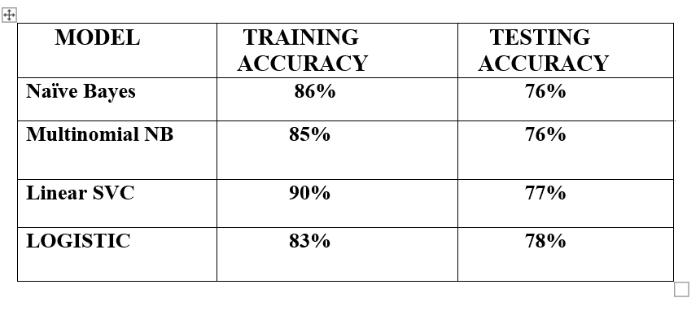
Results and Evaluation

Slide 13


