Slide 1
Room reservation system for Friends’ Hotel
Nhujan Maharjan
190603
Aman Maharjan
190604

Slide 2
Introduction
Our proposed project is a room reservation system which helps in online reservation of rooms.
Friend’s hotel is one of those hotel businesses for whom we are going to develop the room reservation system.
It helps people to reserve the hotel rooms from anywhere at any time with the help of internet.
This system provides good information sharing to both customer and staff of the hotel.
Room reservation system is also considered as efficient, informative and user- friendly website.
The system provides faster and more efficient way to book a room.
Customer can easily select rooms within their range by simply going through the website of hotel.

Slide 3
Problem Statement
Lack of hotel website promotion.
Inability to match customer expectation.
Double booking.
Mishandling of reservations.
There may cause an technical error like server down or other problem.

Slide 4
Objectives
To avoid manual and repetitive work.
To secure all the data and records.
To provide speed reservation and registration service.
To retrieve records simply whenever necessary.
To authorize the users to have access to the records.
To create a database where every customer’s detail is recorded.
To generate a proper invoice.
To keep track of available rooms and reservations.

Slide 5
Study of existing system
The current system of hotel management is fully based on paper work. There may occur some delay or problems while providing services by a human. Manually handling the hotel rooms records, customers details, and other management is hard and time-consuming. While all the records are kept in files they may get torn out, lost, or get damaged due to water or fire. Making room reservation is also time-consuming as a customer have to visit the hotel first and ask for available rooms then inspect those room then only if customers like it, he will take the room or else he won’t and for all these processes it takes a lot of time.

Slide 6
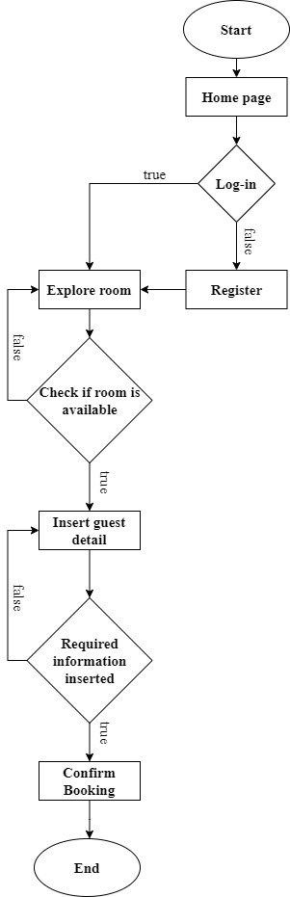
System flow chart

Slide 7
Methodology of the Proposed System
Methodology we are using for room reservation system is waterfall model.
It is easy to implement as each phase in the waterfall model has specific deliverables and a review process.
Fixed requirements and related behaviors in environment makes it possible to use this methodology.
Requirement analysis is first phase we will be implementing.
In second phase we will consider system design.
Implementation of the design will be done in third phase.
In fourth phase system testing will be done.
Deployment of the system will be done in fifth phase.
Maintenance will be done in the sixth phase.

Slide 8
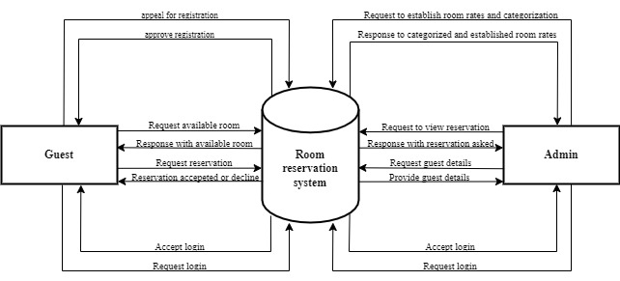
Working Mechanism of the Room reservation system

Slide 9
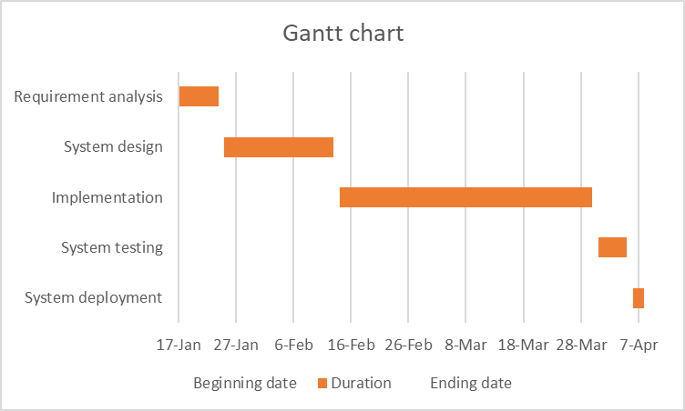
Gantt chart

Slide 10
Expected Outcomes
The system will make it easier and faster to make room reservation.
Record will be saved in database which makes it safer and takes less space.
Access to reserving a room from anywhere at anytime.
Easy to prepare invoice.

Slide 11
References
D.-Y. K. A. M. M. Xinran Y. Lehto∗, "The Effect of Prior Destination Experience on Online Information Search Behaviour," vol. 6, no. 2, pp. 160-178, 1 February 2006.
P. a. F. A. O’Connor, "An Evaluation Methodology for Hotel Electronic Channels of Distribution," International Journal of Hospitality Management, pp. 179-199, 2004.
L. Sherrell, Waterfall Model, Springer, Dordrecht, (2013).

Slide 12
THANK YOU

