Slide 1
Analysis of gtd datasets
Using Global Terrorism Database (GTD)
Performed using Python Libraries (Pandas, Matplotlib, Seaborn, Folium, Plotly, GeoPandas)

Slide 2
Brief discussion:
India has faced major terror incidents for over 47 years.
Purpose: Analyze long-term terrorism patterns & high-risk areas.
Dataset: Global Terrorism Database (GTD), 1970–2017.
Approach: Data cleaning, visualization, mapping, clustering & risk scoring.

Slide 3
Dataset Summary (GTD)
Worldwide terrorism dataset.
Covers 1970–2017.
Contains 135+ columns.
Includes:
Date, location (state/city)
Attack type, weapon type
Target type
Terrorist group
Casualties (killed/wounded)
Coordinates (lat/lon)

Slide 4
Libraries Used
Pandas: Data cleaning, filtering, grouping.
NumPy: Numerical operations.
Matplotlib: Line charts, plots.
Seaborn: Attractive barplots & visualizations.
Folium: Interactive geo-maps (HTML).
Plotly: Animated time-series maps.
GeoPandas: Choropleth/state maps.
Scikit-Learn: DBSCAN clustering (hotspot detection).

Slide 5
Project Workflow
Load GTD dataset
Select India (1970–2017)
Clean date, casualties, coordinates
Time-series analysis
Bar charts: attack types & targets
6. State-wise analysis
7. Hotspot clustering
8. Choropleth heatmap
9. Interactive and animated maps
10. Risk scoring

Slide 6
Data Cleaning
Converted year/month/day → single date field
Converted nkill/nwound → numeric
Removed missing coordinates
Filtered India records
Created derived fields for analysis

Slide 7
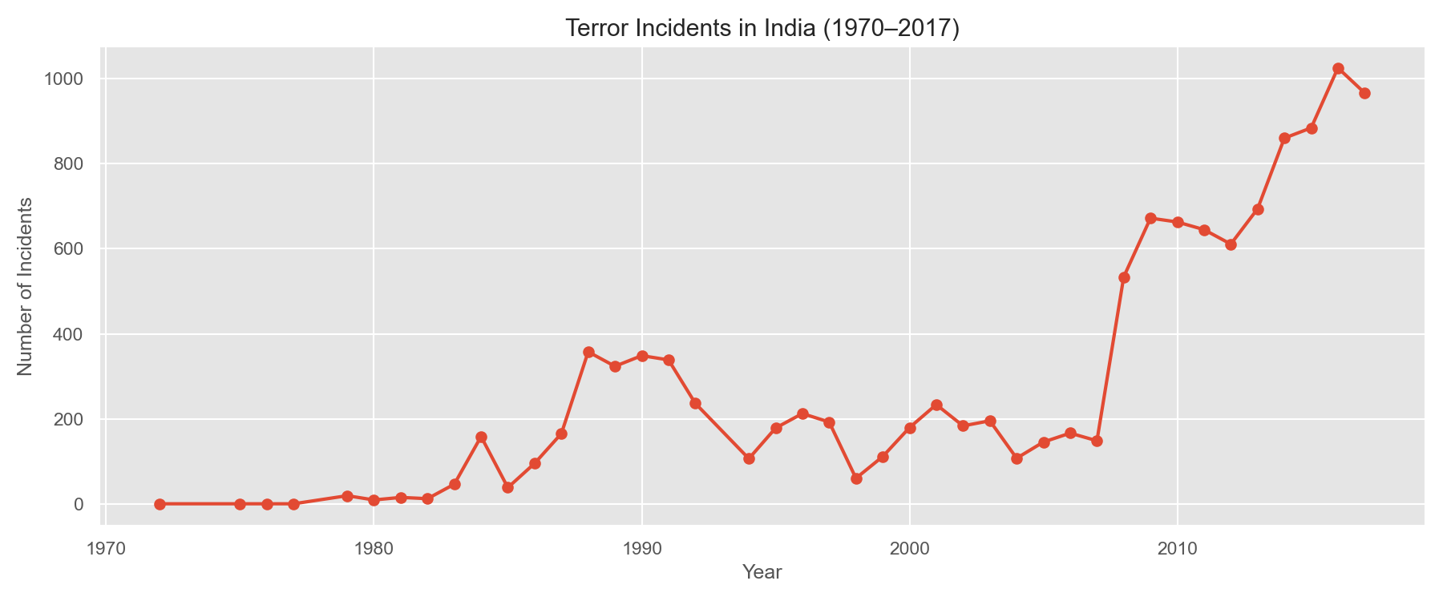
— Attacks Per Year
Shows increase in attacks over decades.
1970s–80s: low incidents
Late 80s–90s: rise due to insurgencies
2000–2010: high fluctuations
2014–2017: peak due to certain regional
conflicts.

Slide 8
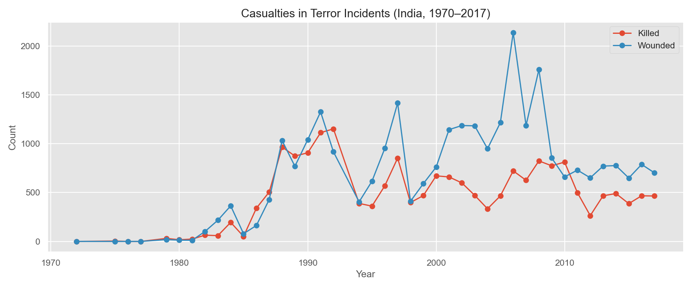
— Casualties Over Time
Graph of killed vs wounded.
Periodic spikes indicate major violent
periods.
Wounded count generally higher than
killed.

Slide 9
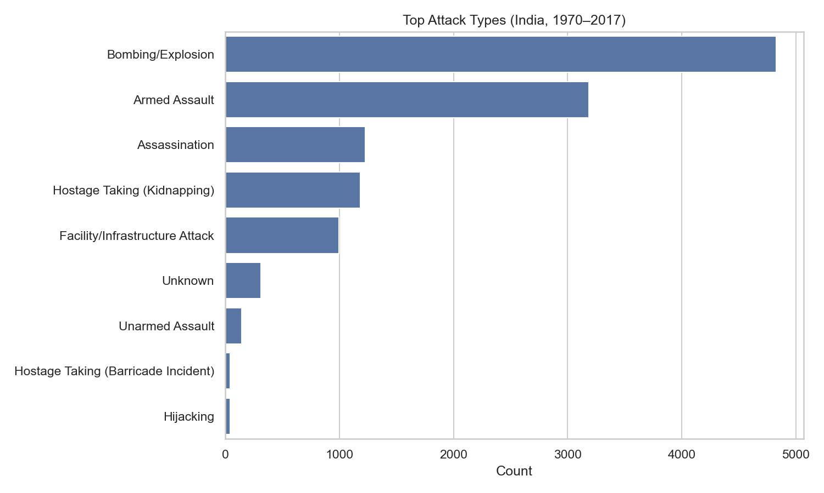
— Attack Types
Bombings/Explosions are most common.
Armed assaults second most.
Kidnapping, assassinations also significant

Slide 10
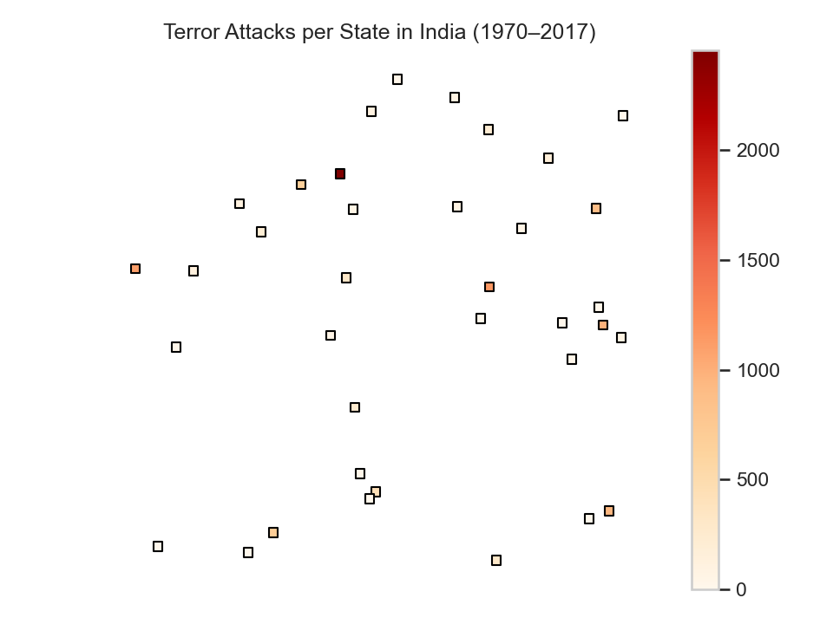
— State-Wise Choropleth
Shows intensity of terror across states.
Highest incidents in:
Jammu & Kashmir
Northeastern states
Central India (Naxal-affected areas)

Slide 11
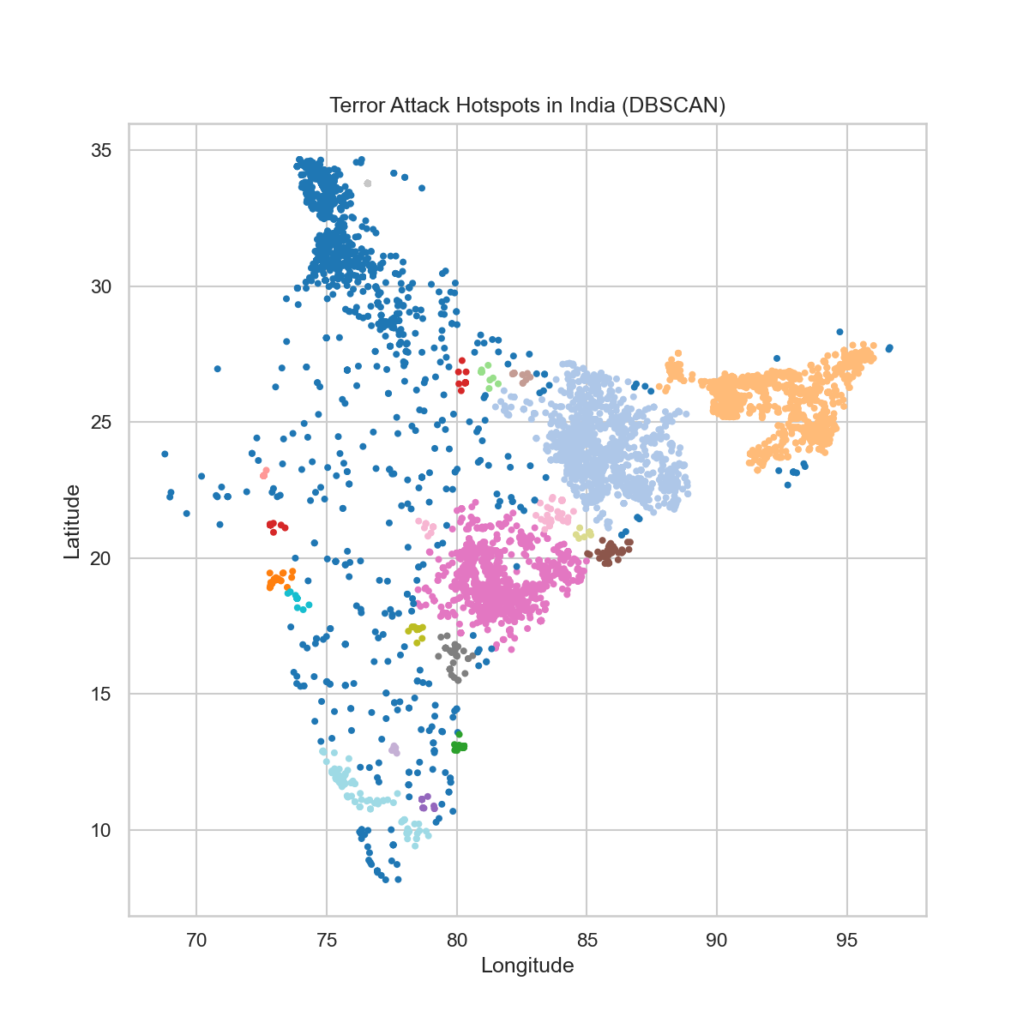
— Hotspot Analysis (DBSCAN)
Clusters represent areas with high
incident density.
Helps identify major conflict zones
Data-driven method using geographic
coordinates..

Slide 12
— Interactive & Animated Maps
Folium Map: Clickable, zoomable
incident map.
Plotly Animation: Shows year-wise spread
of terrorism.
Files created:
india_attacks_map_full.html
india_animated_timeline.html

Slide 13
— State Risk Score
Risk Score =
0.5 × (Incidents %)
0.3 × (Killed %)
0.2 × (Wounded %)
Higher score = higher terrorism risk.
Highlights vulnerable states for
policymakers.

Slide 14
— Conclusions
Sharp rise in terrorism during 1985–2010.
High concentrations in J&K, NE states,
and Central India.
Bombings were the dominant attack type.
Civilians were the most targeted category.
Risk scoring identifies chronic high-risk
regions.

Slide 15
— Future Scope
Add population data → per-capita risk map
Use ML models for attack prediction
Add news sentiment & socio-political factors
Real-time dashboard with live visualization

Slide 16
Thank You

