Slide 1
Terrorism Analysis in India (1970–2017)
Using Global Terrorism Database (GTD)
Visualisation, Hotspots, State Risk, Mapping
Created with Python

Slide 2
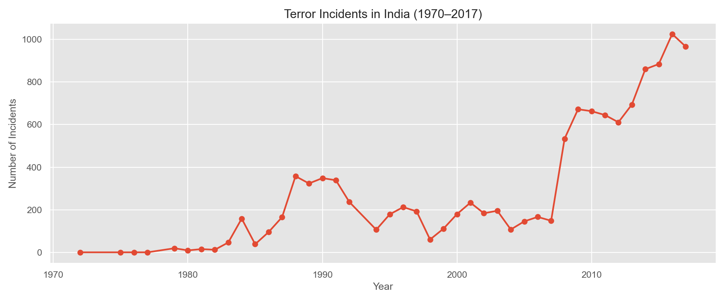
Terror Attacks per Year (1970–2017)

Slide 3
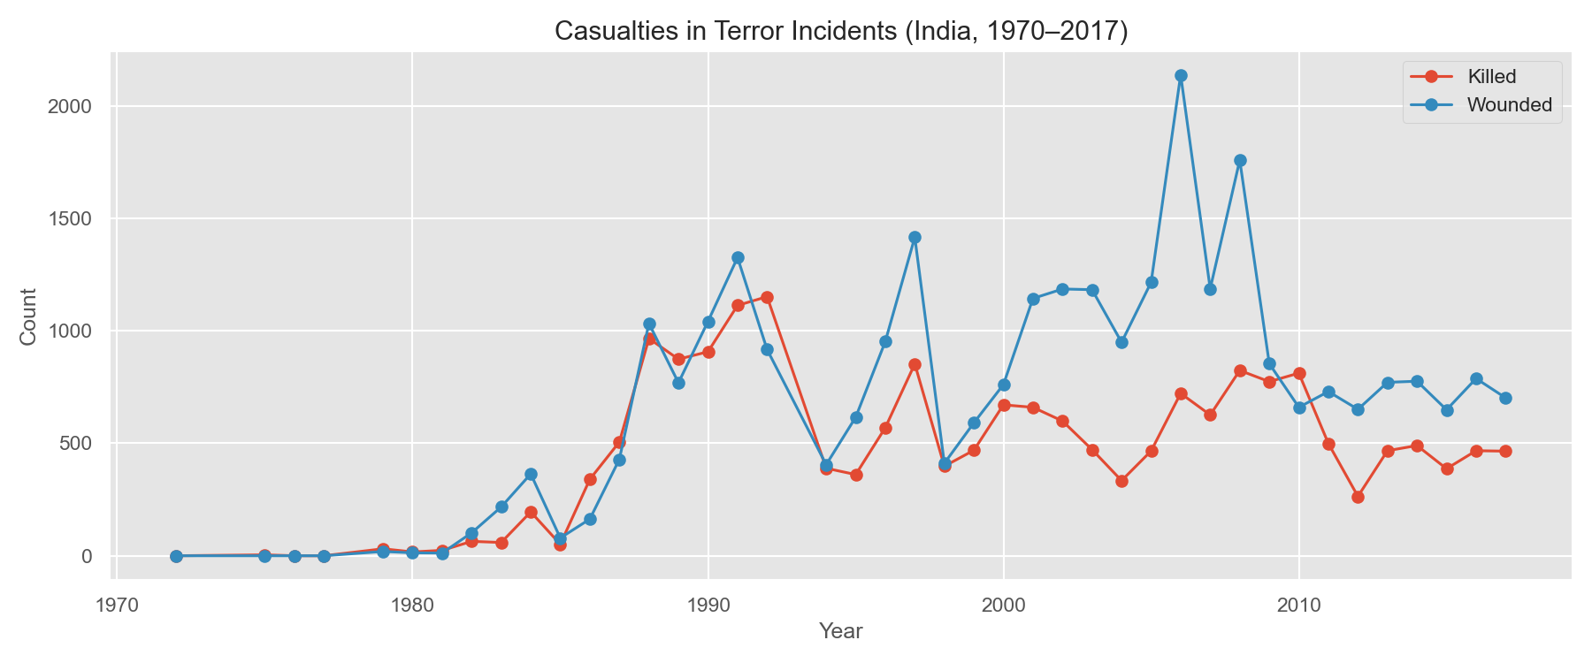
Casualties per Year

Slide 4
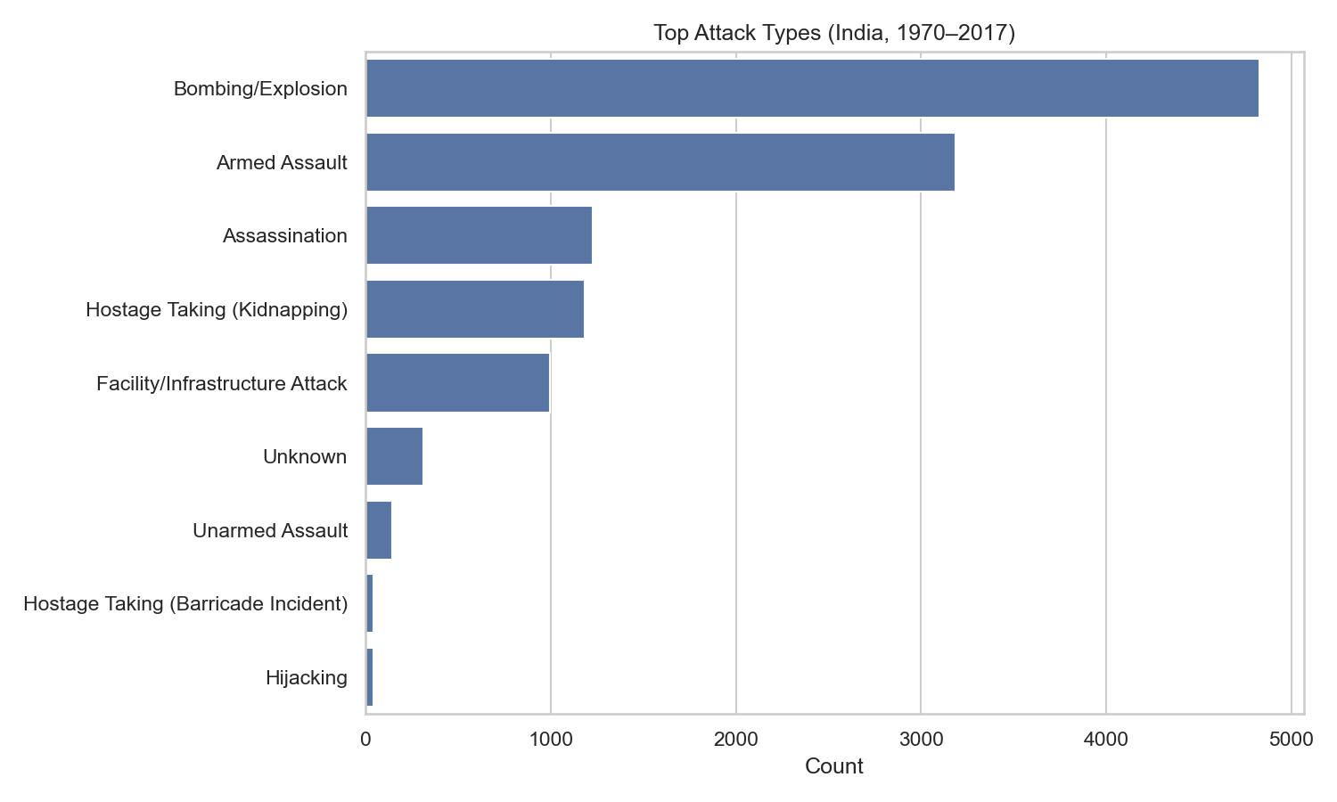
Top Attack Types

Slide 5
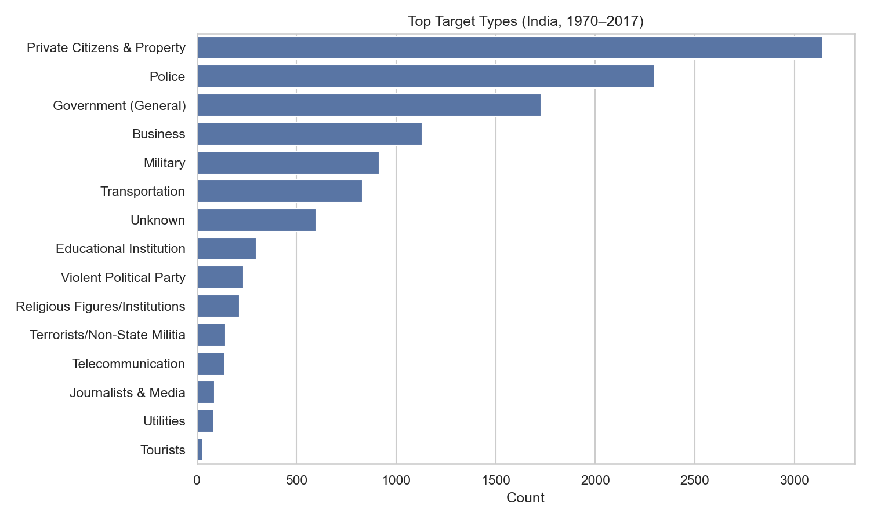
Top Target Types

Slide 6
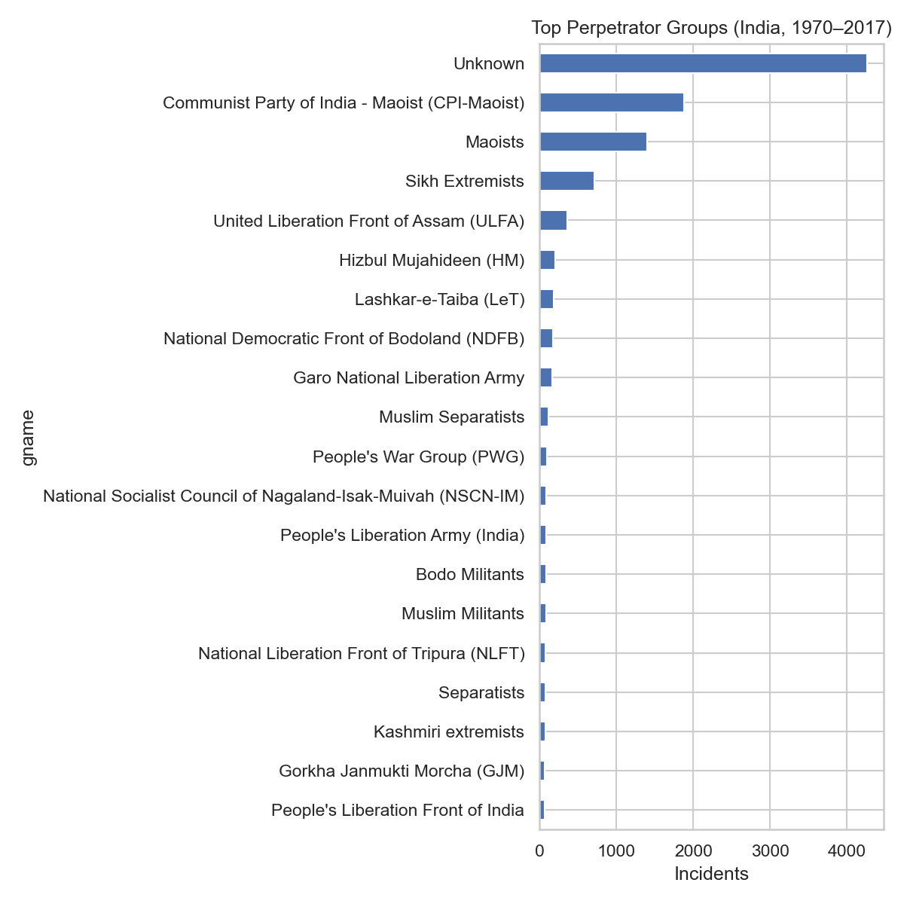
Top Terrorist Groups

Slide 7
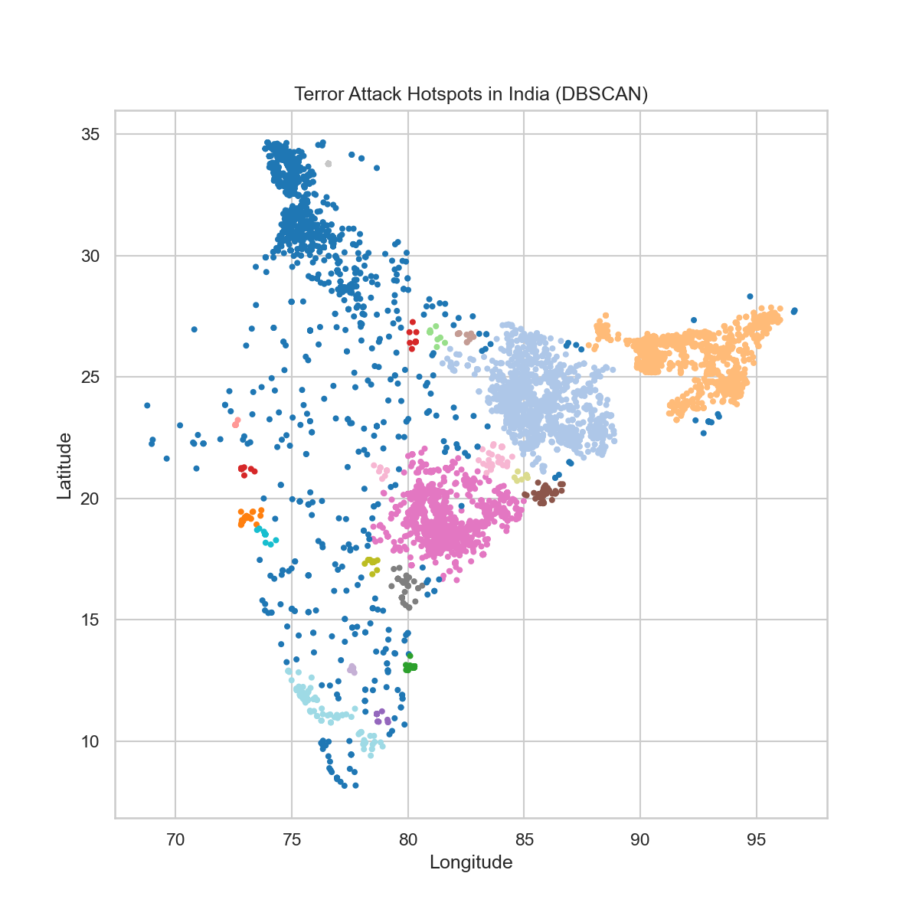
Hotspot Clusters (DBSCAN)

Slide 8
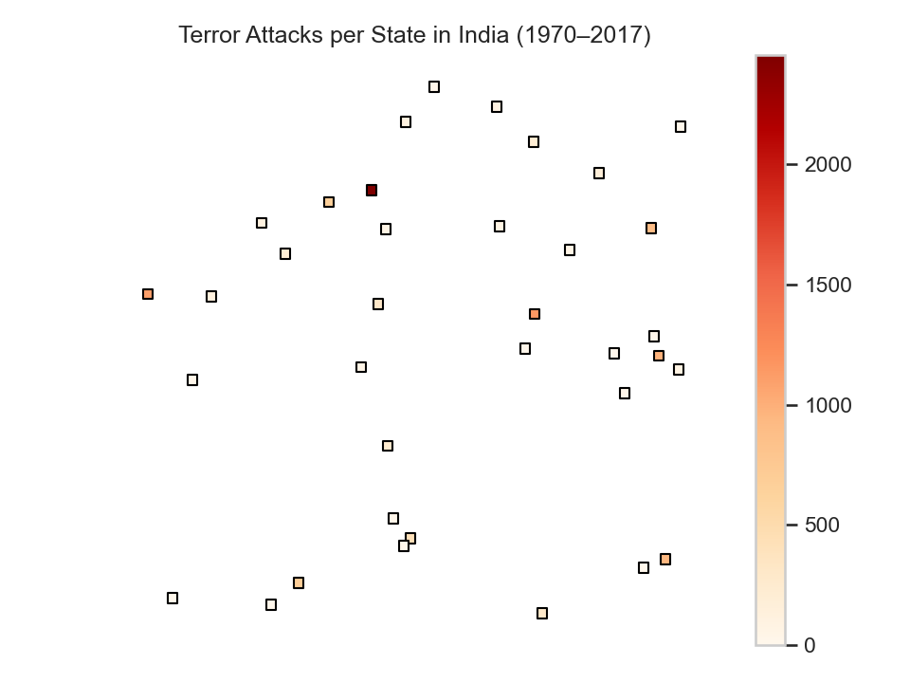
State-wise Terror Attack Heatmap

Slide 9
Interactive Visualisations
The following files were generated:
1. india_attacks_map_full.html — Interactive zoomable map
2. india_animated_timeline.html — Year-by-year animated map
Open these HTML files in a browser for full interaction.

