Slide 1

CORS
Aman Negi

Slide 2


Agenda
What is CORS
Same Origin policy
Preflight Requests

Slide 3

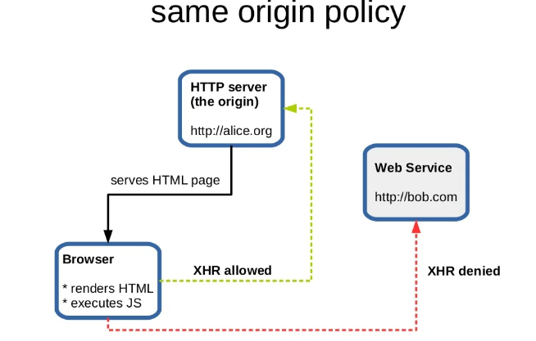
Same Origin policy

Slide 4
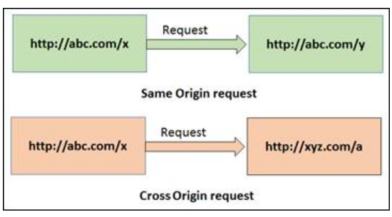
Cross Domain Interaction

Slide 5
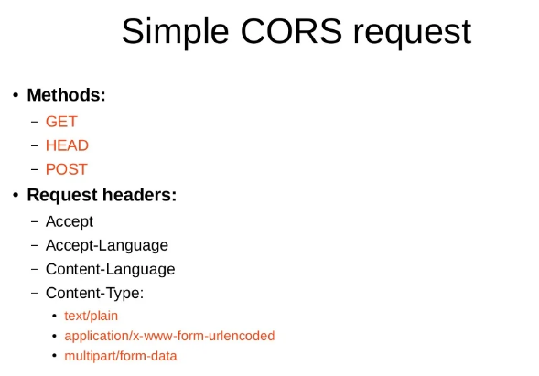
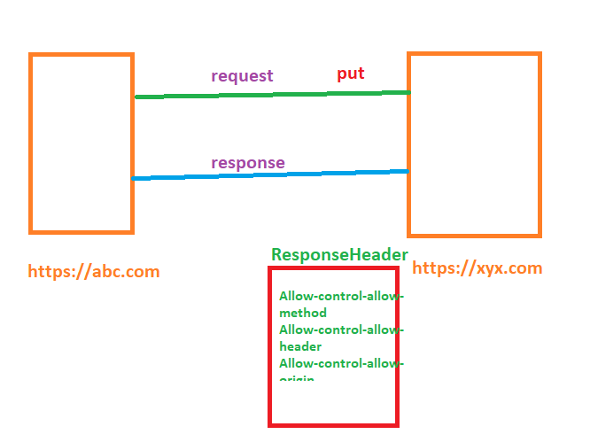
CORS
PreFlight Request
If there are any modification in Simple request in that case preflight request will be forwarded by browser…
Api.abc.com

Slide 6


Thank you
Aman Negi

