Slide 1
Zero day hackathon PRESENTING RENT_A_ROOM.COM
Team : order of one leader : aman negi

Slide 2

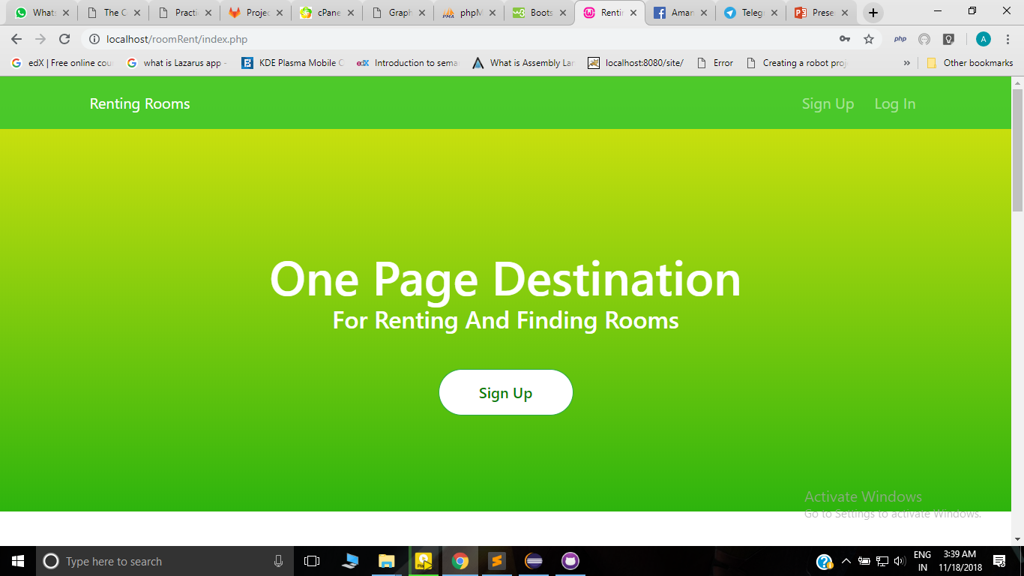
landing page.
...

Slide 3
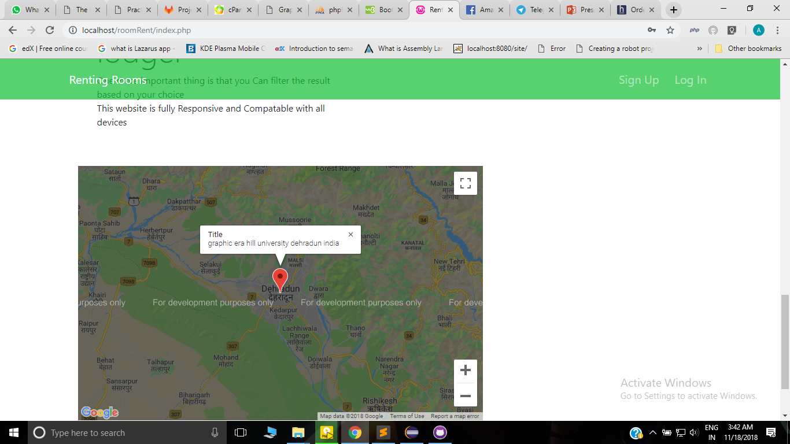
Second view:
….

Slide 4


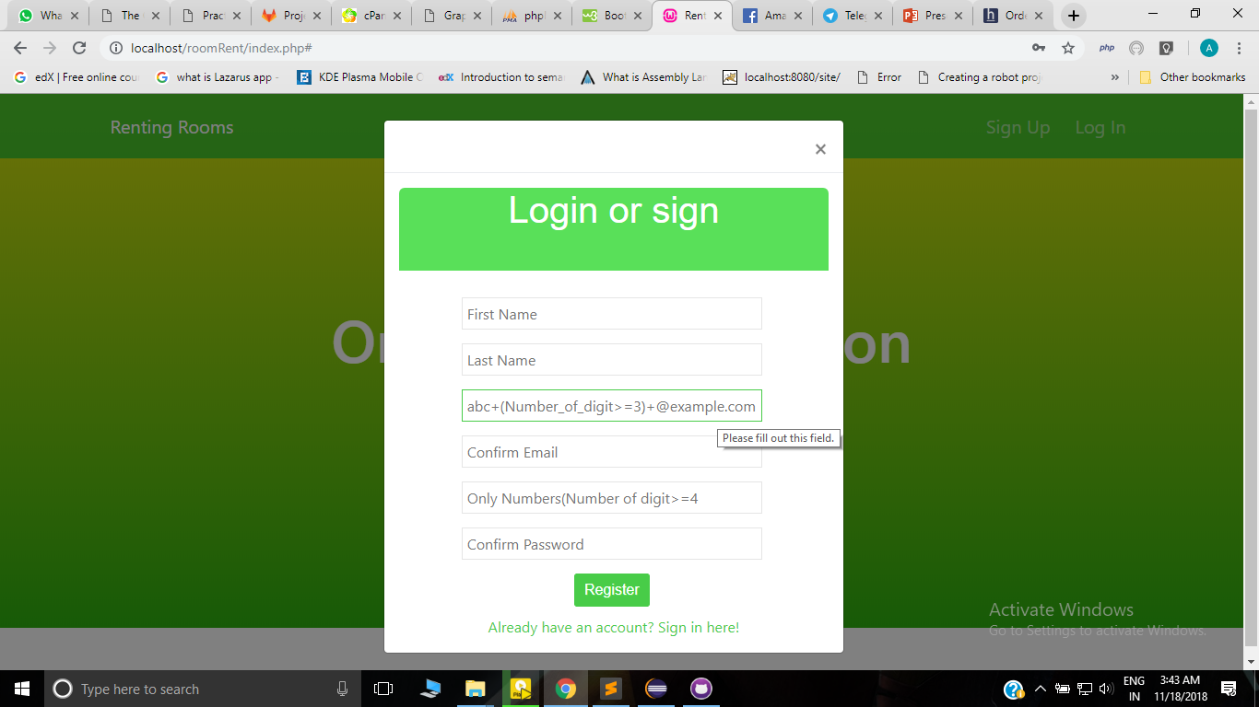
Login and sign up
…..

Slide 5
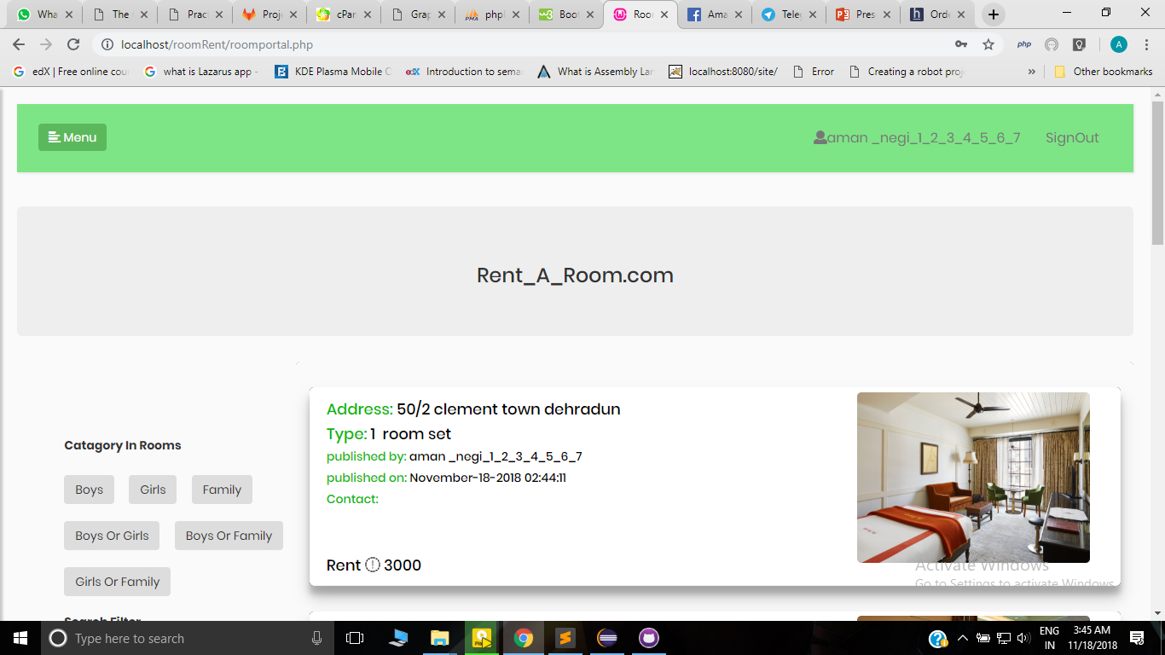

After that home page
...

Slide 6
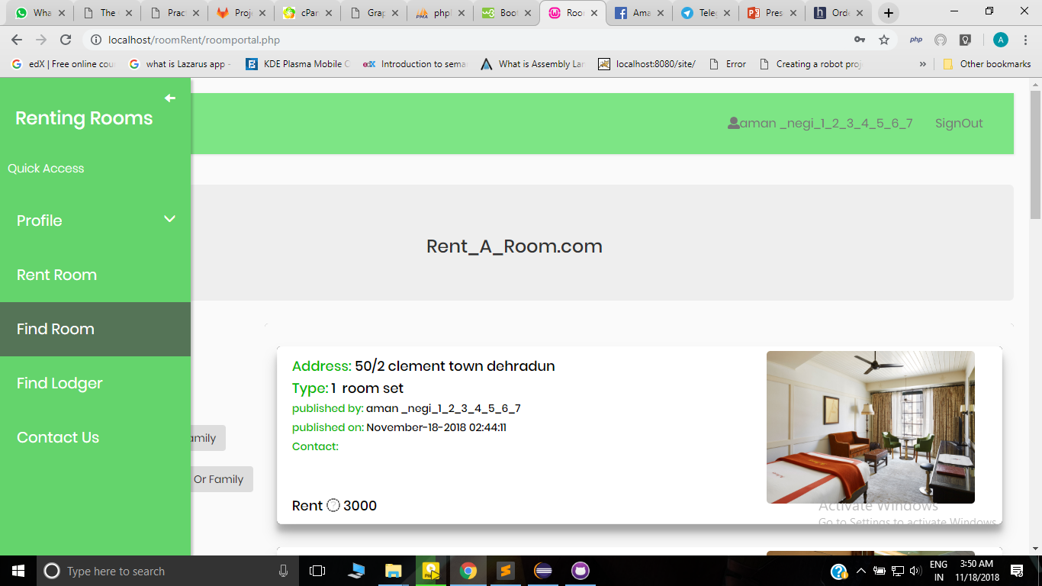
Second view of 'home page'
...

Slide 7
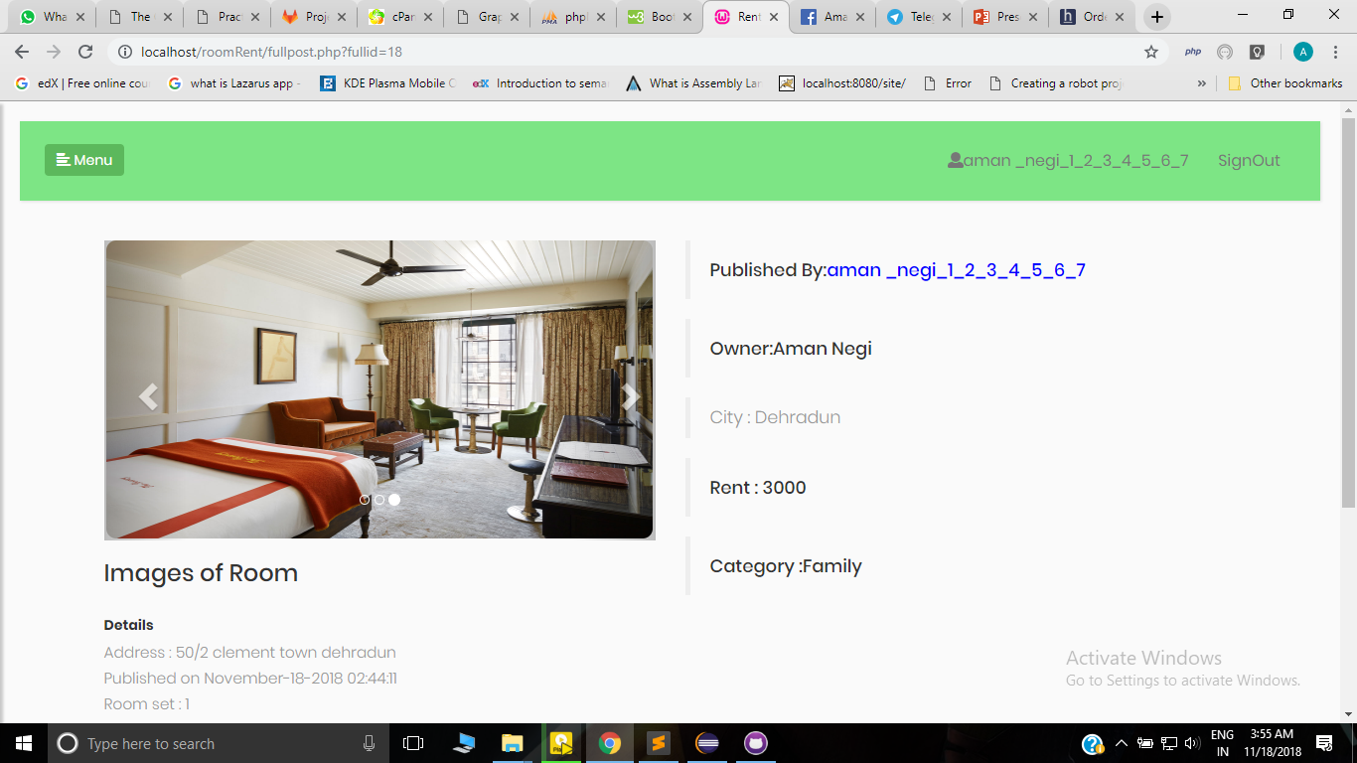
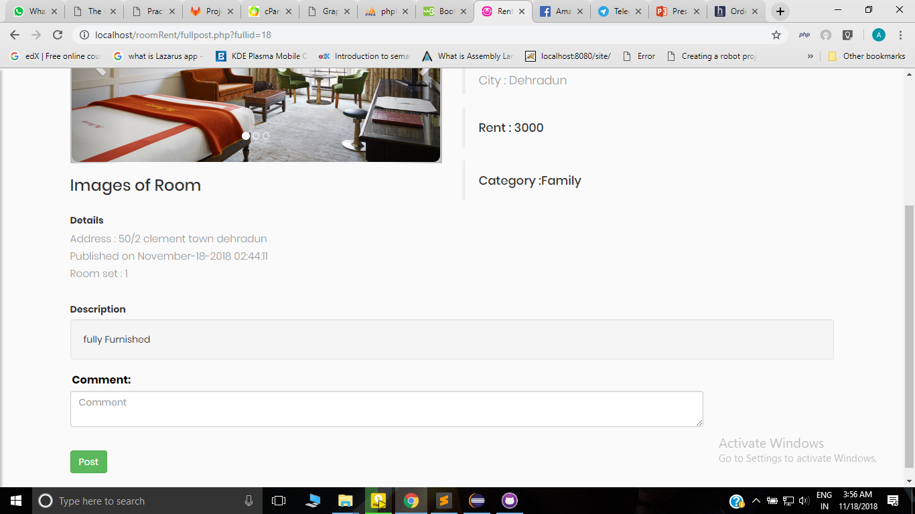
ROOM INFORMATION : WITH COMMENTS
…..

Slide 8
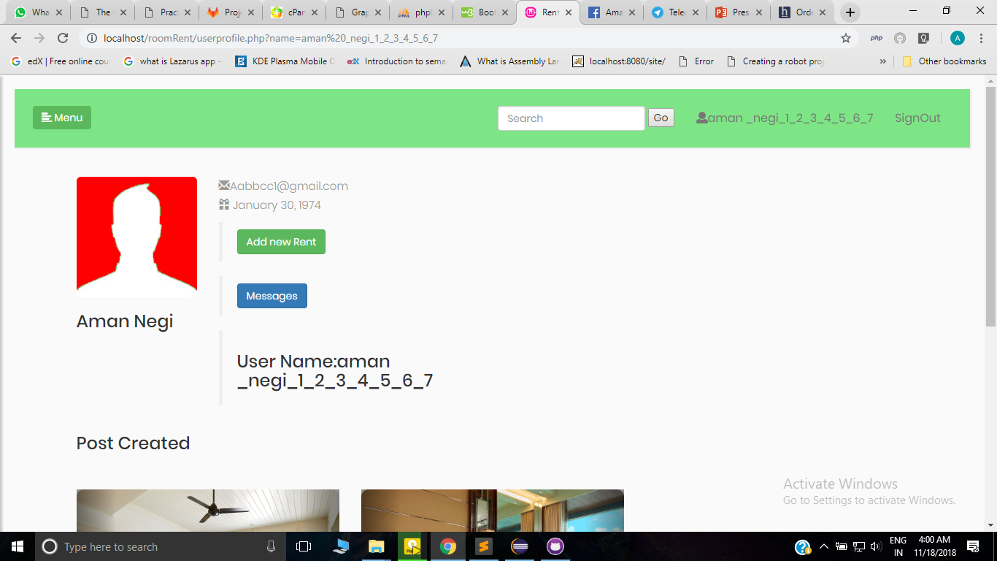
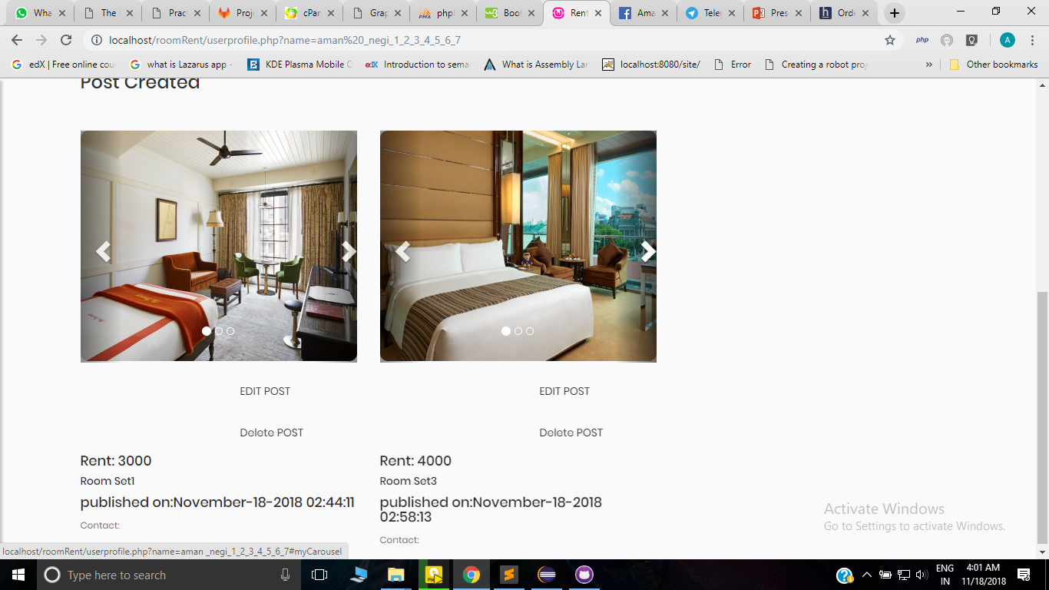
User profile:1:user can create a post and can make chat with other user 2:User can delete and edit their post
..

Slide 9
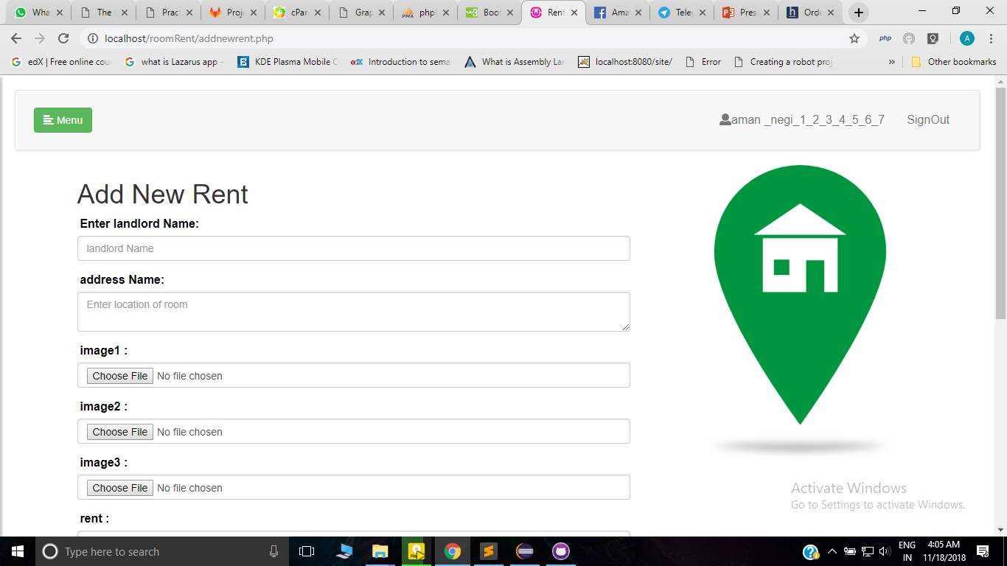
Adding a new rent:
...

Slide 10
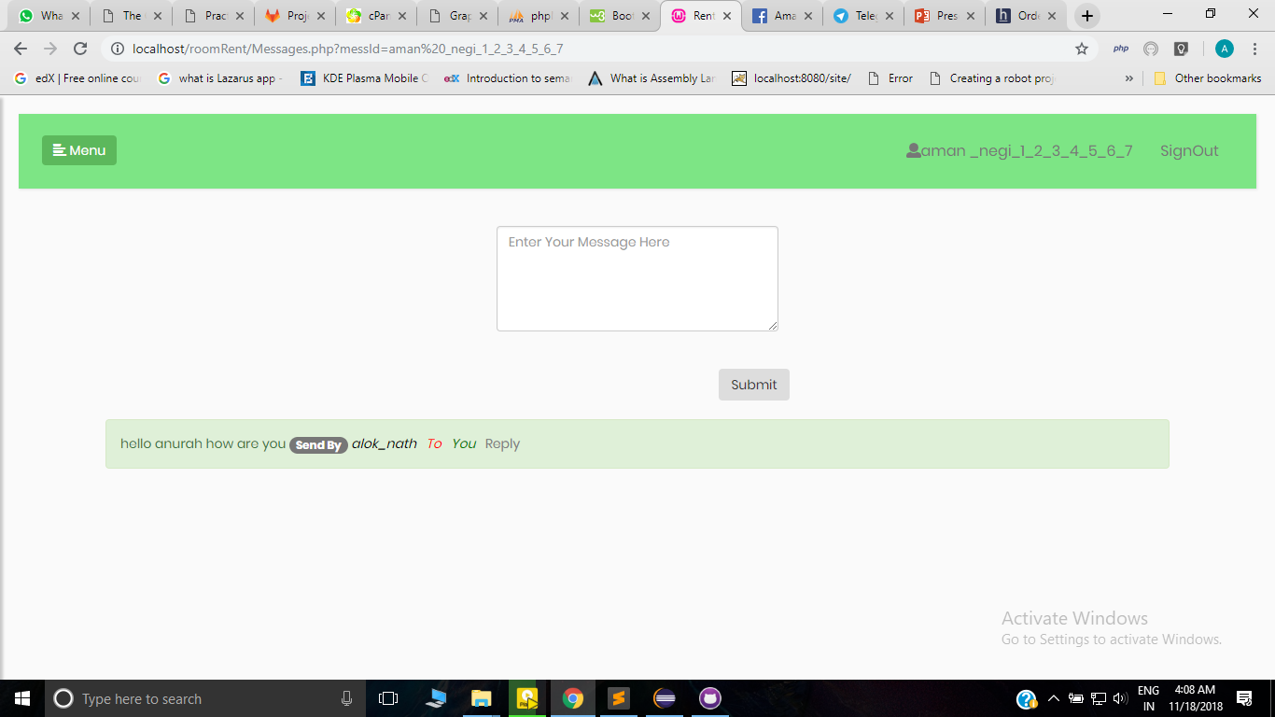
Chating page :user can chat with other user
...

Slide 11
Thank you
….....

