Slide 1
SHUBHAM TANEJA AMAN NIMJE
GIT

Slide 2

AGENDA
Version Control System(VCS)
What is GIT?
Uses of GIT
GIT Basic Command Lines
GIT Branching
GIT Merging
GIT GUI Clients
GIT RESET

Slide 3

Version Control System (VCS)
Easy management collaboration on a project by avoiding swapping files.
Ability to have multiple number of developers working on the same code base.
Easily revert back your files if something happened.

Slide 4

What Is GIT
GIT is free and open source distributed system.
No centralized connectivity
Branching with easy to merge.
Loosing work in your project is almost impossible.

Slide 5
USES OF GIT
If you accidentally delete your code, using git can help you get it back.
If you accidentally change your code and break something, git can revert it.
Git lets you share and exchange code with other developers easily.
If you want to know what recent changes you made to you code, git will show you.
Git lets you backup your code easily to a remote server.
Many more things!

Slide 6
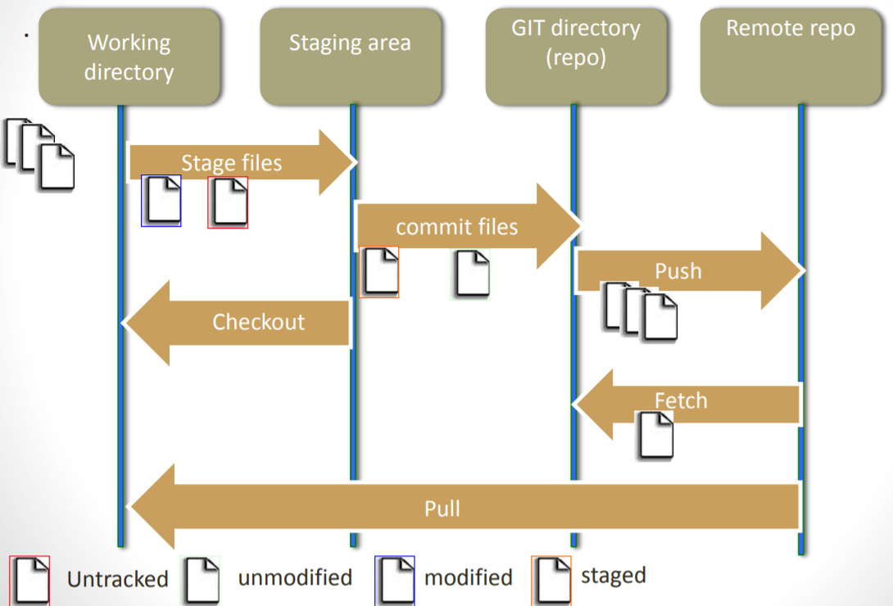
GIT STATE OPERATIONS

Slide 7
BASIC COMMANDS
Initialize a REPO- $ git init
Clone a REPO - $ git clone repo_path
Staging Changes- $ git add file_name ; $ git add .
Commit - $ git commit –m “comment”
Pushing - $ git push ; $ git push origin branch_name
Branching - $ git branch branch_name ; $ git checkout branch_name ; $ git branch --list
Stashing - $ git stash ; $ git stash pop ; $ git stash apply ; $ git stash list
Merging - $ git merge branch_name
Log - $ git log ; $ git log –oneline
Reset - $ git reset --soft HEAD ; $ git reset –hard HEAD

Slide 8
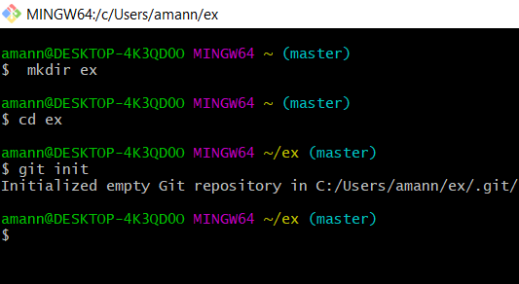
Initialize a repo
This command turns a directory into an empty git repository.
$ git init

Slide 9
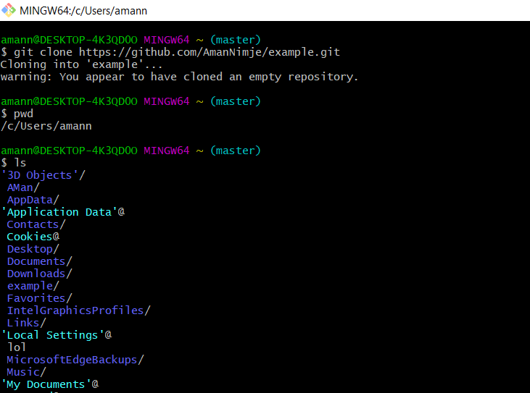
CLONE A REPO
It will clone the repository to create a local copy on your computer and sync between the two locations.
$ git clone repo_path

Slide 10
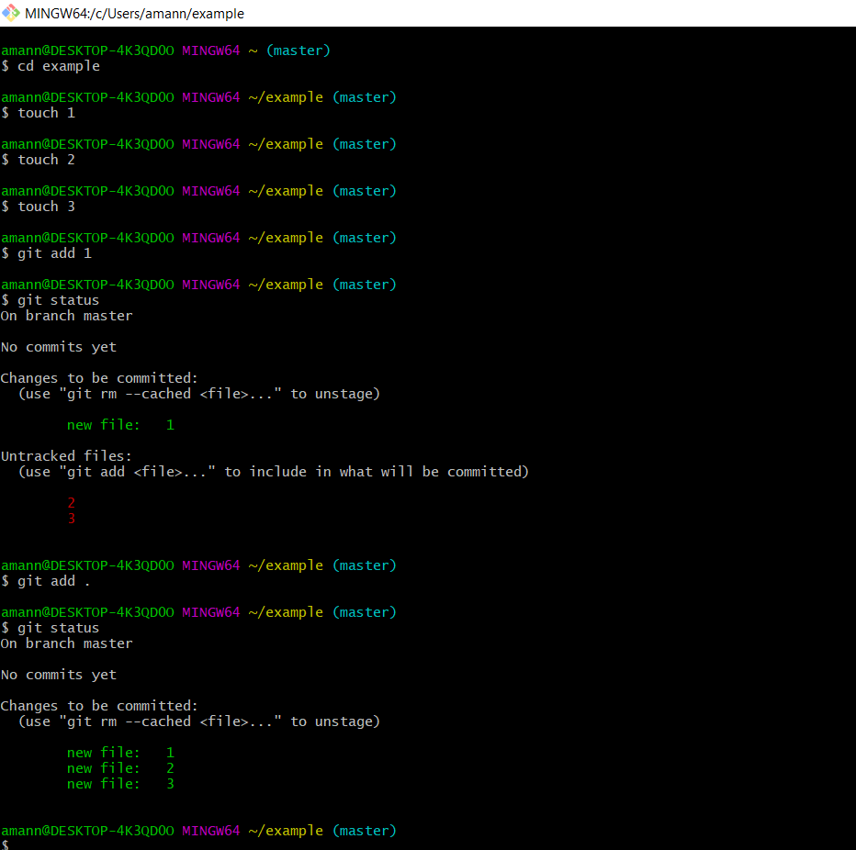
ADDING FILE TO STAGING AREA Files can be staged individually as well as all files at once.
$ git add file_name
$ git add .

Slide 11
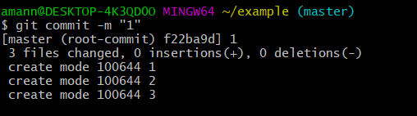
COMMIT-It is used before pushing the file into server. It transfer the file from staging area to local repository.
$ git commit –m “comment”

Slide 12
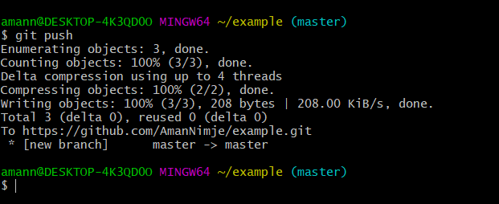
PUSHING-It pushes the file from local repository to the server.
Syntax- $ git push
To push a local branch :
Syntax- $ git push origin branch_name

Slide 13
BRANCHING
To switch between different branches quite commonly. As such, you generally want to stay off the master branch and work on your own feature branches so that master is always clean and you can base new branches off of it.

Slide 14
Types of branches
DEVELOPMENT
Here we create our new branch.
RELEASE
Where merging takes place.
HOTFIX
It checks the error
FEATURES
It is used to create new versions of the branch.

Slide 15
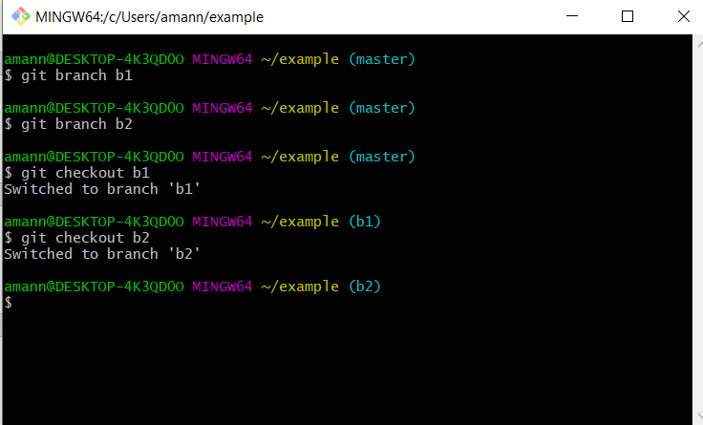
To create branch
$ git branch branch_name
To switch branches
$ git checkout branch_name

Slide 16
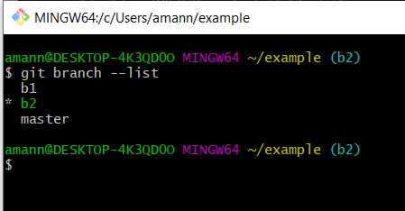
To see list of branches
$ git branch --list

Slide 17
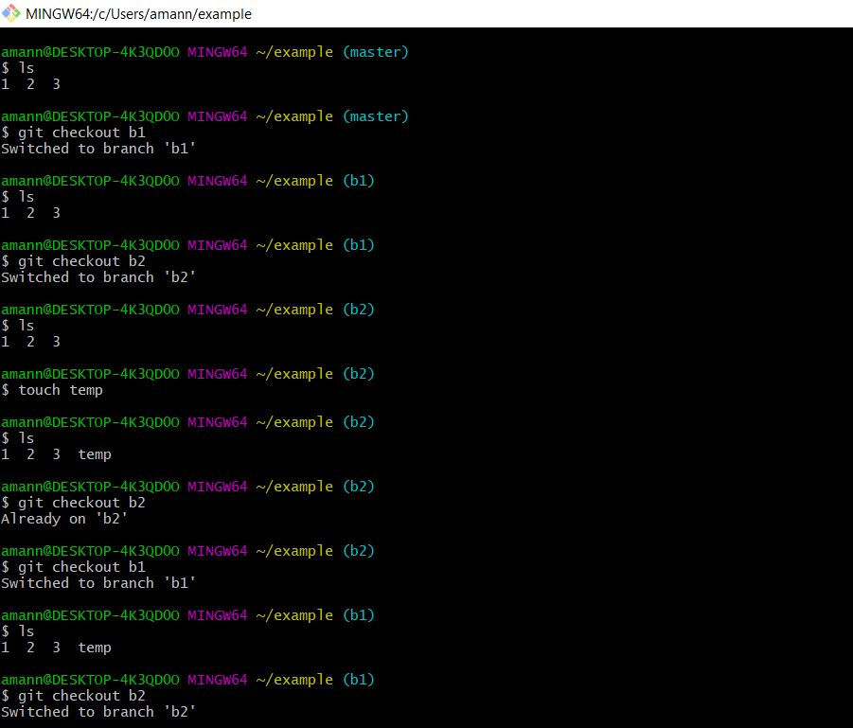
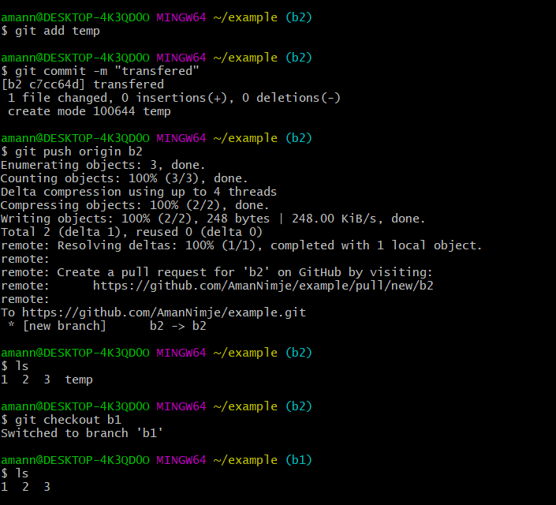
CREATING AND PUSHING

Slide 18
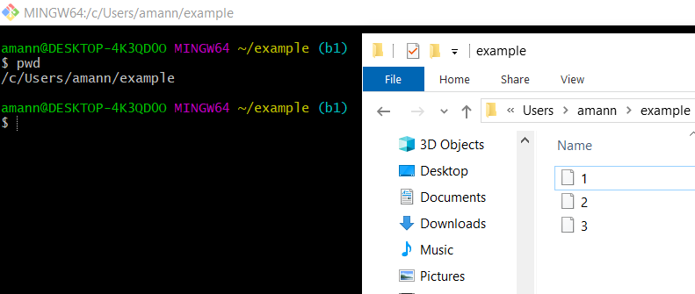
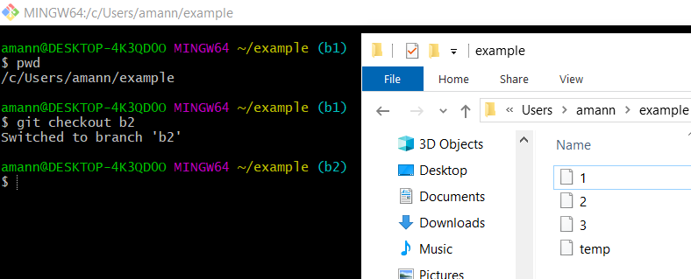

Slide 19
STASH
Sometimes you need to stash your changes so you can be on a clean branch or maybe because you want to go back and try something before you make a commit with these changes. Here's how you do a stash.

Slide 20
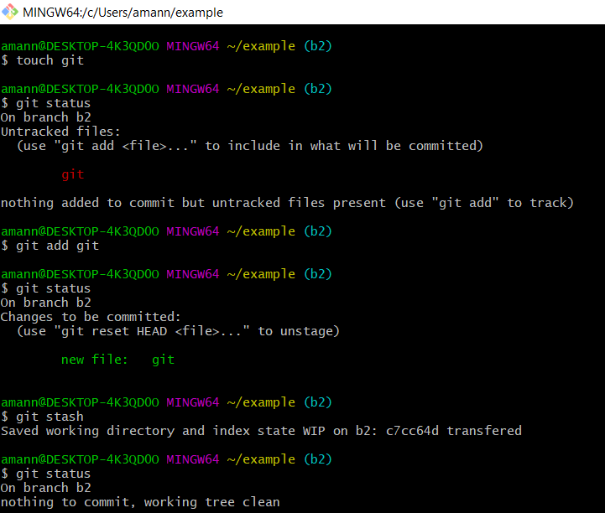
To stash a file
$ git stash

Slide 21
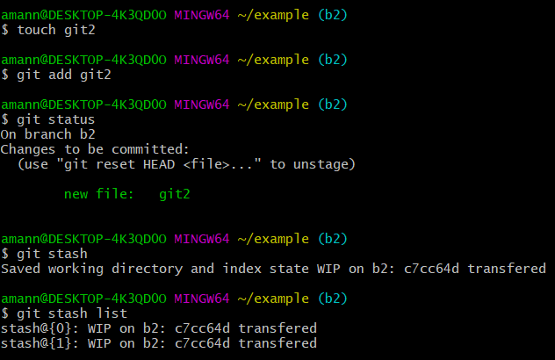
To see list of stash
$ git stash list

Slide 22
POP-It moves the file from stash to staging area.
$ git stash pop
APPLY-It copies the file from stash to staging area.
$ git stash apply
POP and APPLY

Slide 23
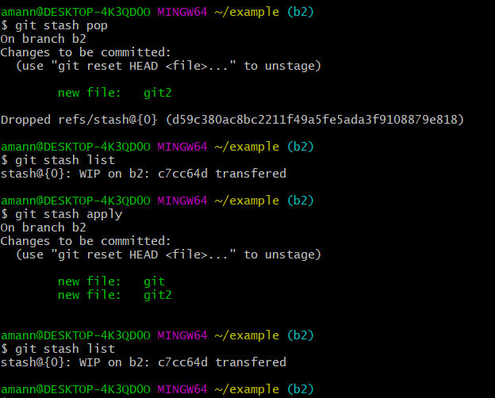

Slide 24
MERGING
It is used to merge 2 branches and the branch where it takes place will get overwritten and the other branch is remains unchanged.
$ git merge branch_name

Slide 25
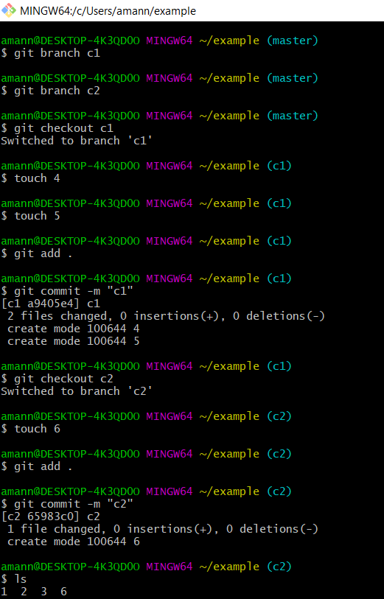
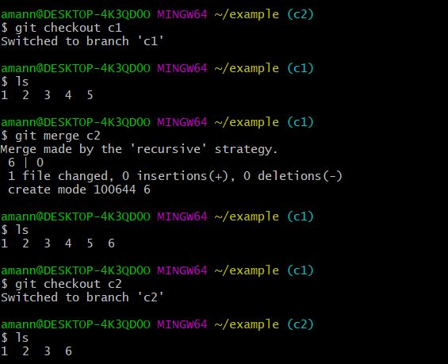

Slide 26
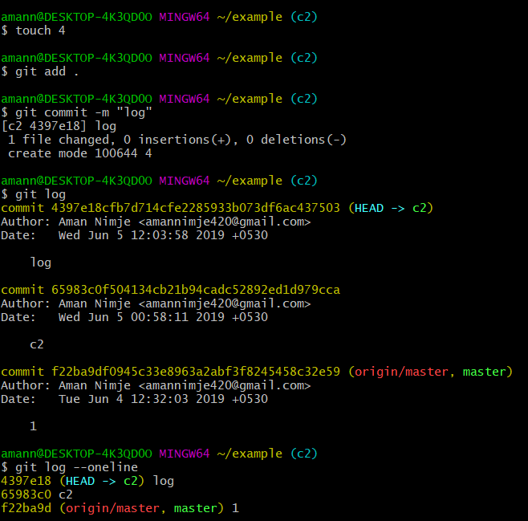
Git log-It shows recent commit logs with date and time.
$ git log
For HEAD log of recent commit
$ git log --oneline

Slide 27

GIT RESET-It will reset the current HEAD to the specific state git reset is opposite of git add
SOFT RESET-It will undo your most recent commit and put those changes back into staging, so you don't lose any work.
$ git reset --soft HEAD
HARD RESET-IT will completely delete the commit and throw away any changes.
$ git reset --hard HEAD

Slide 28
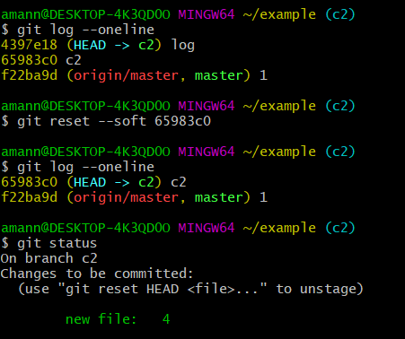
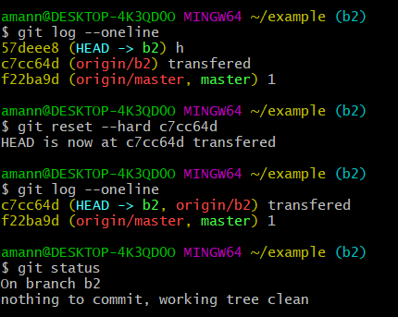

Slide 29
GIT GUI CLIENTS
GitKraken
SourceTree
TortoiseGit
SmartGit
GitUp
Tower
GitEye
unGit

Slide 30
THANK YOU

