Slide 1

LANGUAGE
Human Language: Commonly used to express Feeing and understand other person expression. It can be oral or gestural kind of Communication.

Slide 2
DEFINITION OF COMPUTER LANGUAGES
A computer languages are the languages by which a user command a computer to work on the algorithm which a user has written to get an output.
TWO TYPES OF COMPUTER LANGUAGES
Low-level languages
High-level languages

Slide 3
Lower Level Language
A low-level programming language is a programming language that provides little or no abstraction from a computer's instruction set architecture. It consists of numeric codes i.e 0 & 1. These codes are easily understandable to computer but difficult to human.. A lower level language is used in two generations of computer.
first generation
second generation

Slide 4
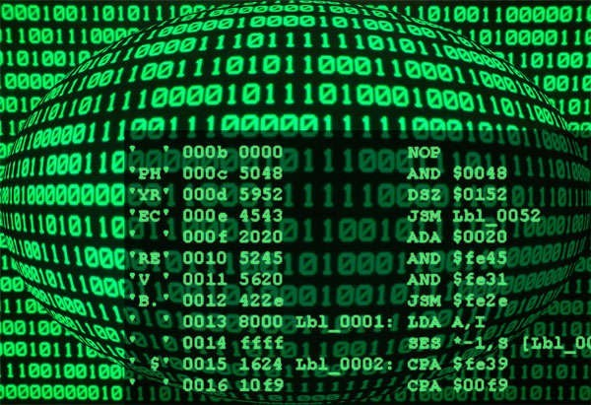
First generation languages or 1GL
Represent the very early, primitive computer languages that consisted entirely of 1's and 0's - the actual language that the computer understands (machine language).

Slide 5
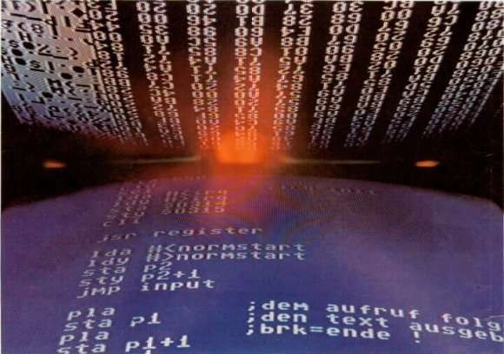
Second generation languages (2GL)
Represent a step up from the first generation languages. Allow for the use of symbolic names instead of just numbers. Second generation languages are known as assembly languages. Code written in an assembly language is converted into machine language (1GL).

Slide 6
CHARACTERSTICS OF LOW LEVEL LANGUAGES
Direct memory management
Little-to-no abstraction from the hardware
Register access
Statements usually have an obvious correspondence with clock cycles
Superb performance

Slide 7
Advantages
Computational Speed is very fast.
Directly understandable by computer.
Disadvantages
Development of a program in machine language is very time consuming.
Error correction is tedious process.

Slide 8
HIGH LEVEL LANGUAGES
High-level programming languages allow the specification of a problem solution in terms closer to those used by human beings. These languages were designed to make programming far easier, less error- prone and to remove the programmer from having to know the details of the internal structure of a particular computer. This language is used in third generation.

Slide 9
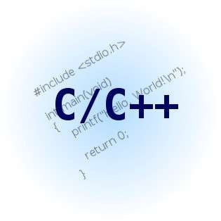
Third generation languages (3GL)
With the languages introduced by the third generation of computer programming, words and commands (instead of just symbols and numbers) were being used. These languages therefore, had syntax that was much easier to understand. Third generation languages are known as "high level languages" and include C, C++, Java, and Javascript, among others.

Slide 10
TYPES
C++
VISUAL BASIC
JAVA
JAVASCRIPT

Slide 11
C++
C++ is
statically
typed, free-form, multi-
paradigm, compiled,
general-purpose programming
language. It is regarded as a "middle-level" language, as it comprises a combination of both high- level and low-level language features.
Language features
Operators and operator overloading Templates
Objects Polymorphism

Slide 12
VISUAL BASIC
Visual Basic (VB) is the third-generation event- driven language and integrated
programming
development environment (IDE) from Microsoft for its COM programming model. Visual Basic is relatively easy to learn and use.

Slide 13
CHARACTERSTICS
Interpreted
Dynamic constructs (open classes, message- style methods, etc)
Poor performance
Concise code
Flexible syntax (good for internal DSLs)

Slide 14
Advantages
These are simple to adopt due to their english like structure of statements.
They are easy to maintain and debug.
Disadvantages
The Program written in high level language are less efficient as they take more execution time.
The compiler also consumes some memory as it is required for the translation process.

Slide 15

Now the House is open for Queries??

