Slide 1

FAST FOURIER TRANSFORM AND ITS APPLICATIONS
PRESENTED BY GROUP 13

Slide 2
Fundamental Concept
The Fourier Transform is a mathematical technique that transforms a time-domain signal into its frequency-domain representation, allowing for the analysis of the signal's frequency components and their amplitudes, which is essential in various fields such as real life problems such as telecommunications, medical imaging, financial analysis.
Overview of Fourier Transform
02

Slide 3
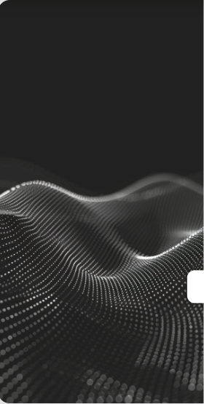
01
Signal Characterization
Importance of Frequency Analysis
Frequency analysis enables the identification and characterization of signal components, facilitating the understanding of underlying patterns and behaviors in various applications, from audio processing to biomedical signals.
02
Noise Reduction
By analyzing frequency components, it becomes possible to isolate and reduce noise in signals, enhancing the quality and clarity of data for more accurate interpretations and analyses.
03
System Performance Evaluation
Frequency analysis is crucial for evaluating system performance in engineering applications, allowing for the assessment of stability, resonance, and response characteristics in dynamic systems.

Slide 4
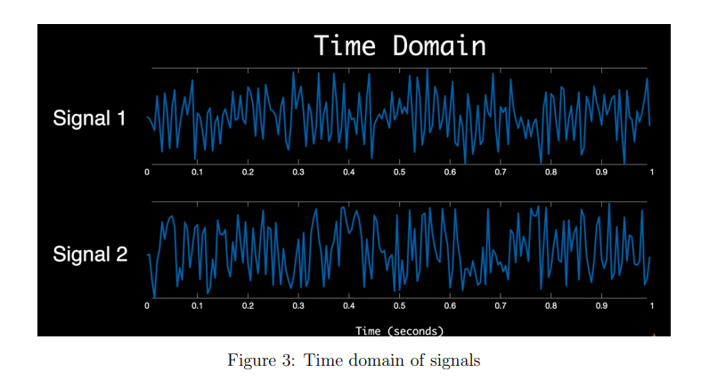
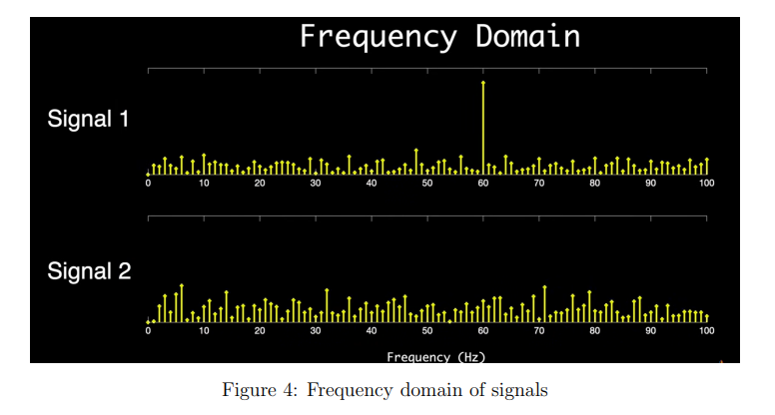
Signal Characterization
Frequency analysis enables the identification and characterization of signal components, facilitating the understanding of underlying patterns and behaviors in various applications, from audio processing to biomedical signals.
For example, here we have two time domain signals that are sampled at 200 hertz. And the question I have for you is, which of these has a significant 60 hertz component? It’s not terribly obvious, right? They both look pretty similar. But if we transform them into the frequency domain, it’s much easier to answer

Slide 5
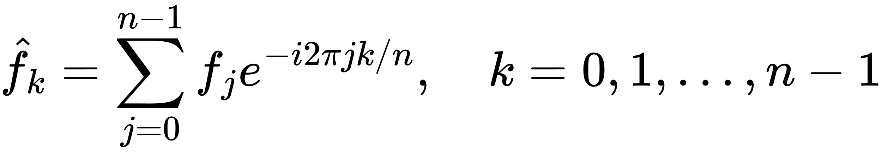
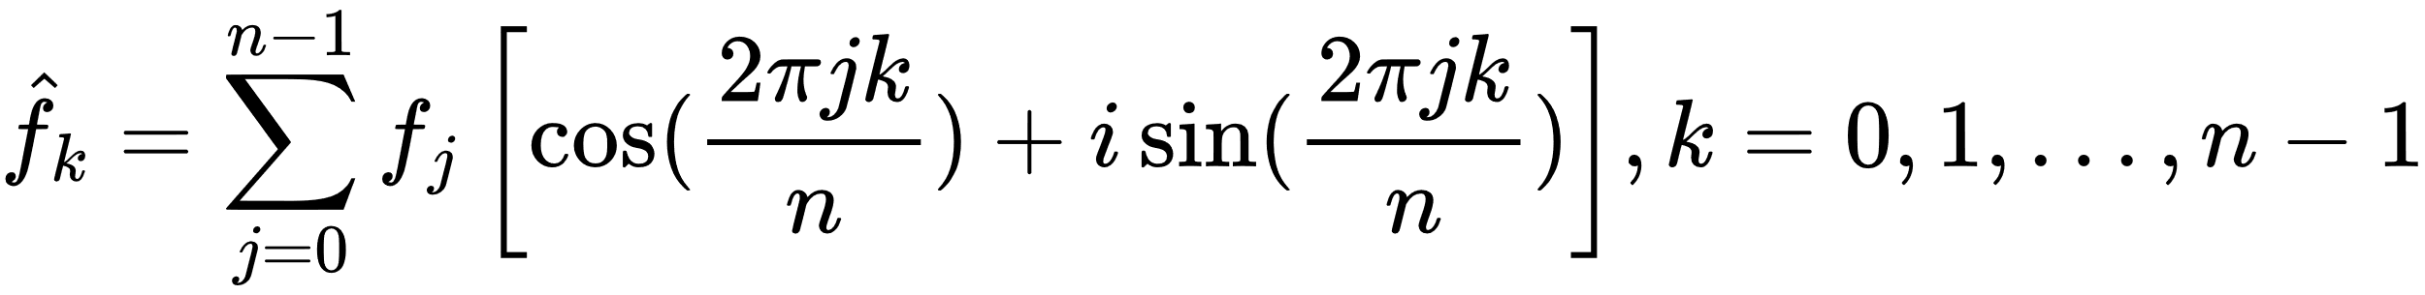
Discrete Fourier Transform (DFT) Explained
01
02
03
Definition and Purpose
Mathematical Representation
Applications in Signal Processing
The Discrete Fourier Transform (DFT) converts a sequence of samples into complex numbers representing frequency amplitude and phase, essential for digital signal processing.
The DFT for a sequence of n data points is given by:
FFT's structure enables efficient parallelization across multiple processors, greatly accelerating processing in high-performance computing.

Slide 6
Limitations of DFT
Computational Complexity
Sampling Limitations
Windowing Effects
For eg, a 10-sec audio clip sampled at 44.1 kHz, results in N = 4.41 × 10^5 samples. If we assume a processor can perform one million multiplications per second, then the DFT computation would take around 200,000 seconds, or more than 55 hours.
Applying window functions in DFT can cause spectral leakage, where energy spills between frequency bins, complicating frequency analysis in non-stationary signals.
DFT requires uniform sampling, and an insufficient rate can cause aliasing, distorting frequency representation and losing information.

Slide 7
Transition from DFT to FFT
Efficiency Improvement
Algorithmic Advancements
The transition from Discrete Fourier Transform (DFT) to Fast Fourier Transform (FFT) significantly enhances computational efficiency, reducing the time complexity from O(N^2) for DFT to O(N log N) for FFT, making it feasible to analyze large datasets in real-time applications.
FFT algorithms, such as the Cooley-Tukey algorithm, leverage symmetries and periodicities in the DFT calculations, allowing for a systematic breakdown of the transform into smaller, manageable parts, which streamlines processing and opens up new possibilities in digital signal processing.

Slide 8
Computational Efficiency of FFT
Time Complexity Reduction
Memory Usage Optimization
Parallel Processing Capabilities
Returning to the example of the 10-second audio clip, the FFT would only require approximately 6 × 10^6 multiplications. With same processor, FFT would complete in just 6s, 30,000 times faster compared to the DFT.
FFT algorithms minimize memory usage by reusing intermediate results, making them ideal for resource-limited applications like embedded systems and mobile devices.
FFT's structure enables efficient parallelization across multiple processors, greatly accelerating processing in high-performance computing.

Slide 9
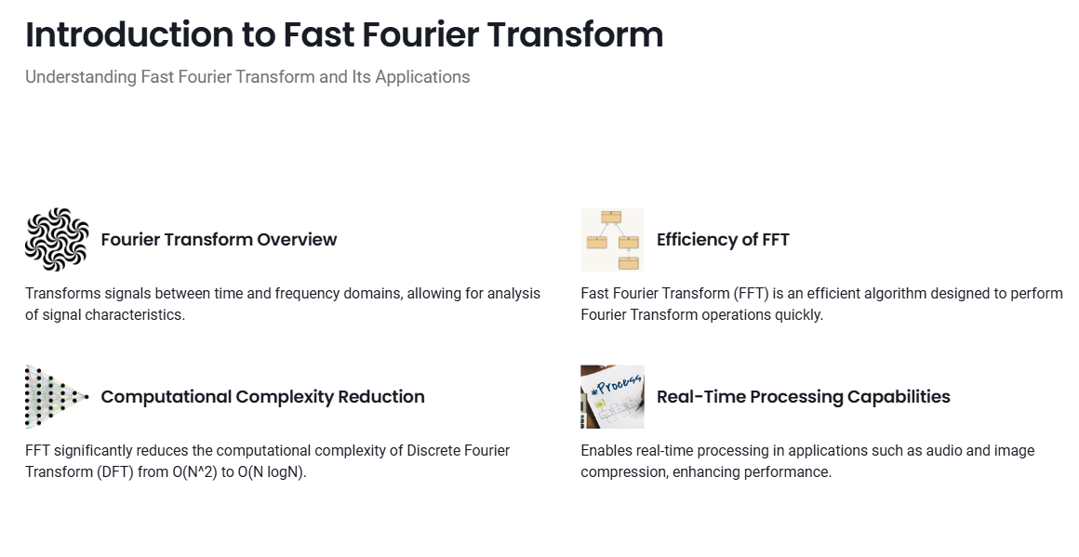

Slide 10
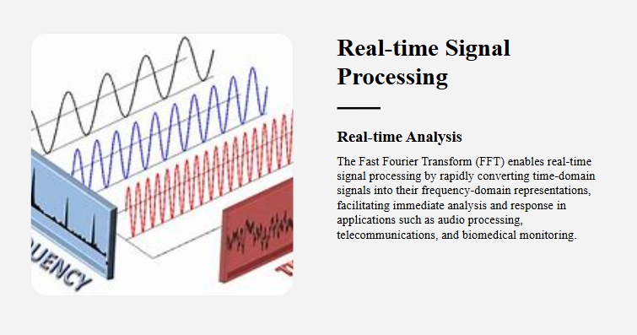

Slide 11
FFT in Medical Imaging
Techniques like MRI (Magnetic Resonance Imaging) and CT scans rely on Fourier transforms to process raw data from sensors and convert it into usable images. FFT reduces the computation time, making these imaging techniques more efficient.
FFT in Medical and Financial Analysis
FFT in Financial Analysis
In financial markets, FFT is applied to detect patterns in stock prices and other time-series data. It helps in identifying cyclical trends or anomalies that can guide investment strategies
02

Slide 12
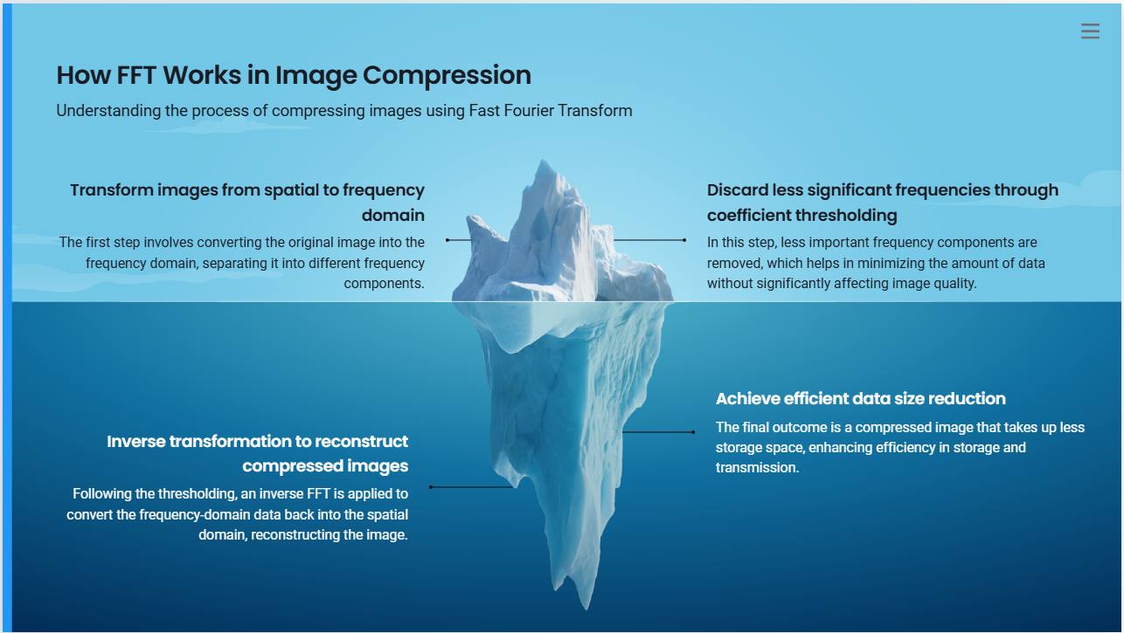

Slide 13
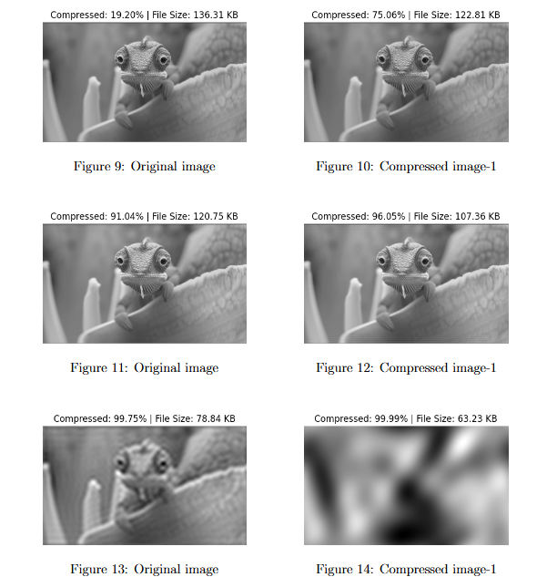
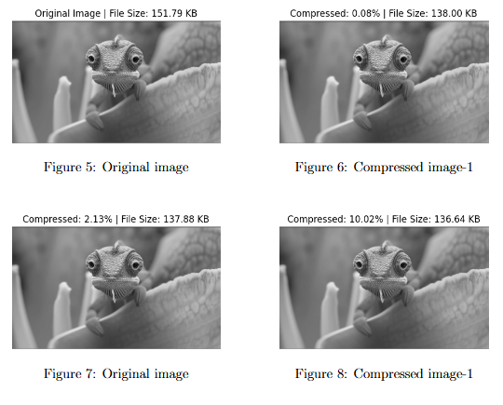
Results on Image Dataset

Slide 14

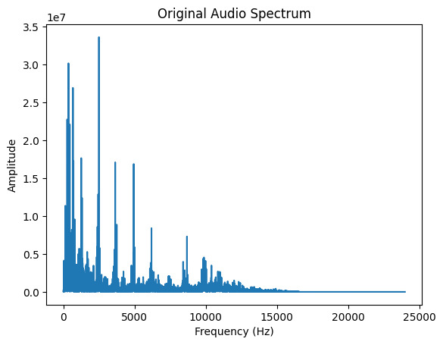
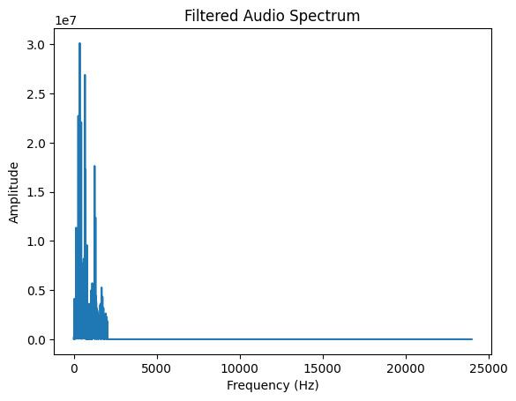
Original Audio
Results on Audio Filtering
Filtered Audio

Slide 15
Integration with Machine Learning
Future Work in FFT Applications
02
The integration of Fast Fourier Transform (FFT) with machine learning algorithms is emerging as a significant trend, enabling enhanced feature extraction from time-series data across various domains such as healthcare, finance, and environmental monitoring, thereby improving predictive modeling and decision-making processes.

Slide 16
Comprehensive Overview
02
Summary of Key Findings
The Fast Fourier Transform (FFT) is a pivotal algorithm that significantly enhances the efficiency of frequency analysis, enabling rapid processing of signals across various applications, including audio and image compression, real-time signal processing, and telecommunications, while addressing computational challenges associated with traditional Discrete Fourier Transform (DFT).

Slide 17
THANK YOU
Vikas Jain
Adarsh Gupta
Aman Pushkar
220120029
220120001
220120004

