Slide 1


Uber Clone
Developed By:
Aman Altaf Bhai Puthawala 195180686032 Mohammed Uzaif Zakirmiya Saiyed 195180686039
Group No:
MCM_10_33 Under the Guidance of: Prof. Rita Gokani
Submitted To: -
L.J. Institute of Computer Applications
Gujarat Technological University (GTU)

Slide 2
Introduction:
A cutting-edge solution crafted to revolutionize the way people commute within cities.
Our Uber Clone application is designed to offer riders a seamless and convenient transportation experience, mirroring the interface and efficiency of the original Uber app. Whether you are a rider in need of a reliable mode of transport or a driver seeking flexible earning opportunities.
Our Uber Clone Application implements the core principles of accessibility and efficiency. With just of few taps on your smartphone, rider can effortlessly request rides, track their journey in real-time, and reach the destination with convenience.
For drivers, our platform offers an interface for managing trips, optimizing routes, and maximizing earnings.

Slide 3
Existing System:
There are many existing Transportation Application for easy ride, each with their own unique feature and functionalities. Some Transportation Application includes: -
Uber: Uber first official application debuted in San Fransisco in 2011. Uber’s pricing is fairly competitive with other offerings, and with the number of drivers on the platform.
Ola: Ola is one of the most popular ride apps in India. Launched in 2010. Ola cabs stands as one of the premium taxi-booking platform in India.
Rapido: Rapido is a unique ride-app that specializes in bike. Launched in 2015, the app allows riders to book a ride on a motorcycle for a faster ride.

Slide 4
Need for the New System:
As compared to existing transportation apps they are not made in single language,
e.g: - Uber app uses Node js.as a backend language and the mobile app (Frontend) is made in React Native and for Data Storage uber using various databases.
So for this we developed this Uber Clone app in a single language (Dart) and for data storage we use Firebase which provides an easy developing solution.
Objective of the New System:
The objective of the new system for the Uber Clone Application, typically revolves around enhancing the existing functionalities, addressing rider needs more effectively. Here some common objectives for a new system:
Enhanced Rider Experience
Enhanced Reliability and Performance
Localization and Personalization
Integration:

Slide 5
Problem Definition:
A cutting-edge solution crafted to revolutionize the way people commute within cities.
Our Uber Clone application is designed to offer riders a seamless and convenient transportation experience, mirroring the interface and efficiency of the original Uber app. Whether you are a rider in need of a reliable mode of transport or a driver seeking flexible earning opportunities.
Our Uber Clone Application implements the core principles of accessibility and efficiency. With just of few taps on your smartphone, rider can effortlessly request rides, track their journey in real-time, and reach the destination with convenience.
For drivers, our platform offers a interface for managing trips, optimizing routes, and maximizing earnings.

Slide 6
Core Components:
Rider
Driver
Admin

Slide 7
Assumptions and Constraints:
Assumptions:
The rider should have basic knowledge of English language.
Rider Availability
Driver Availability
Payment Processing
Location Accuracy
Constraints:
Technology Stack
Security
Scalability
Rider Behaivor

Slide 8
Advantages and Limitations:
Advantages:
Convenience
Accessibility
Safety
Cost-Effectiveness
Limitations:
Dependences on Technology
Regulatory Challenges
Driver Availablity
Customer Support

Slide 9
Requirement Determination:
Hardware Requirement:
Development Requirement: Minimum requirement is 8GB RAM, Windows machine, Android Studio / VS Code.
Application Requirement: Minimum requirement is 4GB RAM, Android 10, Internet Connection.
Software Requirement: We require following software:
Code Editor: Visual Studio Code / Android Studio
Diagram Editor: draw.io
Database: Firebase
Browser: Chrome, Microsoft edge etc.

Slide 10
Functional Requirement:
Rider Registration and Authentication:
Riders should be able to register and create accounts using email, phone number.
2. Ride Booking:
Riders should be able to specify pickup and drop-off locations and request rides.
Riders should receive confirmation notifications upon successful booking.
Driver Matching and Dispatching:
Riders should receive confirmation notifications upon successful booking.
The platform should match riders with nearby available drivers based on location and availability.
Drivers should receive ride requests and have the option to accept or reject them.

Slide 11
Non-Functional Requirement:
Performance:
The app should be responsive and provide quick load times for seamless rider experience.
Scalability:
The platform should be able to handle a large volume of concurrent riders and ride requests, especially during peak hours.
Reliability:
The app should have minimal downtime and service interruptions to ensure continuous availability for riders.

Slide 12
Targeted User:
Rider: - The rider is an individual who uses the Uber clone app to request rides and travel to various destinations.
Driver: - The driver is an individual who uses the Uber clone app to provide transportation services to riders.
Admin: - The admin is responsible for managing and overseeing the operations of the Uber clone platform.

Slide 13
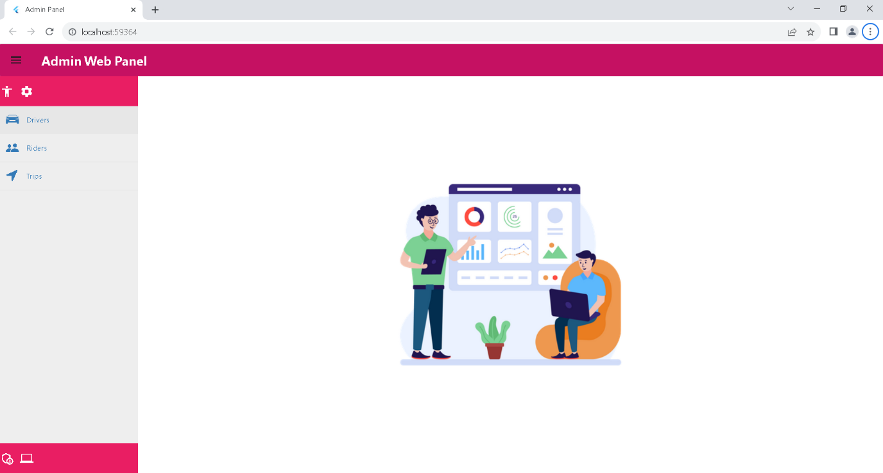
Project Screenshots:
Admin Side:

Slide 14
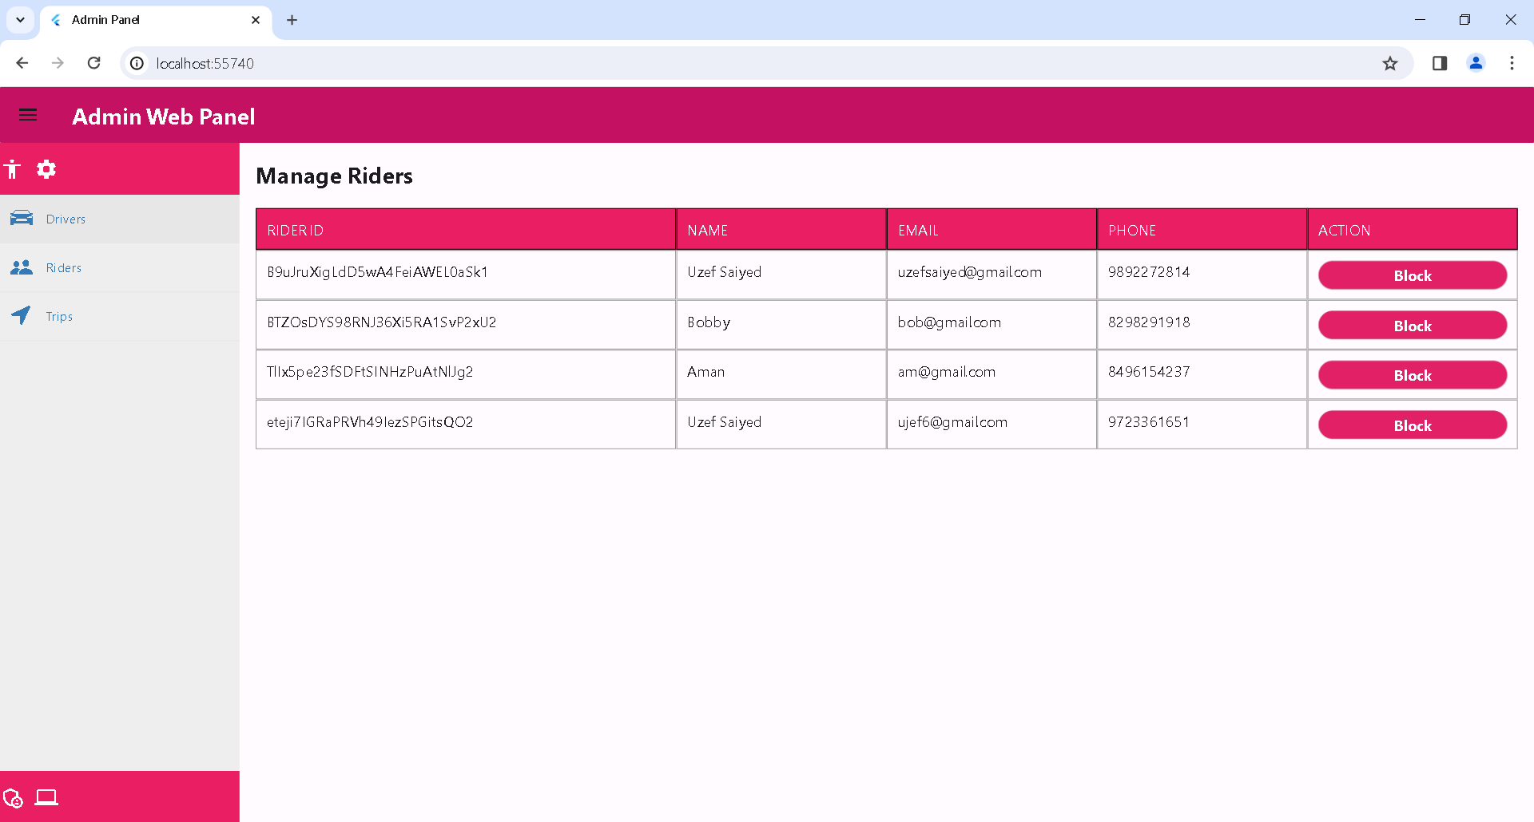

Slide 15
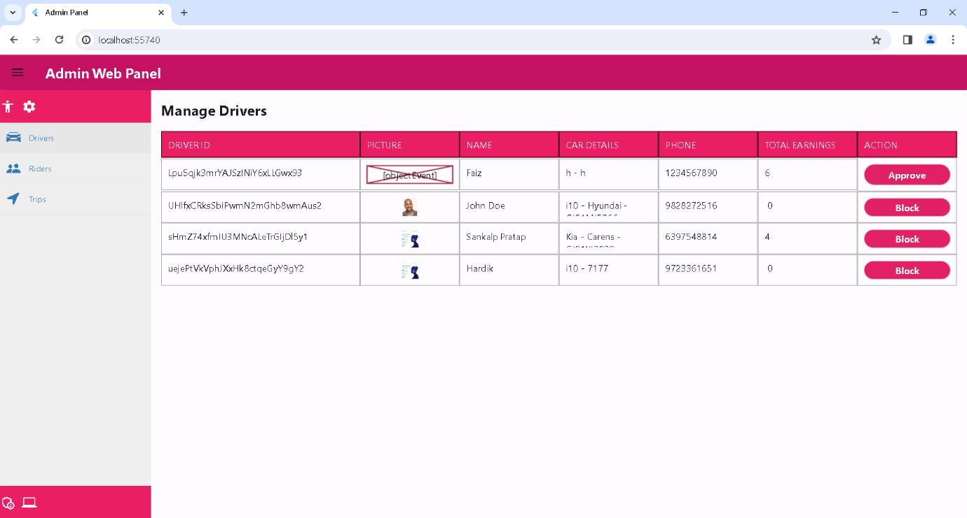

Slide 16
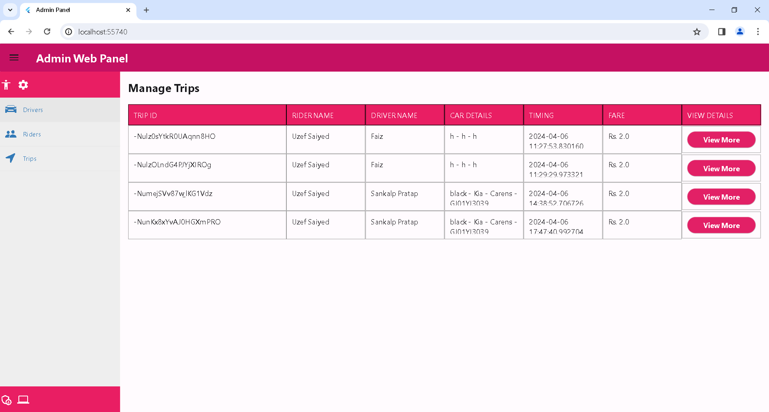

Slide 17
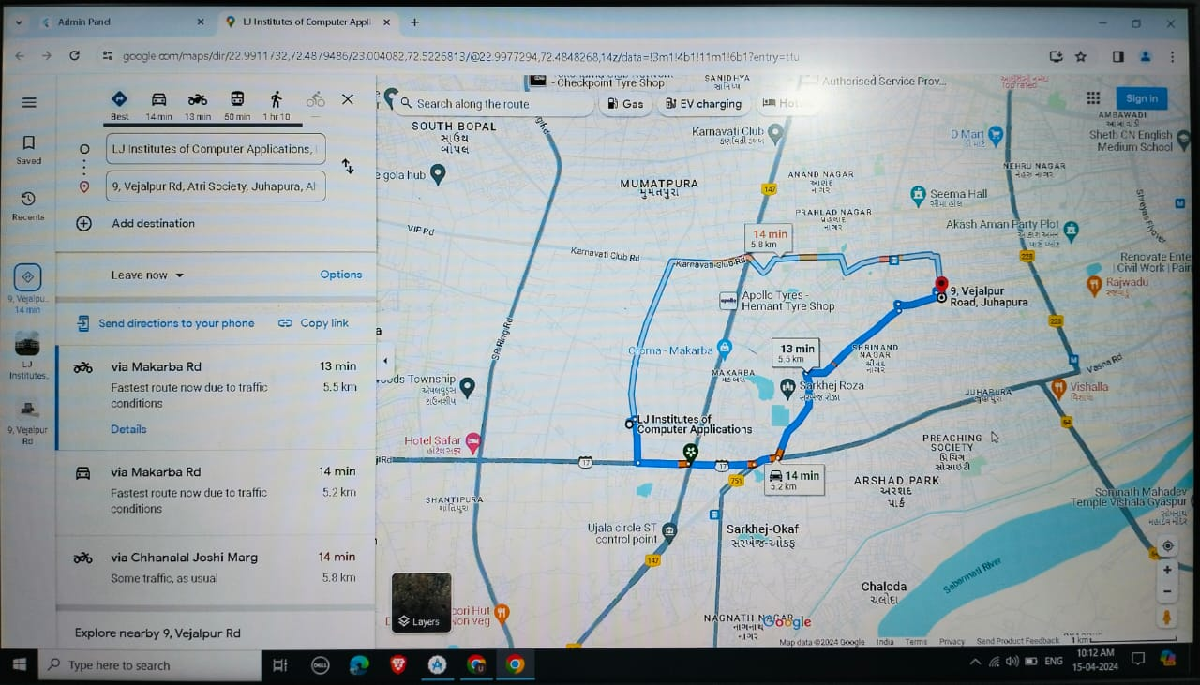

Slide 18
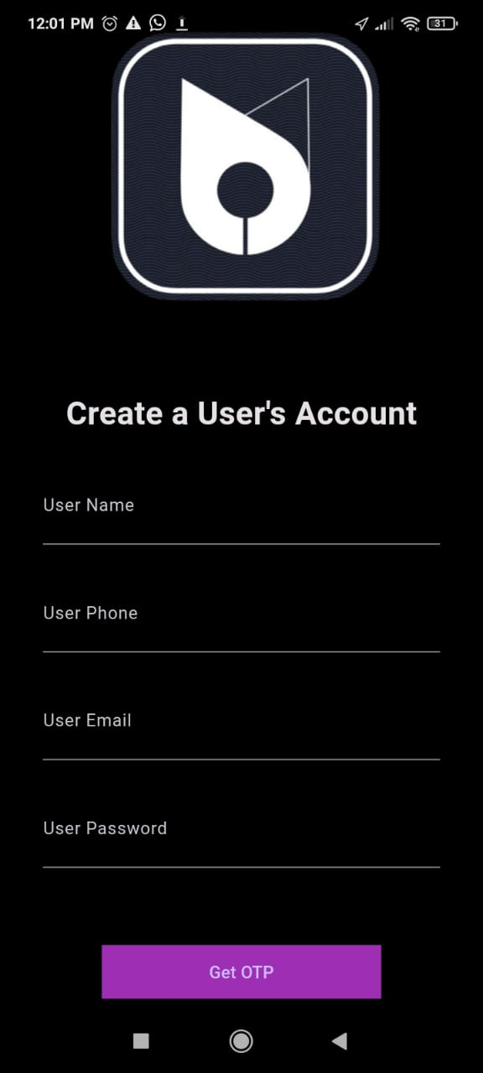
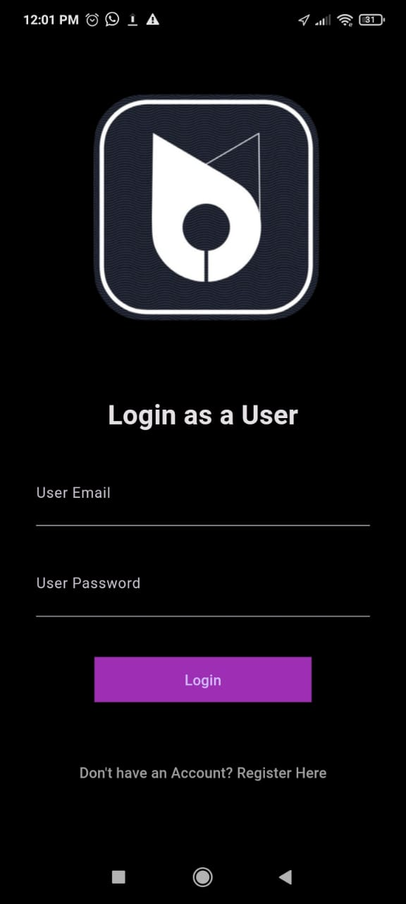
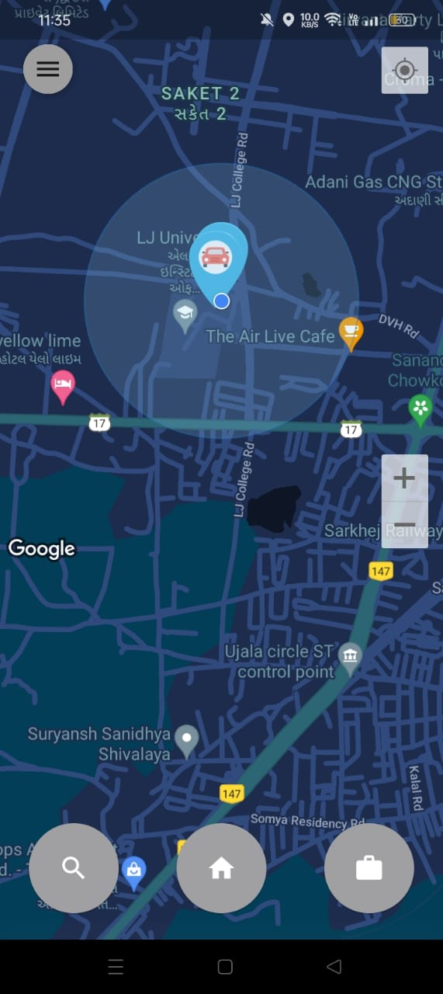
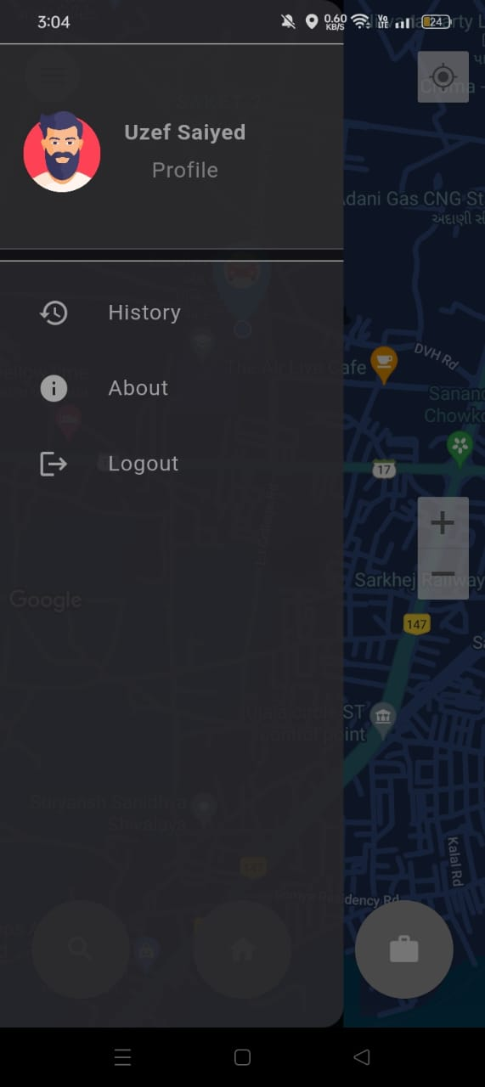
Rider Side:

Slide 19
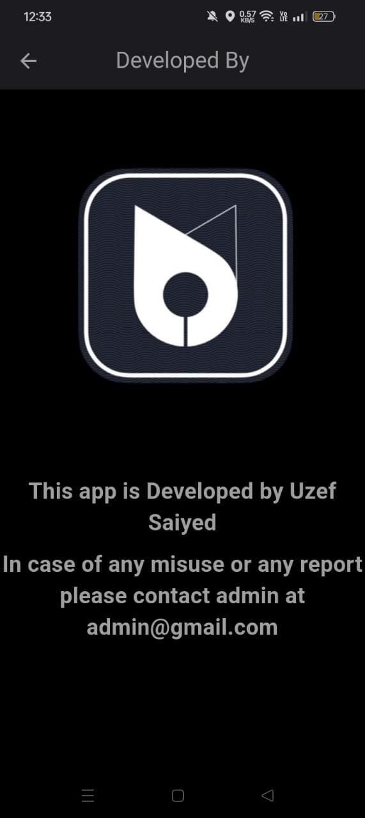
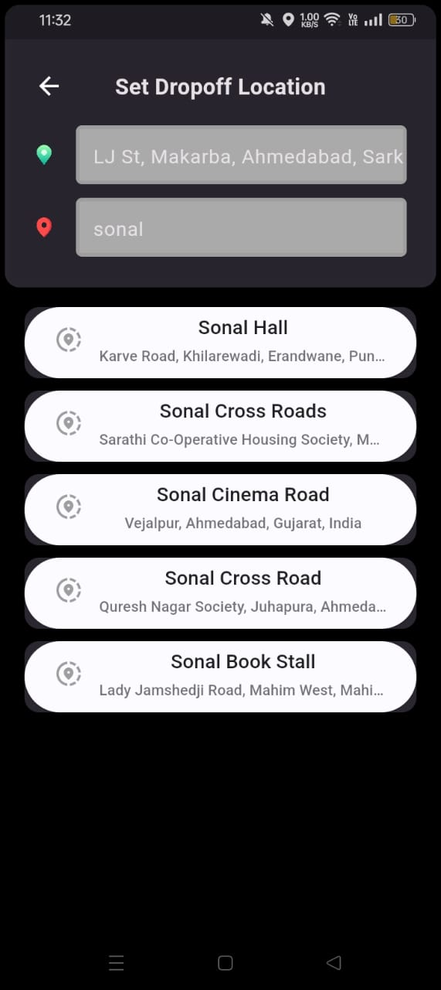
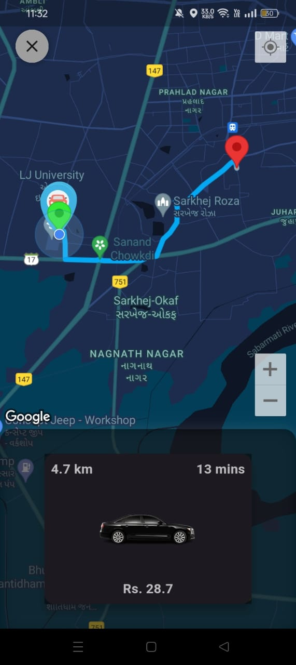
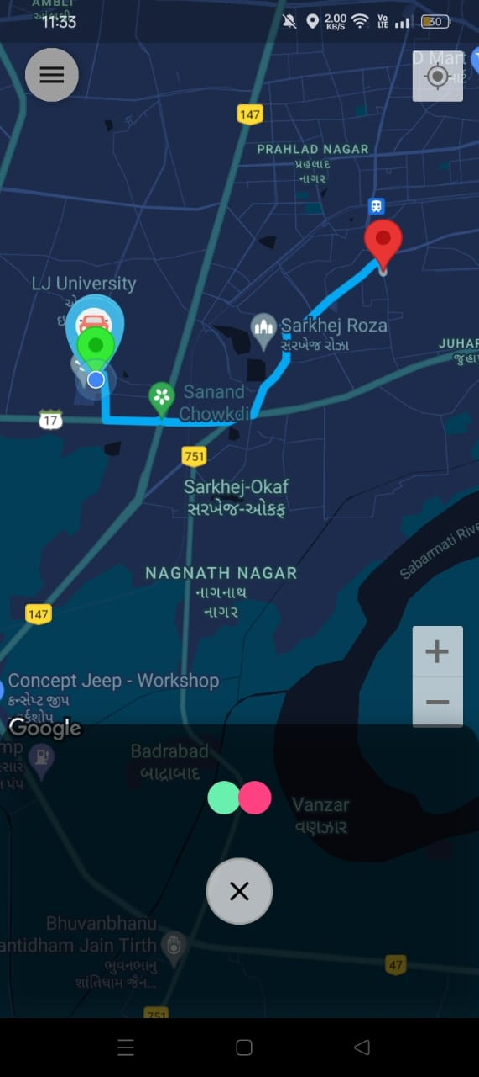

Slide 20
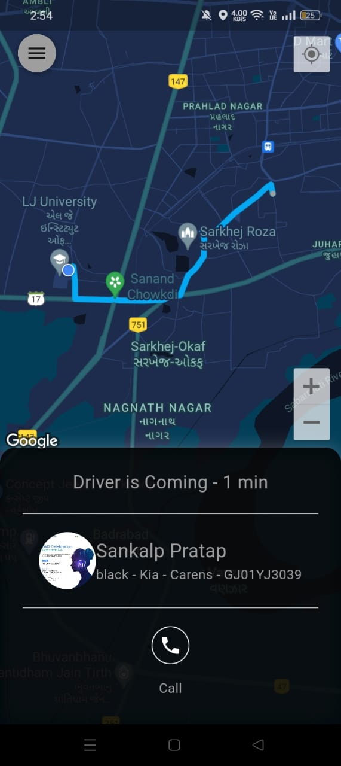
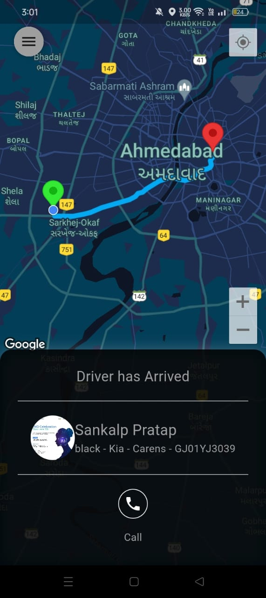

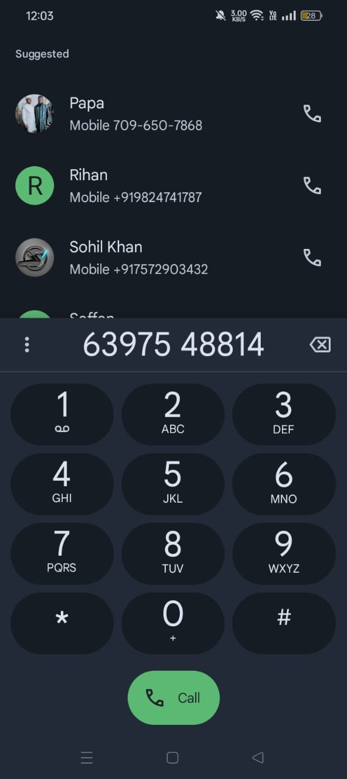

Slide 21
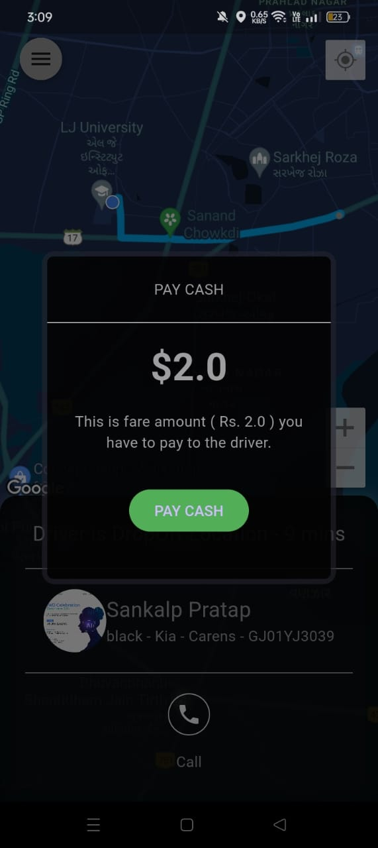
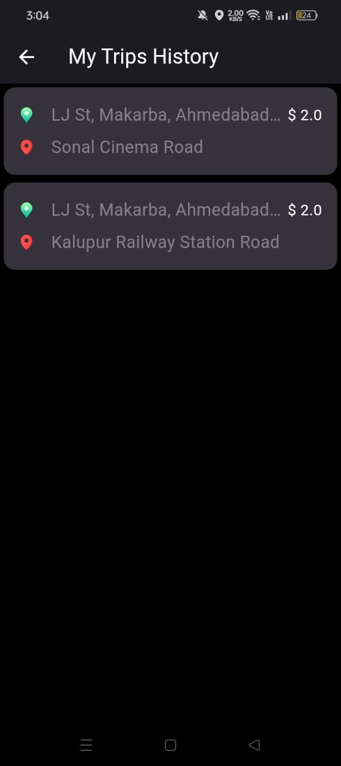
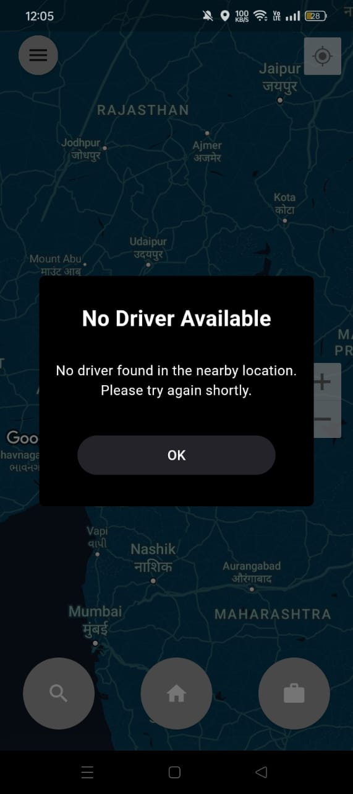

Slide 22
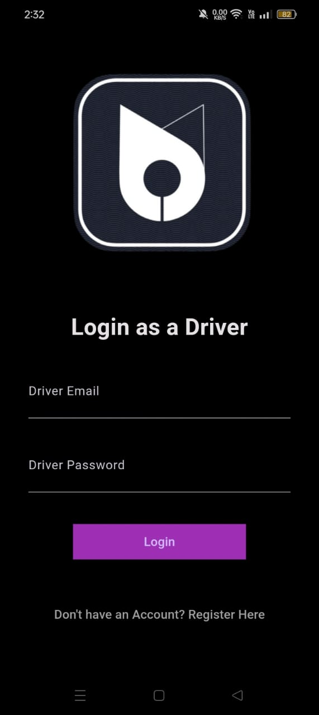
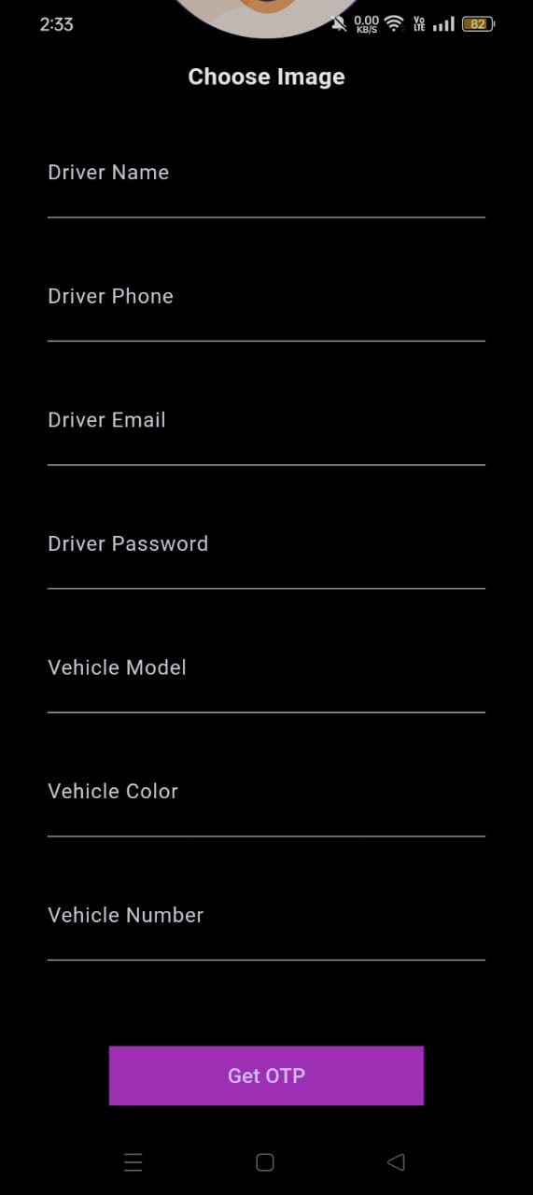
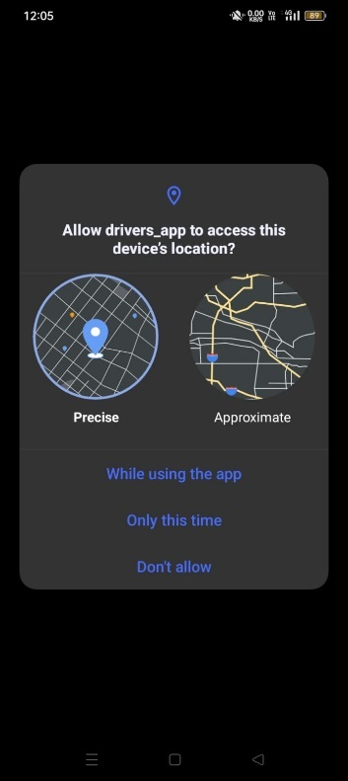
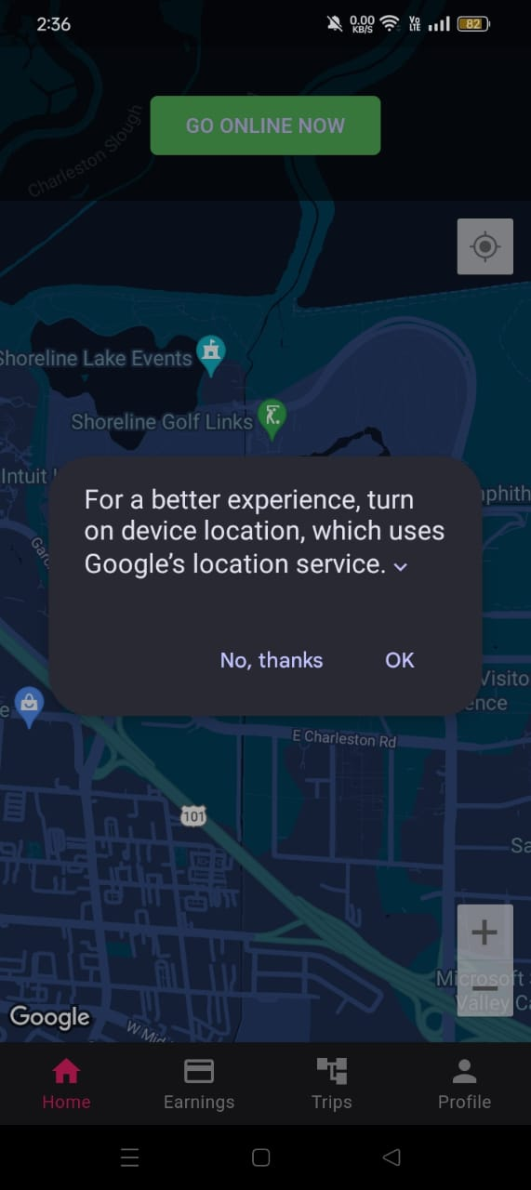
Driver Side:

Slide 23
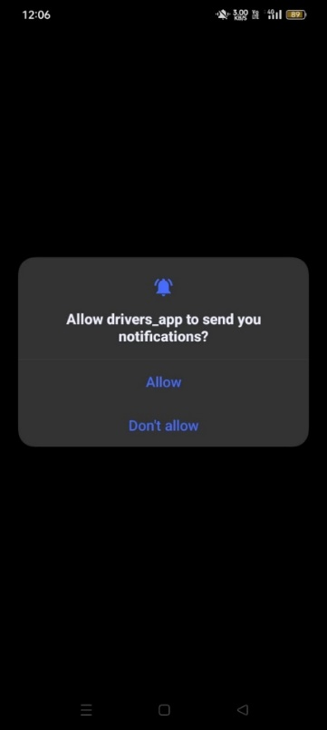
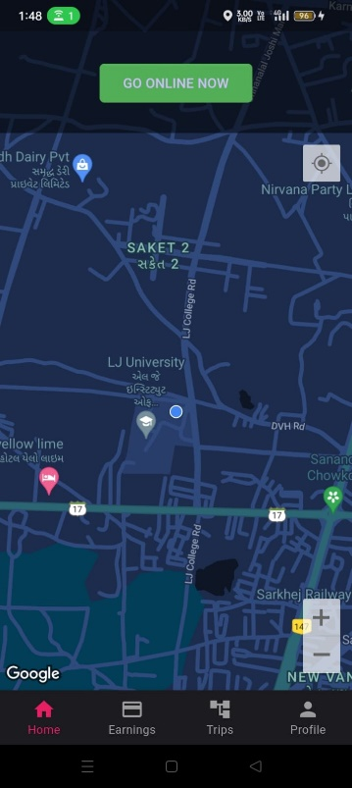
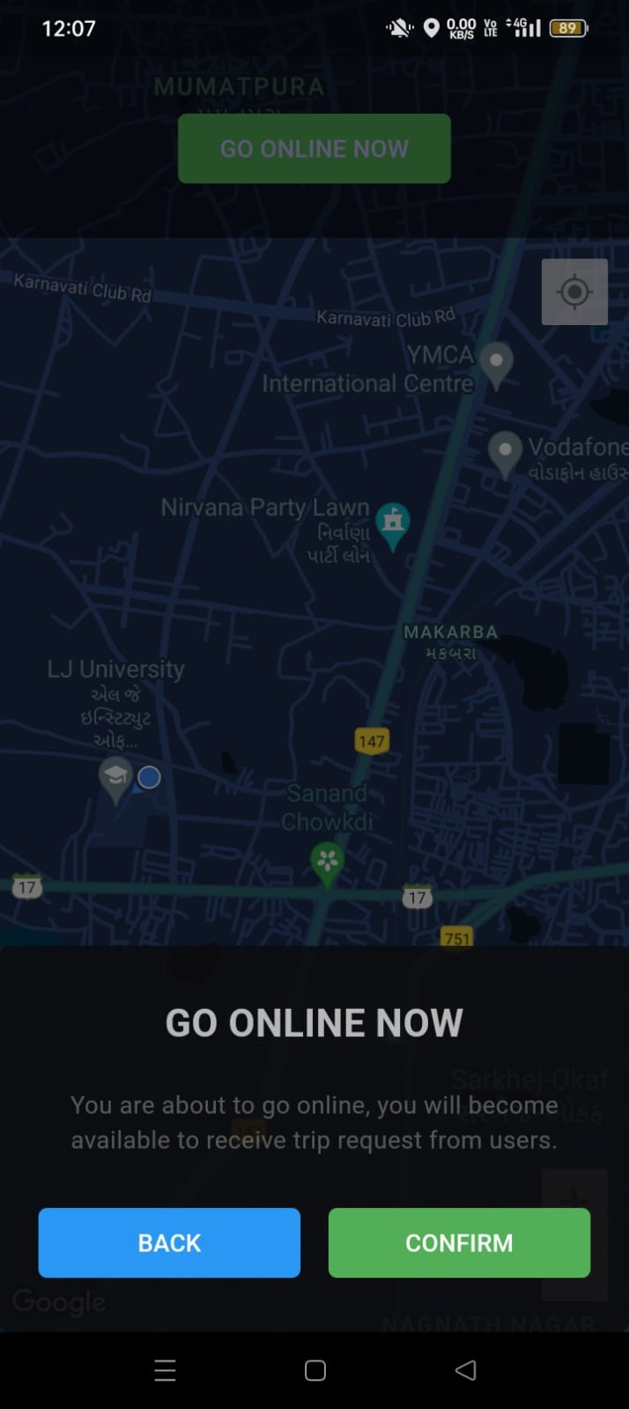
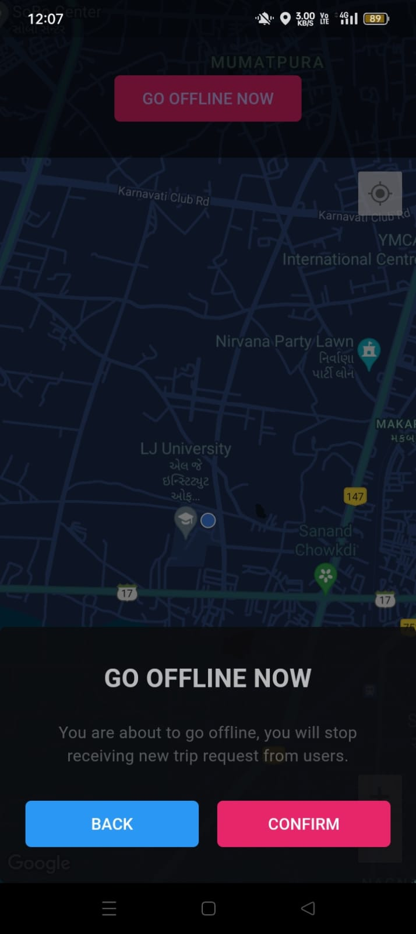

Slide 24
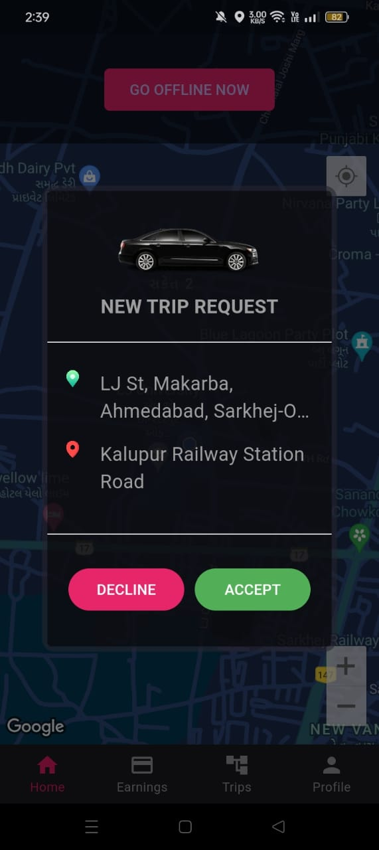
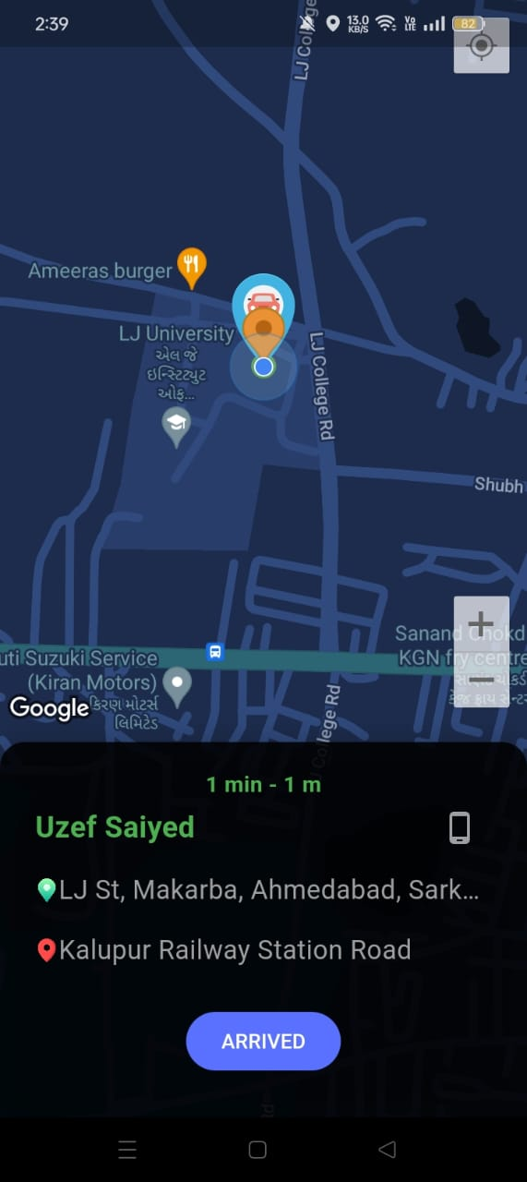
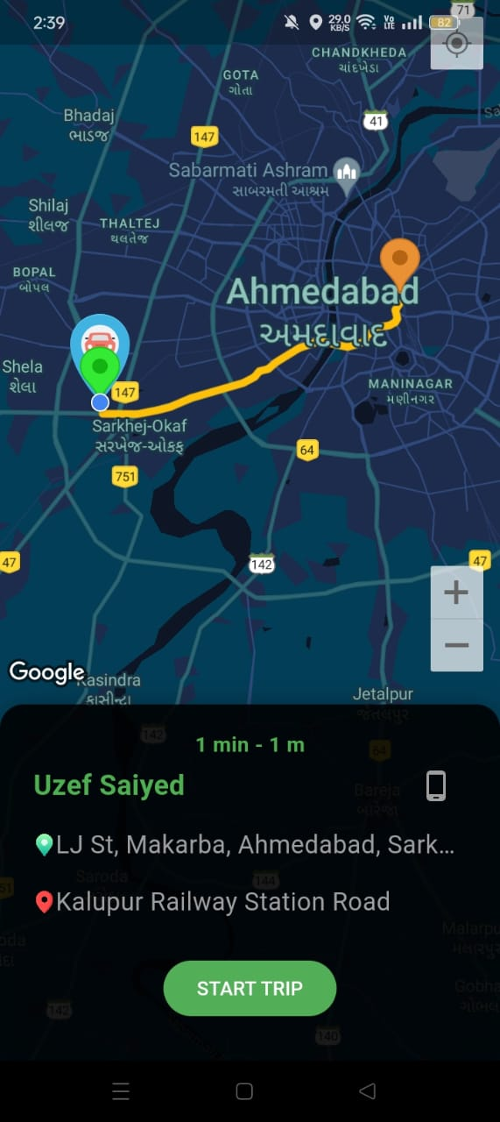
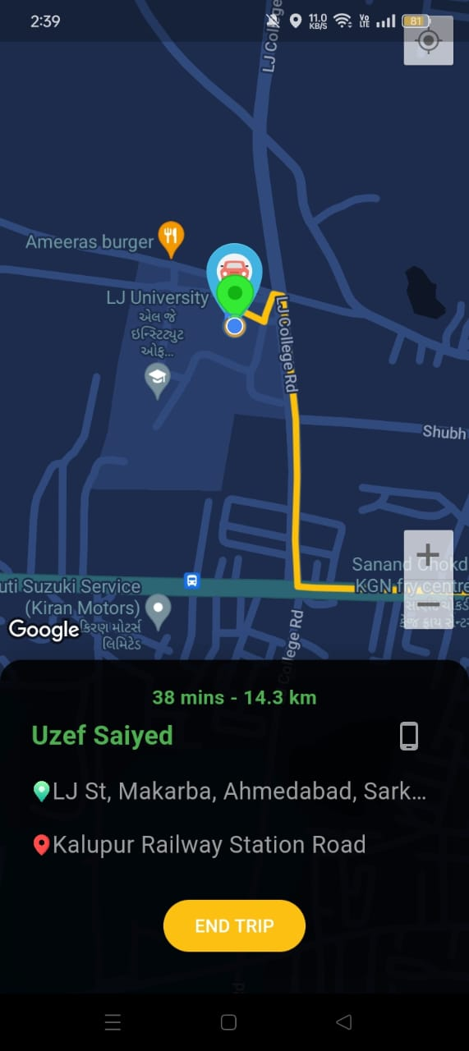

Slide 25
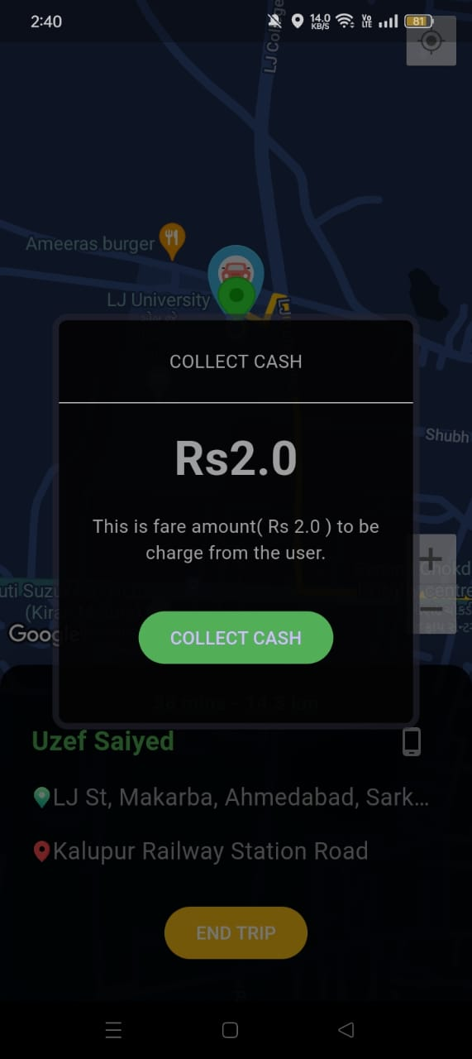
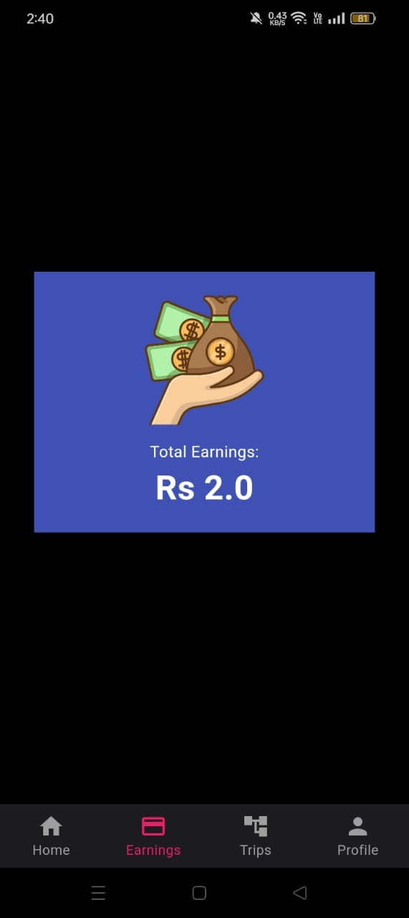
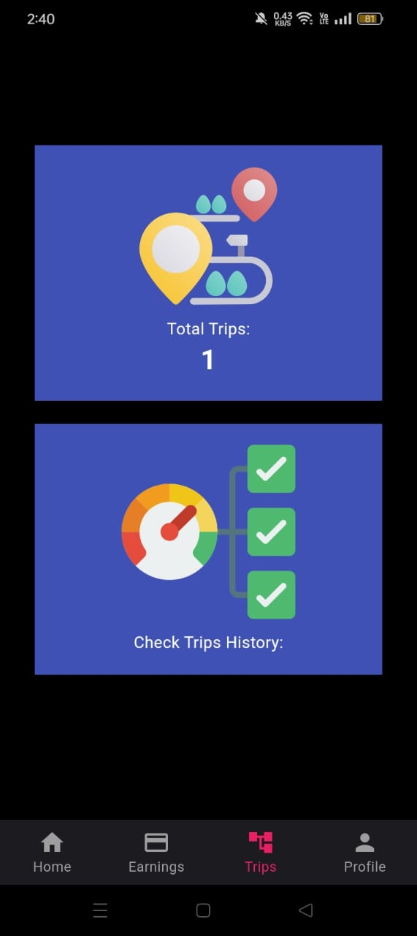
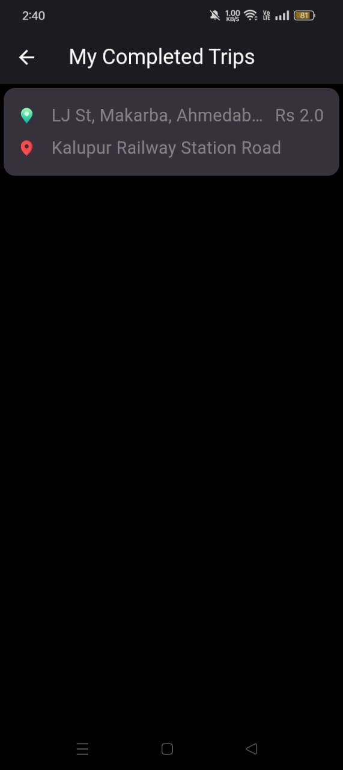

Slide 26
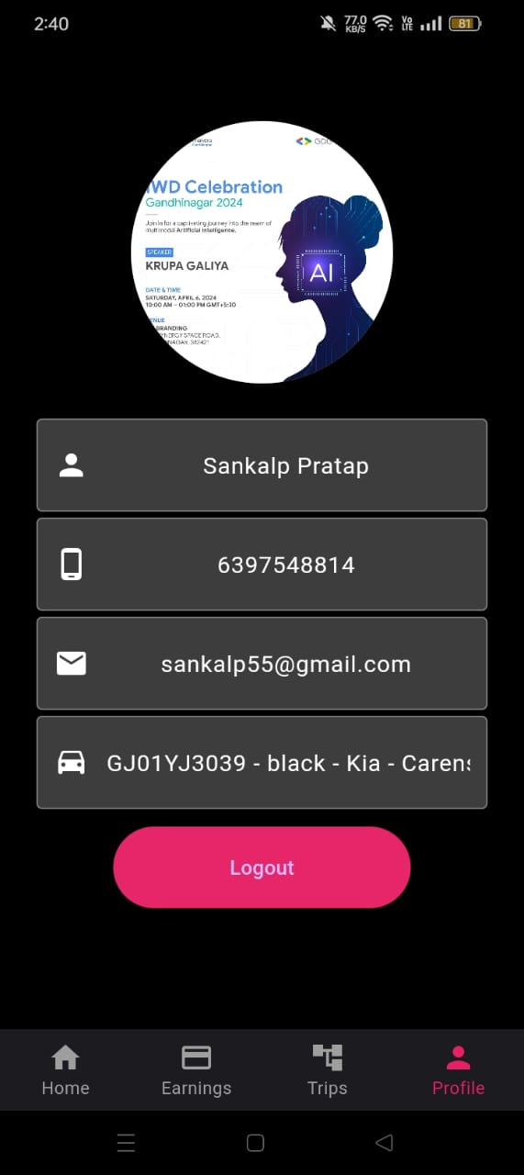
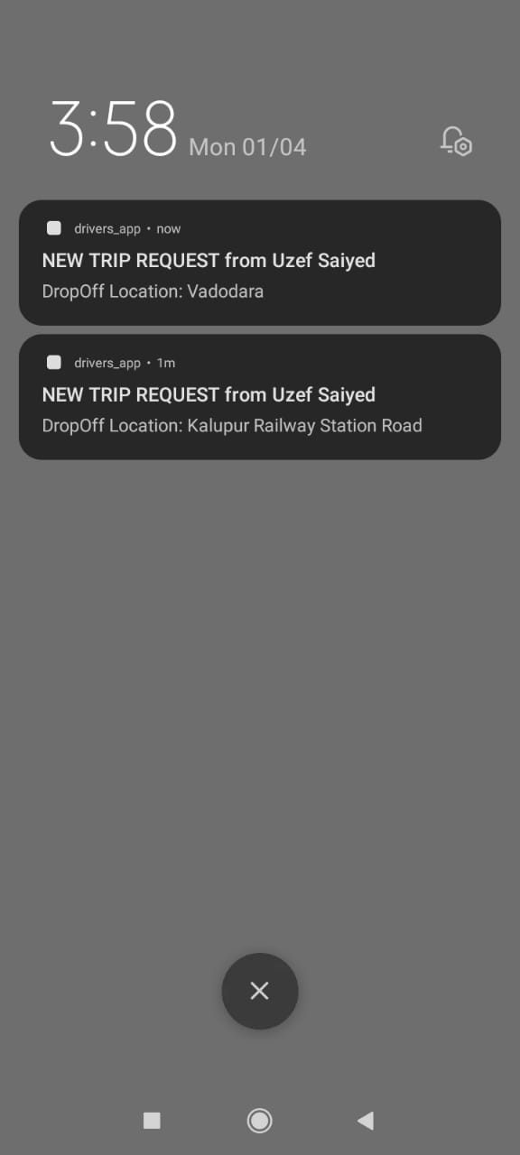

Slide 27
Data Dictionary:
Table name: - Riders Registration
Description: Details of the logged in riders
Column | type | constraints | description | sample data
Rider_id | String | Unique key | identification | 636e95883774caecb0cb35a5
Name | String | Not null | Name of the user | Amaan
Email | String | Unique,not null | Email of the user | amaan@gmail.com
Blockstatus | String | Not null | Status of the user | No / Yes
phone | String | Not null | Phone number of the user | 8986969786

Slide 28
Table name: - Driver
Description: Details of the drivers
Column | type | constraints | description | sample data
Driver_id | String | Unique key, Not null | identification | 6fsfh83774caecb0cb35a5
Trip_id | String | Foreign Key | Trip table id | Dfgh45dhgdh56hh
Name | String | Not null | Name of the driver | Aadil
Photo | String | Not null | Photo of the driver | Xyz/abc.png
Blockstatus | String | Not null | Status of the driver | No / Yes
phone | String | Not null | Phone number of the driver | 8986969786
Total Earnings | Integer | Not null | Total earnings of the driver | 110Rs.

Slide 29
Table name: - Trips
Description: Details of the trips
Column | type | constraints | description | sample data
Trip_id | String | Unique key, Not null | identification | 6fsfh83774caecb0cb35a5
Payment_id | String | Foreign Key | Payment table id | jhsgdjhdjdss
Rider_id | String | Foreign Key | Rider table id | Dfgh45dhgdh56hh
Driver_id | String | Foreign Key | Driver table id | Dfgh45dhgdh56hh
Timing | DateTime | Not null | Time and date of the trip | Sept 2023 12:30
Starting Point | String | Not null | Address of the starting point | Vadodara
Ending Point | String | Not null | Address of the ending point | Ahmedabad

Slide 30
Table name: - Payment
Description: Details of the payment
Column | type | constraints | description | sample data
Payment_id | String | Unique key, Not null | identification | 6fsfh83774caecb0cb35a5
Rider_ref_id | String | Foreign Key | Rider table id | Dfgh45dhgdh56hh
Driver_ref_id | String | Foreign Key | Driver table id | Dfgh45dhgdh56hh
Amount | Integer | Not null | Amount of the trips | 20Rs.

Slide 31
Table name: - Admin Registration
Description: Details of the admin registration
Column | type | constraints | description | sample data
Admin_id | String | Unique key | identification | 636e95883774caecb0cb35a5
Name | String | Not null | Name of the user | Amaan
Email | String | Unique,not null | Email of the user | amaan@gmail.com
phone | String | Not null | Phone number of the user | 8986969786

Slide 32
Coding Standards:
Use descriptive names for variables, functions, classes, and methods.
Organize your files logically, typically following Flutter’project structure.
Separate UI components, business logic, and data models into different directories.
Use camelCase for variable names and lowerCamelCase for method and function names.
Follow the Dart formatter (`dartfmt`) for code formatting.
Provide comments to explain complex algorithms or clarify the intent of the code.

Slide 33
Agile Project Charter
 | General Project Information
Project Name | Uber Clone
Project Champion | Aman puthawala, Uzef Saiyed
Project Sponsor | LJ Institute of Computer Application
Project Manager | Prof. Rita Gokani
Stakeholders | Admin, Rider, Driver
Expected Start Date | 30/12/2023
Expected Completion Date | 16/4/2024
 | Project Details
Mission | We continuously innovate to be the best transportation app for our customers.
Vision | To contribute towards the success of our clients, to help them to achieve their goals.
Scope | To the particular transportation site’s scope
Date | 30/12/2023

Slide 34
 | Project Details
Mission | We continuously innovate to be the best transportation app for our customers.
Vision | To contribute towards the success of our clients, to help them to achieve their goals.
Scope | To the particular transportation site’s scope
Date | 30/12/2023

Slide 35
Agile Roadmap/Schedule

Slide 36
Agile Project Plan
Task Name | Duration | Start | Finish | Status
Sprint#1: Project Structure | 15d | 30/12/2023 | 13/01/2024 | Completed
UI Designing | 11d | 30/12/2023 | 09/01/2024 | Completed
Firebase Management | 4d | 10/01/2024 | 13/01/2024 | Completed
Sprint#2: Registration | 5d | 14/01/2024 | 18/01/2024 | Completed
Rider Registration | 3d | 14/01/2024 | 16/01/2024 | Completed
Driver Registration | 2d | 17/01/2024 | 18/01/2024 | Completed
Sprint#3: Login and Logout | 6d | 19/01/2024 | 24/01/2024 | Completed
Rider Login | 2d | 19/01/2024 | 20/01/2024 | Completed
Driver Login | 2d | 21/01/2024 | 22/01/2024 | Completed
Admin Login | 2d | 23/01/2024 | 24/01/2024 | Completed
Sprint#4: Map Approval | 14d | 25/01/2024 | 07/02/2024 | Completed
Map setup | 14d | 25/01/2024 | 07/02/2024 | Completed
Sprint#5: Ride Booking | 14d | 08/02/2024 | 21/02/2024 | Completed
Request for ride | 4d | 08/02/2024 | 11/02/2024 | Completed
Notification for Accept or reject ride | 3d | 12/02/2024 | 14/02/2024 | Completed
Show driver and rider details | 4d | 15/02/2024 | 18/02/2024 | Completed
Start ride & End ride | 3d | 19/02/2024 | 21/02/2024 | Completed
Sprint#6: Payment | 4d | 22/02/2024 | 25/02/2024 | Completed
Amount paid | 2d | 22/02/2024 | 23/02/2024 | Completed
Confirm amount | 2d | 24/02/2024 | 25/02/2024 | Completed
Sprint#7: Total Earnings | 2d | 26/02/2024 | 27/02/2024 | Completed
Sprint#8: Trips Page | 10d | 28/02/2024 | 08/03/2024 | Completed
Total Trips | 3d | 28/02/2024 | 01/03/2024 | Completed
Check Trips History(Driver) | 3d | 02/03/2024 | 04/03/2024 | Completed
Check Trips History(Rider) | 4d | 05/03/2024 | 08/03/2024 | Completed
Sprint#8: Profile | 2d | 09/03/2024 | 10/03/2024 | Completed
Driver Profile | 2d | 09/03/2024 | 10/03/2024 | Completed

Slide 37
Agile User Story
User Story ID | As a (type of user) | I want to (perform some task) | So that I can (achieve some goal)
1 | Admin | Manage Rider | Block and Un-block Rider
2 | Admin | Manage Driver | Block and Un-block Driver
3 | Admin | Manage Trips | View Trip details
4 | Driver | Ride request | Accept the request or reject request
5 | Driver | Earnings | Check total earnings
6 | Driver / Rider | Trips | Check trips history
7 | Rider | Ride booking | Request for ride booking
8 | Rider | Payment | Payment of the ride

Slide 38
Agile Release Plan
Task Name | Duration | Start | Finish | Status | Release Date
Sprint#1: Project Structure | 15d | 30/12/2023 | 13/01/2024 | Completed | 13/01/2024
UI Designing | 11d | 30/12/2023 | 09/01/2024 | Completed | 09/01/2024
Firebase Management | 4d | 10/01/2024 | 13/01/2024 | Completed | 13/01/2024
Sprint#2: Registration | 5d | 14/01/2024 | 18/01/2024 | Completed | 18/01/2024
Rider Registration | 3d | 14/01/2024 | 16/01/2024 | Completed | 16/01/2024
Sprint#3: Login and Logout | 2d | 17/01/2024 | 18/01/2024 | Completed | 18/01/2024
Rider Login | 6d | 19/01/2024 | 24/01/2024 | Completed | 24/01/2024
Driver Login | 2d | 19/01/2024 | 20/01/2024 | Completed | 20/01/2024
Admin Login | 2d | 21/01/2024 | 22/01/2024 | Completed | 22/01/2024
Sprint#4: Map Setup | 2d | 23/01/2024 | 24/01/2024 | Completed | 24/01/2024
Map setup | 14d | 25/01/2024 | 07/02/2024 | Completed | 07/02/2024
Sprint#5: Ride Booking | 14d | 25/01/2024 | 07/02/2024 | Completed | 07/02/2024
Request for ride | 14d | 08/02/2024 | 21/02/2024 | Completed | 21/02/2024
Notification for Accept or reject ride | 4d | 08/02/2024 | 11/02/2024 | Completed | 11/02/2024
Show driver and rider details | 3d | 12/02/2024 | 14/02/2024 | Completed | 14/02/2024
Start ride & End ride | 4d | 15/02/2024 | 18/02/2024 | Completed | 18/02/2024
Sprint#6: Payment | 3d | 19/02/2024 | 21/02/2024 | Completed | 21/02/2024
Amount paid | 4d | 22/02/2024 | 25/02/2024 | Completed | 25/02/2024
Confirm amount | 2d | 22/02/2024 | 23/02/2024 | Completed | 23/02/2024
Sprint#7: Total Earnings | 2d | 24/02/2024 | 25/02/2024 | Completed | 25/02/2024
Sprint#8: Trips | 2d | 26/02/2024 | 27/02/2024 | Completed | 27/02/2024
Total Trips | 10d | 28/02/2024 | 08/03/2024 | Completed | 08/03/2024
Check Trips History(Driver) | 3d | 28/02/2024 | 01/03/2024 | Completed | 01/03/2024
Check Trips History(Rider) | 3d | 02/03/2024 | 04/03/2024 | Completed | 04/03/2024
Sprint#8: Profile | 4d | 05/03/2024 | 08/03/2024 | Completed | 08/03/2024
Driver Profile | 2d | 09/03/2024 | 10/03/2024 | Completed | 10/03/2024

Slide 39
Agile Sprint Backlog
Task Name | Story | Sprint Ready | Priority | Status | Story Point
Sprint#1: Project Structure | Yes | Yes | High | Completed | 3
UI Designing | Yes | Yes | High | Completed | 2
Firebase Management | Yes | Yes | High | Completed | 2
Sprint#2: Registration | Yes | Yes | High | Completed | 2
Rider Registration | Yes | Yes | High | Completed | 1
Sprint#3: Login and Logout | Yes | Yes | High | Completed | 4
Rider Login | Yes | Yes | High | Completed | 4
Driver Login | Yes | Yes | High | Completed | 4
Admin Login | Yes | Yes | High | Completed | 3
Sprint#4: Map Setup | Yes | Yes | High | Completed | 3
Map setup | Yes | Yes | High | Completed | 4
Sprint#5: Ride Booking | Yes | Yes | High | Completed | 4
Request for ride | Yes | Yes | High | Completed | 4
Notification for Accept or reject ride | Yes | Yes | High | Completed | 4
Show driver and rider details | Yes | Yes | High | Completed | 4
Start ride & End ride | Yes | Yes | Medium | Completed | 4
Sprint#6: Payment | Yes | Yes | High | Completed | 4
Amount paid | Yes | Yes | Medium | Completed | 2
Confirm amount | Yes | Yes | Medium | Completed | 1
Sprint#7: Total Earnings | Yes | Yes | Medium | Completed | 1
Sprint#8: Trips | Yes | Yes | High | Completed | 4
Total Trips | Yes | Yes | High | Completed | 4
Check Trips History(Driver) | Yes | Yes | High | Completed | 2
Check Trips History(Rider) | Yes | Yes | High | Completed | 2
Sprint#8: Profile | Yes | Yes | Medium | Completed | 2
Driver Profile | Yes | Yes | Medium | Completed | 2

Slide 40
Earned-value and burn chart

Slide 41
Proposed Enhancement:
If rider waiting time is greater than 15min then auto cut the accepted driver and show the nearest one.
Localization and Personalization: Incorporate localization features a to support multiple languages.
Multiple options for ride payment.

Slide 42
Conclusion:
Our Uber clone app represents the next generation of ride-sharing platforms, combining convenience, reliability, and safety in one seamless package..
We are confident that our app will not only meet but exceed the expectations of users, driving sustainable growth and success in the dynamic transportation industry.
With this platform we developed, we are hoping to manage the time wasting in travelling and waiting time, avoid misunderstanding provide easy data flow customer pleasure and less hard work we believe that we have accomplished our goals and satisfied with the code we developed.

Slide 43
Bibliography:
Site References:
https://docs.flutter.dev/get-started/install
https://www.youtube.com/
https://app.diagrams.net/
https://console.firebase.google.com/
https://www.geeksforgeeks.org/flutter-tutorial/

