Slide 1
CUSTOMER SHOPPING BEHAVIOR ANALYSIS
Customer behavior
points to the next
growth move
3,900 purchases reveal where revenue concentrates, where loyalty is strong, and where the customer journey still has room to improve.

Slide 2
THE EVIDENCE BASE
The dataset is broad enough to show patterns
3,900
25
purchases
products across 4 categories
$59.76
3.75
average purchase amount
average review rating

Slide 3
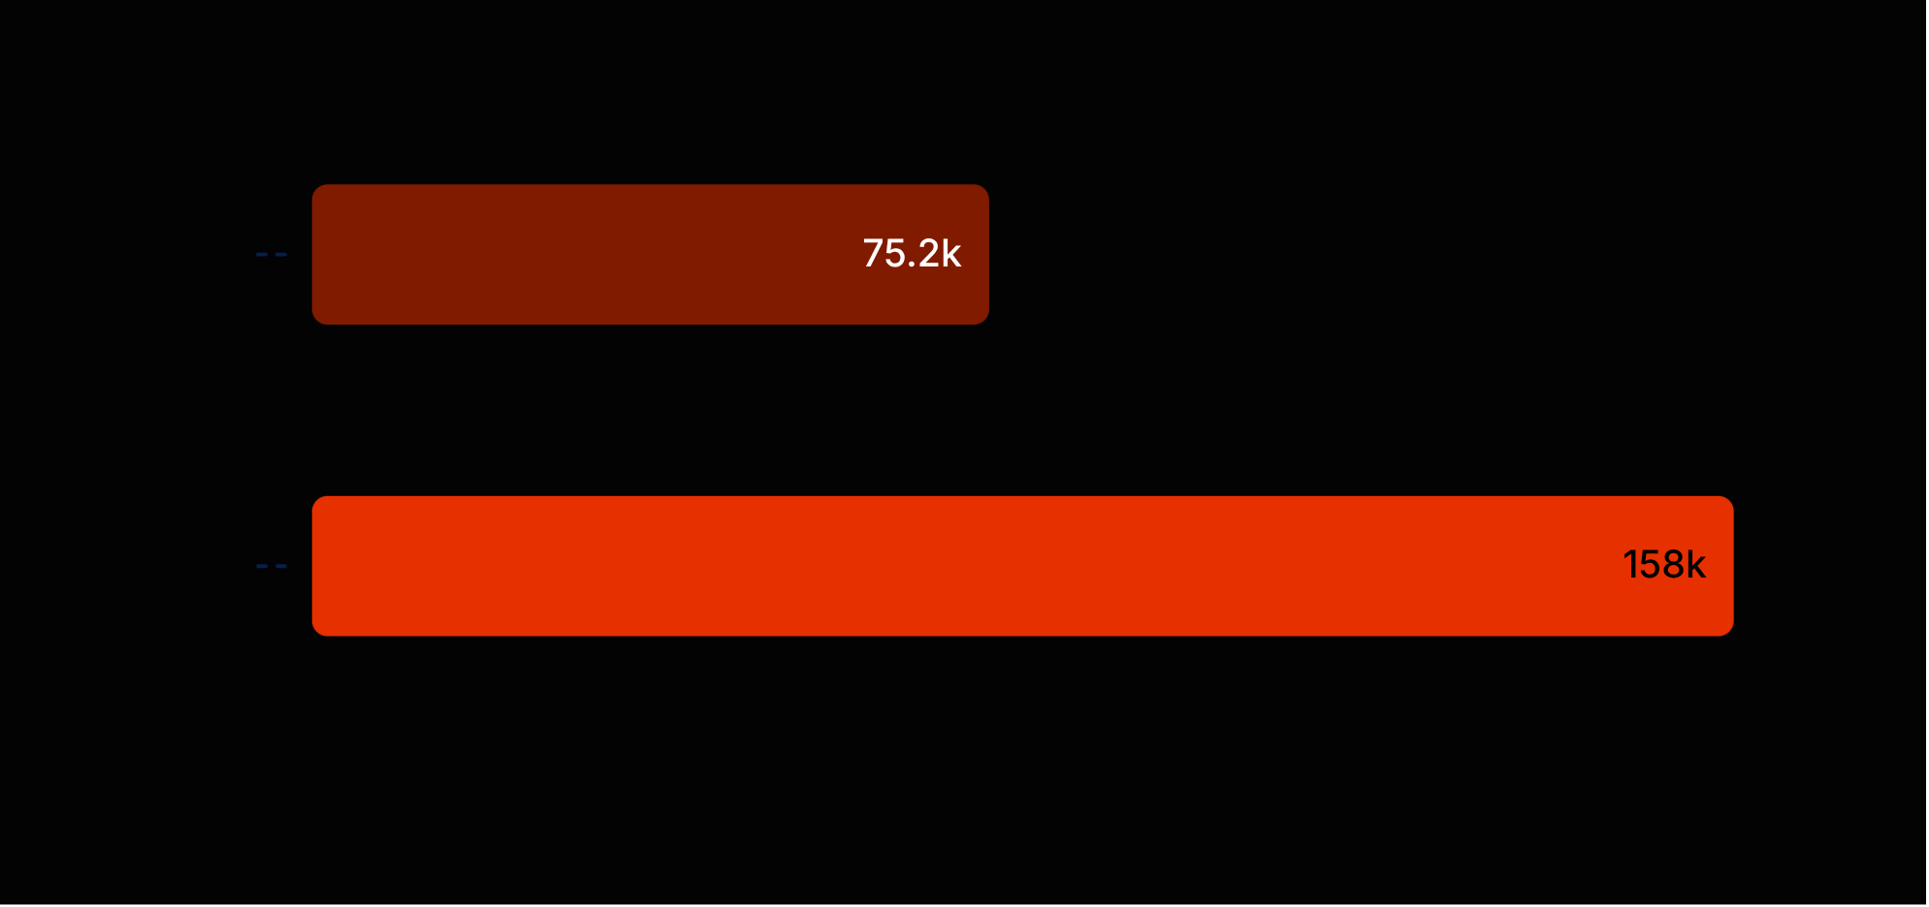
REVENUE MIX
Revenue is concentrated in male customers
$157,890
Male revenue
$75,191
Female revenue
The gap is a targeting signal, not a reason to overlook other customer groups.

Slide 4
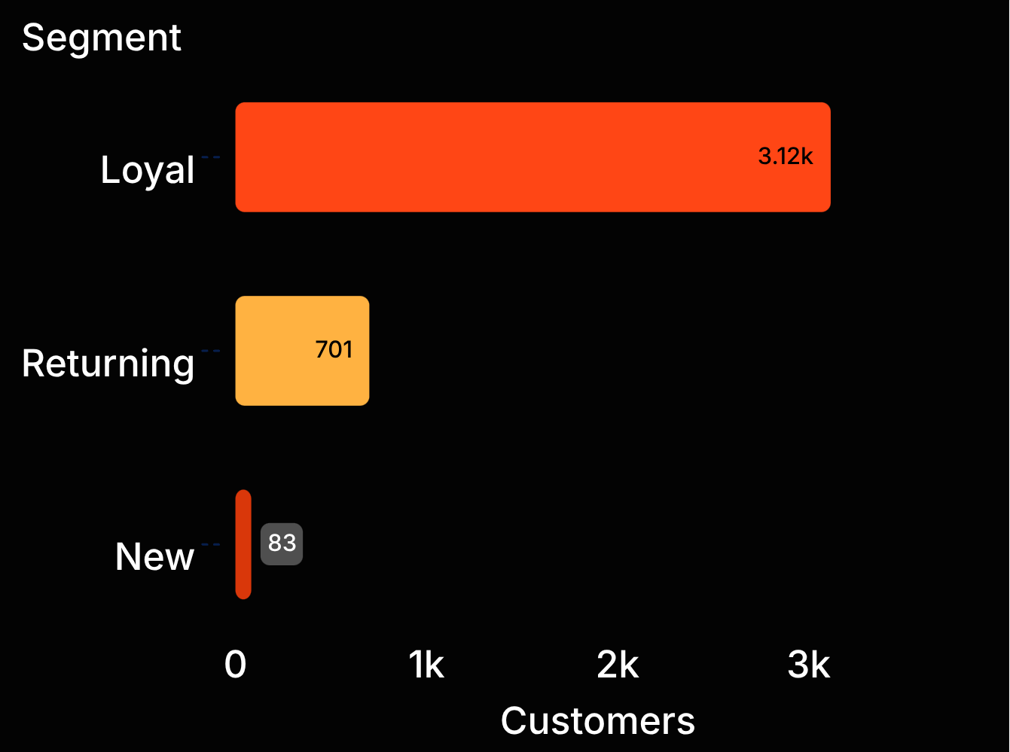
THE BIGGEST GAP
Loyalty is strong,
but subscriptions lag
1,053
3,116 loyal · 701 returning · 83 new
customers subscribe
2,847 non-subscribers

Slide 5




PRODUCT OPPORTUNITY
Clothing leads the product opportunity
Clothing
Top products
Top-rated
Category context
Largest category in the dashboard.
Jewelry, Blouse, Sandals, and Jacket.
Gloves 3.86 · Sandals 3.84 · Boots 3.82.
Ahead of accessories, footwear, and outerwear.

Slide 6
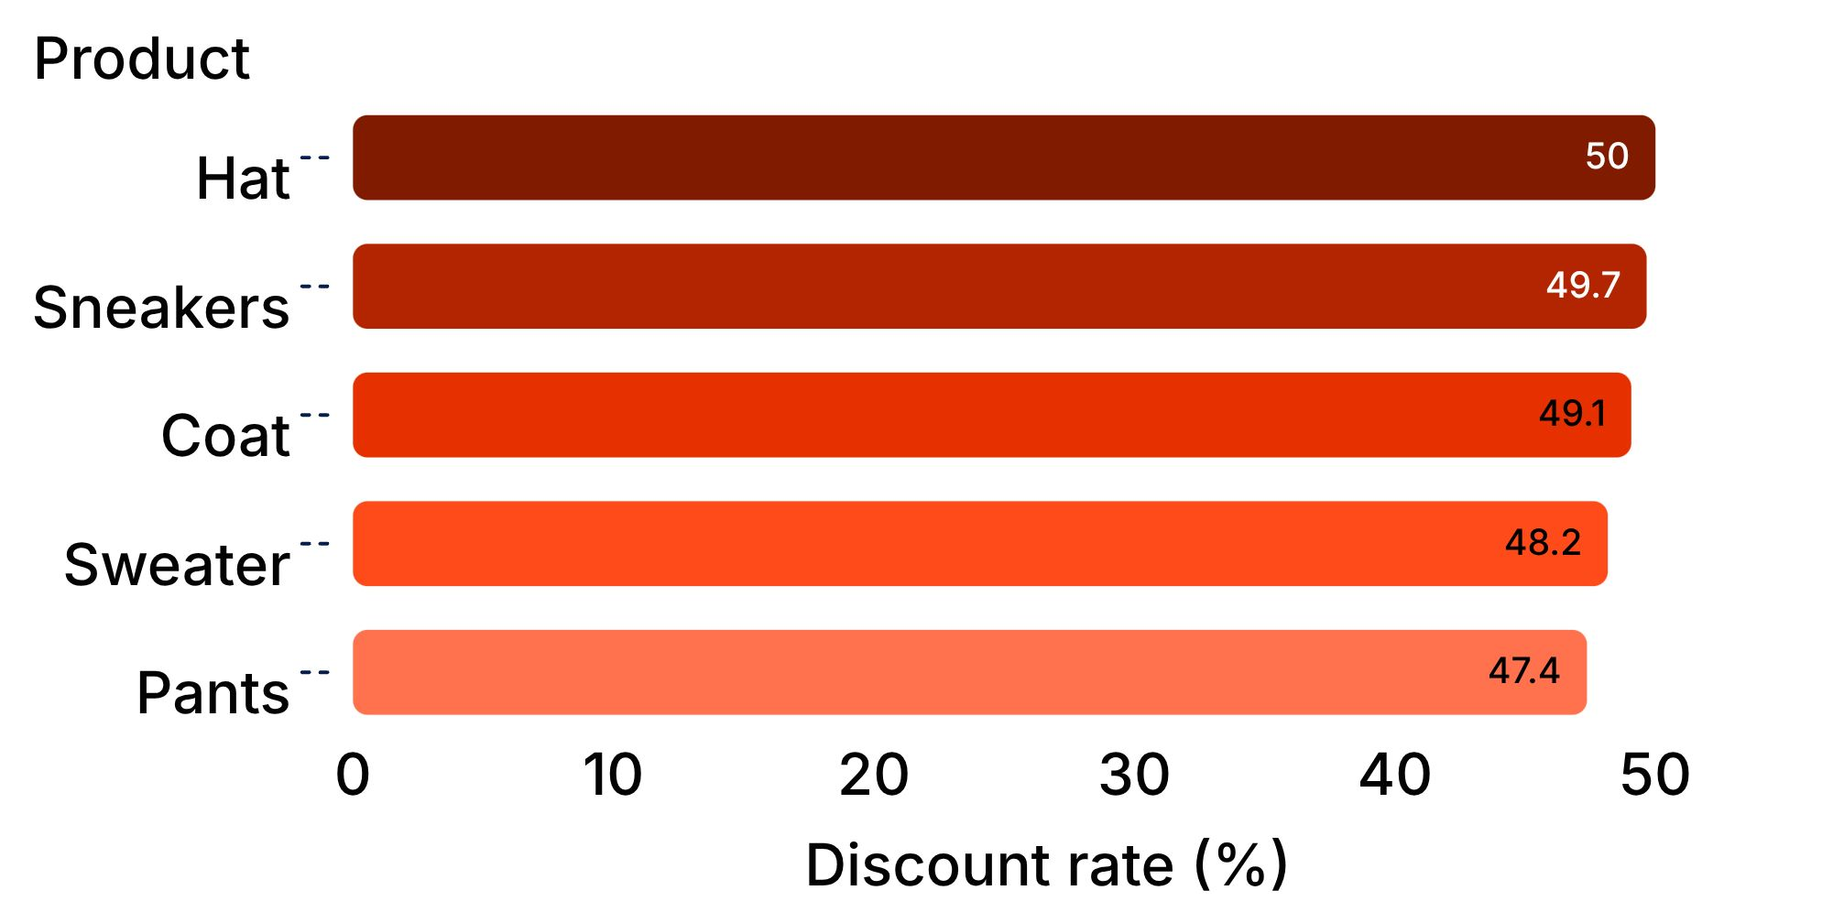
DISCOUNT SIGNAL
Discounts are driving demand in specific products
839
customers used discounts and still spent above the average purchase amount
Review discounting by product so volume does not quietly erode margin.

Slide 7
SERVICE AND AUDIENCE
Small service choices move purchase value
$60.48
$62,143
Express shipping
Young Adults revenue
vs. $58.46 with Standard shipping
Highest among age groups
Target high-revenue age groups with relevant offers and make premium fulfillment easy to choose.

Slide 8
OPERATING MODEL
The solution is a tighter behavior-to-action loop
01
02
03
04
Segment
Diagnose
Act
Measure
Start with loyal, returning, and new customers.
Connect product, discount, shipping, and purchase signals.
Promote subscriptions, loyalty rewards, and top-rated products.
Track conversion, repeat purchase, total purchase amount, and margin.

Slide 9

THE NEXT MOVE
Four moves to turn insight into growth
Boost subscriptions: give loyal customers a clear benefit to join.
Reward repeat buyers: move returning customers toward loyalty.
Rebalance discounts: protect margin on high-discount products.
Target precisely: focus campaigns on high-revenue age groups and express-shipping users.
Source: Customer Shopping Behavior Analysis.

