Slide 1

Speed and Position Control of a DC Motor Using Artificial Neural Networks
Aayushman Naik(21JE0009)
Abhijeet Mourya(21JE0016)
Aman Sanatan(21JE0088)

Slide 2
LITERATURE REVIEW
C. Safarian, T. Ogunfunmi, W. J. Kozacky and B. K. Mohanty, "FPGA implementation of LMS-based FIR adaptive filter for real time digital signal processing applications“
This paper focuses on the issues with existing designs which suffer from excessive use of multipliers impacting the efficiency and real-time performance of adaptive filters.
The simple implementation and convergence behavior of the LMS algorithm has been highlighted.
The authors propose a new architecture using Xilinx DSP48 slices, which reduces the number of multipliers and dynamic power consumption, making it suitable for real-time digital signal processing applications.
The essence of the direction taken in this research paper is to come up with a pure hardware implementation architecture for LMS algorithm in particular so as to make it suitable for on-chip real-time digital signal processing

Slide 3
RESEARCH GAP
01
02
03
04
NAME OF THE SECTION
NAME OF THE SECTION
You can describe the topic of the section here
You can describe the topic of the section here
NAME OF THE SECTION
NAME OF THE SECTION
You can describe the topic of the section here
You can describe the topic of the section here

Slide 4
PROBLEM FORMULATION
Mercury is the closest planet to the Sun and the smallest one in the entire Solar System. This planet's name has nothing to do with the liquid metal, since Mercury was named after the Roman messenger god. Despite being closer to the Sun than Venus, its temperatures aren't as terribly hot as that planet’s. Its surface is quite similar to that of Earth’s Moon, which means there are a lot of craters and plains
Speaking of craters, many of them were named after artists or authors who made significant contributions to their respective fields. Mercury takes a little more than 58 days to complete its rotation, so try to imagine how long days must be there! Since the temperatures are so extreme, albeit not as extreme as on Venus, and the solar radiation is so high, Mercury has been deemed to be non-habitable for humans

Slide 5
BRIEF THEORY
Do you know what helps you make your point crystal clear? Lists like this one:
They’re simple
You can organize your ideas clearly
You’ll never forget to buy milk!
And the most important thing: the audience won’t miss the point of your presentation

Slide 6
WHOA!
This can be the part of the presentation where you introduce yourself, write your email…

Slide 7
RESULT AND DISCUSSION
MERCURY
VENUS
Mercury is the closest planet to the Sun and the smallest one in the Solar System—it’s only a bit larger than the Moon
Venus has a beautiful name and is the second planet from the Sun. It’s hot and has a poisonous atmosphere

Slide 8
01
NAME OF THE SECTION
You can enter a subtitle here if you need it

Slide 9
HERE ARE THREE IMPORTANT IDEAS
MERCURY
VENUS
MARS
Mercury is the closest planet to the Sun and the smallest of them all
Venus has a beautiful name and is the second planet from the Sun
Despite being red, Mars is actually a cold place. It’s full of iron oxide dust

Slide 10
CONCLUSION AND FUTURE SCOPE
Implementation of Deep Neural Networks (DNNs): Explore deeper and more complex architectures to improve prediction accuracy and handle more intricate motor dynamics, including time-varying parameters.
Real-Time Hardware Integration: Implement the trained ANN model on microcontrollers or FPGAs for real-time control applications in embedded systems.
Extension to Multi-Motor Systems: Develop ANN-based coordination strategies for multi-motor setups, useful in fields like robotics, drone control, and industrial automation.
Online Learning and Adaptation: Integrate online training capabilities so that the ANN can adapt in real-time to system wear, load changes, or environmental variations.
Hybrid Control Systems: Combine ANN controllers with classical PID or adaptive controllers to achieve a balance between learning ability and stability guarantees.

Slide 11
REVIEWING CONCEPTS IS A GOOD IDEA
MARS
VENUS
NEPTUNE
Mars is actually a very cold place
Venus has extremely high temperatures
Neptune is the farthest planet from the Sun
MERCURY
SATURN
JUPITER
Mercury is the closest planet to the Sun
Saturn is a gas giant with several rings
Jupiter is the biggest planet of them all

Slide 12
THANK YOU

Slide 13
TABLES REPRESENT YOUR DATA
 | MASS (EARTHS) | DIAMETER (EARTHS) | SURFACE GRAVITY (EARTHS)
MERCURY | 0.06 | 0.38 | 0.38
MARS | 0.11 | 0.53 | 0.38
SATURN | 95.2 | 9.4 | 1.16

Slide 14
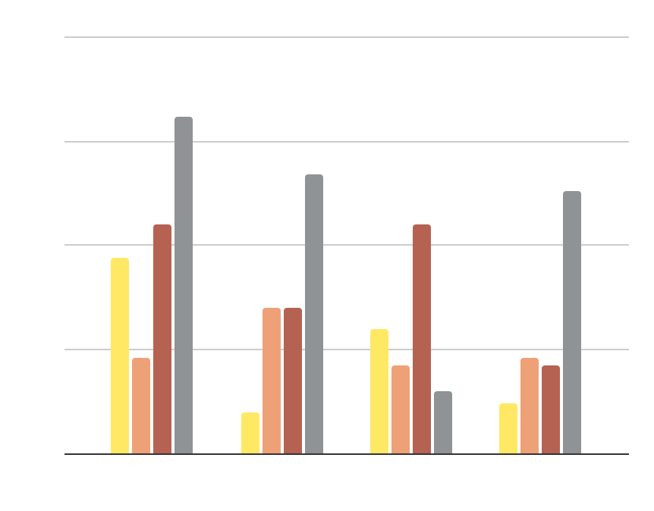
YOU CAN USE THIS GRAPH
MARS
VENUS
Mars is actually a very cold place
Venus has extremely high temperatures
MERCURY
SATURN
Mercury is the closest planet to the Sun
Saturn is a gas giant and has several rings
20XX
20XX
20XX
20XX
Follow the link in the graph to modify its data and then paste the new one here. For more info, click here

Slide 15
THIS IS ANOTHER INFOGRAPHIC
VENUS
50%
Venus has a beautiful name and is the second planet from the Sun
Venus is very big
Mercury is small
Mars is red
MERCURY
75%
Mercury is the closest planet to the Sun and the smallest of them all
Venus is very big
Mercury is small
Mars is red

Slide 16
THIS IS ANOTHER TABLE
CABLE | DESCRIPTION | TYPES
VENUS | Venus has a beautiful name and is the second planet from the Sun. It’s terribly hot, even hotter than Mercury, and its atmosphere is poisonous | Venus is very big Neptune is cold Mars is red
MERCURY | Mercury is the closest planet to the Sun and the smallest one in the entire Solar System. Despite being closer to the Sun than Venus | Venus is very big Neptune is cold Mars is red

Slide 17
ICON PACK

Slide 18
ALTERNATIVE RESOURCES
Here’s an assortment of alternative resources whose style fits that of this template:
Electricity icons
Minimalist technology background

