Slide 1

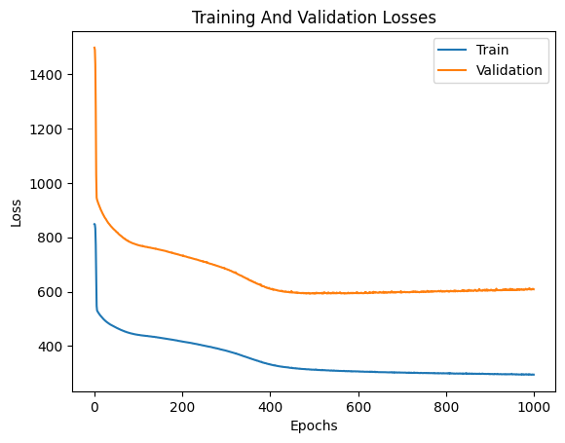
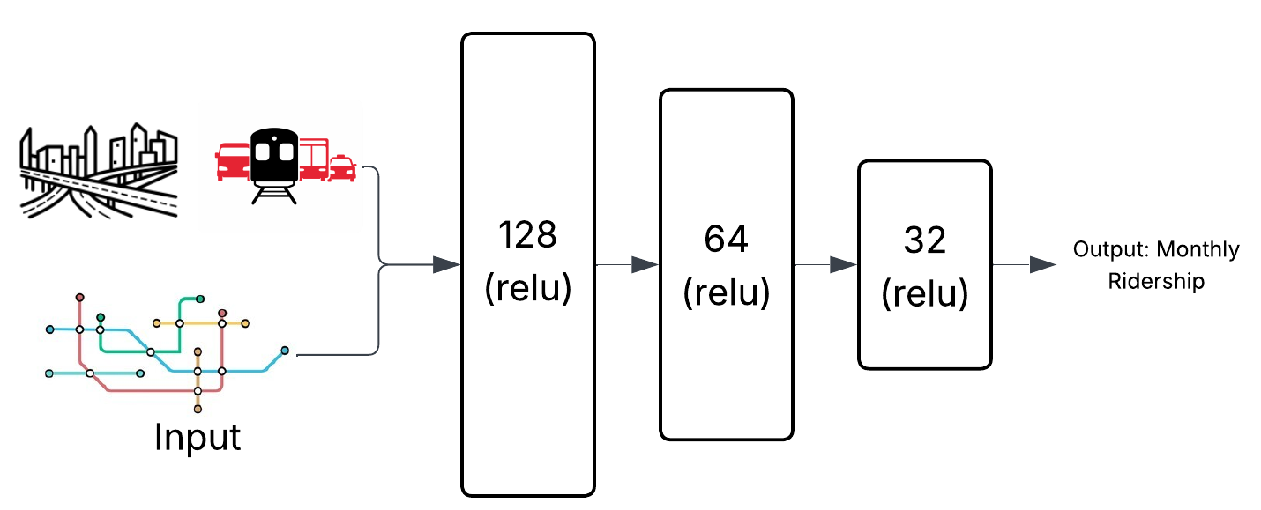


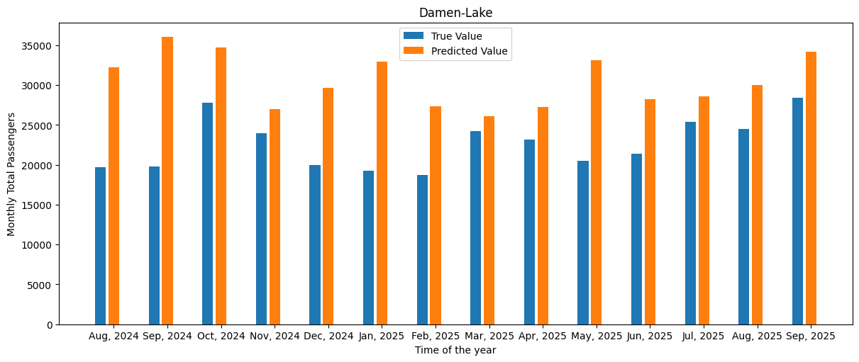

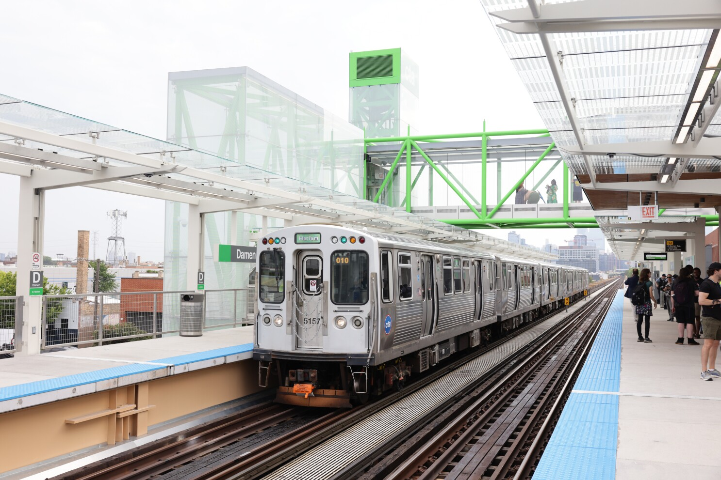

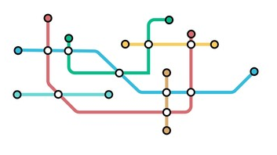
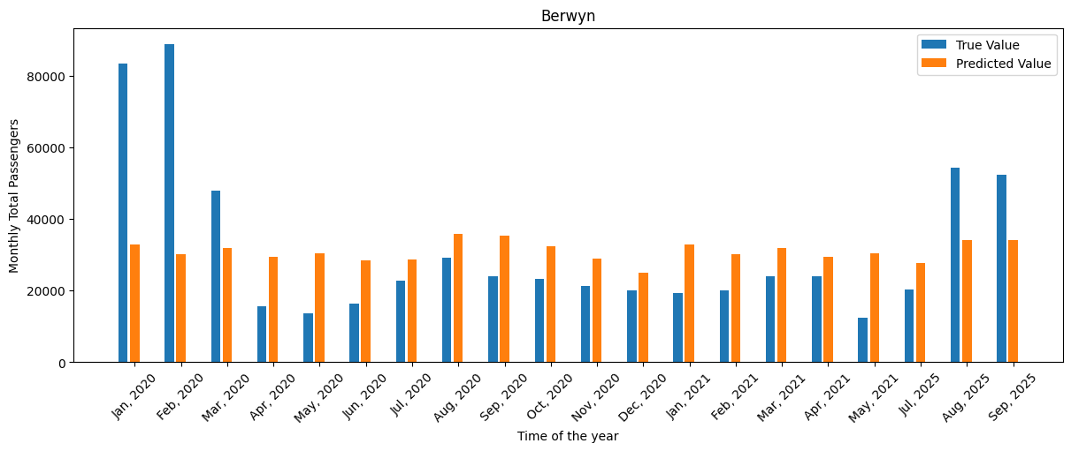
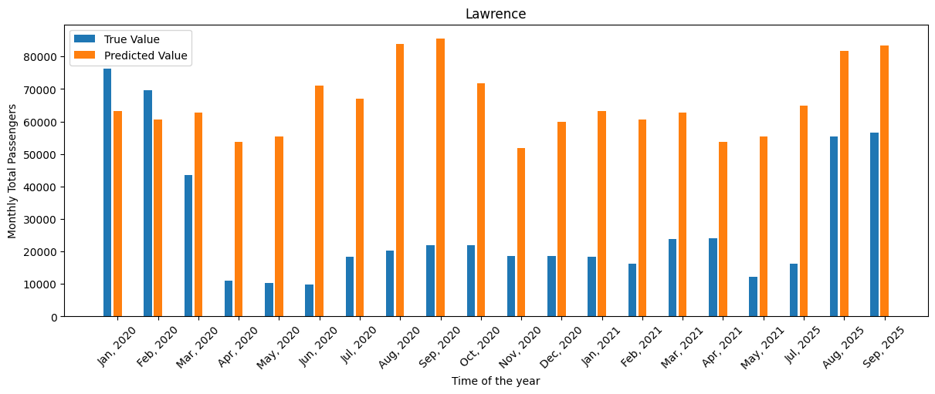
RIDERSHIP PREDICTION FOR EXPANDING METRO NETWORKS
Predicting the Monthly Ridership of a newly created/planned metro station in a city’s metro network using Graphs and Neural Networks.
Model Training
Metro Network Used: Chicago’s L Network
Newly Expanded Stations: Damen (Green line), Berwyn (Red Line) & Lawrence (Red Line)
MLP trained to predict monthly ridership for a station based on these features
Data Sources
Chicago Data Portal: Monthly Ridership, Shapefiles for L stations & Bus stops.
ACS: Population & Housing Data.
Census Bureau: Block Group Shapefiles.
Prediction Results
Damen-Lake (Green Line)
Opened: Aug 2024
Feature Engineering
Multimodal Transport
Bus stops & line counts in a radius 500m across each station
Built Environment
Population Density and Housing Value in a radius 500m across each station
Berwyn (Red Line)
Active till May 2021, Rebuilt and Reopened in Aug 2025
Lawrence (Red Line)
Active till May 2021, Rebuilt and Reopened in Aug 2025
Time-Varied Network Features
Time-Based Centrality & Degree based features for the ‘L Network’

