Slide 1

Assignment 1
Building and Installing the Linux Kernel and Developing a
Loadable Kernel Module

Slide 2
Compiling and Installing the Linux Kernel
Why compile your own kernel?
Customization - Tailor the kernel to include only the features and drivers you need.
Optimization - Improve performance by enabling or disabling features based on your hardware.
Testing - Experiment with new features or patches before they are officially released.
Notes:
https://tldp.org/HOWTO/Module-HOWTO/x73.html

Slide 3
Boot Process of a Linux System
Power-On Self-Test (POST)
The system powers on and the BIOS (Basic Input/Output System) or UEFI (Unified Extensible Firmware Interface) firmware performs the POST.
Checks hardware components (CPU, RAM, disk drives).
Initializes system settings and performs basic hardware configuration.
Bootloader Stage
BIOS uses the Master Boot Record (MBR) whereas UEFI uses the EFI System Partition (ESP) to load the bootloader.
Displays boot menu if multiple kernels or OSes are available.
Loads the kernel image into memory.
Passes control to the kernel.
Notes:
https://tldp.org/HOWTO/Module-HOWTO/x73.html

Slide 4
Boot Process of a Linux System
3. Kernel Initialization
The bootloader loads the Linux kernel from disk into memory.
The kernel initializes hardware and mounts the root filesystem.
Initial RAM Filesystem (initramfs):
A temporary root filesystem loaded into RAM.
Contains necessary drivers and tools to prepare the actual root filesystem.
Used for tasks such as detecting hardware, decrypting disks, and setting up filesystems.
Mounted by the kernel as the initial root filesystem before switching to the real root filesystem.
4. Init System Initialization
The kernel switches from initramfs to the real root filesystem (e.g., /).
The kernel executes the init process, which is the first user-space process (PID 1).
The init system starts system services and daemons as specified in configuration files.
Notes:
https://tldp.org/HOWTO/Module-HOWTO/x73.html

Slide 5
Compiling and Installing the Kernel
Get the kernel image and install dependencies
Download the kernel image from https://www.kernel.org. Unzip the tarball.
Install the required dependencies for compilation sudo apt-get update
sudo apt-get install build-essential libncurses-dev bison flex libssl-dev
Configure the kernel
make menuconfig
Compile
make -j <no. of threads>
Install
make modules_install -j <no. of threads>
make install -j <no. of threads>
To check the kernel version you are using you can use
uname -r
If on rebooting the system does not boot into the new kernel, load into grub and manually choose the kernel
Notes:
https://tldp.org/HOWTO/Module-HOWTO/x73.html

Slide 6
Base Kernel Module vs Loadable Kernel Module
You often have a choice between putting a module into the kernel by loading it as a Loadable Kernel Module (LKM) or binding it into the base kernel.
You can add code to the Linux kernel while it is running
Called a loadable kernel module.
With LKM, you don't have to rebuild your kernel.
Sometimes it is important to build modules into the base kernel instead of making it an LKM.
Anything that is necessary to get the system up must obviously be built into the base kernel.
For example, the driver for the disk drive that contains the root filesystem must be built into the base kernel.
Notes:
https://tldp.org/HOWTO/Module-HOWTO/x73.html

Slide 7
What is LKM?
A loadable kernel module (LKM) is an object file that contains code to extend the running kernel, or so-called base kernel, of an operating system.
LKM's are critical to the Linux administrator as they provide them the capability to add functionality to the kernel without having to recompile the kernel.
Examples: Video and other device drivers can be added to the Linux kernel without shutting down the system, recompiling, and rebooting.
Notes:
https://www.hackers-arise.com/post/2017/11/03/linux-for-hackers-part-10-loadable-kernel-modules-lkm

Slide 8
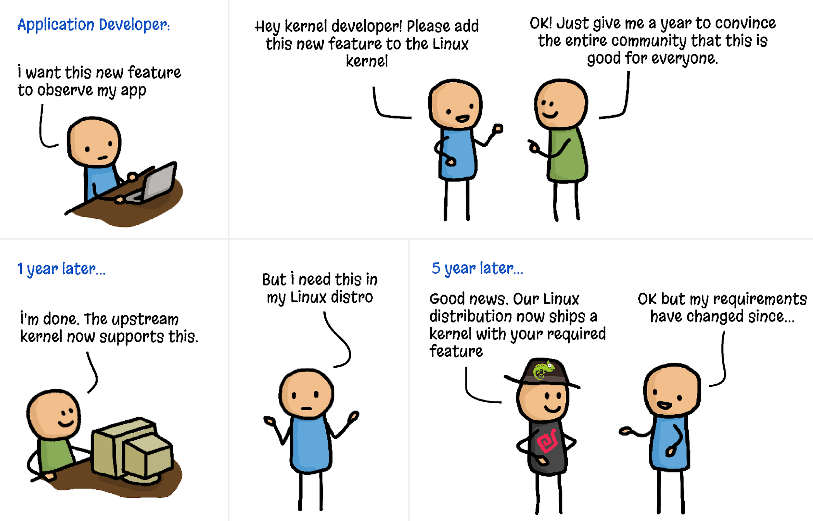
Why LKM?

Slide 9
Evolution of LKM Development?
Early Years (Pre-LKMs)
Emergence of LKM
Linux Kernel 1.2 (1995)
(Introduced the "insmod”)
Linux Kernel 2.2 (1999)
("modprobe" utility
was introduced)
Continued Evolution
Notes:
Before Loadable Kernel Modules, making changes or adding new functionality to the Linux kernel required modifying the kernel source code and recompiling the entire kernel. This process was time-consuming and posed a risk of introducing bugs into the core of the operating system.
The concept of Loadable Kernel Modules emerged as a solution to the limitations of the monolithic kernel architecture. This architecture treats the entire kernel as a single binary and loads it into memory during system boot. LKMs were designed to enable the loading and unloading of specific pieces of code (modules) into the running kernel, allowing for dynamic extension of kernel functionality.
LKMs started gaining prominence in the Linux ecosystem with the release of Linux Kernel 1.2. This version introduced the "insmod" command for loading modules, marking a significant step toward modularizing the Linux kernel. However, the process was still relatively complex, involving manual configuration and sometimes requiring recompilation of parts of the kernel.
The development of Loadable Kernel Modules continued, and by the time Linux Kernel 2.2 was released, the infrastructure for managing modules had improved significantly. The "modprobe" utility was introduced, which automatically resolved dependencies and loaded modules along with their required components. This made module management more user-friendly.
Subsequent kernel releases further refined the LKM system. By allowing modules to be loaded and unloaded as needed, developers could build and test new drivers, filesystems, and other kernel components more easily. The community continued to create a wide variety of LKMs, ranging from device drivers to security modules. Today, the development of Loadable Kernel Modules is an integral part of the Linux kernel ecosystem. The kernel provides a set of APIs and tools that developers can use to build and test their modules. The community places a strong emphasis on maintaining module compatibility across kernel versions, which ensures that modules developed for one version of the kernel can be used with subsequent versions with minimal modifications.

Slide 10
Use Cases
These modules can help in different ways --
Device drivers - The kernel uses it to communicate with that piece of hardware without having to know any details of how the hardware works.
Filesystem drivers - A filesystem driver interprets the contents of a filesystem as files and directories and such.
System calls - Most system calls are built into the base kernel. But you can invent a system call of your own and install it as an LKM. Or you can override an existing system call with an LKM of your own.
Network drivers - A network driver interprets a network protocol.
Notes:
https://www.hackers-arise.com/post/2017/11/03/linux-for-hackers-part-10-loadable-kernel-modules-lkm

Slide 11
Linux Device Drivers – as a LKM
Most of the Linux Device drivers are available as LKM. But Why as LKM?
Device drivers are set of API sub-routines interface to hardware. It mainly abstracts the implementation of hardware-specific details from a user program.
Another important aspect is that every Device is a special file in all Unix like systems i.e. Typically a user/user-program can access the device via file name in /dev , e.g. /dev/dv1.
We have more than 70% of Linux kernel code specific to device drivers for thousands of devices.
Only very few of these devices are needed at any point of time in running instance.
As memory is costly and having all of them at once and having drivers of devices, which are useless is just a waste of memory.
Hence, implementation of device drivers as LKM makes sense.

Slide 12
LKM Utilities
The following is the list of basic LKM commands (utilities)
Utility | Description
insmod | Insert a LKM into the kernel
rmmod | Remove a LKM from the kernel
depmod | Lists dependencies between LKMs
ksyms | Lists symbols that are exported by the kernel for use by given LKMs
lsmod | Lists currently loaded LKMs
modinfo | Display contents of .modinfo section in an LKM object file
modprobe | Loads given module after loading/unloads modules required for the given module. For example, if you must load A before loading B, ‘modprobe’ will automatically load A when you tell it to load B

Slide 13
How to Write a LKM?
Special programs and have structures entirely different from user program.
They don’t have main functions but must have at-least 2 functions init_XXXXXX() and cleanup_XXXXXX() — here XXXXXX represent the module name.
Notes:
https://medium.com/@arunk2/loadable-kernel-modules-and-device-drivers-3c4056b36c53

Slide 14
Loadable Kernel Modules
int init_modulename (void) { /*initialition code*/ }
void cleanup_modulename (void) { /*cleanup code*/ }
These functions will match the following LKM Utilities, while they are plugged into kernel:
insmod: Insert an LKM into the kernel.
rmmod: Remove an LKM from the kernel.
Notes:
https://medium.com/@arunk2/loadable-kernel-modules-and-device-drivers-3c4056b36c53

Slide 15
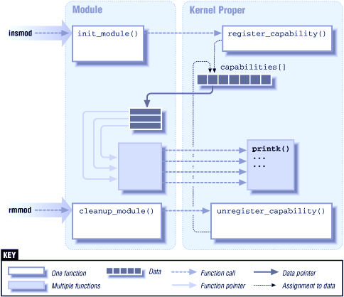
LKM Architecture
init_module():
Executed during loading.
It supposed to initialize the module and register capabilities.
It informs kernel that it is there and it can do this task.
cleanup_module():
Need to free up allocated memory and resources.
It informs kernel that it is no longer there.
module_init() & module_exit():
Allow any name for initialization and cleanup function.
Notes:
https://www.hackers-arise.com/post/2017/11/03/linux-for-hackers-part-10-loadable-kernel-modules-lkm

Slide 16
Cautions
No libc modules. Invoke a function only if it is available in the kernel.
Use static function to avoid namespace pollution.
Be careful about kernel space and user space.
Concurrency in the kernel!!
Notes:
https://www.hackers-arise.com/post/2017/11/03/linux-for-hackers-part-10-loadable-kernel-modules-lkm

Slide 17
Building and Running Modules
Note: Vendor kernels can be heavily patched and divergent from the mainline; at times, vendor patches can change the kernel API as seen by device drivers.
If you are writing a driver that must work on a particular distribution, you will certainly want to build and test against the relevant kernels
Warning: Faults in kernel code can bring about the demise of a user process or, occasionally, the entire system.
They do not normally create more serious problems, such as disk corruption.
Nonetheless, it is advisable to do your kernel experimentation on a system that does not contain data that you cannot afford to lose, and that does not perform essential services.
Notes:
https://www.hackers-arise.com/post/2017/11/03/linux-for-hackers-part-10-loadable-kernel-modules-lkm

Slide 18
The Hello World Module – hello.c
A special macro (MODULE_LICENSE) is used to tell the kernel that this module bears a free license;
without such a declaration, the kernel complains when the module is loaded.
#include <linux/init.h>
#include <linux/module.h>
MODULE_LICENSE("Dual BSD/GPL");
static int hello_init(void) {
printk(KERN_ALERT "Hello, world\n");
return 0;
}
static void hello_exit(void) {
printk(KERN_ALERT "Goodbye, cruel world\n");
}
module_init(hello_init);
module_exit(hello_exit);
Invoked when the module is loaded into the kernel (hello_init)
Invoked when the module is removed (hello_exit)
module_init & module_exit lines use special kernel macros to indicate the role of these two functions.
Notes:
https://www.hackers-arise.com/post/2017/11/03/linux-for-hackers-part-10-loadable-kernel-modules-lkm

Slide 19
The Hello World Module - hello.c
#include <linux/init.h>
#include <linux/module.h>
MODULE_LICENSE("Dual BSD/GPL");
static int hello_init(void) {
printk(KERN_ALERT "Hello, world\n");
return 0;
}
static void hello_exit(void) {
printk(KERN_ALERT "Goodbye, cruel world\n");
}
module_init(hello_init);
module_exit(hello_exit);
The printk function is defined in the Linux kernel and made available to modules; it behaves similarly to the standard C library function printf.
The kernel needs its own printing function because it runs by itself, without the help of the C library.
The module can call printk because, after insmod has loaded it, the module is linked to the kernel and can access the kernel’s public symbols (functions and variables).
Notes:
https://www.hackers-arise.com/post/2017/11/03/linux-for-hackers-part-10-loadable-kernel-modules-lkm

Slide 20
The Hello World Module – hello.c
#include <linux/init.h>
#include <linux/module.h>
MODULE_LICENSE("Dual BSD/GPL");
static int hello_init(void) {
printk(KERN_ALERT "Hello, world\n");
return 0;
}
static void hello_exit(void) {
printk(KERN_ALERT "Goodbye, cruel world\n");
}
module_init(hello_init);
module_exit(hello_exit);
The string KERN_ALERT is the priority of the message
Notes:
https://www.hackers-arise.com/post/2017/11/03/linux-for-hackers-part-10-loadable-kernel-modules-lkm

Slide 21
Compiling Modules - Makefile
obj-m+=hello.o
all:
make -C /lib/modules/$(shell uname -r)/build/ M=$(shell pwd) modules
clean:
make -C /lib/modules/$(shell uname -r)/build/ M=$(shell pwd) clean
The assignment above (which takes advantage of the extended syntax provided by GNU make) states that there is one module to be built from the object file hello.o.
The resulting module is named hello.ko after being built from the object file.
-C : Changing to the kernel source directory
M: Location of external module sources informs kernel an external module is being built
uname –r: version of currently running kernel
Notes:
https://www.hackers-arise.com/post/2017/11/03/linux-for-hackers-part-10-loadable-kernel-modules-lkm

Slide 22
Testing the Module – Loading and Unloading
% make
make[1]: Entering directory `/usr/src/linux-x.y.z’
CC [M] /home/ldd3/src/misc-modules/hello.o
Building modules, stage 2.
MODPOST
CC /home/ldd3/src/misc-modules/hello.mod.o
LD [M] /home/ldd3/src/misc-modules/hello.ko
make[1]: Leaving directory `/usr/src/linux-x.y.z’
% su
root# insmod ./hello.ko
root# dmesg
Hello, world
root# rmmod hello
root# dmesg
Goodbye cruel world
Note: Only the superuser can load and unload a module.
Notes:
https://www.hackers-arise.com/post/2017/11/03/linux-for-hackers-part-10-loadable-kernel-modules-lkm

Slide 23
Configuration – for Debian UNIX
Update current packages of the system to the latest version.
$ sudo apt update && sudo apt upgrade –y
2. Download and install the essential packages to compile kernels
$ sudo apt install build-essential libncurses-dev libssl-dev libelf-dev bison flex -y
$ sudo apt install linux-headers-$(uname -r)
3. Compile LKM
$ make

Slide 24
Sending Data to LKM
// Include the header
#include <linux/proc_fs.h>
// Declare global file operation variable
static struct proc_ops file_ops;
// Create a file in /proc file during initialization (don’t forget to check for error)
struct proc_dir_entry *entry = proc_create("hello", 0, NULL, &file_ops);
if(!entry)
return -ENOENT;
// Set write function pointer
file_ops.proc_write = write;
// Define the write function
static ssize_t write(struct file *file, const char *buf, size_t count, loff_t *pos) {
printk("%.*s", count, buf); return count;
}
// Remove the file in /proc during exit
remove_proc_entry("hello", NULL);

Slide 25
Getting Data to LKM
// Add required header file
#include <linux/uaccess.h>
// Add global variable to store incoming data
static char buffer[256] = {0};
static int buffer_len = 0;
// Update write function to store incoming data
if(!buf || !count)
return -EINVAL;
if(copy_from_user(buffer, buf, count < 256 ? count:256))
return -ENOBUFS;
buffer_len = count < 256 ? count:256;
printk(KERN_INFO "%.*s", (int)count, buf); return buffer_len;
// Add read function to send data to user program
static ssize_t read(struct file *file, char *buf, size_t count, loff_t *pos) {
int ret = buffer_len;
if(!buffer_len)
return 0;
if(!buf || !count)
return -EINVAL;
if(copy_to_user(buf, buffer, buffer_len))
return -ENOBUFS;
printk(KERN_INFO "%.*s", (int)buffer_len, buffer);
buffer_len = 0;
return ret;
}
// Add read function pointer to file_ops
file_ops.proc_read = read;

Slide 26
Further Reading
https://www.iitg.ac.in/asahu/cs421/books/LKM2.6.pdf
https://www.xml.com/ldd/chapter/book/
https://www.oreilly.com/openbook/linuxdrive3/book/
https://www.tldp.org/HOWTO/Module-HOWTO/index.html
https://lasr.cs.ucla.edu/classes/111_fall16/readings/dynamic_modules.html
http://derekmolloy.ie/writing-a-linux-kernel-module-part-1-introduction/
Notes:
https://www.hackers-arise.com/post/2017/11/03/linux-for-hackers-part-10-loadable-kernel-modules-lkm

Slide 27
Command line argument passing to a module
#include <linux/init.h>
#include <linux/kernel.h> /* for ARRAY_SIZE() */
#include <linux/module.h>
#include <linux/moduleparam.h>
#include <linux/printk.h>
#include <linux/stat.h>
MODULE_LICENSE("GPL");
static short int myshort = 1;
static int myint = 420;
static long int mylong = 9999;
static char *mystring = ”hello";
static int myintarray[2] = { 420, 420 };
static int arr_argc = 0;
odule_param(myshort, short, S_IRUSR | S_IWUSR | S_IRGRP | S_IWGRP);
MODULE_PARM_DESC(myshort, "A short integer");
module_param(myint, int, S_IRUSR | S_IWUSR | S_IRGRP | S_IROTH);
MODULE_PARM_DESC(myint, "An integer");
module_param(mylong, long, S_IRUSR);
MODULE_PARM_DESC(mylong, "A long integer");
module_param(mystring, charp, 0000);
MODULE_PARM_DESC(mystring, "A character string");
module_param_array(myintarray, int, &arr_argc, 0000);
MODULE_PARM_DESC(myintarray, "An array of integers");
Notes:
https://sysprog21.github.io/lkmpg/#what-is-a-kernel-module

Slide 28
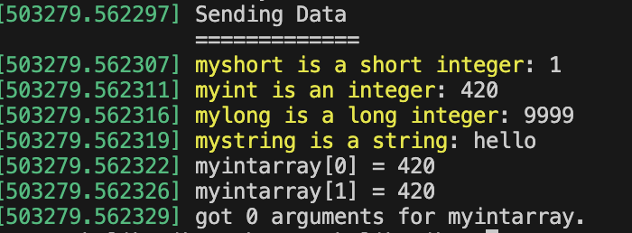
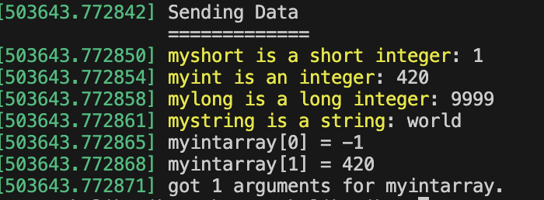
Command line argument passing to a module
static int __init senddata_init(void) {
int i;
pr_info("Sending Data\n=============\n");
pr_info("myshort is a short integer: %hd\n", myshort);
pr_info("myint is an integer: %d\n", myint);
pr_info("mylong is a long integer: %ld\n", mylong);
pr_info("mystring is a string: %s\n", mystring);
for (i = 0; i < ARRAY_SIZE(myintarray); i++)
pr_info("myintarray[%d] = %d\n", i, myintarray[i]);
pr_info("got %d arguments for myintarray.\n", arr_argc);
return 0;
}
static void __exit senddata_exit(void) {
pr_info("Removed senddata module!\n");
}
module_init(senddata_init);
module_exit(senddata_exit);
# insmod senddata.ko
# insmod senddata.ko mystring="world" myintarray=-1
# rmmod ./senddata.ko

Slide 29
Thank You!

