Slide 1
Because we know your needs
EnggMART
Engg
Mart
EnggMart

Slide 2
Problem:
For tools & books student to go through different platforms.
Few students find it difficult to interact in order arrange study materials and help.
Wastage of tools and equipments.
Student find a difficult to evaluate themselves .
Secondary cost becomes more than primary cost.

Slide 3
Solution:
One platform for all engineering material.
A complete digital platform for student to discuss share ideas, needs, problems & solution.
This platform ensures optimum utilisation of engineering tools ,books & lab equipments etc.
Proper evaluation of student through assessment.
Arrangement of study material at reasonable price.

Slide 4
Concept:
We provide an application for all the engineering student where they can sell or buy any type of material of their concerned. We can also provide an individual profile to every student with the help of this they can share their views, ideas. It also contains a chatting platform through which anyone can contact anyone for any help

Slide 5
Why us :
Here you sell & buy engineering materials new or old one.
Along with books we provide useful hand written notes, xerox books.
there is no home delivery convenience in selling & buying that we do.
Platform to enhance your soft skills.
Updated news & novels available

Slide 6
Business aspects :
No. of users
Earnings

Slide 7
Services:
Newsfeed:
a. Post
b. Read
c. Review
Store:
a. Book (Academic + competitive)
b. Tools
Work/job:
a. Coding practice
b. CRT & aptitude practice
c. Apply for job
Sell on EnggMart:
a. Old books
b. Handwritten notes
c. Engineering tools

Slide 8
Services:
Engg Library:
a. Novel
b. Newspaper
c. Current affairs
d. Skill development/personality development books
Chat:
a. Chatting through our plateform
b. File sharing
Profile:
a. Name
b. College Name(year/semester/branch)
c. Address(current/permanent)
d. Upload resume

Slide 9
About us :
- Helping hand
- Services
- Time Saving
- References & latest technology
- Beneficial books
- Kits & schematic supports
- Proven and useful notes

Slide 10
Unique selling Proposition :
What students want to buy?
Student needs, ideas, problems & solution
What students to sell?
WE

Slide 11
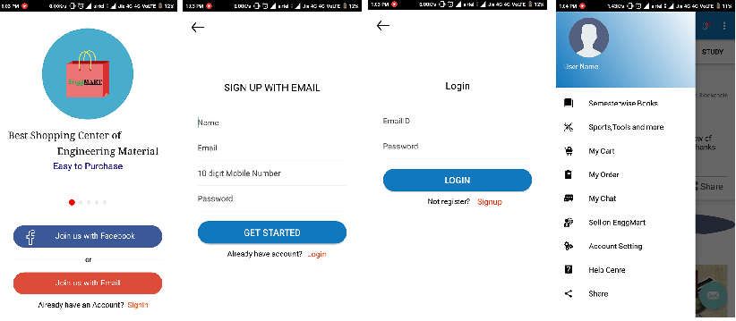
View of Application:

Slide 12
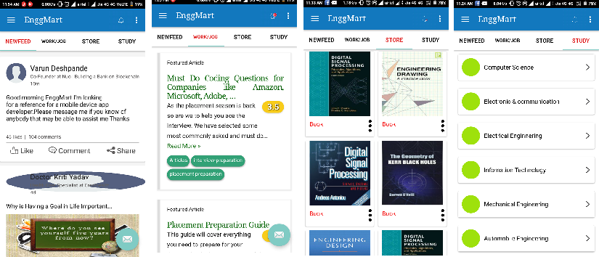
View of Application:

Slide 13
Thank you

