Slide 1
BLOCK-CERTIFY

Slide 2
INTRODUCTION
Authentication and distribution of certificates is a growing problem in the digital world. This is a problem for both employers as many graduates lie on their CVs, and a problem for the average person with costly and inconvenient certificates. By utilising the Ethereum blockchain we hope to provide a more convenient & permanent, software solution to this growing issue.

Slide 3
WHAT IT DOES ?
Our solution has two major components: the backend of smart contracts on the Ethrereum blockchain for storing the certificates and a web app based on flask which allowing for easy verification.

Slide 4
FUNCTIONING
Every user and certificate issuing organizations have a permanent address on Ethereum block-chain.
The user gets certificates on his Ethereum address while organizations issues certificates on the name of the Ethereum address.

Slide 5
Certificates can be verified for their authenticity based on the unique identification number issued to the certificate.
Along with this, user can use it as a platform to showcase his certificates and experience.
It is more economical than issuing a physical copy of any certificate (approximately 3.35 INR ).

Slide 6
FUTURE EXPANSIONS
Support can be further extended to android and iOS as it is backed by a RESTful API.
Its use cases can be further extended to verification of other government or non-government issued ID's and licenses.

Slide 7
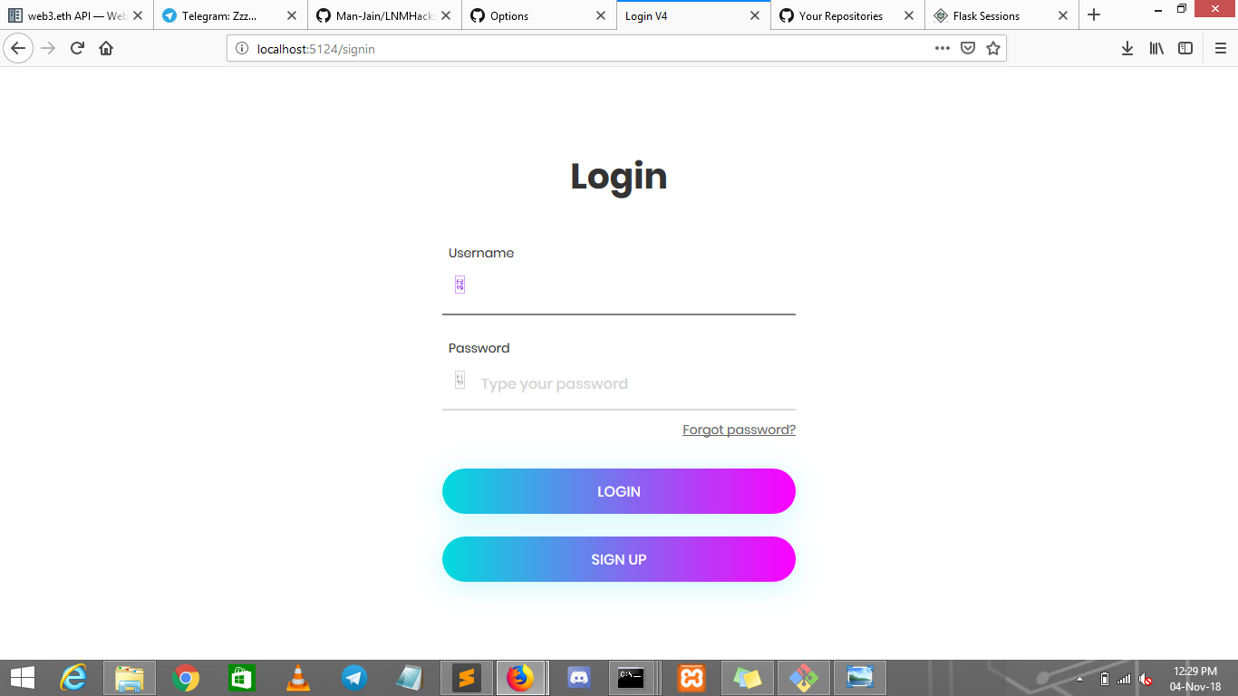

Slide 8
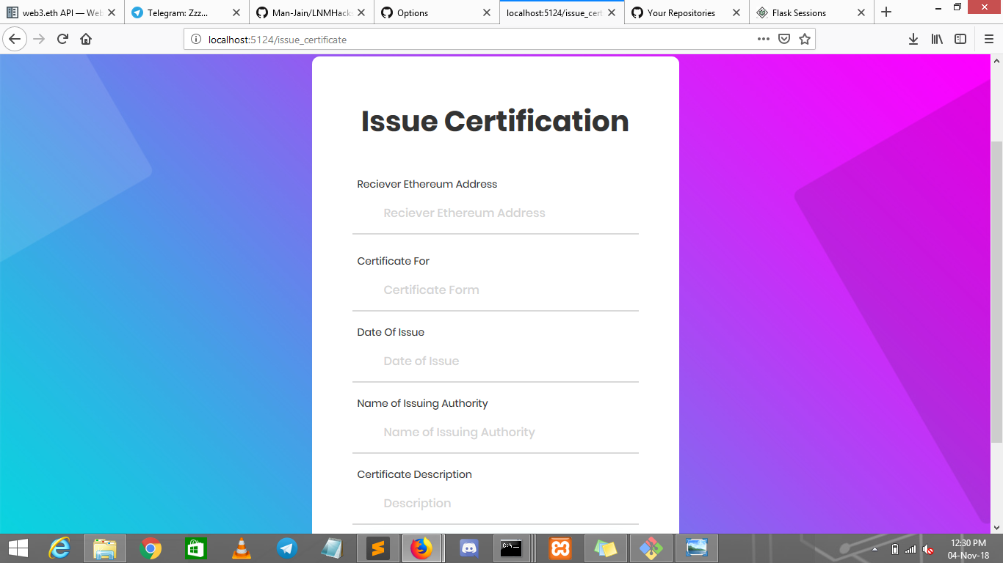

Slide 9
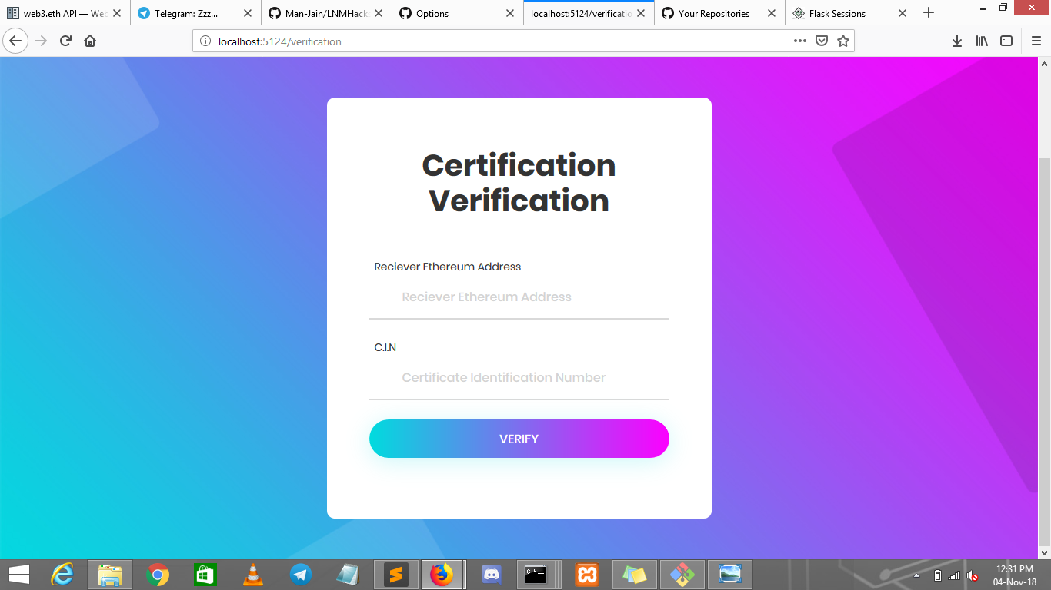

Slide 10
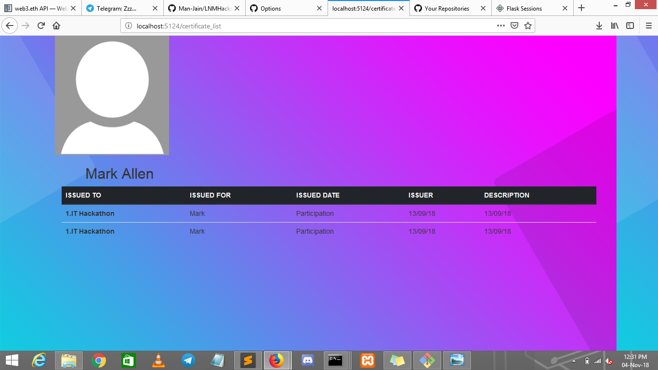

Slide 11
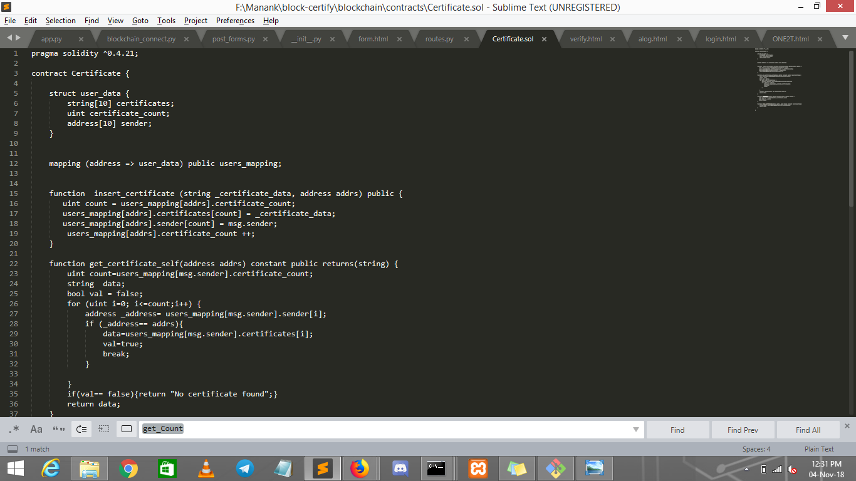

Slide 12
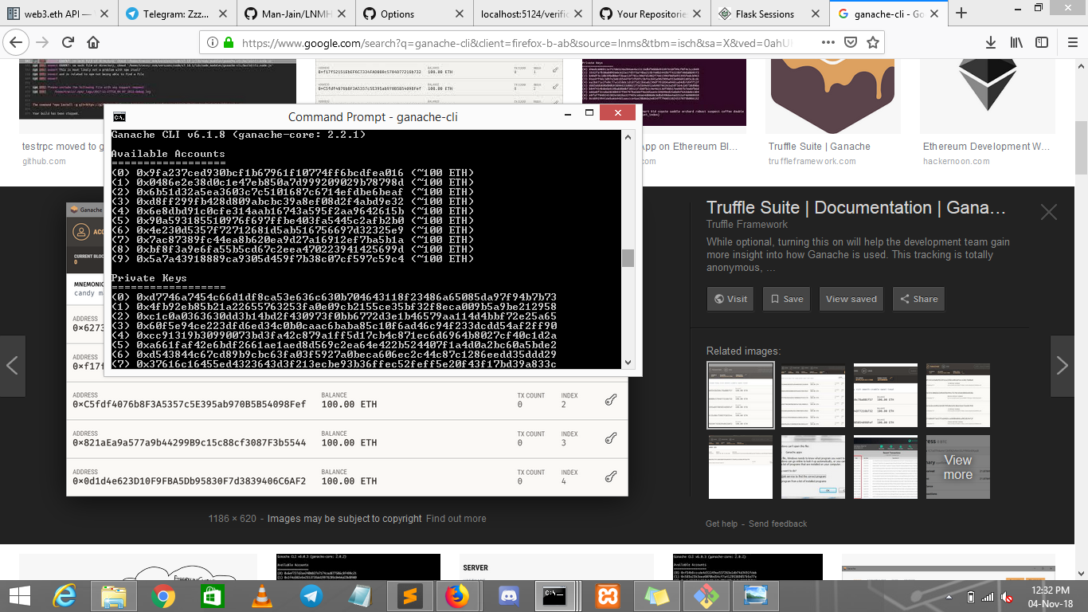

Slide 13
THANKING YOU
-THE STRAWHATS

