Slide 1
*Hack_Overflow* PRODUCT:- SPECULO
OUR TEAM MEMBERS:
ROBIN SINGH
AMITESH ACHARYA
ABHISHEK SONI

Slide 2
PROJECT DESCRIPTION
“SPECULO”(A Latin Name for Mirror) ,This Android application will provide the following Utilities to User:
Acquainting the user with the power of scanning text from anywhere(using the camera) and user can extract the text like website url ,email-Id and copy that text and use as and when required.
This also allows the user to scan the QR Code and Retrive Data and Use it as per Requirement.

Slide 3
A Little Description
This app uses ML-Kit(By Google) for text Detection
Using the phone camera.
In addition to deploying your models, ML-Kit releases an experimental model compression flow that aims to reduce model size.
Works on ML-kit for Firebase for text detection and QR-Code Scanning.

Slide 4
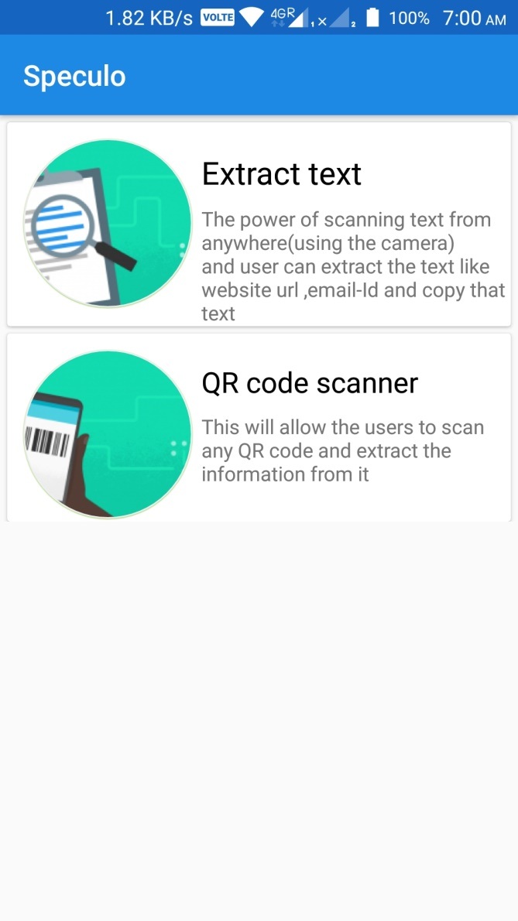
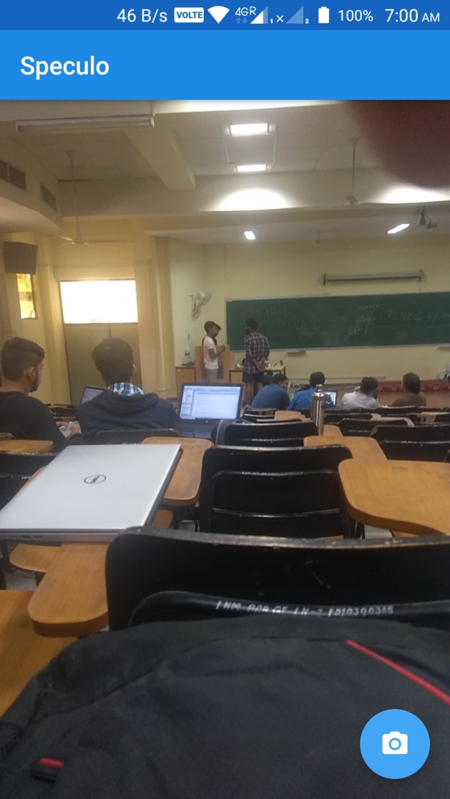
App Screenshots

Slide 5
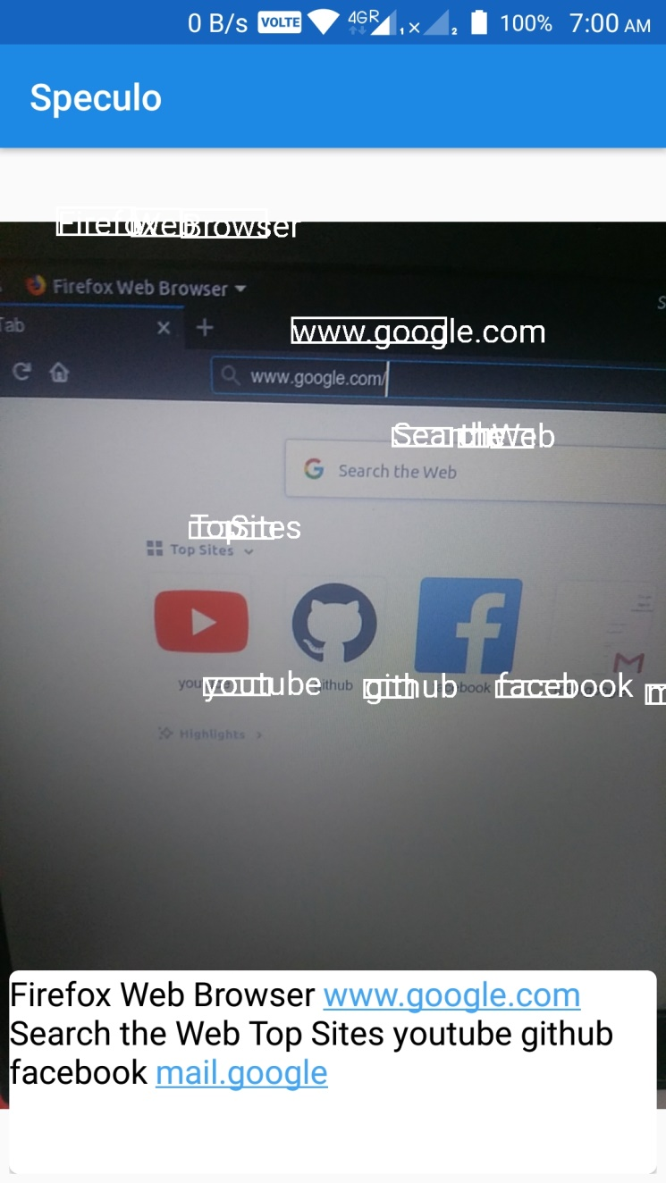
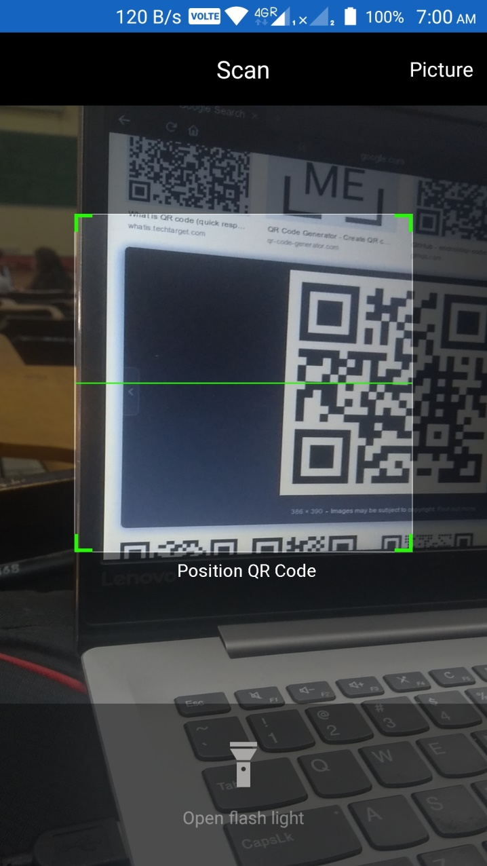
Few more Screenshots

Slide 6
*^END^*

