Slide 1
Movie Recommender
&
TV Series Status

Slide 2
Our project aims to protect every tv series lover from the spoiler.
User will input his/her favourite tv series and their respective mail ids
Email will be send to every user mail id with message providing their tv series status(next episode release date , finished streaming, upcoming season year)
1st use

Slide 3
Our project aims to provide best movie recommendations according their genre(based on movie ratings on imdb)
User will input his/her choice of genres and their respective mail ids
Email will be send to every user mail id with message providing top five movie recommendations for each genre provided
2nd use

Slide 4
Getting Started
Dependencies
1. Make sure these libraries are installed in your system
Libraries:
smtplib
urllib
bs4 ( BeautifulSoup)
datetime
Mysql.connector
Installation
Installing dependencies:
sudo apt-get install python3-mysql.connector
sudo apt-get install python3-bs4

Slide 5
Enter your Credentials at config.py code.
EmailAddress="Your_Email_Address"
Enter your email address through which you want to email all the users
Password="Your_Password"
Enter Password of your email addres​ s

Slide 6
Enter host name, username and password of your mysql
​ #Mysql
MysqlHost="Your_Host_Name"
MysqlUser="Your_User_Name"
MysqlPassword="Your_password"
Example:
MysqlHost=”local host”
MysqlUser="Innovaccer"
MysqlPassword="My password"
Your Gmail should allow third party apps(Less secure apps) to send mails.

Slide 7
Usage
Run this code in terminal and enter number of users you want to enter.
Enter user email address
example: sample@gmail.com
Enter tv series information requirement separating with comma
example: Game of thrones, black mirror, da vinci demons, breaking bad

Slide 8
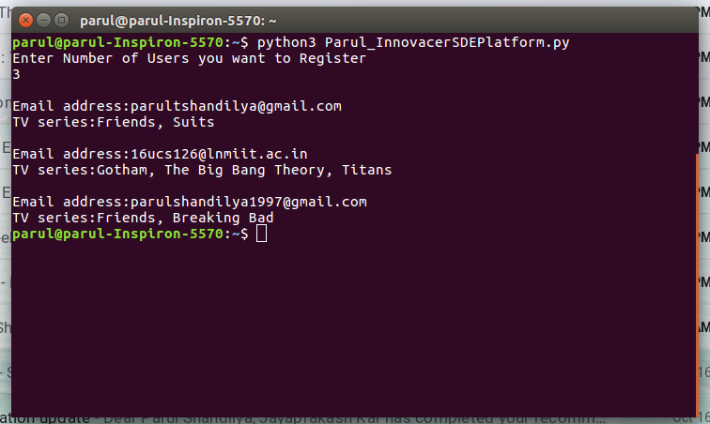
User input favourite tv series

Slide 9
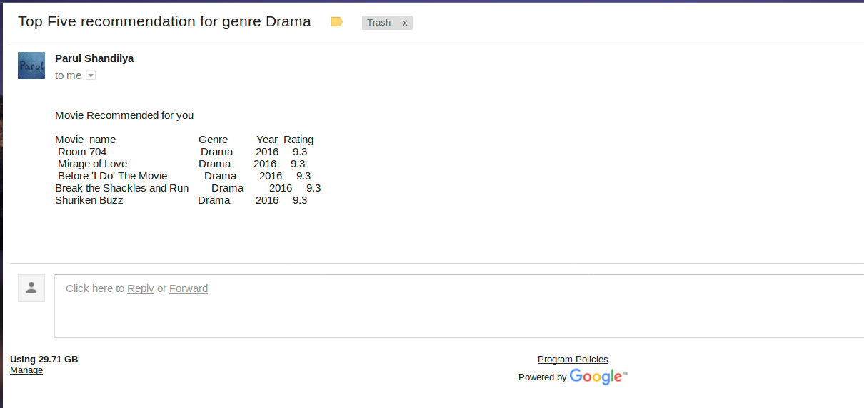
Movie recommendation in mail

Slide 10
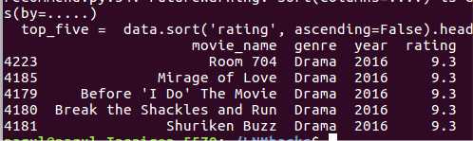
Movie recommending terminal

Slide 11
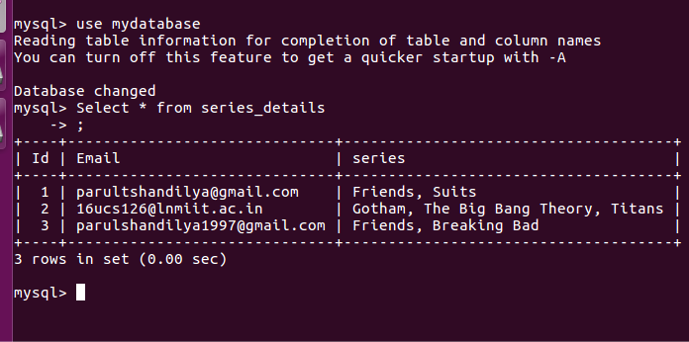
DataBase of TV Series

