Slide 1


EDURES SPREAD YOUR KNOWLEDGE
TEAM – TECHMAGNIFIERS
RISHABH AREN
ASHISH GUPTA
MOHIT JINDAL

Slide 2

TECHNOLOGIES USED
Database
Firebase Database
Language
JAVA
XML
Tools
Android studio
Firebase Console

Slide 3
APPLICATION FLOW

Slide 4
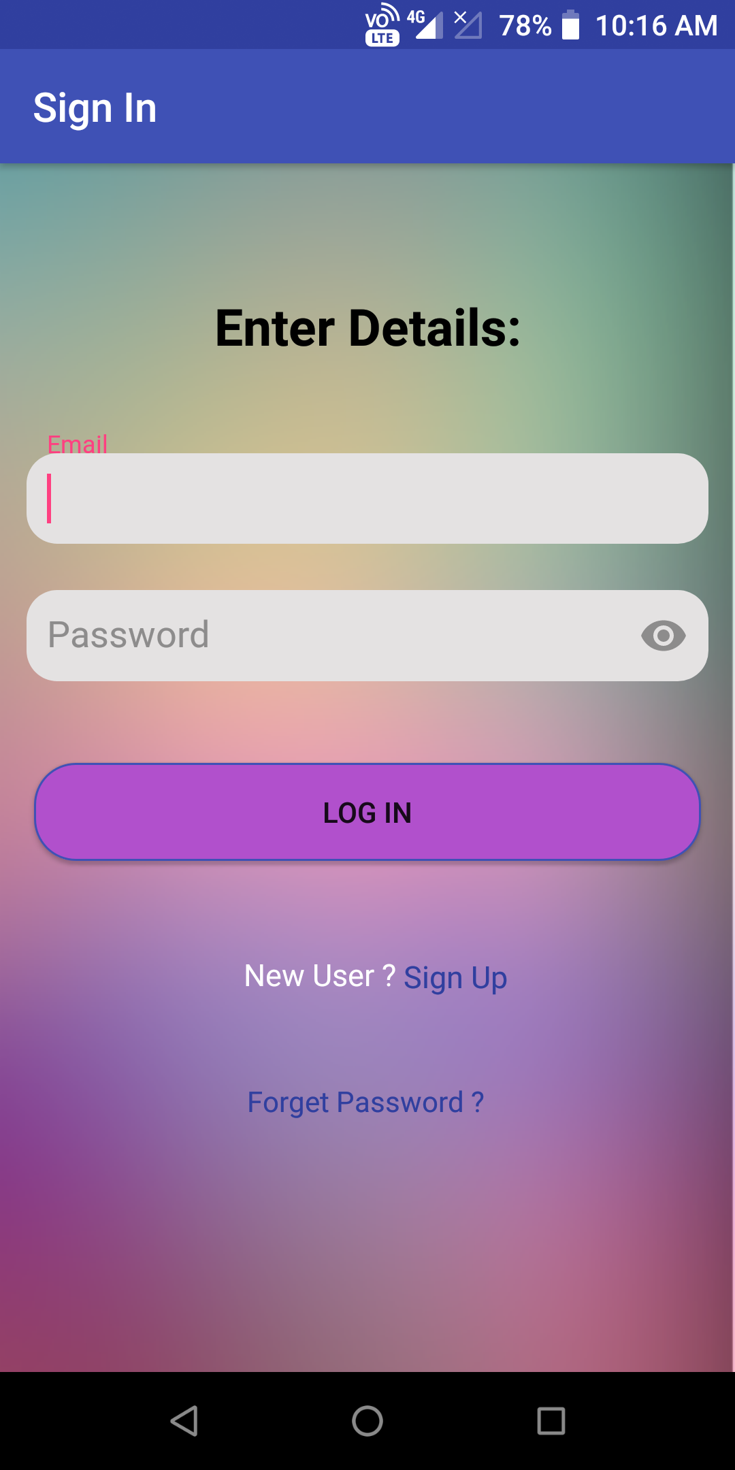
LOGIN PAGE
Login can be done only by registered lnmiit.ac.in domain users
Non registered users can choose for sign up option

Slide 5
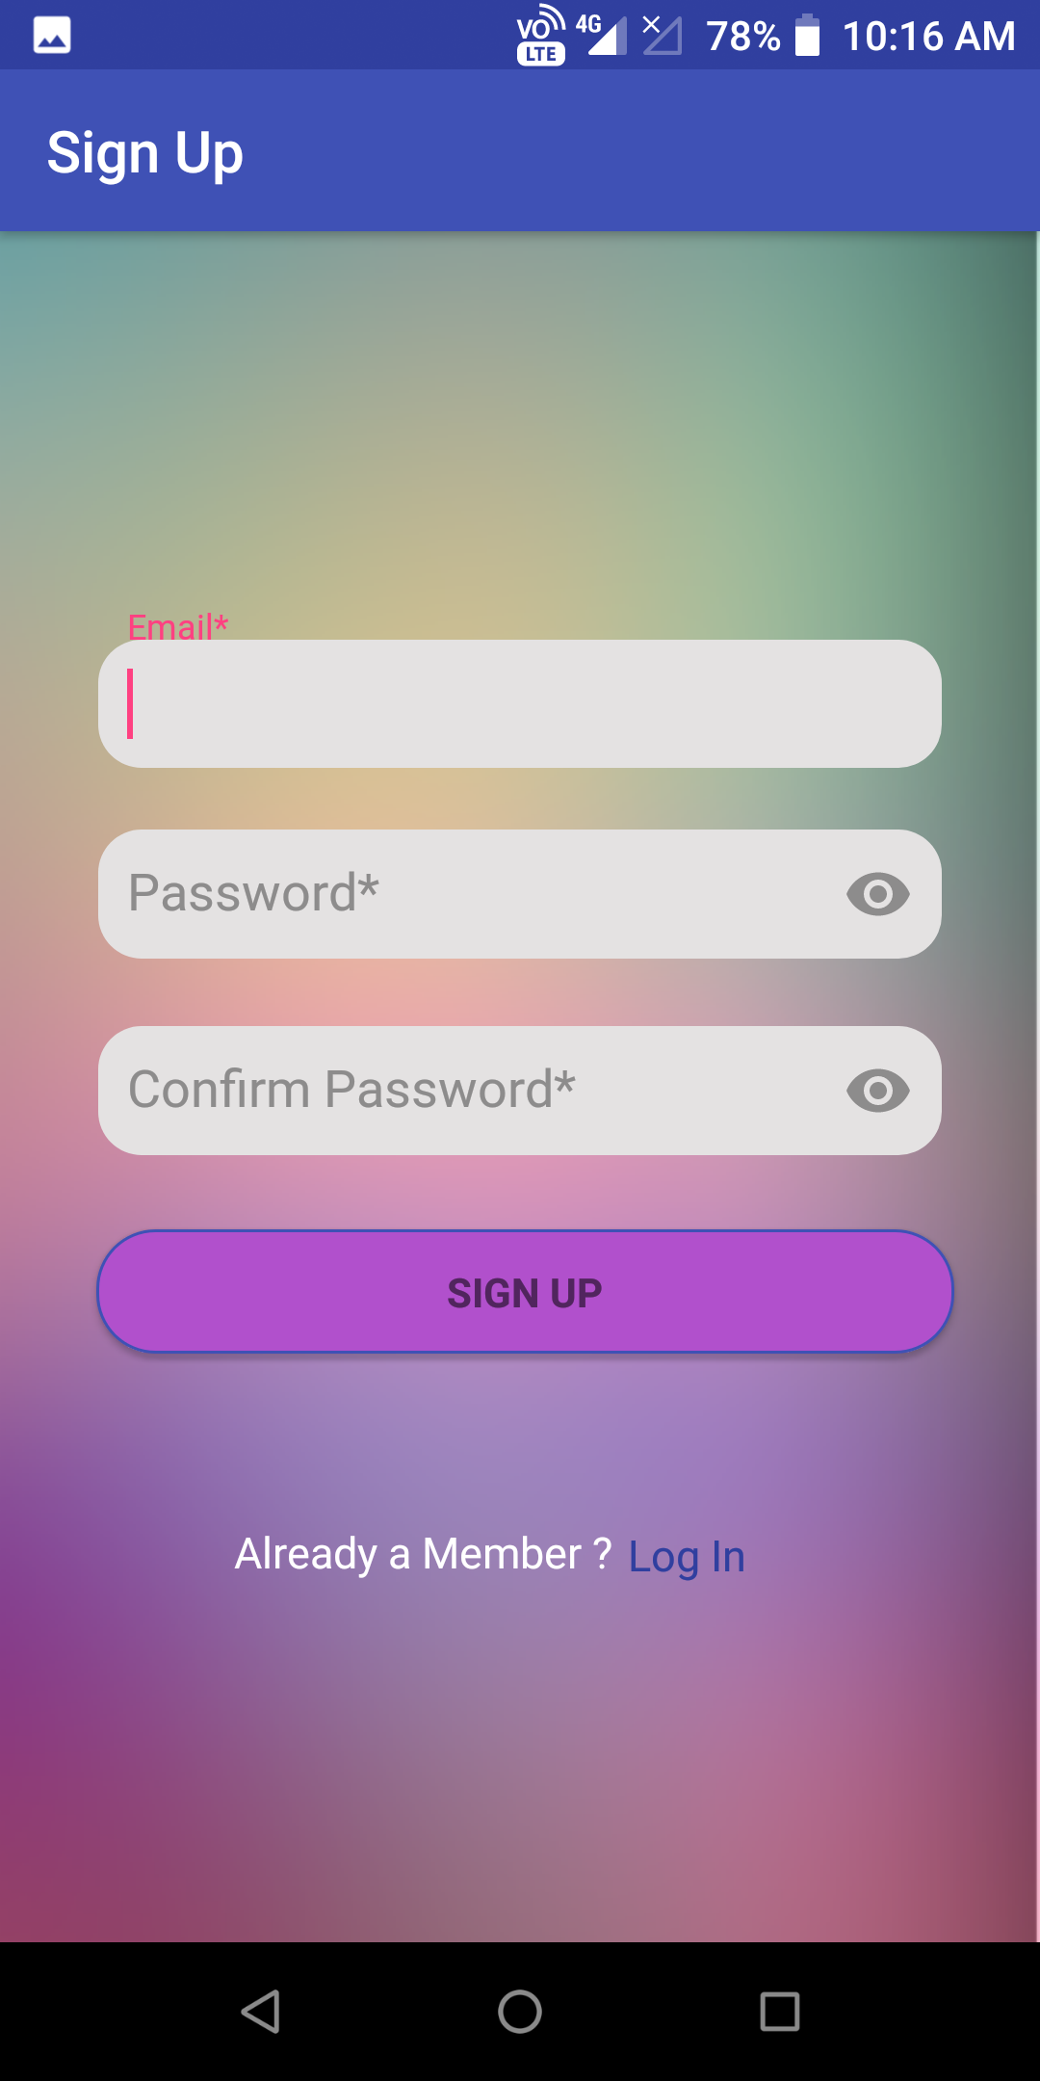
SIGN UP
Exclusive for LNMIIT domain users.

Slide 6
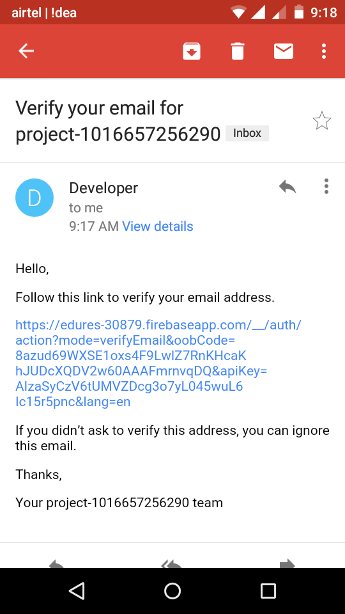
CONFIRMATION MAIL
Confirmation mail received for signing up.

Slide 7
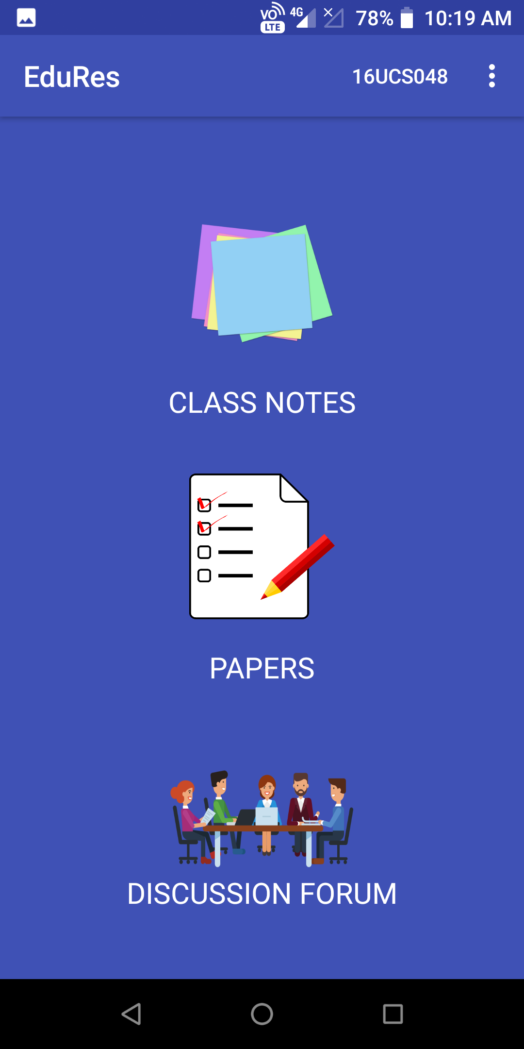
HOME PAGE
Three icons for different purposes.
First icon for opening class notes section
Second icon for opening papers section containing term papers, quizzes and assignments.
Third icon for opening discussion form to see different queries.

Slide 8
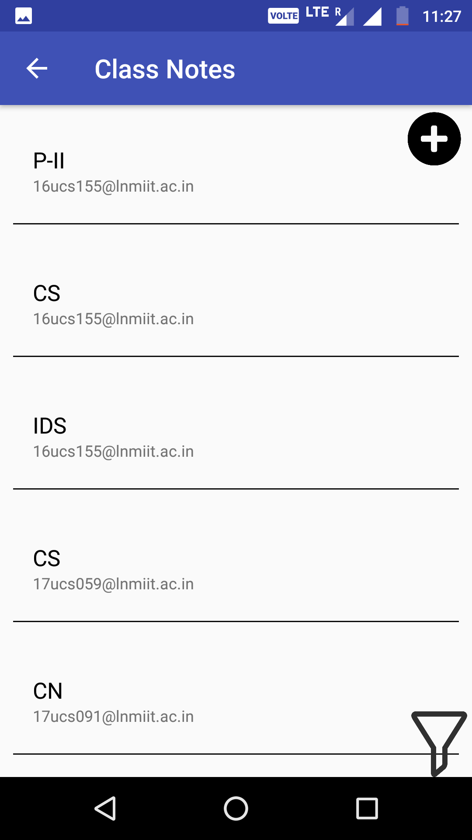
CLASS NOTES PAGE
Shows list of all available class notes.
Filter button at bottom right corner listing only related class notes , opens up a filter dialog.
Upload button at top right corner for uploading a new file , opens up a upload dialog.

Slide 9
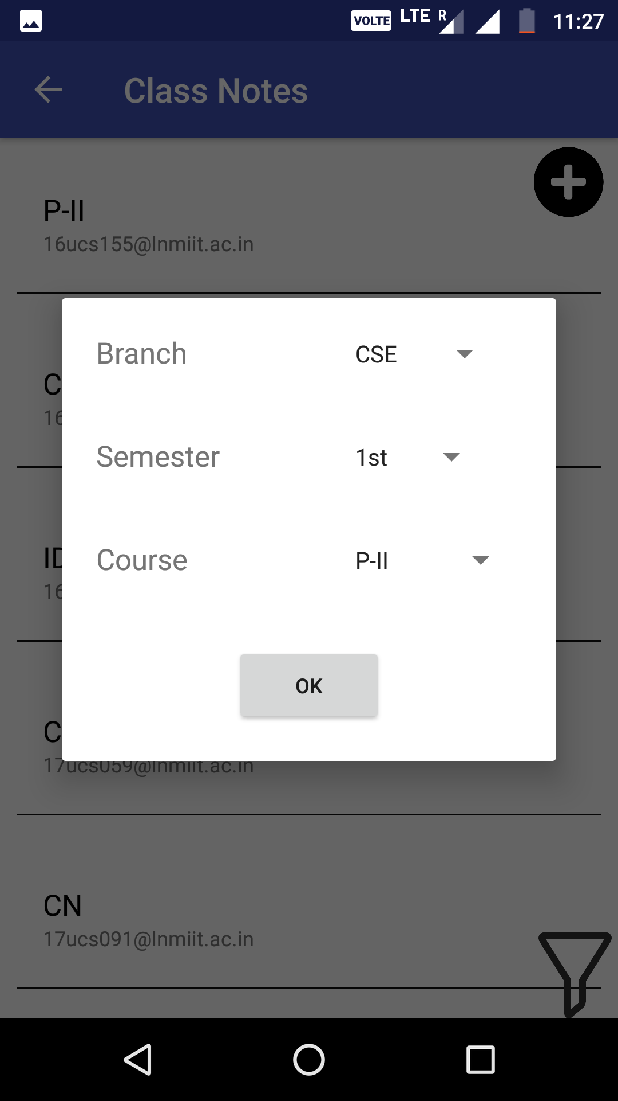
FILTER DIALOG
Three filter options for filtering the list.
First for filtering branch wise.
Second for filtering semester wise.
Third for filtering course specific notes.

Slide 10

UPLOAD DIALOG
Three classification keys
First for specifying the branch of notes belong to.
Second for specifying the semester of course is being taught .
Third for giving the name of course , which notes are of.

Slide 11
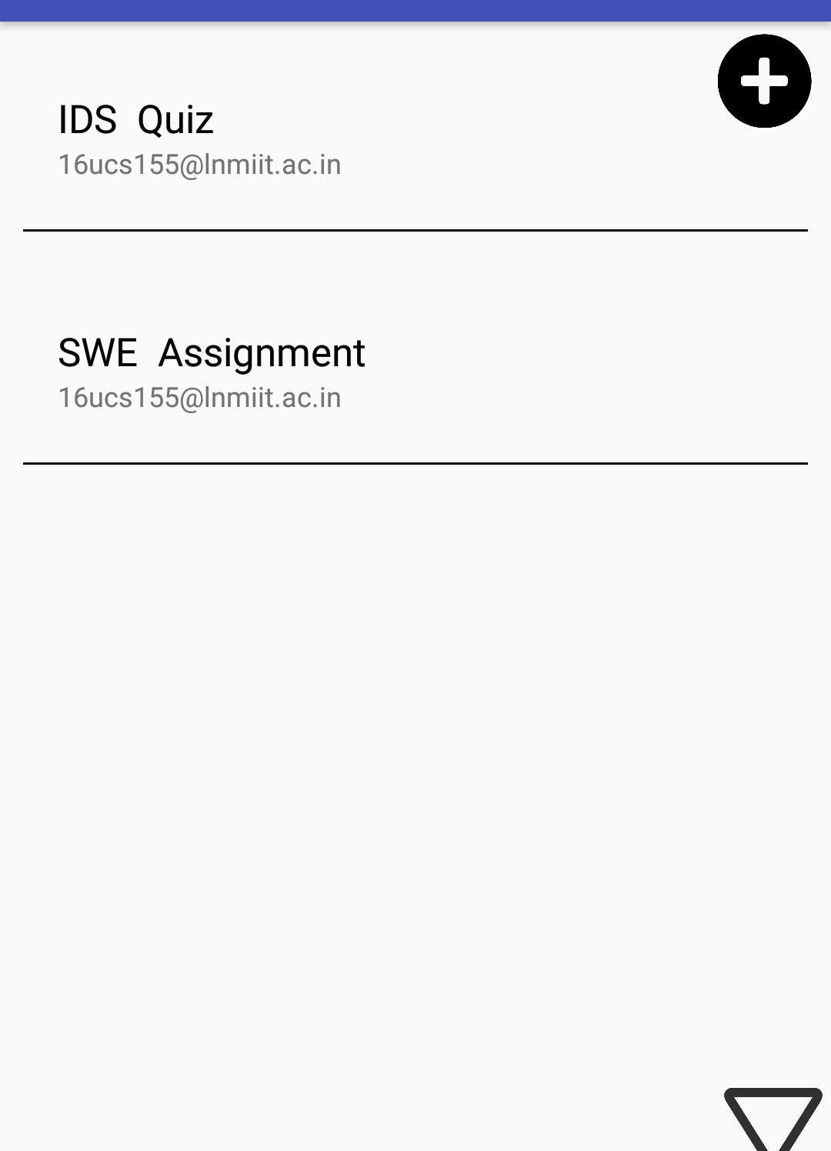
QUESTION PAPERS PAGE
Shows list of all available quizzes, papers and assignments.
Filter button at bottom right corner listing only related papers , opens up a filter dialog.
Upload button at top right corner for uploading a new file , opens up a upload dialog.

Slide 12
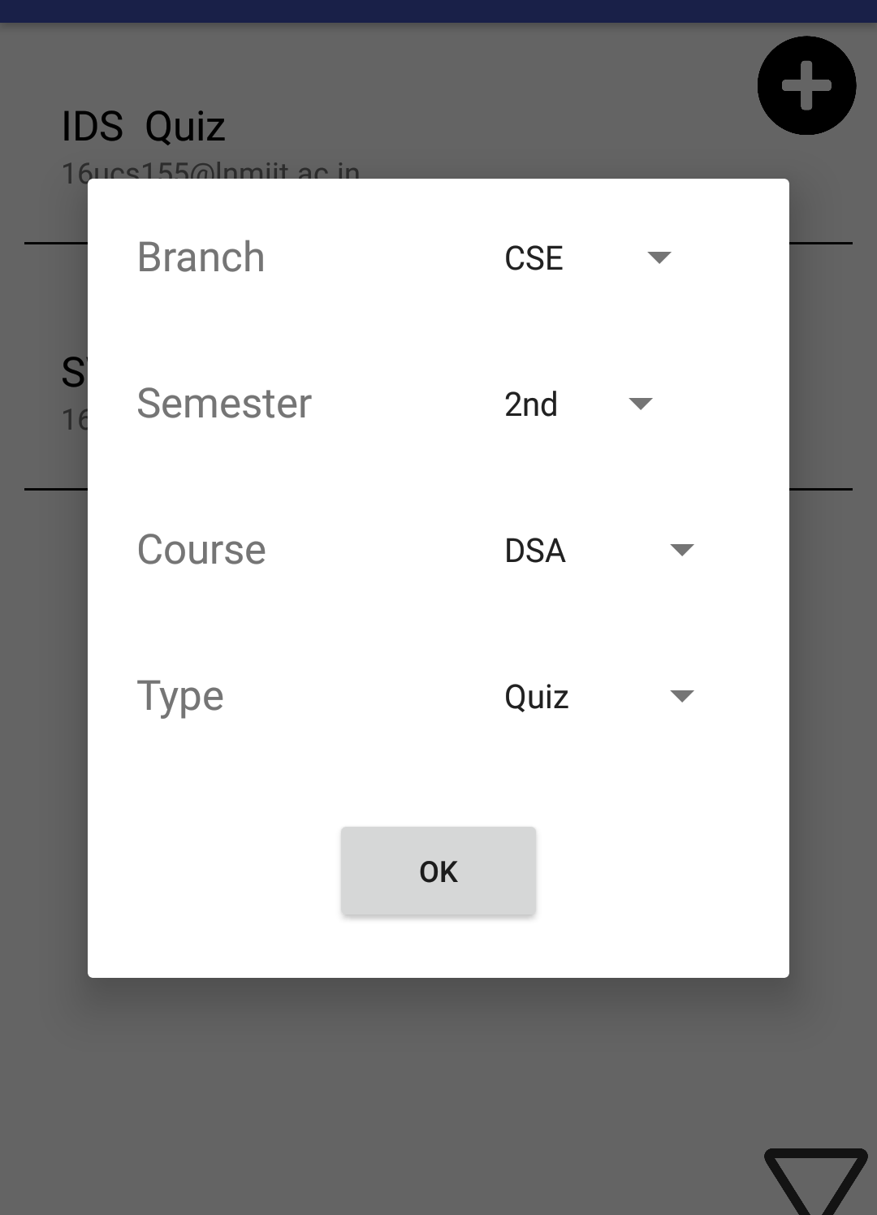
FILTER DIALOG
Four filter options for filtering the list.
First for filtering branch wise.
Second for filtering semester wise.
Third for filtering course specific papers.
Fourth for getting only specific type of papers.

Slide 13

UPLOAD DIALOG
Four classification keys
First for specifying the branch of papers , its belong to.
Second for specifying the semester of course is being taught .
Third for giving the name of course , which paper is of.
Fourth for classifying type of paper.

Slide 14
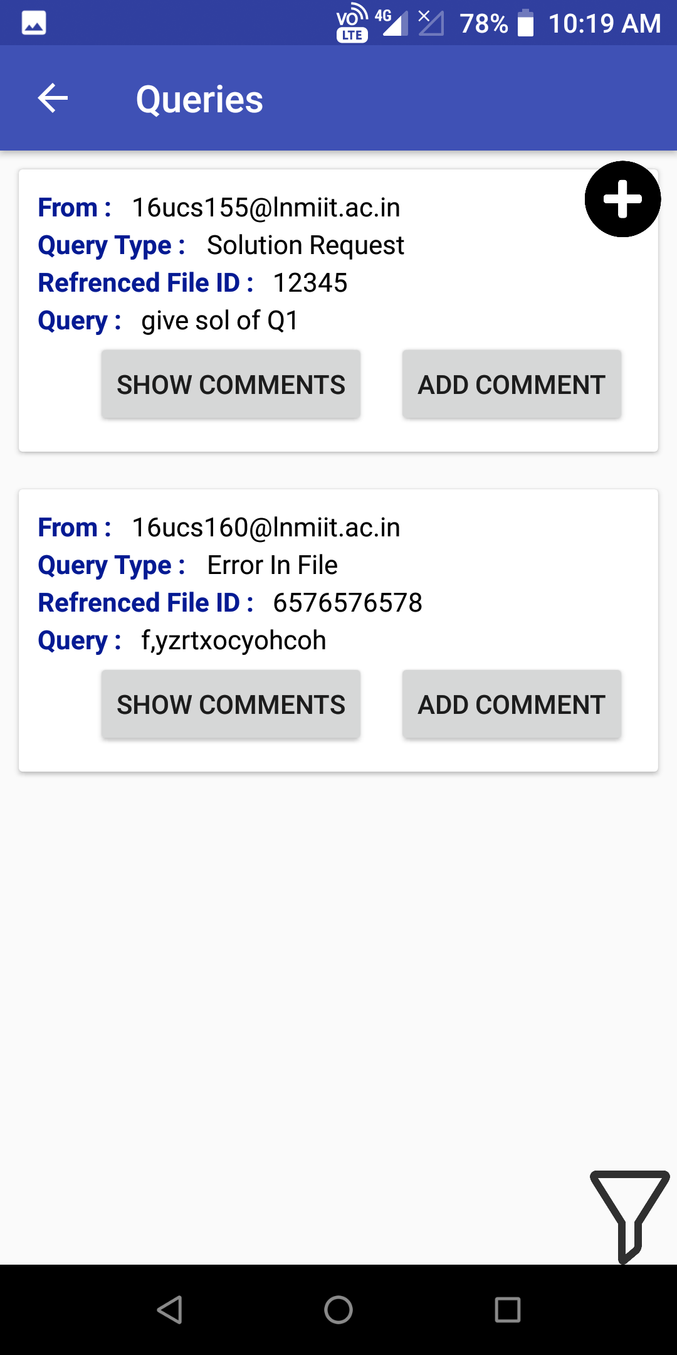
QUERY PAGE
Shows queries asked by users.
Filter button at bottom right corner listing only related queries , opens up a filter dialog.
Plus icon button at top right corner for adding a new query , opens up a dialog.

Slide 15
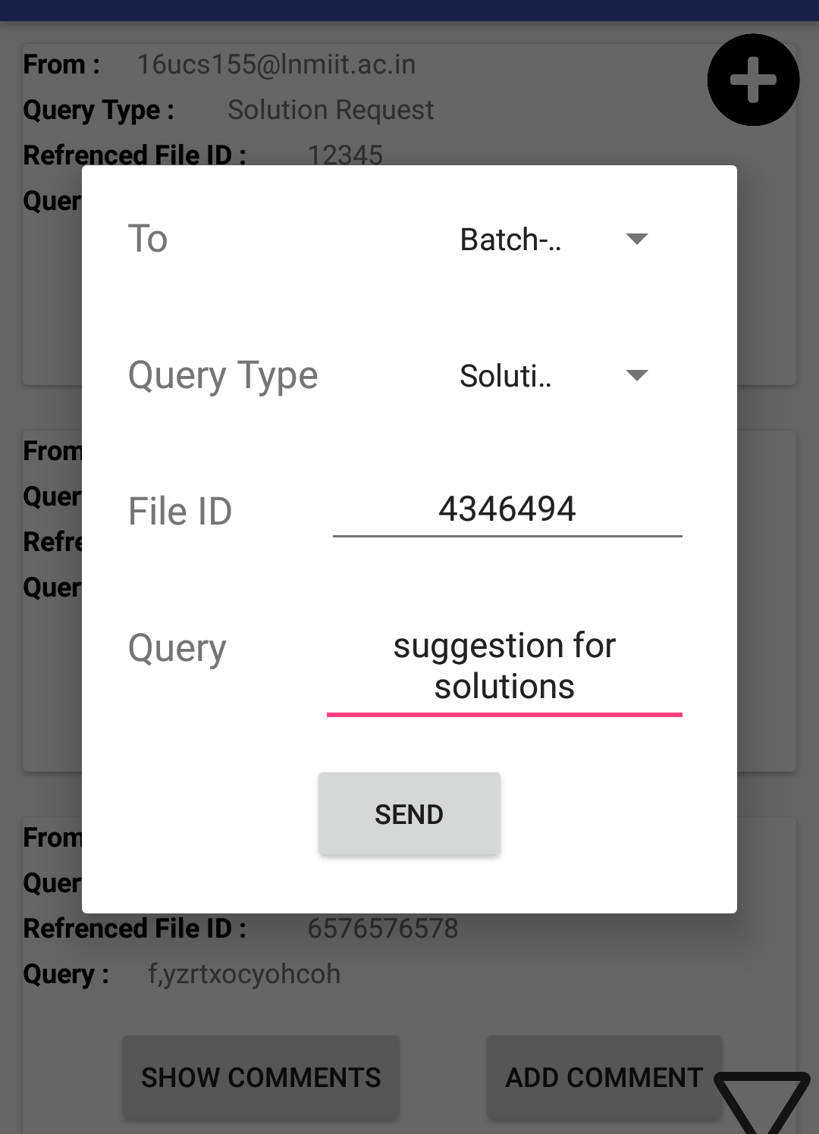
ADDING A QUERY
This dialog have four field.
To whom query is being asked.
Type of query – Solution , Duplicate file, Error in file
File id – Id of file on which user has query.
Description of query.

Slide 16
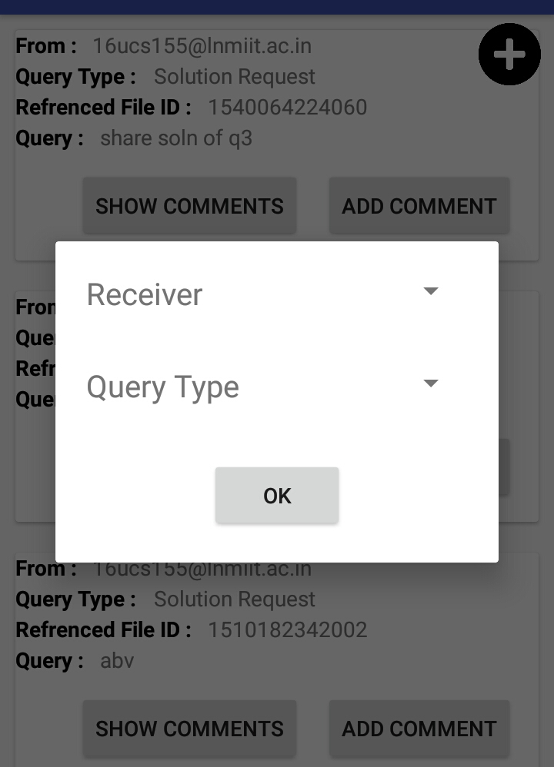
FILTERING QUERIES
Filter dialog show two options.
First to filter on the basis of receiver.
Second to list queries by their type.

Slide 17
ADD COMMENTS
Click on add comment button.
Fill out the necessary details that are required.
Click on post button to add the comment.

Slide 18
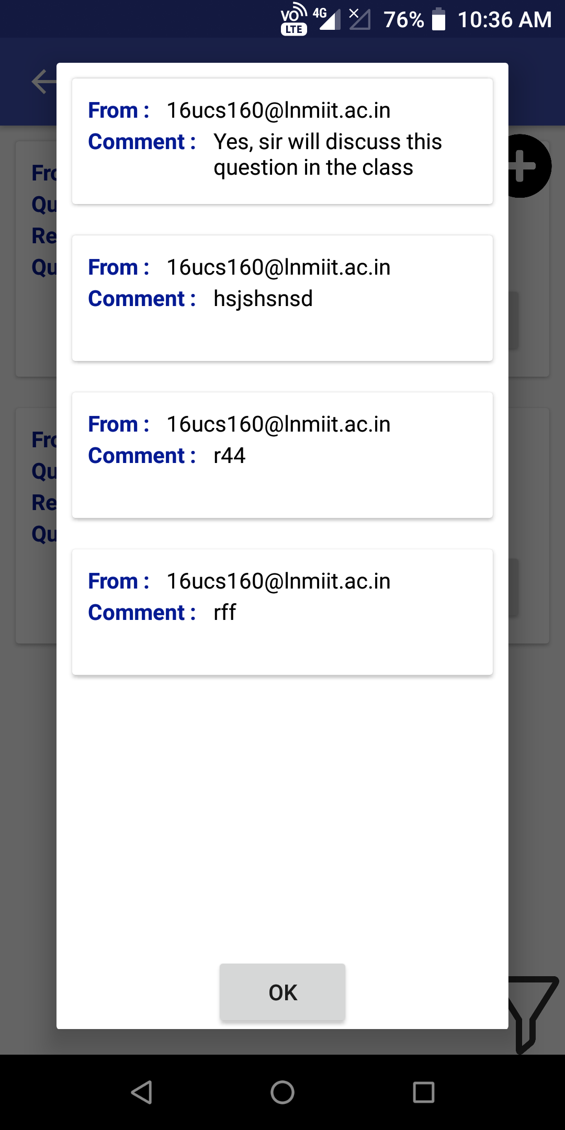
SHOW COMMENT
Click on show comment button.
Comments will be shown in a specific order with some details like senders mail id and the text in comment.

Slide 19
DATABASE AND CLOUD STORAGE

Slide 20
DATABASE TABLES
Database contains three tables for the following purpose
To store records of all class notes uploaded.
To store records all paper uploaded.
For storing queries added by users.
Cloud Storage for storing all uploaded documents.

Slide 21
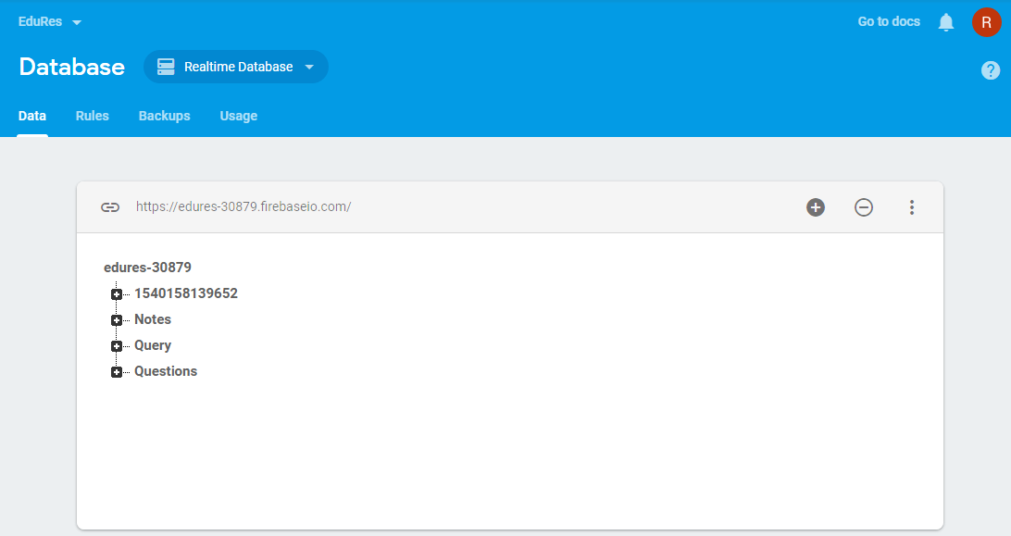
DATABASE SCHEMA

Slide 22
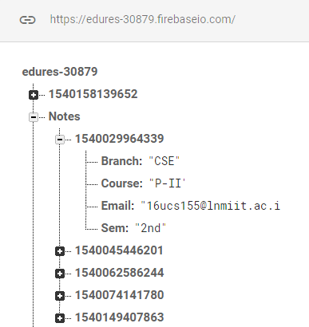
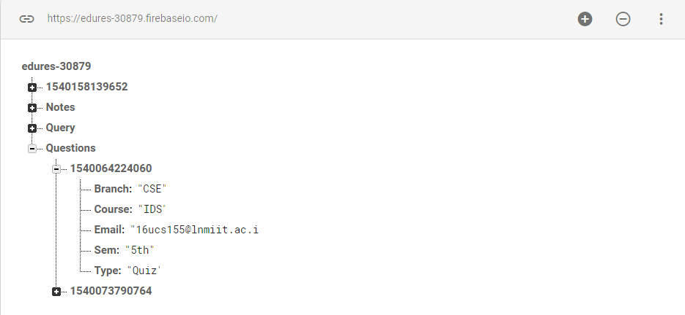
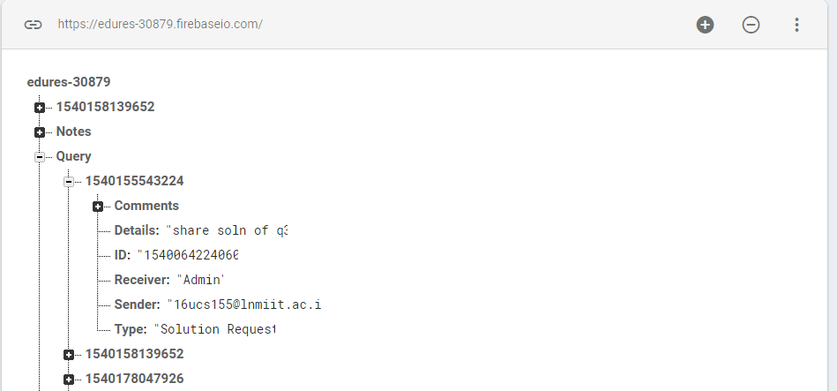
TABLES SCHEMA
NOTES
QUESTIONS
QUERY

Slide 23
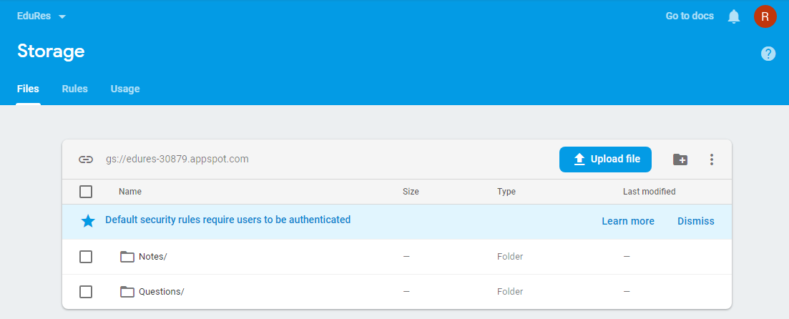
CLOUD STORAGE
Only registered users can access it.

Slide 24
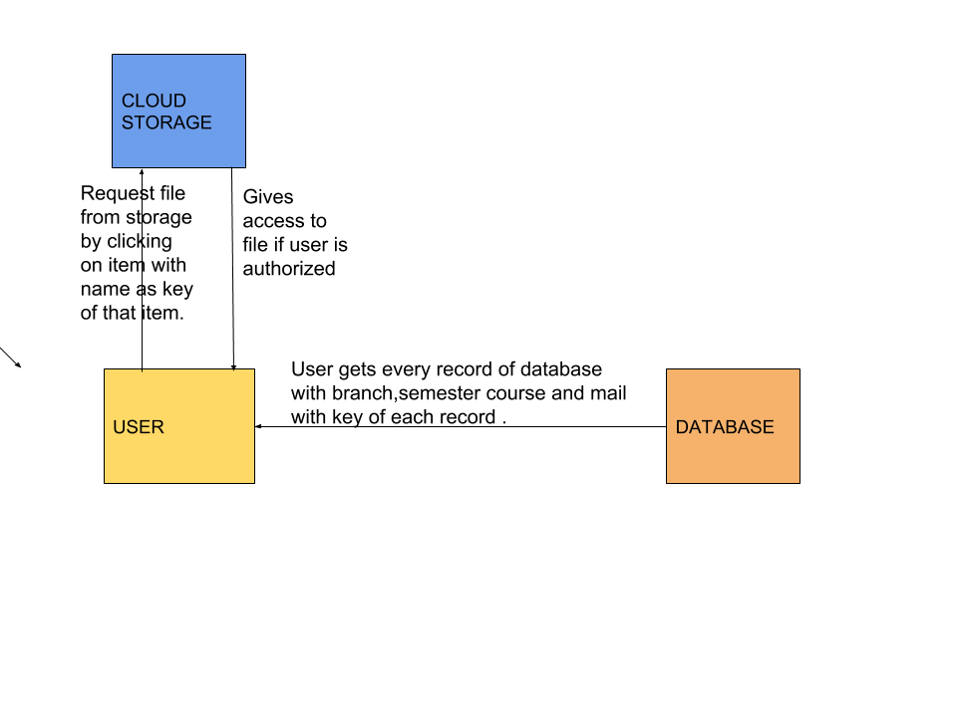
GETTING CLASS NOTES
User select filter options in filter dialog, records matching the options list on the app screen.
User can click on the note’s item ,he likes to download or see.
Name of the file stored in storage is stored in database so that record can be linked with proper file in storage.
NOTE : THIS PROCESS IS SAME FOR PAPERS WITH ONE MORE FIELD TYPE

Slide 25

UPLOADING CLASS NOTES
User select branch, semester and course of the note, then app makes sure if every option is selected , otherwise file can’t be uploaded.
User can select the file to be uploaded , file get uploaded on cloud storage, app stores it name.
App automatically add a record in database of uploaded notes with reference id as filename of uploaded document.
NOTE : THIS PROCESS IS SAME FOR PAPERS WITH ONE MORE FIELD TYPE

Slide 26
THANK YOU

