Slide 1
OSTRAIT
Ostrait helps to detect osteoporosis at an early stage by analysing the video of a person in which he is doing some simple activities like walking, climbing stairs etc.

Slide 2
What is osteoporosis?
Osteoporosis is a disorder in which bones become thinner and lose their strength. Individuals with osteoporosis are at higher risk for breaking bones. The most common osteoporosis-related fractures occur in the wrist, hip and spine

Slide 3
Symptoms
Osteoporosis is a disease that causes your bones to become weak and brittle and more likely to break. Unfortunately, you probably won't have visible symptoms until the disease is in it’s advanced stage or you actually experience a fracture.

Slide 4
Diagnosis
The best way to diagnose osteoporosis is with a bone density test which is done with dual-energy X-ray absorptiometry (DEXA).
Cost of whole body DEXA scan is approximately ₹3000. This cost is not affordable by a lot of people.

Slide 5
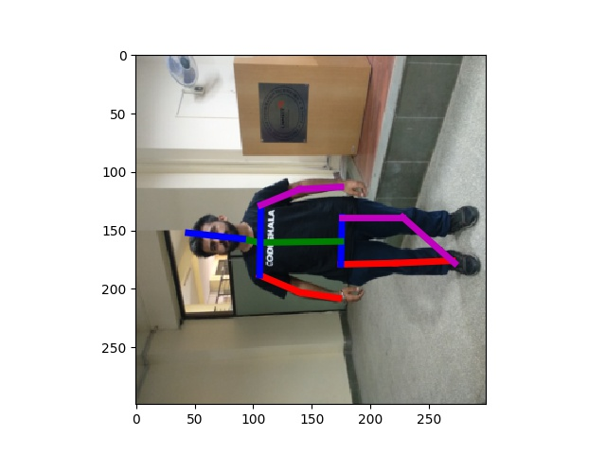
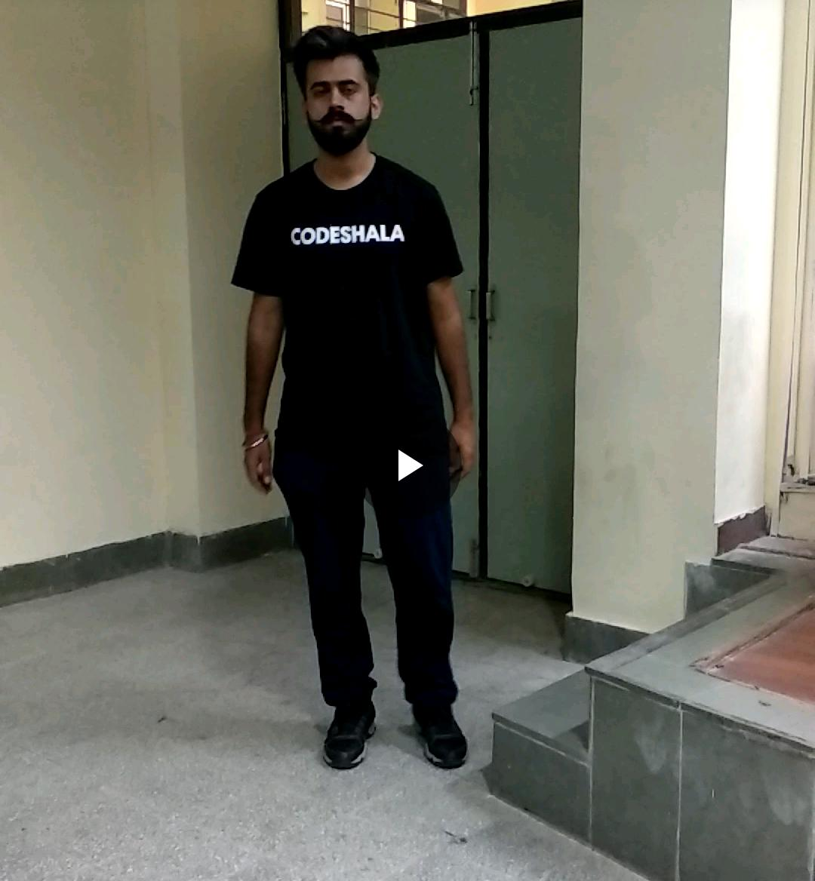
How Ostrait works?
Classification
VIDEO
FRAMES
POSE DESCRIPTOR

Slide 6
Benefits of Osteoporosis
Affordable as compared to other methods
Ostrait system is mobile
Doesn’t require a Doctor

