Slide 1
Loan Bazaar A webapp to predict whether a person can get a loan or not
Team-techieguys
Members: saransh bankiwal
Harsh kumbhat
Ayush goyal

Slide 2
Problem scenario
Many people face the problem of going bank to bank looking for how they can get a loan with low interest rate and get to know which bank would grant them the required loan based on their previous loan histories, credit balance and their income.

Slide 3
introduction
This project deals with the problem faced by people in getting loans and determining which bank to approach.
It uses machine learning algorithms to predict the chances of getting a loan from a particular bank on the basis of a person’s previous bank loans, his income, age, number of family dependents and other credit details.
The frontend of this webapp is made with html, css and javascript and backend is made with flask. The machine learning algorithms are written on jupyter notebook.

Slide 4
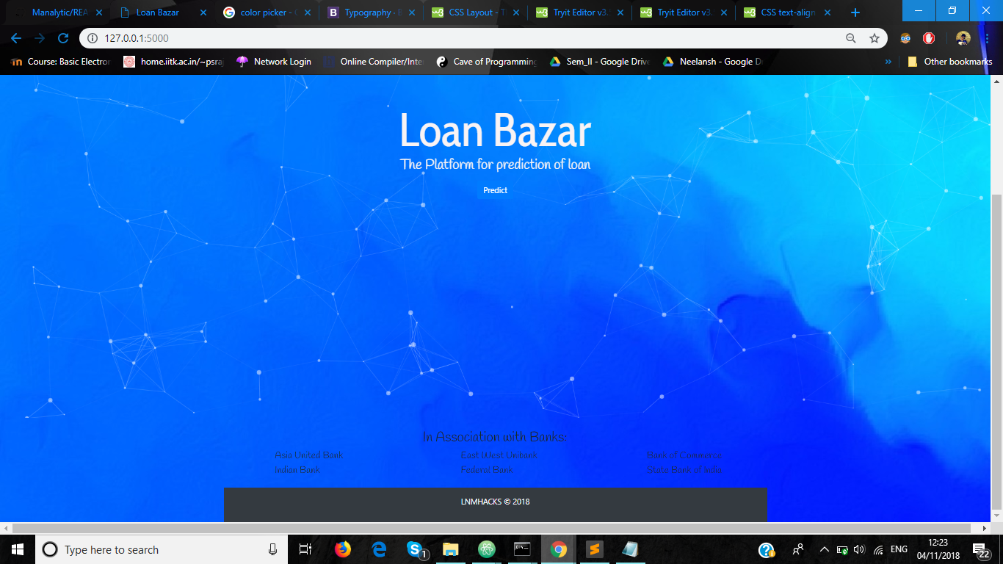
Frontend implementation

Slide 5
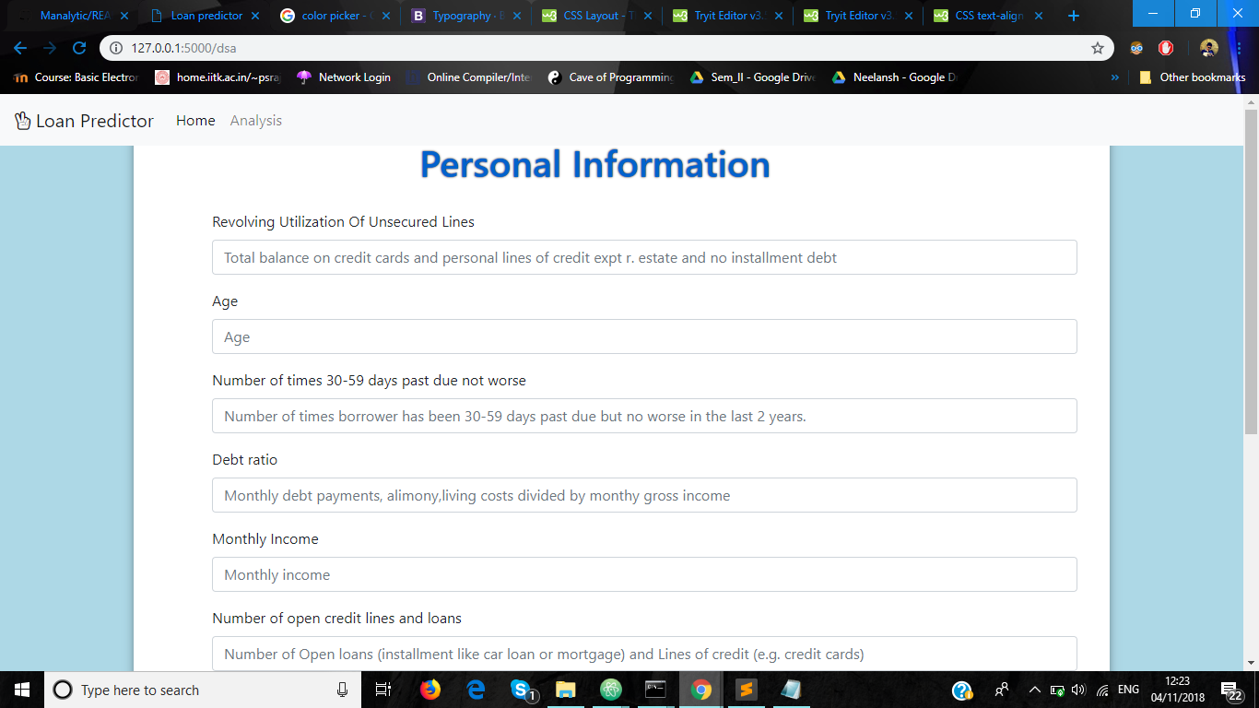

Slide 6
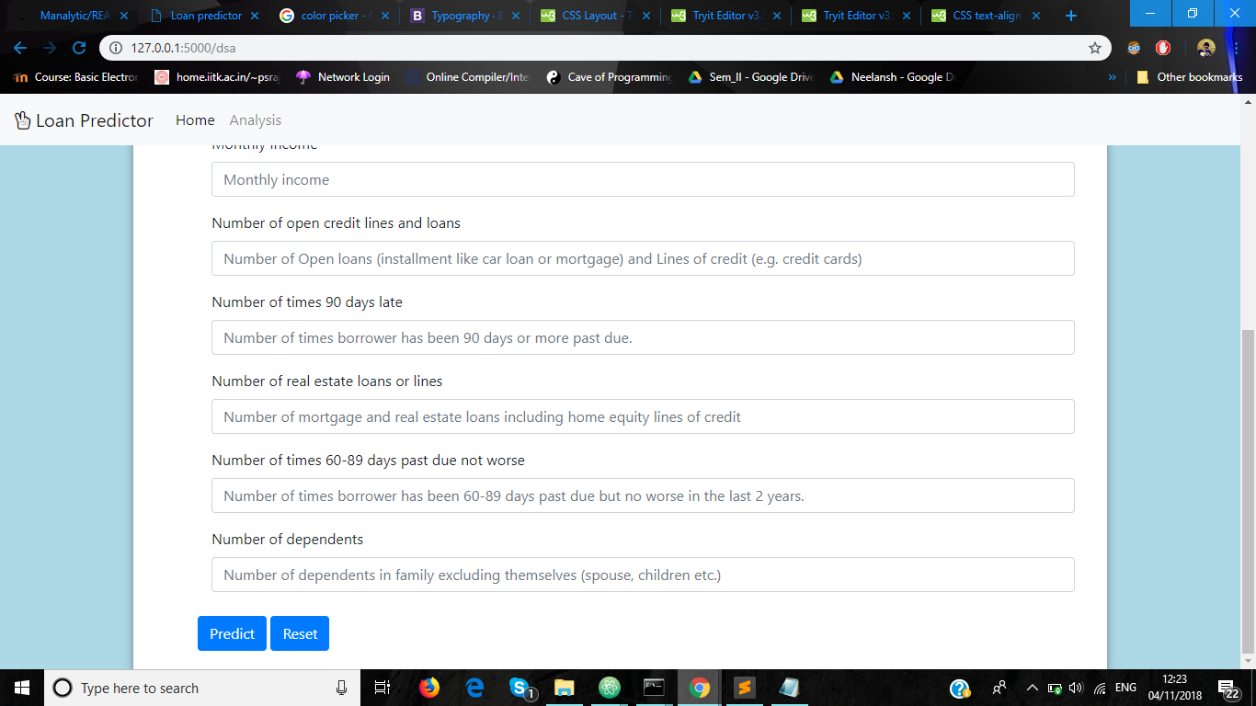

Slide 7
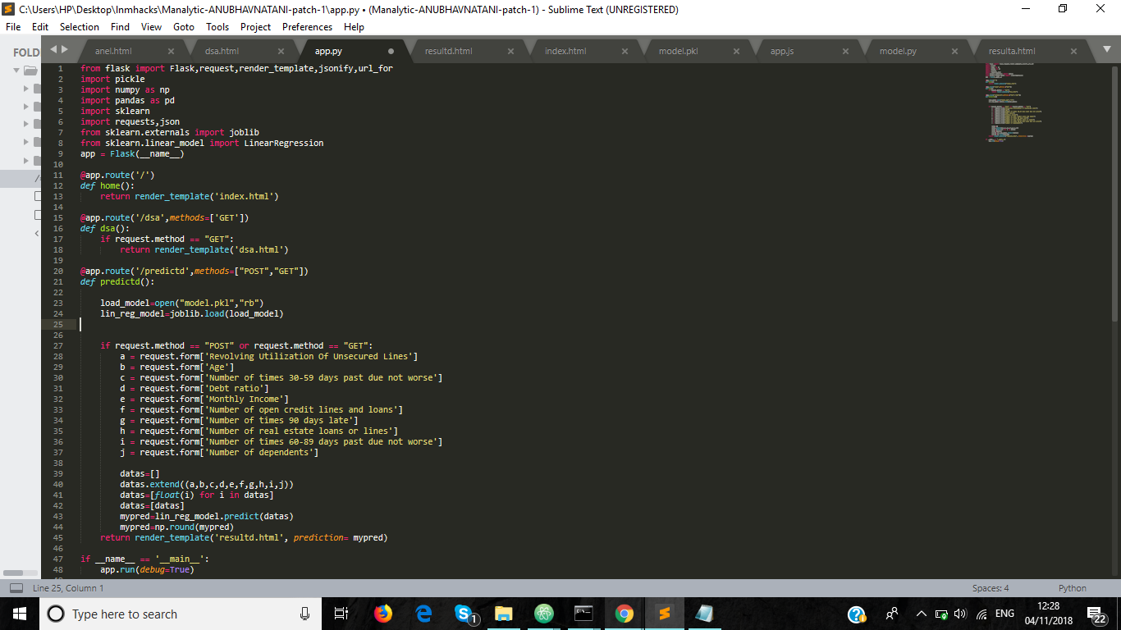
Backend implementation

Slide 8
ML Model used And Prediction Accuracy
We have tried various machine learning algorithms including linear regression, logistic regression, random forest regressor, sgd regressor etc.
Our model gave the best results on logistic regression.
The project has an accuracy of 93.78

Slide 9
Thank you!

