Slide 1
CyAnalytics
An Intelligent Way to Analyse and Visualize Data
For Full Documentation and Usage Instructions : Refer we_eat_cyanide.md

Slide 2
Problem Statement:
We regularly face the problem of good quality Generic Data Analysis and Visualization Software. Most softwares like SAP, DataPine, etc are build on SQL base model which limits our power to extract derived information from the data.

Slide 3
Solution:
Our solution is based on a Fully Generic NoSQL based model to enhance our power to extract information from the data with many varied features like Regex search, Geo-Index Based Searches, toggle between single to range queries etc, all on the Real Time Basis. It also provides features to visualize the information and play with the structure of the data.

Slide 4
Possible Impact:
Easy learning curve for data visualization
Reach for non-tech users
Easy, Quick data visualization without requirements for setting up environment
Gui based visualization makes data analytics even for beginners fun :)

Slide 5
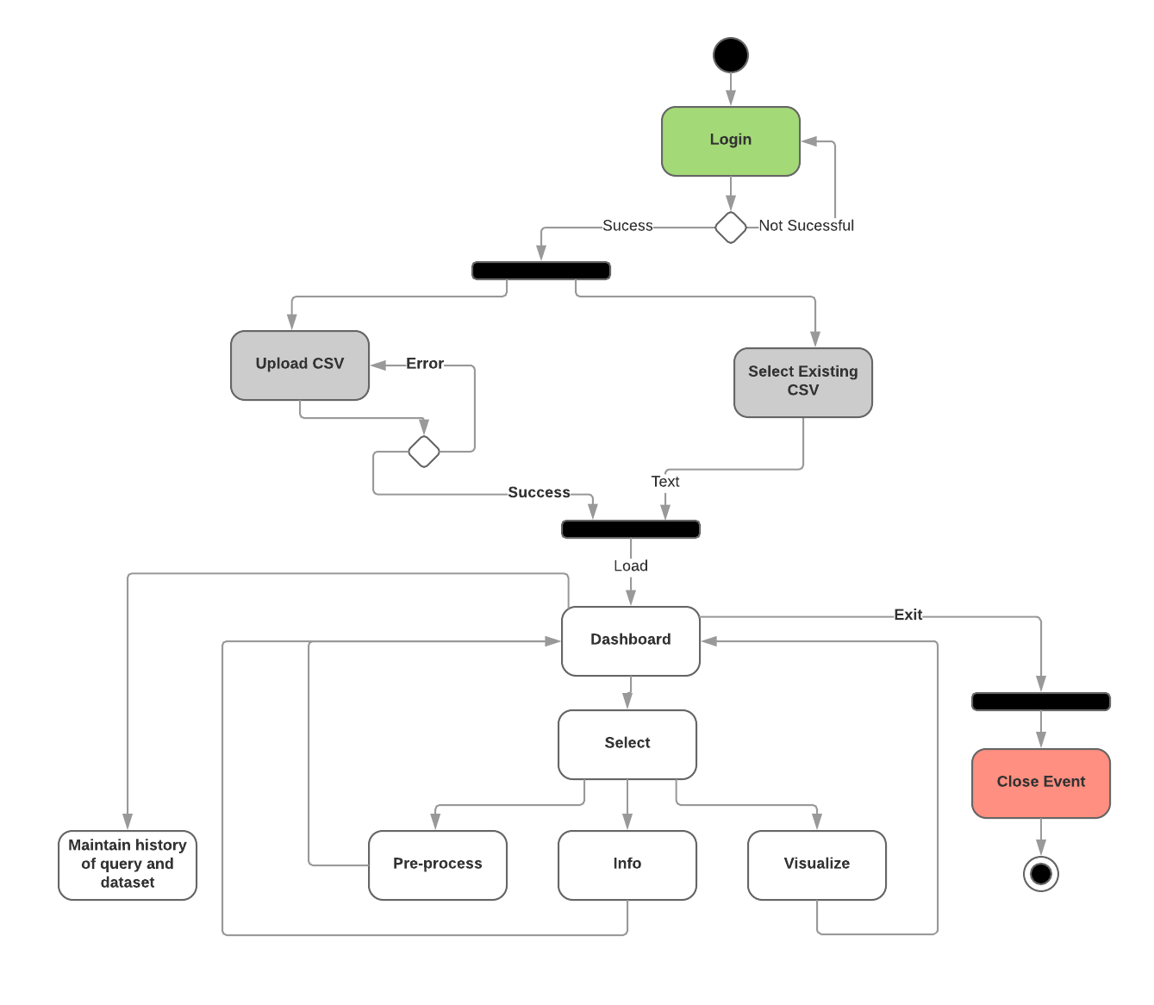
Session Flow

Slide 6
Future Work:
Making app secure for user data privacy concerns.
Optimizing Data Processing and Visualization.
Making an electron/Standalone Desktop App for easy use and more powerful API Integration.
Deploy the already build Data Preprocessing/ Structuring APIs onto the front-end Website.

Slide 7
Team: we_eat_cyanide
Shrey Batra @shreybatra
Ankit Khandelwal @ankk98
Arvind PJ @arvindpunk
Mayank @im-gozmit
College: Jaypee Institute of Information Technology, Noida
Contact: shreybatra97@gmail.com

