Slide 1
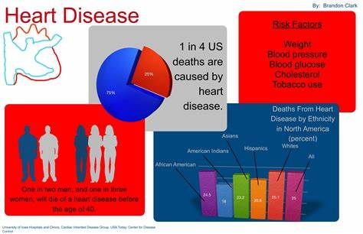
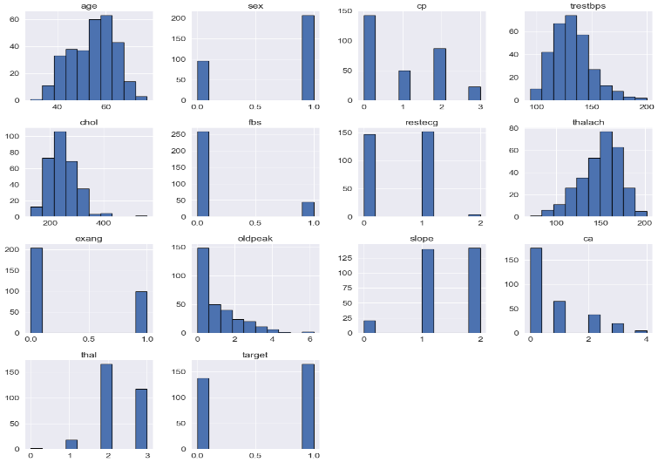
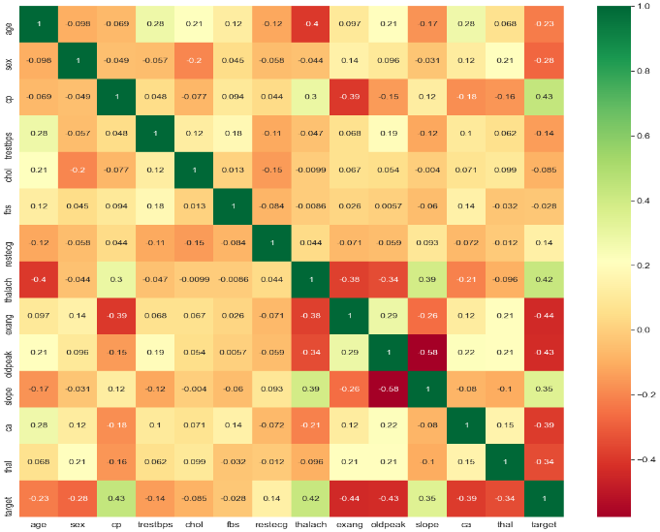
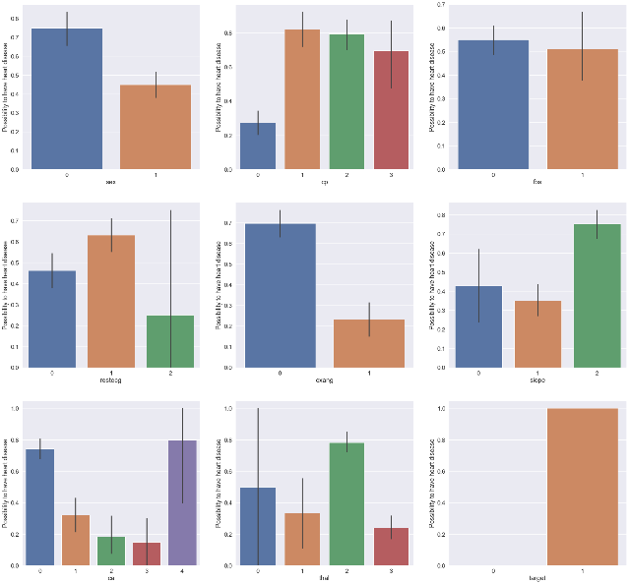
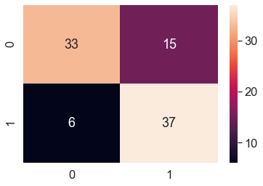
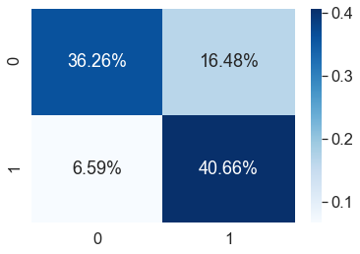
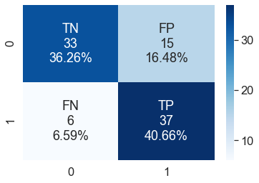
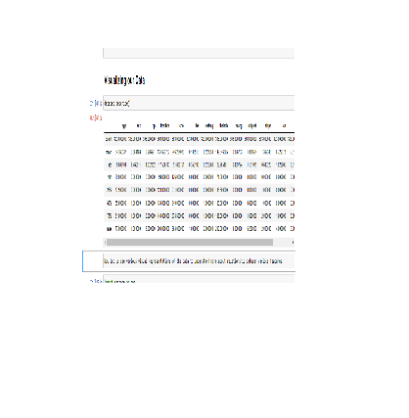
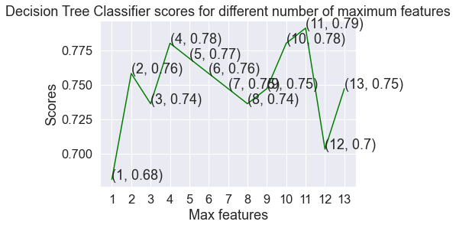
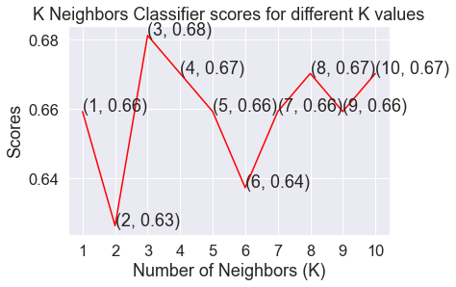
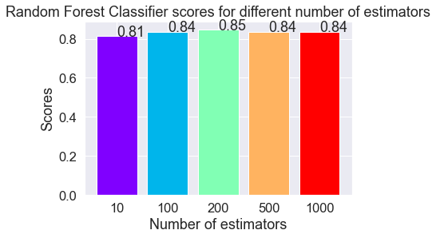
HEART DISEASE PREDICTION USING MACHINE LEARNING ALGORITHM
AMAN SINGH
UG Student, Fisk University, Nashville, TN, 37208
ABSTRACT
The major killer cause of human death is heart disease (HD). Many people die due to this disease. Many researchers have been discovering new technologies to prognosticate the disease early before it’s too late for helping healthcare as well as people. These processes are still under research phase. Machine Learning (ML) is faster-emerging technology of Artificial Intelligence (AI) that contributes various algorithms for HD. Based on the proposed problem, ML provides different classification algorithms to divine the probability of patient having HD. For predicting HD, a lot of research scholars contributes their effort in this work using various techniques and algorithms such as Decision Tree (DT), KNN (K- Nearest Neighbor) etc. To give some effort on this work, we are going to implement three of ML algorithms that are K neighbor Classifier, Random Classifier and Decision Tree Classifier. We are using the UCI repository HD dataset to train model by comparing DT, KNN and Random Forest Classifier algorithm for our final output. The dataset contains 303 instances with 14 attributes that help to train a prediction model that will be deployed into for prediction.
Background
Data Visualization
Conclusion
In this project, I used Machine Learning to find or predict whether a person is suffering from a heart disease or not. After importing the data, I analyzed it using plots. Then, I did generate dummy variables for categorical features and scaled other features. After that, I applied 3 Machine Learning algorithms, K Neighbors Classifier, Decision Tree Classifier and Random Forest Classifier. I varied parameters across each model to improve their scores. At the end, Random Classifier achieved the highest score of 83.5%.
CVDs are one of the major cause of people death globally. Many people have died from CVDs compare to other cause. In 2016, due to CVDs, an estimated 17.9 million human died. It’s illustrating 31% of human deaths all over the world. Stroke and heart attack have occupied 85% of these deaths. (World Health Organization, 2019)
Now let us see various visual representations of the data to understand more about relationship between various features
Confusion Matrix and Heatmaps
Future work
Future enhance of the Heart Disease Prediction Model is to predict a specific HD type such Heart attracts, CVD, CAD, etc. the potential of the HDPS in a different area are hospital, Clinic, smartphone, smart wear, hospital/police emergency system and integrate with fitness mobile application.
Design Methodology
Results
References
Segue Technologies, 2015. The Benefits of Adhering to Software DevelopmentMethodology Concepts. [Online] Available at: https://www.seguetech.com/benefits-adhering-softwaredevelopment-methodology-concepts/ [Accessed 28 01 2019]. Abhishek, t., 2013. Heart Disease Prediction System Using Data Mining Techniques. Oriental Scientific Publishing Co., India, 6(4), pp. 457-466. Afros, R. R. a. F., 2013. Comparison of Various Classification Techniques Using Different Data Mining Tools for Diabetes Diagnosis. Journal of Software Engineering and Applications, 6(3), pp. 85-97. Aparna K., D. R. N. C. S. P. I. S. S. D. K. V., 2014. Disease Prediction in Data Mining Techniques. International Journal of Computer Science and technology, 5(2), pp. 246-249 Arsenault, R., 2019. Sublime Text. [Online] Available at: https://www.utest.com/tools/sublime-text [Accessed 30 01 2019]. Asthana, S., 2018. Essential libraries for Machine Learning in Python. [Online] Available at: https://medium.freecodecamp.org/essential-librariesfor-machine-learning-in-python-82a9ada57aeb [Accessed 08 02 2019]. Bahram, B. a. S. M., 2015. Prediction and Diagnosis of Heart Disease by Data Mining Techniques. Journal of Multidisciplinary Engineering Science and Technology (JMEST),2(2), pp. 164-168. Chalay Beyene, P. K., 2018. “Survey on Prediction and Analysis the Occurrence of Heart Disease Using Data Mining Techniques. International Journal of Pure and Applied Mathematics, 118(8), pp. 165-174. Dangar Chitrali S., P. A. S. S., 2012. Improved Study of Heart Disease Prediction System using Data Mining Classification Technique. International Journal of Computer Applications (0975 – 888) , 47(10), pp. 44-48
Model is trained to predict whether the person has heart disease or not based on the following features as input:
Age
Gender
Blood Pressure
Cholestrol level
Max heart rate
As we can see, at the end we compare different Machine Learning Algorithms to find out different scores and we see Random Forest Classifier achieved the highest score of 83.5%.

