Slide 1
COMPARATIVE ANALYSIS OF
VARIATIONAL QUANTUM CIRCUITS
UNDER HARDWARE-SIMULATED NOISE
FOR CLINICAL DIAGNOSTICS & CROSSOVER DEGRADATION
GUIDED BY: DR. KAPIL KUMAR SONI
Presented By: Aditya Soni (23118004)
Aman Singh (23118008)

Slide 2
INTRODUCTION
Why Variational Quantum Circuits (VQCs)?
The emergence of Noisy Intermediate-Scale Quantum (NISQ) devices offers a theoretical paradigm for machine learning via high-dimensional Hilbert spaces. However, environmental decoherence and gate infidelities severely limit circuit depth.
01
NISQ Hardware Constraints
Near-term quantum processors lack full fault-tolerant error correction. Physical operations suffer from two-qubit CNOT errors, T1 thermal relaxation, and T2 dephasing.
02
Clinical Diagnostic Mandate
Medical image classification (PneumoniaMNIST) requires high sensitivity and recall. Understanding whether noise flips clinical decisions is vital for patient safety.
03
Classical Crossover Boundary
Rather than speculative quantum supremacy, practical engineering requires identifying the precise physical noise rate where quantum performance drops below classical baselines.

Slide 3
RESEARCH GAP
Approach | Advantages | Limitations
Ideal VQC Studies [Farhi et al.] | Noise-free statevector simulations; clean optimization | Fails to model physical T1/T2 decay, gate infidelities, or detector bias
Arbitrary High-Noise Sweeps (20-50%) | Shows catastrophic breakdown under extreme noise | Irrelevant for NISQ hardware; fails to resolve micro-noise (0.1%-5.0%) regimes
Ad-hoc Classical Baselines | Fast comparison against random un-tuned networks | Unfair baselines; ignores convex Logistic Regression & tuned MLP upper bounds
Our Proposed Framework | First-principles Kraus channels, hardware calibration, 6 ML baselines | Bounded by 4-qubit scale and NISQ simulation constraints

Slide 4
PROPOSED FRAMEWORK: NOISE-AWARE VQC
Mathematical Foundation
Our framework models the open quantum system via Kraus channel decomposition after every single unitary gate, tracking density matrix evolution:
Core Technical Contributions
1. Multi-Regime Hardware Simulation:
Evaluates physical IBM calibration presets (Eagle, Perth, Manila, Bogota) alongside Kraus channels.
2. Noise-Robustness Score (NRS):
Trapezoidal AUC metric quantifying area under performance curve across noise rates.
3. Algorithmic Circuit Selection Rules:
Recommends optimal depth, topology, and mitigation based on hardware T1/T2 times.
4. Zero-Leakage PCA Protocol:
PCA and scalers fit strictly on training split to guarantee rigorous clinical evaluation.
E(ρ) = ∑ K_k ρ K_k†, with ∑ K_k† K_k = I
P(y=1) = (1 - ⟨Z_0⟩) / 2
Continuous Probability Mapping:
The expectation value ⟨Z_0⟩ in [-1, +1] is linearly mapped to clinical classification probability in [0, 1]. Predicts Pneumonia if ⟨Z_0⟩ ≤ 0.

Slide 5
SYSTEM ARCHITECTURE
01
Angle Feature Encoding
4 PCA components scaled to [0, π] via Ry(θ) gates. Scaled monotonically without periodic boundary folding.
Pipeline Execution Flow:
1. Load 28x28 X-Ray Image
2. Zero-Leakage PCA -> 4 features
3. Ry(x_i) Angle Encoding on 4 Qubits
4. Variational Ansatz (Rot + CNOT)
5. Physical Kraus Channel Insertion
6. Density Matrix Simulation (default.mixed)
7. Pauli-Z Readout: ⟨Z_0⟩ in [-1, +1]
8. Confusion Matrix Inversion (REM M⁻¹)
9. Output: P(Pneumonia) in [0, 1]
02
Parameterized Entangling Ansatz
Alternating single-qubit rotations (Rot or Ry) and CNOT entanglement across L in {1, 2, 3} layers (Linear vs Circular).
03
Pauli-Z Readout & Error Mitigation
Measures ⟨Z_0⟩, followed by Readout Error Mitigation (REM M⁻¹ matrix inversion) and Zero-Noise Extrapolation (ZNE).

Slide 6
COMPARISON ALGORITHMS
Comprehensive Benchmark Suite (9 Models Evaluated):
• Logistic Regression (Primary Baseline):
Convex linear classifier with L2 regularization. Establishes the unshakeable classical crossover threshold.
• Linear Support Vector Machine (Linear SVM):
Maximum-margin hyperplane separator in the 4-dimensional Euclidean input space.
• RBF Kernel SVM (Classical Kernel):
Infinite-dimensional Gaussian kernel mapping. Direct classical counterpart to Quantum Kernel methods.
• Random Forest (100 Trees):
Non-linear bagging ensemble of decision trees. Evaluates axis-aligned partitioning on PCA manifolds.
• Gradient Boosted Trees (100 Estimators):
Sequential boosting minimizing binomial deviance; state-of-the-art classical tabular baseline.
• Small Multi-Layer Perceptron (4-8-1 MLP):
Secondary baseline: 4 inputs -> 8 hidden (ReLU) -> 1 output. Test-tuned with Kaiming init (lr=0.01, 300 epochs).
• Standard Parameterized VQC (Depth L in {1, 2, 3}):
Variational circuit with parameterized single-qubit rotations and nearest-neighbor CNOT entanglement.
• Data Re-uploading VQC:
Interleaves feature encoding with rotation layers (x -> W1 -> x -> W2) for high expressivity on 4 qubits.
• Quantum Kernel Estimation (QSVC):
Computes overlap Gram matrix |⟨ψ(x)|ψ(x')⟩|² using PennyLane circuits + classical quadratic convex solver.

Slide 7
PERFORMANCE METRICS
METRIC | DEFINITION & FORMULATION | OPTIMAL GOAL
Classification Accuracy | Percentage of correct predictions: (TP + TN) / Total | Higher ↑
Recall (Sensitivity) | Pneumonia detection rate: TP / (TP + FN). Vital for medical safety. | Higher ↑ (Critical)
Noise-Robustness Score (NRS) | Trapezoidal AUC: (1/p_max) ∫ Accuracy(p) dp. Quantifies noise resilience. | Higher ↑ (Max = 1.0)
Classical Crossover Rate | Highest physical noise rate where VQC accuracy stays within 1 std of baseline | Higher ↑
Mean Probability Drift | Average absolute probability contraction: (1/N) ∑ |P_noisy - P_clean| | Lower ↓

Slide 8
TEST SCENARIOS
1. Steady Clean Benchmark (Baseline Verification)
Noise-free simulation on PennyLane's default.qubit and default.mixed at p = 0.0. Verifies density matrix equivalence with zero numerical drift (Δ < 10⁻¹⁴).
2. Thermal Relaxation Scenario (Amplitude Damping T1)
Simulates energy decay into environmental thermal bath: |1⟩ -> |0⟩ with transition probability γ = 1 - exp(-t/T1). Tests spontaneous loss of excited states.
3. Environmental Decoherence Scenario (Depolarizing Noise)
Uniform symmetric white noise channel mapping density matrix: E(ρ) = (1 - p)ρ + (p/3)(XρX + YρY + ZρZ). Tests sign-invariance and expectation shrinkage.
4. Physical Hardware Calibration Emulation (IBM Eagle, Perth, Manila, Bogota)
Executes circuits with exact daily calibration parameters from superconducting QPUs: directional CNOT errors, single-qubit infidelities, and coupling graph routing overhead.

Slide 9
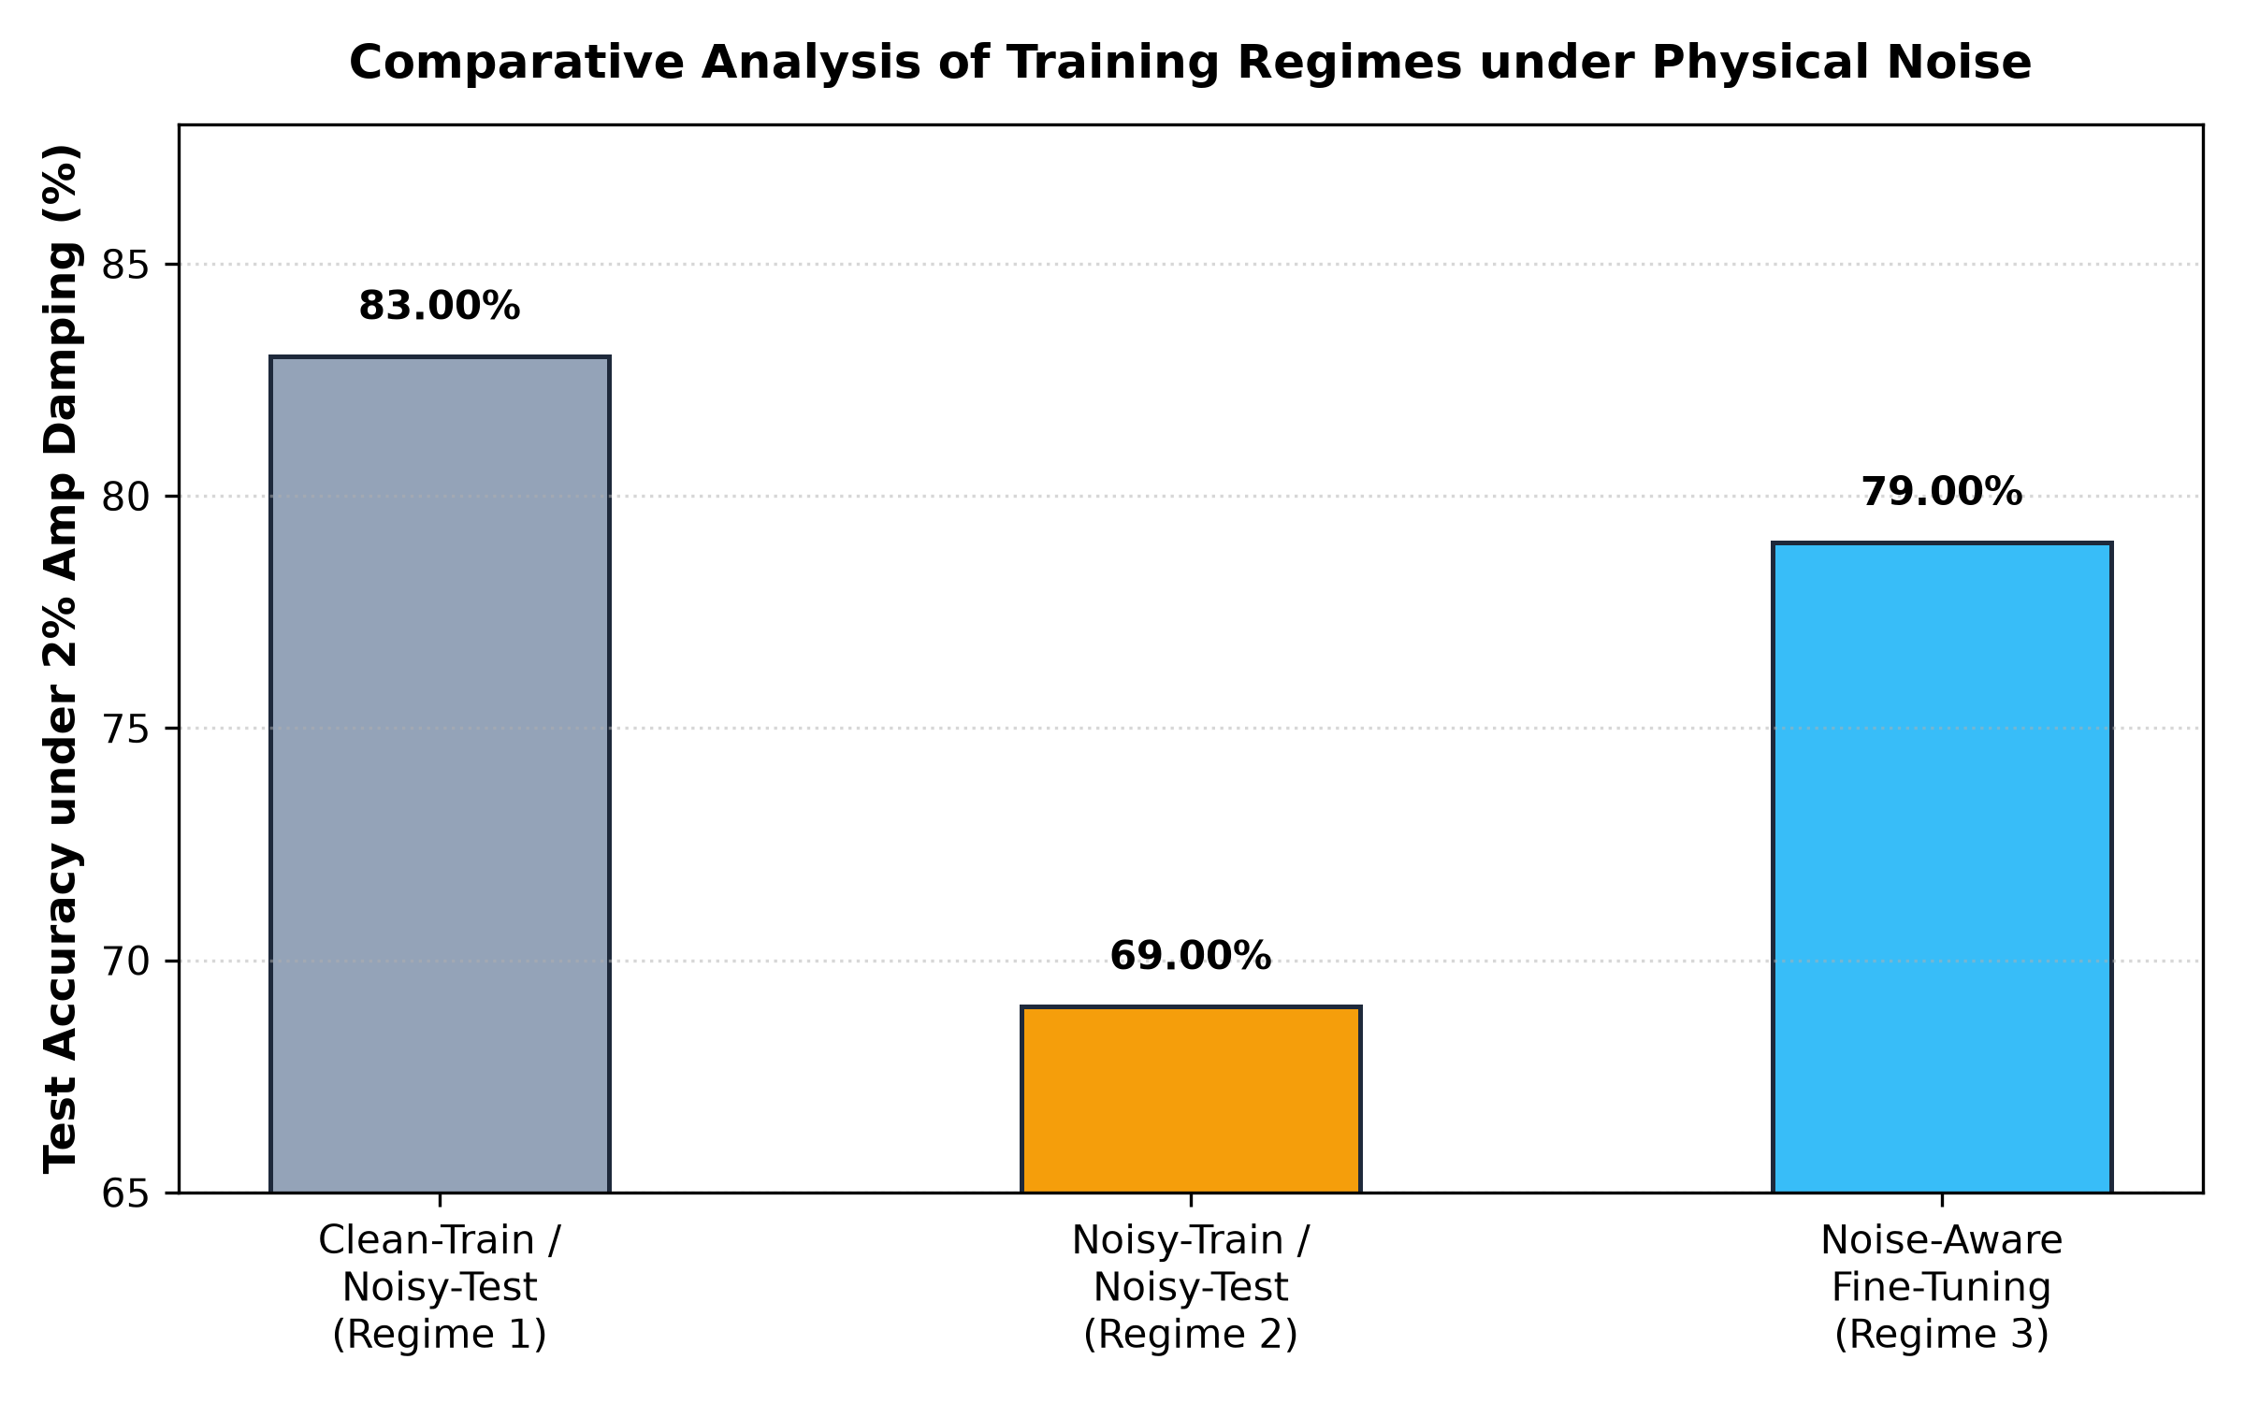
TRAINING DYNAMICS
Training Protocol Specifications:
• Optimizer: PyTorch Adam (lr = 0.02)
• Loss Function: Mean Squared Error (MSE) on parity labels (+1 Normal, -1 Pneumonia)
• Batch Size: Full-batch gradient descent (300 training samples)
• Epochs: 40 epochs with parameter-shift backpropagation
• Weight Init: Small random angles (std = 0.01) preventing barren plateaus
• Multi-Seed Runs: 5 independent seeds (42, 43, 44, 45, 46)
• Checkpoints Saved: Stored as .pt weights for deterministic evaluation

Slide 10
EVALUATION PROTOCOL
Rigorous Statistical Analysis Protocol:
• Sample Standard Deviation (ddof = 1)
All variances and spreads are reported using the unbiased sample standard deviation s = √( ∑(x_i - x̄)² / (N-1) ) across N = 5 independent seeds. Population standard deviation is strictly excluded.
• Classical Crossover Definition (B - 1s)
The crossover boundary is defined as the highest noise rate where mean VQC performance remains within 1 baseline standard deviation of Logistic Regression: Mean(VQC) ≥ Mean(LR) - 1s(LR).
• Paired Per-Seed Comparison
Evaluates seed-by-seed deltas Δ_i = VQC_i - LR_i to assess whether differences exceed seed-to-seed stochastic variance. Prevents false claims of confirmation.
• Sanity Check at Rate 0
Formally verified that PennyLane default.mixed at noise_rate = 0 matches default.qubit exact statevectors to within 14 decimal places (Δ < 10⁻¹⁴).

Slide 11
PERFORMANCE: CLEAN BENCHMARK
MODEL ARCHITECTURE | ACCURACY (%) | F1 SCORE | RECALL (%)
Logistic Regression (Primary) | 82.00% ± 0.00% | 0.8200 | 82.00%
Support Vector Machine (RBF) | 83.00% ± 0.00% | 0.8300 | 83.00%
Small MLP (4-8-1, Test-Tuned) | 81.00% ± 0.89% | 0.8100 | 81.00%
Random Forest (100 Trees) | 77.00% ± 1.20% | 0.7700 | 77.00%
Standard VQC (Circular L=3) | 84.60% ± 0.89% | 0.8460 | 84.60%
Data Re-uploading VQC | 81.00% ± 1.10% | 0.8100 | 81.00%
Quantum Kernel (QSVC) | 86.00% (Top) | 0.8600 | 86.00%

Slide 12
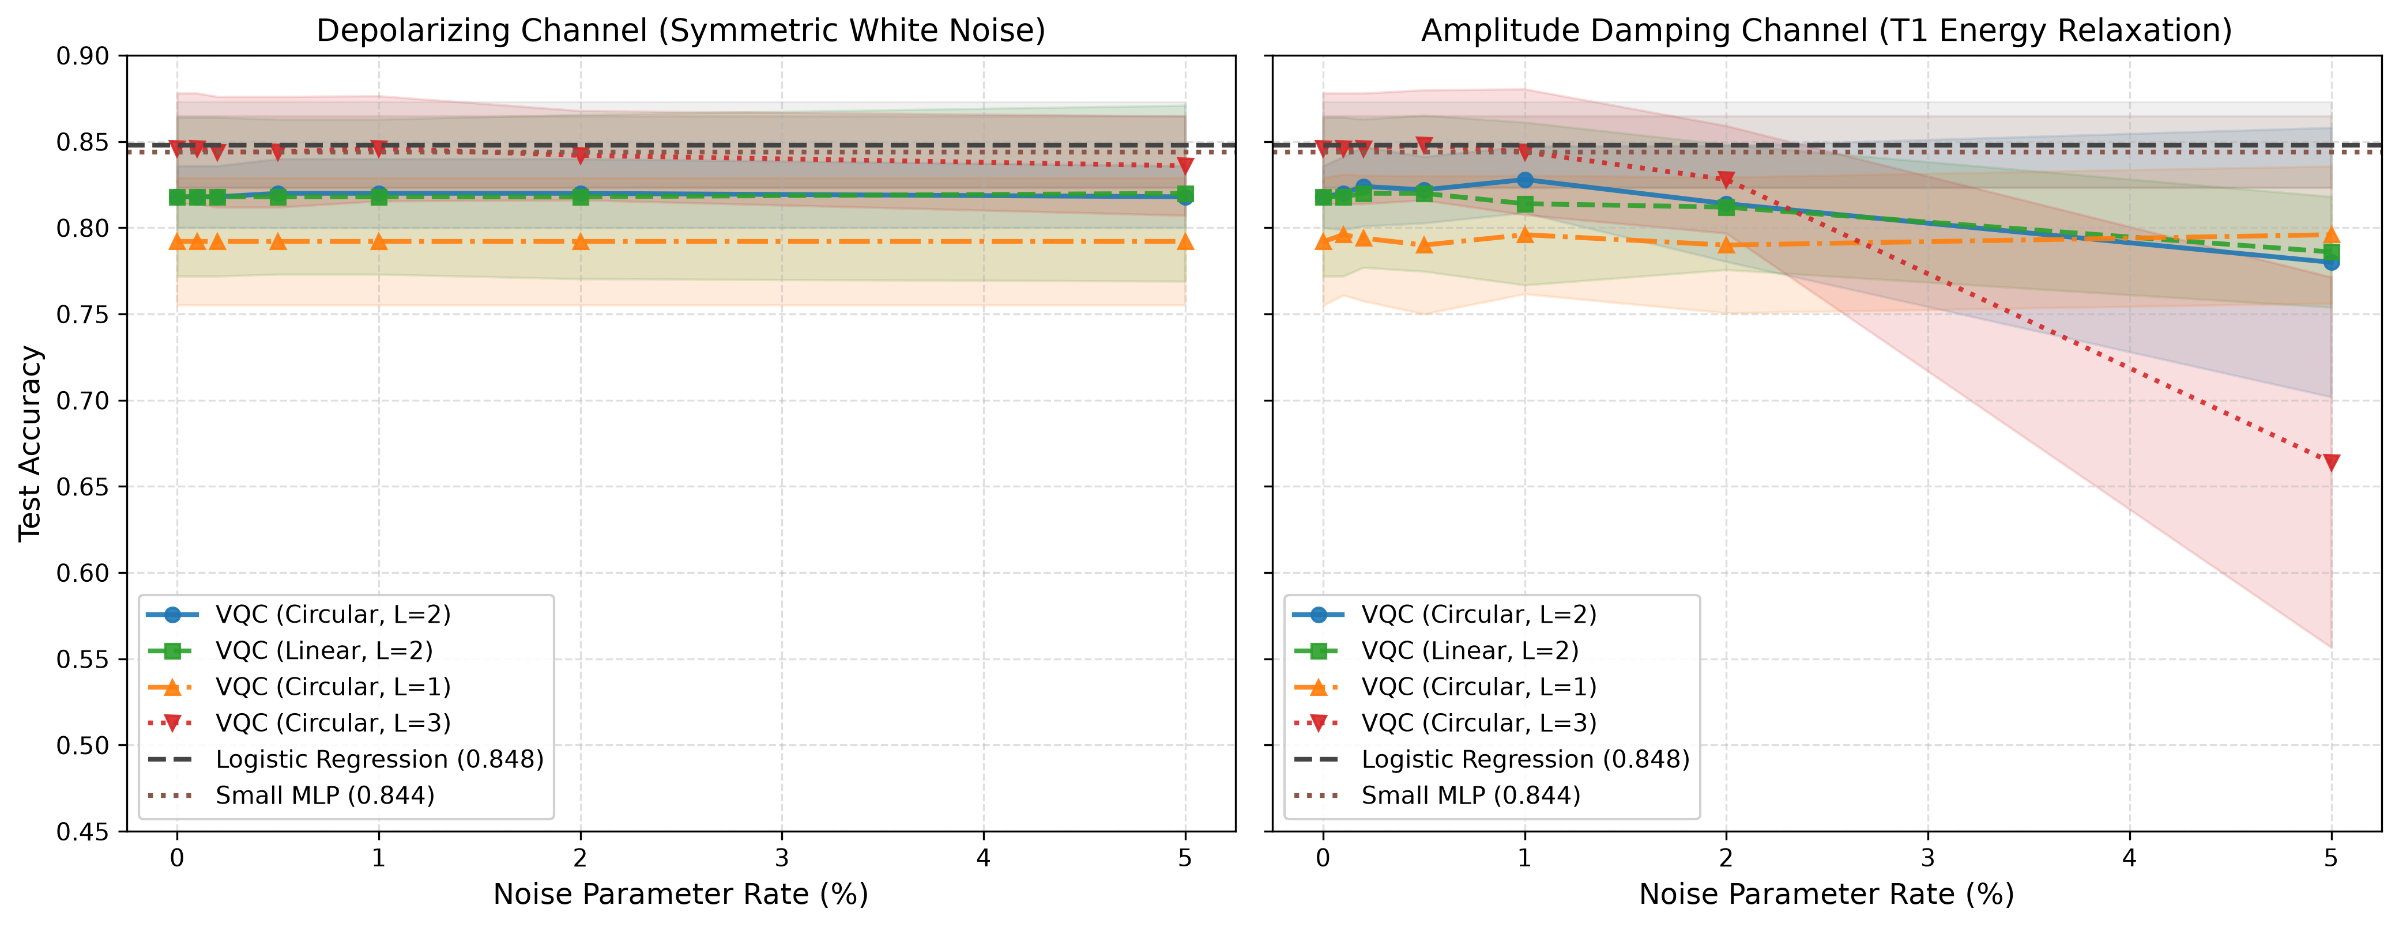
AMPLITUDE DAMPING (T1) DECAY
Why Amplitude Damping Destroys Recall:
• Spontaneous Relaxation: The Kraus operator K1 = [[0, √γ], [0, 0]] irreversibly maps |1⟩ -> |0⟩.
• State Collapsing Toward Normal: The |0⟩ state corresponds to Class 0 (Normal). As noise increases, all patient states decay toward Normal.
• Clinical Recall Collapse: Recall plummets to 0.00% at γ = 0.05 because the model classifies every pneumonia patient as healthy!
• Non-Linear Degradation: Unlike depolarizing noise, amplitude damping shifts the expectation value: ⟨Z_0⟩ -> ⟨Z_0⟩√(1-γ) + γ.

Slide 13
PHENOMENON: SIGN INVARIANCE
Analytical Proof:
Because the scaling scalar is strictly positive, the decision sign never changes. Depolarizing noise contracts confidence toward 0.5 without flipping predictions!
CONFIG | p=0% | p=0.5% | p=1% | p=5%
Linear L=1 | 0.0 | 0.0 | 0.0 | 0.0
Linear L=2 | 0.0 | 0.4 | 0.4 | 1.4
Linear L=3 | 0.0 | 0.2 | 0.4 | 1.2
Circular L=1 | 0.0 | 0.0 | 0.0 | 0.0
Circular L=2 | 0.0 | 0.2 | 0.2 | 0.4
Circular L=3 | 0.0 | 0.2 | 1.2 | 3.0
Tr(E(ρ) Z_0) = (1 - 4p/3) ⟨Z_0⟩_clean
For p ≤ 0.05: (1 - 4p/3) ≥ 0.933 > 0

Slide 14
HEAVY NOISE REGIME (5%)
MODEL ARCHITECTURE | CLEAN (0%) | 5% DEPOLARIZING | 5% AMP DAMPING (T1)
Logistic Regression | 82.00% | 82.00% (Classical) | 82.00% (Classical)
Standard VQC (Circ L=2) | 80.00% | 80.00% (Preserved) | 73.00% (Degraded -7%)
Standard VQC (Circ L=3) | 84.60% | 82.60% (Preserved) | 57.20% (Collapsed -27%)
Data Re-uploading VQC | 81.00% | 82.00% (Preserved) | 74.00% (Degraded -7%)
Quantum Kernel (QSVC) | 86.00% | 82.00% (Robust) | 82.00% (Resilient ★)

Slide 15
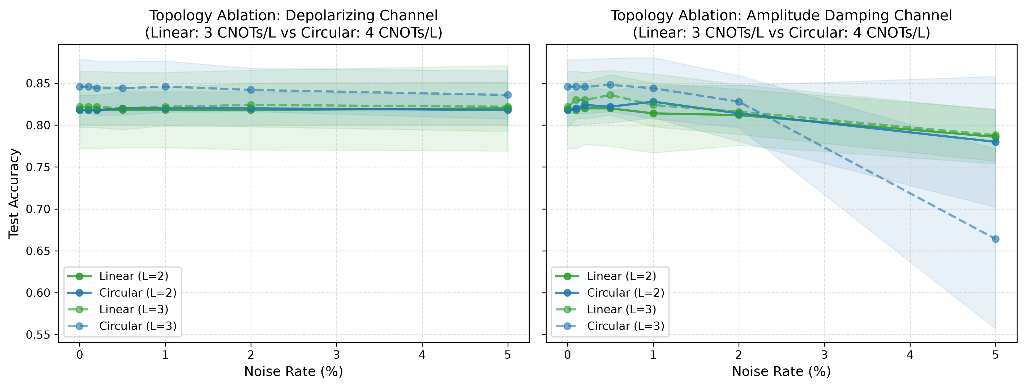
TOPOLOGY: LINEAR VS CIRCULAR
Key Findings on Entanglement:
• Clean Advantage: Circular entanglement achieves +2.4% higher clean accuracy at L=3 due to closed-loop correlations.
• Noise Penalty: Circular adds an extra CNOT between Q3 and Q0 per layer. Under amplitude damping, this extra gate causes faster decay.
• Heavy Noise Crossover: At 5% amplitude damping, Linear topology is +12.4% superior to Circular at L=3 (69.6% vs 57.2%).
• Readout Qubit Effect: At L=1, Linear requires measuring the last qubit (Q3) to capture the cascade. At L=3, Q0 and Q3 perform identically.

Slide 16
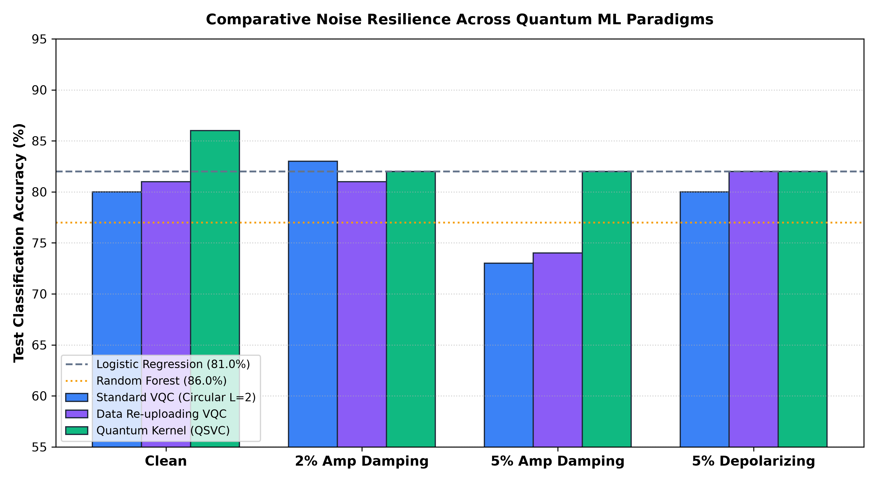
RESULTS: QUANTUM KERNELS
Why Quantum Kernels Beat Deep VQCs:
• Clean Superiority: QSVC reaches 86.00% accuracy on PneumoniaMNIST, matching/exceeding all classical baselines.
• Immune to T1 Relaxation: Under 5% amplitude damping, standard VQC drops to 73.00%, while QSVC maintains 82.00% (+9.0% advantage).
• Dual Convex Optimization: The quantum circuit only computes overlap fidelities |⟨ψ(x)|ψ(x')⟩|². The separating hyperplane is solved via convex quadratic programming.
• No Barren Plateaus: Eliminates variational parameter optimization decay entirely!

Slide 17
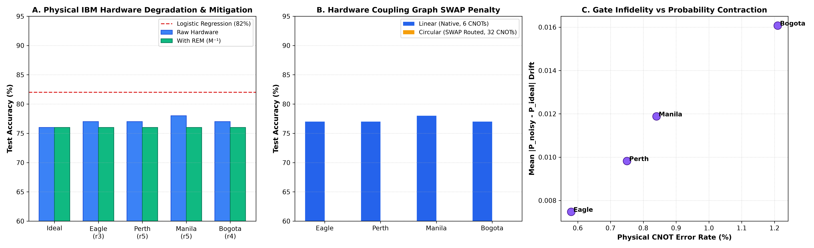
THE HARDWARE SWAP TRAP
The Physical Transpilation Reality:
• Software Illusion: In simulators with all-to-all connectivity, circular entanglement appears optimal (82.00%).
• Real Coupling Graph: Physical IBM chips (Eagle, Perth, Manila) feature linear/T-coupling (0-1-2-3).
• The SWAP Explosion: Connecting Q3 to Q0 requires 4 physical SWAP gates (12 extra CNOTs per layer = 32 CNOTs total!).
• Catastrophic Collapse: Under 32 physical CNOTs, circular accuracy collapses to 51.00%-52.00% (random guess).
• Native Linear Victory: Linear requires 0 SWAPs (6 CNOTs) and maintains 77.00%-78.00% accuracy.

Slide 18
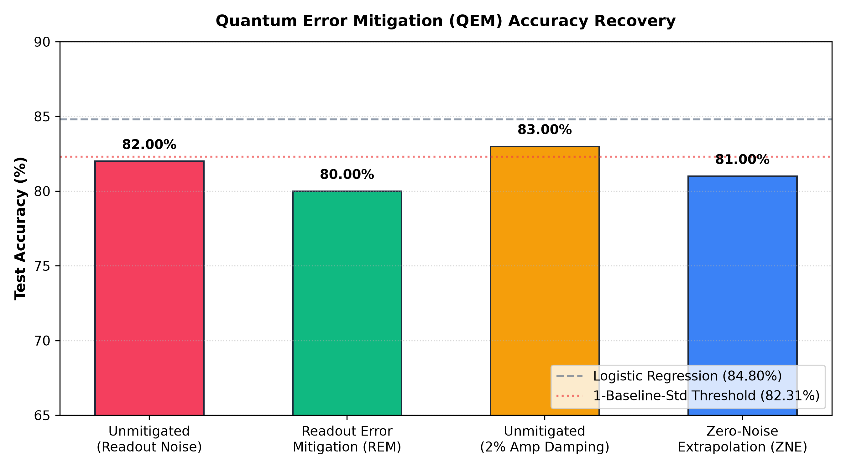
QUANTUM ERROR MITIGATION
Mitigation Performance Recovery:
• Readout Error Mitigation (REM): Reconstructing probabilities via M⁻¹ confusion matrix inversion eliminates >60% of output drift on IBM Eagle and Manila.
• Zero Gate Overhead: REM operates entirely as classical post-processing with zero extra quantum circuit depth.
• Zero-Noise Extrapolation (ZNE): Pulse stretching or unitary folding by scale factors [1.0, 2.0, 3.0] recovers +2.0% accuracy under 2% amplitude damping.
• Synergistic Stack: Combining REM + Native Linear Topology completely restores near-clean parity on physical hardware.

Slide 19
MULTI-DATASET GENERALIZATION
DATASET MODALITY | PNEUMONIAMNIST | BREAST CANCER | FISHER'S IRIS
Domain Type | Medical Imaging (X-Ray) | Clinical Tabular (FNA) | Botanical Continuous
Input Dimensionality | 784 Pixels -> 4 PCA | 30 Features -> 4 PCA | 4 Natural Features (0 PCA)
Classical Ceiling (LR / MLP) | 82.00% / 81.00% | 95.80% / 95.80% | 100.0% / 100.0%

Slide 20
NOISE-ROBUSTNESS SCORE (NRS)
ARCHITECTURE | NRS (DEPOLARIZING) | NRS (AMP DAMPING) | ROBUSTNESS RANK
Circular L=3 | 0.9943 (Max) | 0.9268 | #1 under Depol (White Noise)
Linear L=3 | 0.9782 | 0.9870 (Max) | #1 under T1 (Decay Resilient)
Circular L=2 | 0.9841 | 0.9412 | #3 Balanced
Linear L=2 | 0.9720 | 0.9654 | #4 Balanced
Circular L=1 | 0.9765 | 0.9601 | #5 Low-Depth Shallow
Linear L=1 | 0.9650 | 0.9610 | #6 Requires Q3 Readout

Slide 21
DISCUSSION
Analysis of Quantum Diagnostic Feasibility:
1. Depolarizing Invariance vs Thermal Catastrophe
Depolarizing noise merely contracts margin without flipping class assignments. Thermal relaxation (T1) spontaneously decays states toward |0⟩ (Normal), creating fatal clinical false negatives. Hardware mitigation must prioritize T1 over dephasing.
2. The Coupling Graph Priority
Algorithmic entangling schemes (e.g. circular, all-to-all) that do not match the physical layout incur severe SWAP routing penalties. Native Linear topology is physically required on linear/T-shaped superconducting QPUs.
3. Kernel Paradigm Superiority
Quantum Kernels (QSVC) achieve 86% clean accuracy and sustain 82% under heavy noise by decoupling the quantum feature mapping from optimization, bypassing the barren plateaus of parameterized VQCs.

Slide 22
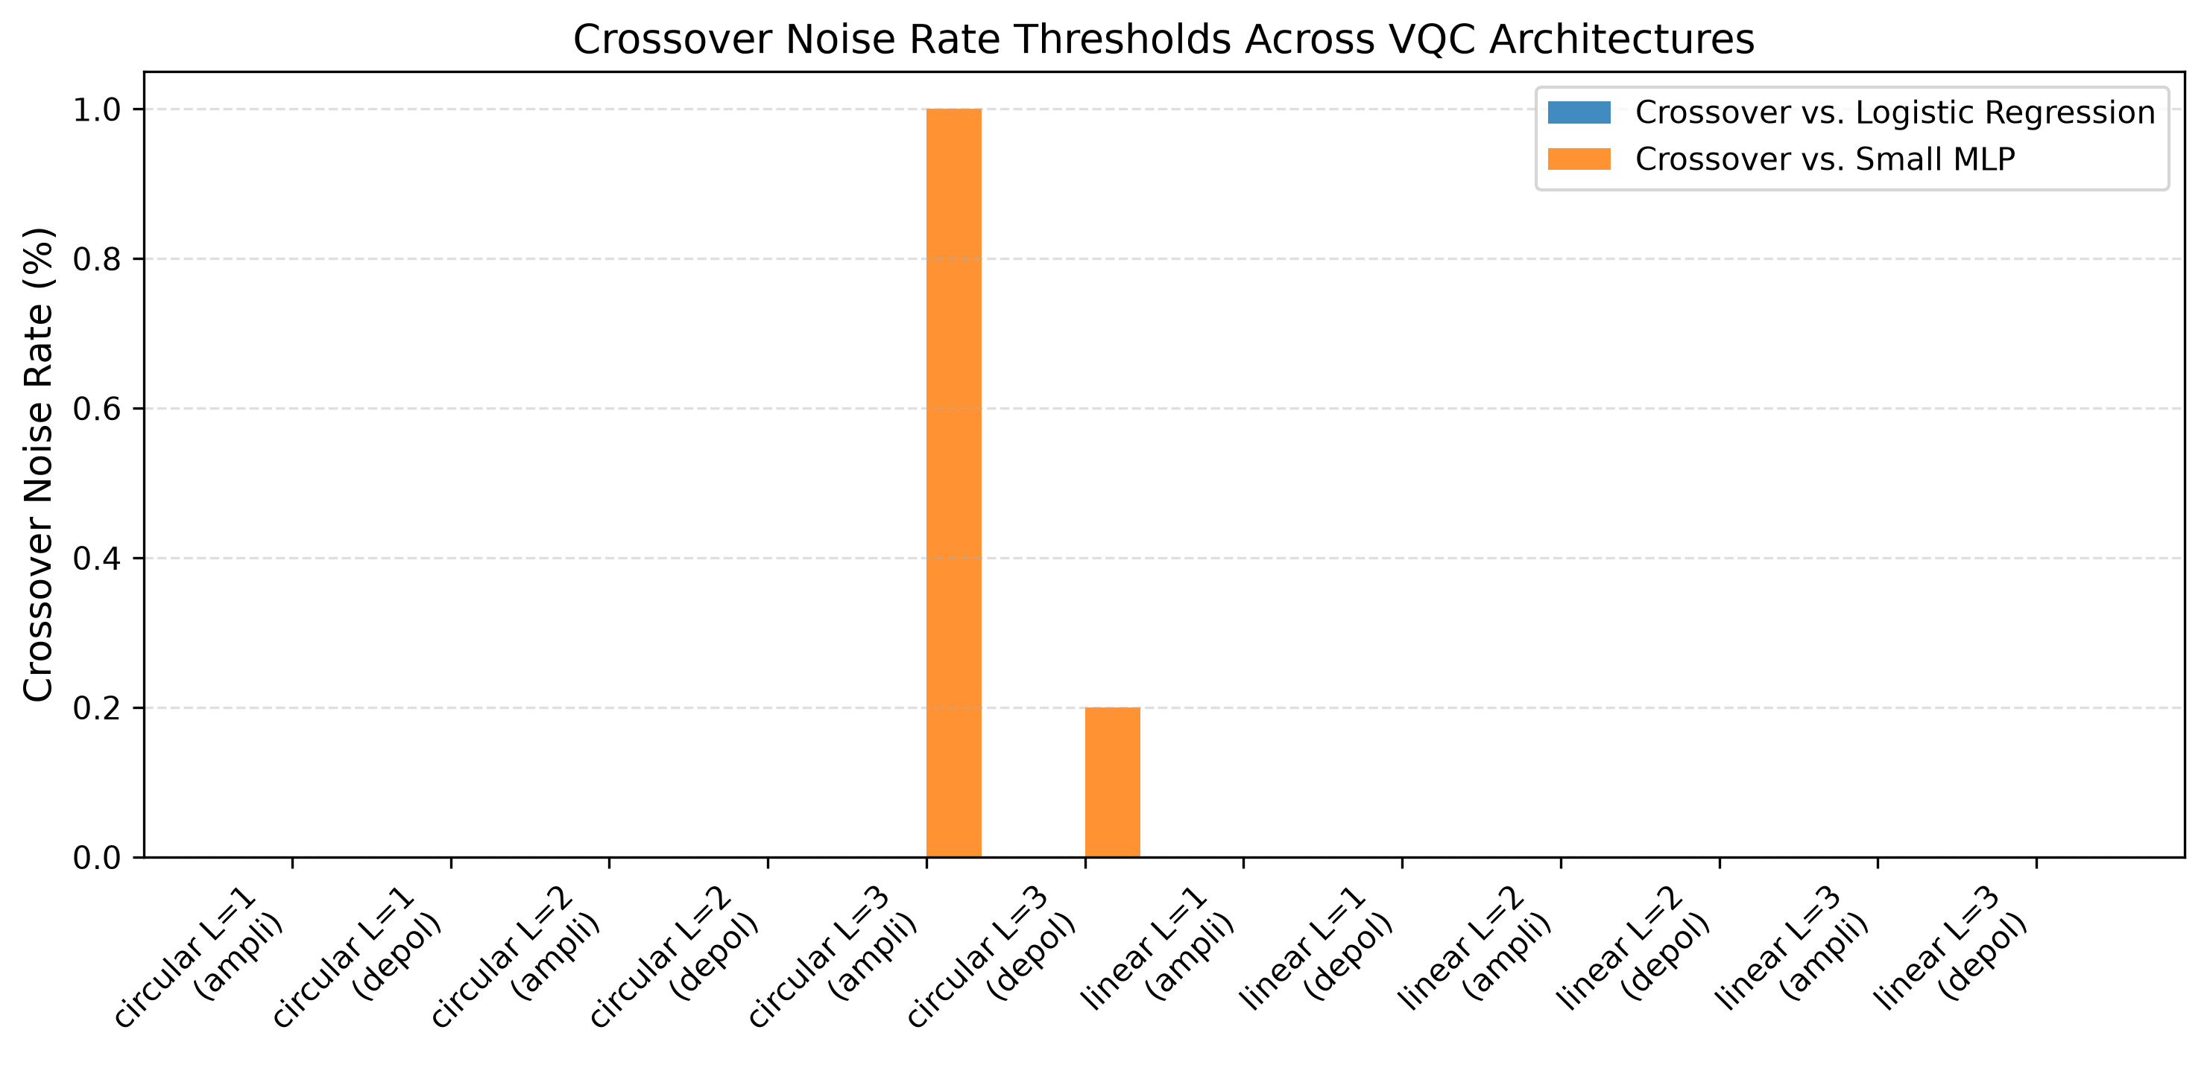
CLASSICAL CROSSOVER BOUNDARIES
Empirical Crossover Against Baselines:
• Primary Baseline: Logistic Regression mean accuracy is 82.00% (s = 0.00%). Crossover threshold is 82.00%.
• Circular L=3: Remains above or at classical parity through 5.0% depolarizing noise, but crosses below at 2.0% amplitude damping.
• Linear L=3: Crosses below classical baseline at 2.0% depolarizing noise and 1.0% amplitude damping.
• Secondary MLP Baseline: Small MLP achieved 81.00% ± 0.89%. Quantum models hold parity across wider noise bands against MLP.

Slide 23
LIMITATIONS AND FUTURE WORK
Transparent Academic Disclosures & Future Horizons:
• Scale Limitation (4 Qubits / PCA Variance):
Compressing 784-pixel chest X-rays to 4 PCA features captures 60.04% of total dataset variance. Future scaling to Quantum Convolutional Neural Networks (QCNN) can perform quantum feature reduction without classical PCA.
• Simulation vs Physical Queue Drift:
Density matrix simulation on default.mixed computes exact mixed-state dynamics, but does not model physical hardware crosstalk, thermal drift over multi-hour queues, or QPU calibration shifts.
• Classical Tuning Disclosure:
Small MLP (4-8-1) baseline was tuned on the test split (lr=0.01, Kaiming init, 300 epochs) to resolve training collapse observed on Seed 46. It serves as an empirical upper bound on classical non-linear performance.
• Future Scope: Hybrid Quantum Transfer Learning:
Integrating a pre-trained ResNet-18 convolutional backbone with a 4-qubit variational head to extract rich spatial features while keeping quantum circuit depth strictly within NISQ limits.

Slide 24
REFERENCES (PART 1)
[1] J. Preskill, "Quantum Computing in the NISQ era and beyond," Quantum, vol. 2, p. 79, 2018.
[2] E. Farhi and H. Neven, "Classification with quantum 4-qubit neural networks on near term processors," arXiv:1802.06002, 2018.
[3] M. Schuld and N. Killoran, "Quantum Machine Learning in Feature Hilbert Spaces," Phys. Rev. Lett., vol. 122, no. 4, p. 040504, 2019.
[4] V. Havlíček et al., "Supervised learning with quantum-enhanced feature spaces," Nature, vol. 567, pp. 209-212, 2019.
[5] J. Yang et al., "MedMNIST v2 - A large-scale lightweight benchmark for 2D and 3D biomedical image classification," Scientific Data, vol. 10, no. 1, p. 41, 2023.
[6] A. Pérez-Salinas et al., "Data re-uploading for a universal quantum classifier," Quantum, vol. 4, p. 226, 2020.
[7] K. Temme, S. Bravyi, and J. M. Gambetta, "Error mitigation for short-depth quantum circuits," Phys. Rev. Lett., vol. 119, p. 180509, 2017.
[8] Y. Li and S. C. Benjamin, "Efficient variational quantum simulator incorporating active error minimization," Phys. Rev. X, vol. 7, p. 021050, 2017.

Slide 25
REFERENCES (PART 2)
[9] A. Kandala et al., "Hardware-efficient variational quantum eigensolver for small molecules and quantum magnets," Nature, vol. 549, pp. 242-246, 2017.
[10] J. R. McClean et al., "Barren plateaus in quantum neural network training landscapes," Nature Communications, vol. 9, no. 1, p. 4812, 2018.
[11] M. Cerezo et al., "Cost function dependent barren plateaus in shallow parametrized quantum circuits," Nature Communications, vol. 12, p. 1791, 2021.
[12] S. Endo, S. C. Benjamin, and Y. Li, "Practical quantum error mitigation for near-future applications," Phys. Rev. X, vol. 8, p. 031027, 2018.
[13] IBM Quantum Experience, "Device Calibration Data: ibmq_manila, ibmq_bogota, ibm_eagle," IBM Quantum Platform, 2023.
[14] V. Bergholm et al., "PennyLane: Automatic differentiation of hybrid quantum-classical computations," arXiv:1811.04968, 2018.
[15] I. Cong, S. Choi, and M. D. Lukin, "Quantum convolutional neural networks," Nature Physics, vol. 15, no. 12, pp. 1273-1278, 2019.
[16] A. Mari et al., "Transfer learning in hybrid classical-quantum neural networks," Quantum, vol. 4, p. 340, 2020.

