Slide 1

Industrial Interaction Report
7th Semester
Name: Aman Verma
Roll No: 55
Student ID: 200211000

Slide 2
Objective
During my internship, our main goal is to develop a resilient and user-friendly online system for logging vegetable market activities.

Slide 3
Motivation
1. Tackling Challenges in the Agricultural Industry
2. Empowering Farmers with Digital Solutions
3. Improving Consumer Convenience
4. Embracing Innovation Driven by Technology
5. Making Contributions to Ensure Food Security

Slide 4
Work Responsibility
1. Utilizing machine learning, I created a Price Prediction model.
2. I deployed the price prediction module using Streamlit.
3. I took on the responsibility of constructing the About Us page for the website.

Slide 5
Technologies Used
Machine Learning Frameworks: The development and training of predictive models involved the use of machine learning libraries such as TensorFlow, PyTorch, or scikit-learn.
Programming Language: Python served as the primary programming language for the implementation of various tasks.
Data Processing: Libraries such as Pandas and NumPy played a crucial role in preprocessing and manipulating the data.
Data Visualization: Visualizing historical price trends and predictions was achieved through the utilization of libraries like Matplotlib, Seaborn, or Plotly.
Frontend Development: For crafting the user interface and designing the About Us page, HTML, CSS, and JavaScript were employed, or alternatively, a frontend framework like React, Angular, or Vue.js was utilized.

Slide 6
OUTPUT SCREENS

Slide 7
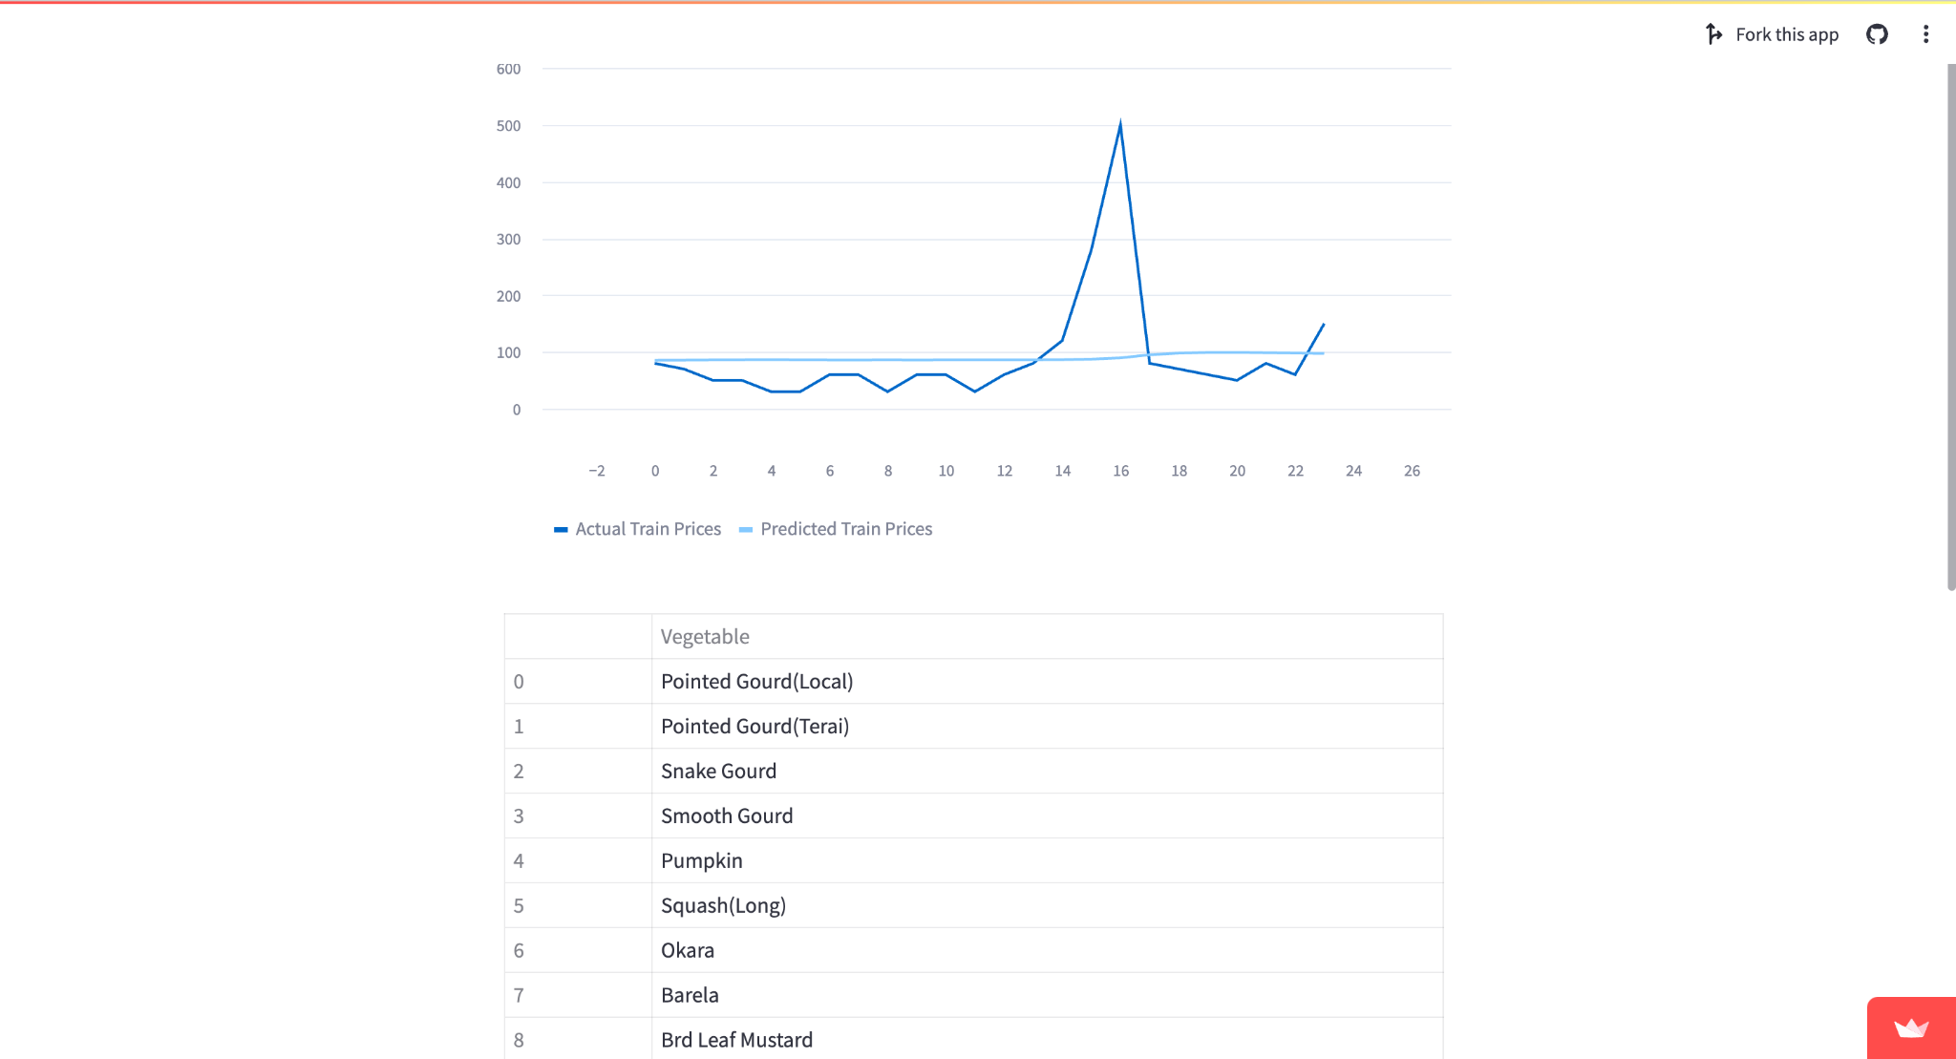
Price Prediction Module

Slide 8
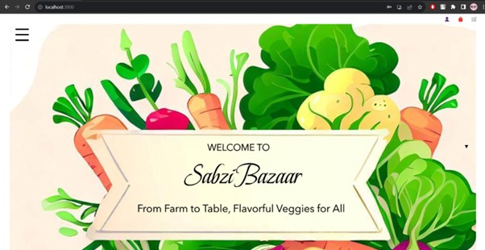
Home Page

Slide 9
Conclusion
My internship at Graphic Era University has been a transformative experience, enriching both my technical expertise and interpersonal skills. Engaged in a dynamic setting, I participated in varied projects, refining my problem-solving and critical thinking capabilities. Working closely with a skilled team, I gained insights into the significance of teamwork and adaptability. Taking on the role of mentoring a group of interns not only offered leadership opportunities but also imparted lessons in conflict resolution and upholding integrity. This valuable experience has prepared me for future achievements and personal development in my career.

Slide 10
THANK-YOU

