Slide 1
Customer Churn Data Analysis
(Capstone Project)
By Aman Verma

Slide 2
Introduction
A certain bank in North America wants to perform customer churn analysis, as the credit card business of the bank is not performing very well.
Churn analysis will help the bank evaluate the customers who have stopped purchasing the credit card of the bank and figure out measures to reduce the bank's customer loss rate
Showing percentage of all customers who is exit or stay in the bank.
To begin with, A data analyst, has been asked to analyze the banks customers' churn data by performing the tasks given in the upcoming slides.
We are required to tableau workbook to perform the Customer churn analysis

Slide 3
The objective of the project is to use Tableau Workbook to analyze the Customer Churn Data to perform exploratory data analysis by answering the questions in the upcoming slides.
Mention the key questions or areas of interest to be explored:
Percentage of Attrited and Existing Customers.
Relationships between budget and revenue
Genre preferences and their impact on success
Actors or directors with the most appearances or successful movies
Other interesting aspects specific to the dataset
3. Mention the technologies and tools used for the analysis:
Tableau Work book to perform Customer churn data analysis and for better visualization.
Creating dashboard for better visuals of all the tasks.
Customer Churn Dataset as the primary data source
Objective

Slide 4
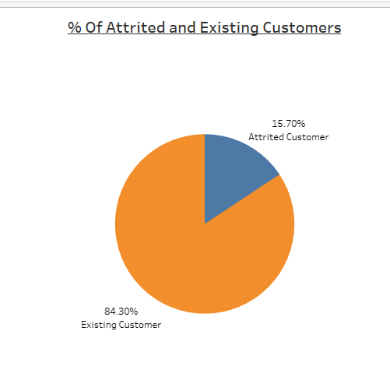
Display the percentage of the Attrited and the Existing customers from the data.
Output:
Conclusion:
From the output Attrited Customer % is 15.70 and Existing Customer % is 84.30. Which mean 15.70% customer has left the bank.

Slide 5
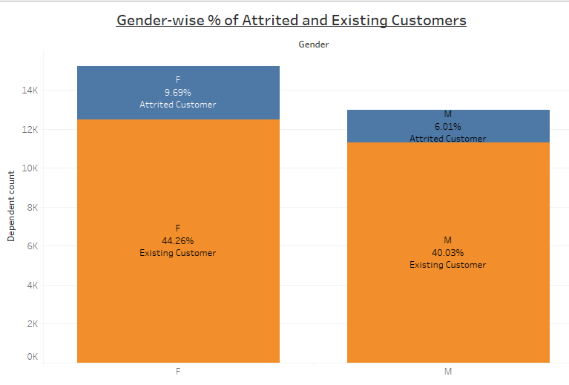
Display gender-wise percentage of the attrited and existing customers.
Conclusion:
Here we display gender- wise % of attrited and existing customer. From the output we can clearly see that 9.69% female and 6.01% male customers has left the bank.

Slide 6
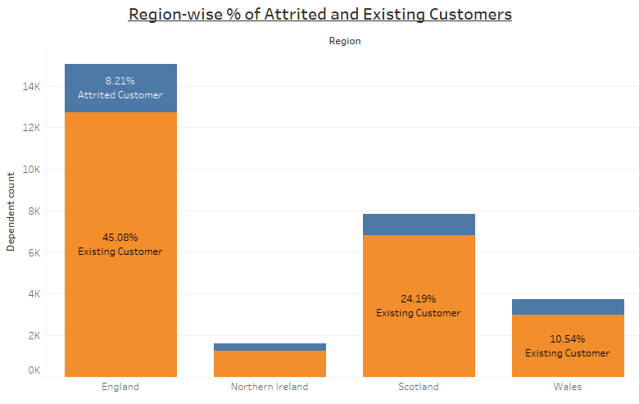
Display region-wise percentage of the attrited and the existing customers.
Output:
Conclusion:
In this question we perform region-wise % of attrited and existing customer. So in the England region 8.21% customer has left the bank which is highest.

Slide 7
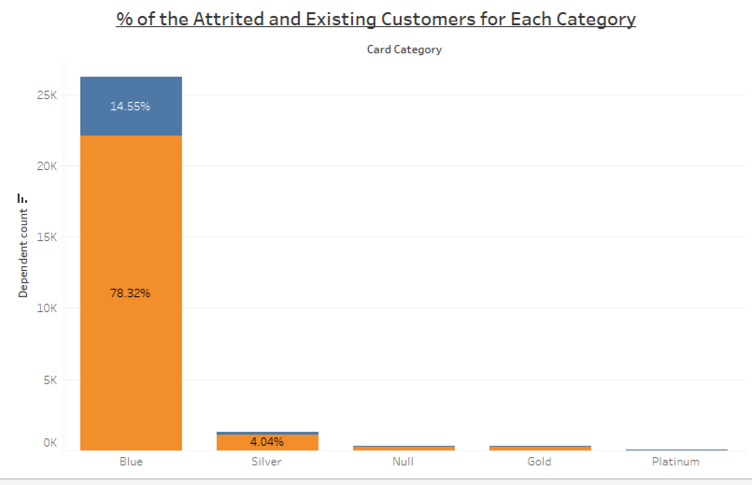
Display the percentage of the attrited and the existing customers for each category.
Output:
Conclusion:
So from the output we can clearly see that in Blue Category 14.56% Customer has left the bank, and 78.32% customer is still in the bank which is highest in any other category.

Slide 8
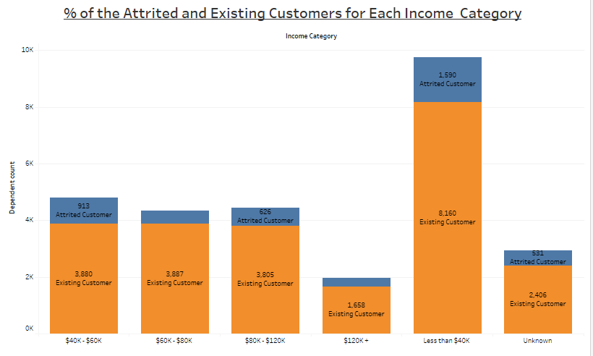
Display the percentage of the attrited and the existing customers for each income category.
Conclusion:
Here we find out for Each Income Category The Percentage of the Attrited and the Existing Customers based on Dependent count. So in the Income Category less than $40k has the maximum existing customer 8160.

Slide 9
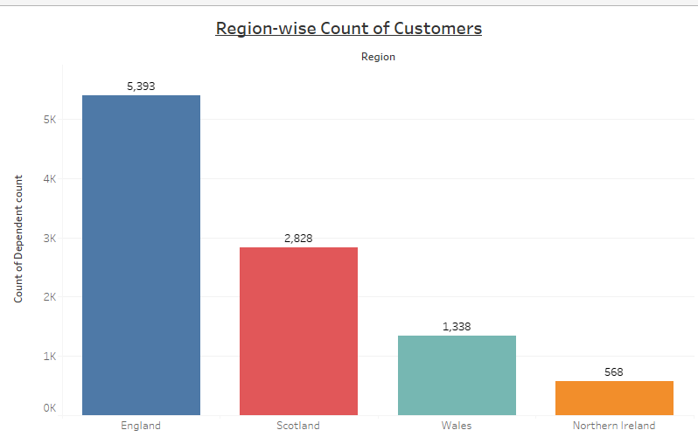
Display region-wise count of customers. Identify the region that has the maximum numbers of customers.
Output:
Conclusion:
Here we display region-wise count of customer . England region has the maximum numbers of customers that is 5393 .

Slide 10
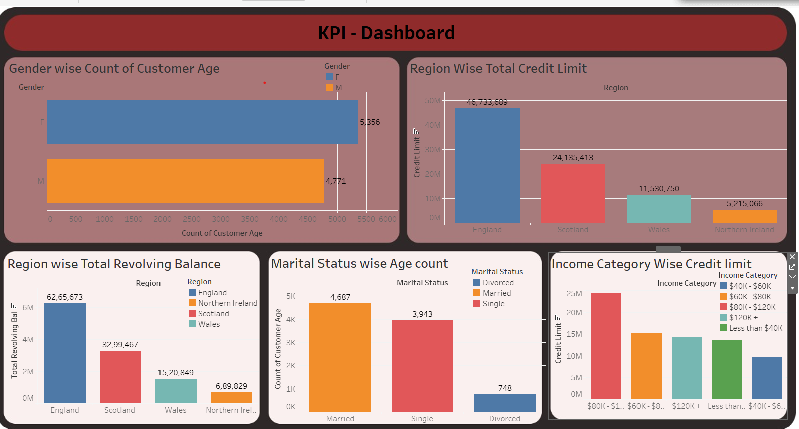
Create an interactive dashboard by following the given instructions.
-Create a Figma template for the dashboard.
-Design the dashboard with the charts created in task 1-6
-Apply actions filter on the charts created in task 1-6
Output:
Conclusion:
So here we create the Figma template For showing the Dashboard. In this KPI-DASHBOARD we show the all task which we mention in previous slides. And in this dashboard we apply the actions filter on the chart that means, changing in any of the task all tasks are affected .

Slide 11
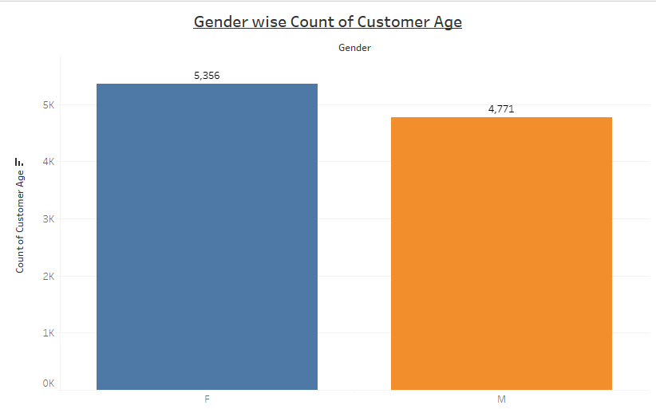
Identify 5 more points of analysis, present them using charts/graphs, and build an interactive dashboard using these charts/graphs.
1 - Point : Display gender-wise count of customer age.
Output:
Conclusion:
In this task, a gender-wise count of customer age is analyzed. The results reveal that females have the highest count of customer age, totaling 5356 individuals. Conversely, males have a slightly lower count, with 4771 individuals falling within the specified customer age range.

Slide 12
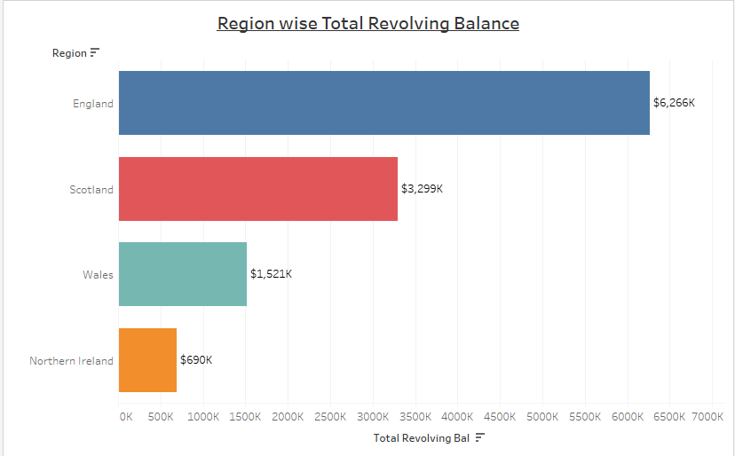
2 – Point : Display Region–wise Total Revolving Balance.
Output:
Conclusion:
In this task, a region-wise analysis of the total revolving balance was performed. The outcome revealed that the England region has the highest revolving balance, reaching $6,266K. This insight provides a concise summary of the regional distribution of revolving balances, emphasizing the notable financial activity in England.

Slide 13
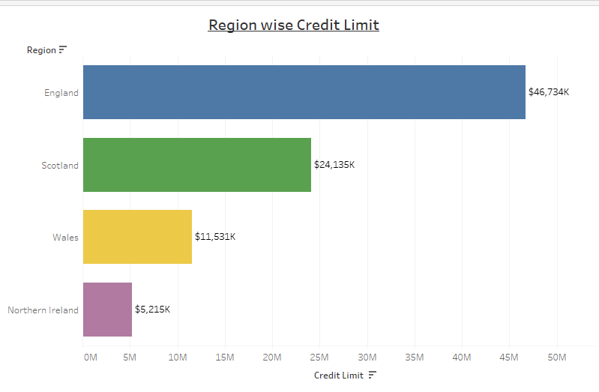
3 – Point : Display Region-wise Credit Limit.
Output:
Conclusion:
In this task, a region-wise examination of credit limits is conducted, revealing that the England region possesses the highest credit limit, amounting to $46,734k

Slide 14
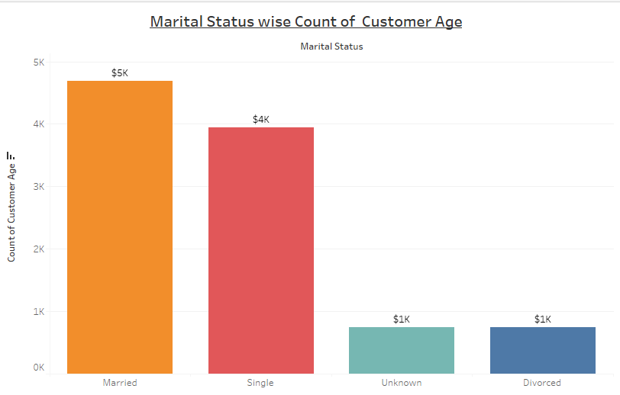
4 – Point : Display Marital Status wise count of Customer Age.
Output:
Conclusion:
From the task we get the count of customer age based on marital status. The count of married customer has highest count which is $5k

Slide 15
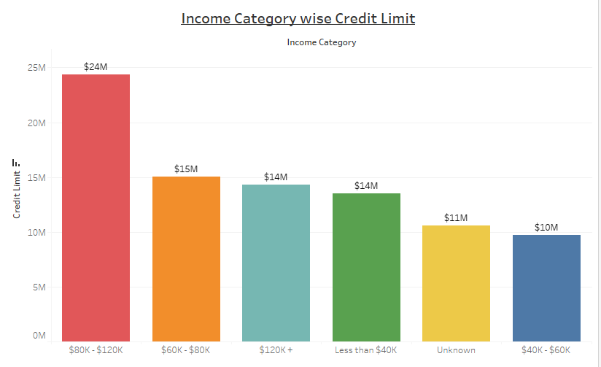
5 – Point : Income Category wise Credit Limit.
Output:
Conclusion:
In this task we found out credit limit based on Income Category. And from the output we see the income category between $80k - $120k has the highest credit limit that is $24M.

Slide 16
Create an interactive dashboard by following the given instructions.
Output:
Conclusion:
So here we create the Figma template For showing the Dashboard. In this KPI-DASHBOARD we show the all task which we mention in previous slides. And in this dashboard we apply the actions filter on the chart that means, changing in any of the task all tasks are affected .

Slide 17
Conclusion
Attrited vs. Existing Customers:
Overall: 15.70% of customers have attrited, while 84.30% are existing.
Gender-wise: 9.69% of female customers have attrited, compared to 6.01% of male customers.
Region-wise: England has the highest attrited customer percentage at 8.21%, while North Ireland has the lowest at 1.24%.
Blue Category: 14.55% of customers in the Blue category are attrited, with 78.32% being existing.
Income Category (< $40k): 1590 customers are attrited, and 8160 customers are existing.
Region-wise Count: The England region has the highest count of customers at 5393.
Dashboard:
A dashboard displays all the tasks completed, providing a comprehensive overview of the analyzed data.

Slide 18
Thankyou
Presented by:
Aman Verma
Mentor
Sharayoo Dixit

