Slide 1
Movie Rental Data Analysis SQL
By Aman Verma

Slide 2
INTRODUCTION
MovieOnRent is a prominent chain of movie rental stores offering a diverse collection of movies in DVD and Blu-ray formats. The management is eager to understand customers' preferences by analyzing the types of movies, genres, and actors that are most frequently rented. This analysis aims to enhance the inventory, ensuring that it aligns with the audience's tastes for an improved and personalized movie-watching experience at MovieOnRent.

Slide 3
OBJECTIVE
To kick start the project, our primary goal is to leverage MySQL for a comprehensive analysis of a movie rental store's data, ultimately aiming for enhanced business growth. The management has presented specific questions that will guide our tasks and help the firm make informed decisions. Our role is to assist by crafting queries that address these tasks and yield the desired output. Let's embark on this journey of data-driven insights to propel the movie rental store towards further success.

Slide 4
Description of Sakila Database
The Sakila sample database is a meticulously designed representation of a DVD rental store, featuring tables like film, actor, customer, rental, and more. Notable for its normalized structure, it incorporates many-to-many relationships and multiple paths between entities, allowing for extensive practice in join operations. The database ensures consistency with well-named columns, adhering to a specific pattern for primary and foreign keys. Eschewing surrogate keys, relationship tables use composite primary keys. Additionally, each table includes a last update audit column, and a generated dataset of considerable size enhances its utility for educational purposes.

Slide 5
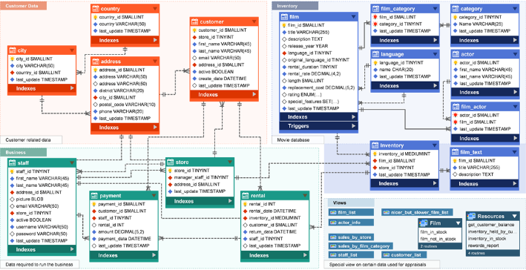
ER of Sakila Database

Slide 6
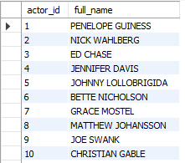
Task 1. Display the full names of all the actors
Approach
Used concat function to merge first and last name
Output
In the output, there is total 200 Actor’s name.

Slide 7
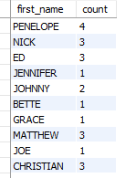
Task 2.1 : Display Number of times each first name appears in database.
Output
In the Output maximum number of appearance is 4 and minimum is 1

Slide 8
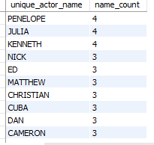
Task 2.2: Count of actors those have Unique first names in the database.
Output
Conclusion
There are total of 76 unique first name.

Slide 9
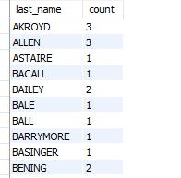
Task 3.1: Number of times each last name appears in database.
Output
Conclusion
The maximum number of times each last name has appeared is 3 and the least is 1.

Slide 10
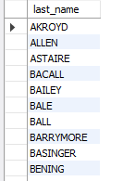
Task-3.2: All Unique last names in the database.
Output
Conclusion
These are the unique last name in the entire database.

Slide 11
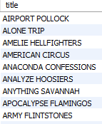
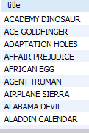
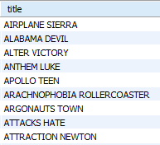
Task-4.
i. List of Movies with rating “R”. ii. List of Movies that are not rated “R”. iii. List of Movies that are suitable for below 13 years of age.
Output i.
Output ii.
Output iii.
Conclusion
These are the Movies in the database that are “R” rated.
Conclusion
These are the Movies in the database that are not “R” rated.
Conclusion
The are the Movies that are suitable for audience below 13 year of age.

Slide 12
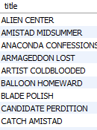

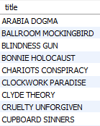
Task-5.
i. Movies with replacement cost up to $11. ii. Movies with replacement cost between $11 to $20. iii. Movies in descending order of their replacement costs.
Output
Output
Output
Conclusion
These are the Film Title in the database with replacement cost up to $11.
Conclusion
These are the Film Title in the database with replacement cost between $11 to $20.
Conclusion
The maximum and minimum replacement cost is $29.99 and $9.99 in the database.

Slide 13
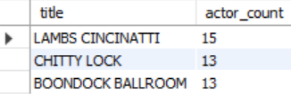
Task-6.
Top 3 Movies with greatest number of actors.
Method
Joined film & film_actor table using ‘film_id’ .
Grouped by ‘title’ and Order by actor_count (generated field).
Desc and limit to 3 rows only.
Output
Conclusion
The Top movie in the database with greatest number of actors is “LAMBS CINCINATTI” with total of 15 actors.

Slide 14
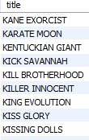
Task-7.
Movies titles starting with the letter ‘K’ and ‘Q’.
Method
Selected ‘title’ column from ‘film’ table.
‘LIKE’ operator with % symbol after both the alphabets i.e. ‘K%’ and ‘Q%’ .
Output
Conclusion
These are the movies in the database where the titles are starting with the letter ‘K’ and ‘Q’.

Slide 15
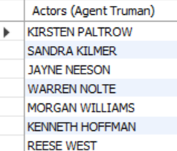
Task-8.
Actors who have worked in “Agent Truman” movie.
Method
Concat to add first_name & last_name from ‘actor’ table.
Subquery with where Claus.
Nested subquery in inner where Claus.
Where Claus with movie name “AGENT TRUMAN”
Output
Conclusion
There’re total 7 actors in the database who have worked in the movie “AGENT TRUMAN”.

Slide 16
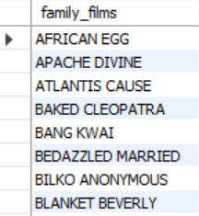
Task-9.
All the movies categorized as family films in DB.
Method
Selected title from ‘film’ table.
Subquery with where Claus.
Nested subquery in inner where Claus.
Where Claus with category “FAMILY”.
Output
Conclusion
These are the movies which are categorized as FAMILY FILMS.

Slide 17
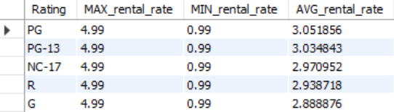
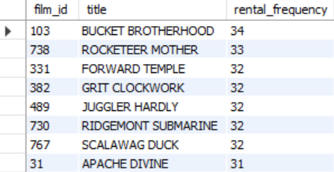
Task-10.
i. Max, Min, Avg rental rates of movies based on their ratings. ii. Movies in desc order of their rental frequencies.
Output
Output
Conclusion
The maximum average rental rate is of PG rating i.e. $3.05 where as the minimum average rental rate is of G rating i.e. $2.88
Conclusion
The max rental_frequency of movie in the database is of ‘Bucket Brotherhood’ i.e. 34 and the min rental_frequency is of movie ‘Train Bunch’ i.e. 4

Slide 18
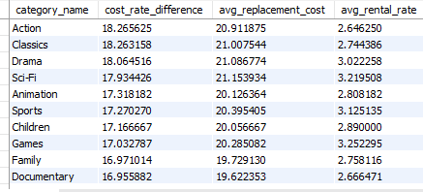
Task-11.
Film categories with difference between average film replacement cost & average film rental rate more than $15
Method
Selected category, avg of RC, avg of RR and difference b/w RC & RR.
Joined ‘film_category’ and ‘category’.
Where Claus with difference b/w RC & RR > $15.
Output
Conclusion
These are the movies with max difference between RR & RC is of Action category i.e. $18.26 and the min difference is of Travel category i.e. $15.789

Slide 19

Task-12.
Film categories in which number of movies is greater than 70.
Method
Selected category and count(*) as ‘movie_count’.
Joined film, film_category and category table
Group by with ‘category_id’.
Having Claus with movie_count > 70.
Output
Conclusion
Here, we can see there’re only 2 film categories where the number of movies are greater than 70. i.e. Foreign with 73 movies & Sports with 74 movies.

Slide 20
THANKYOU
By: AMAN VERMA
Mentor: Sharayoo Dixit

