Slide 1
TMBD Movie data analysis
(Capstone Project)
By Aman Verma

Slide 2
Introduction
A production company wants to analyze a movie dataset to identify what kinds of movies perform well in cinemas.
Which genres they belong to, and so on. It will help the company predict if a movie will be a commercial success, if the movie will be highly rated, etc.
Movies that cost over $100 million can still fail, why so? Movie lovers might have different interests.
To begin with, the management has asked us, as a data analyst, to answer certain questions by carrying out the upcoming tasks.
We are required to write Python codes in a Python notebook to perform.

Slide 3
The objective of the project is to use Python programming to analyze a movie data to perform exploratory data analysis by answering the questions in the upcoming slides.
Mention the key questions or areas of interest to be explored:
Movie popularity trends over time
Relationships between budget and revenue
Genre preferences and their impact on success
Actors or directors with the most appearances or successful movies
Other interesting aspects specific to the dataset
3. Mention the technologies and tools used for the analysis:
Python programming language
Popular data analysis libraries: Pandas, NumPy, Matplotlib, Seaborn
Jupyter Notebook for coding and visualization
TMDB Movie Dataset as the primary data source
Objective

Slide 4
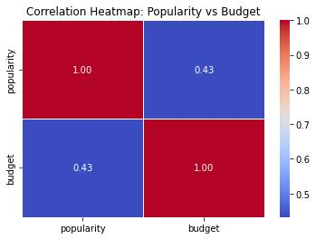
Correlation between Numerical columns using HEAT MAP :-
If the correlation coefficient is close to 1, it suggests a strong positive correlation, meaning as the movie budget increases, the popularity tends to increase.
If the correlation coefficient is close to -1, it suggests a strong negative correlation, meaning as the movie budget increases, the popularity tends to decrease.
If the correlation coefficient is close to 0, it suggests a weak or no correlation, meaning there is no clear linear relationship between movie budgets and popularity.

Slide 5
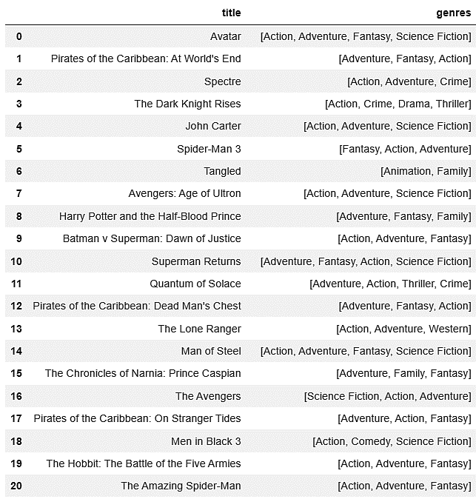

Load the movie dataset in the Python notebook. Display the numbers of rows and columns in the dataset. Display the titles and genres of the first 50 movies from the dataset.
Output:
Conclusion:
The first 50 movies with their genres where each movie is consist of 2 to 4 number of genres in them.

Slide 6
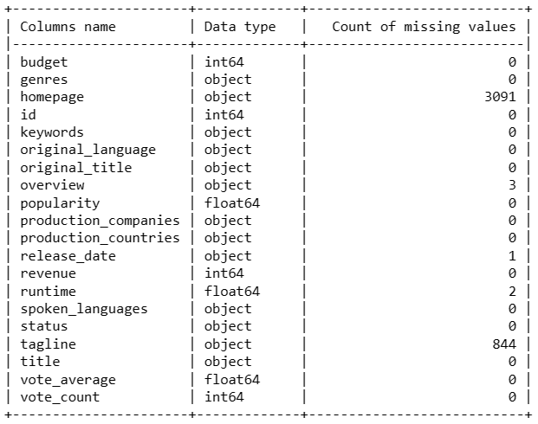
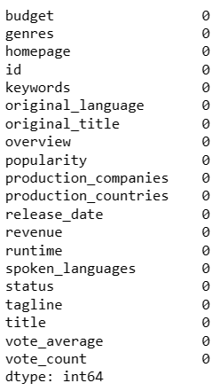
Identify the columns that have null values and perform the null value treatment. (Choose the imputation method based on the type of data in the columns of interest)
Before imputation:
After imputation:
Conclusion:
I applied the forward imputation method to fill all the null values in the database.

Slide 7
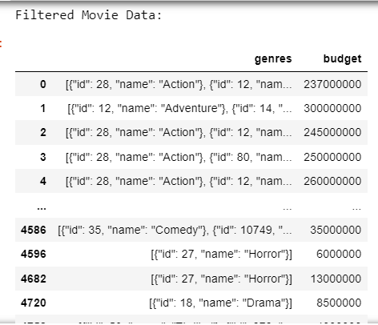
Display the movie categories that have a budget greater than $220,000
Output:
Conclusion:
These are the genres that have the Budget greater than $220,000.
Where the maximum budget we can see is of Action genre.

Slide 8
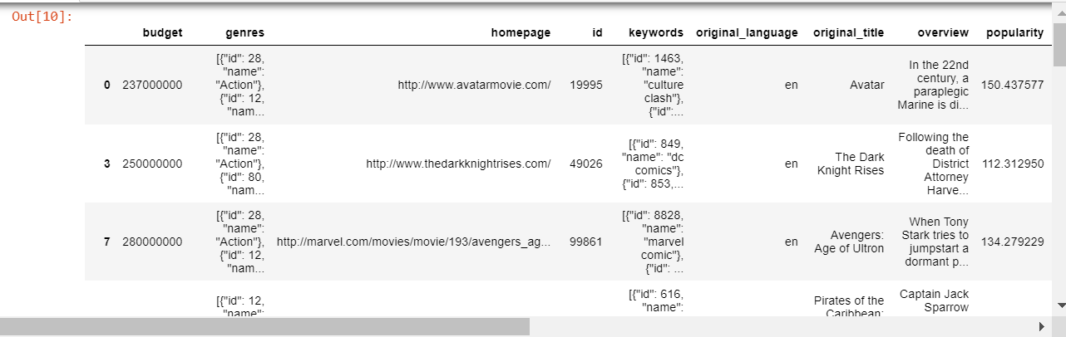
Display the movie categories where the revenue is greater than $961,000,000
Output:
Conclusion:
There’re total of 24 genres that have the Revenue greater than $961,000,000
Where the maximum Revenue we can see is of Adventure genre.

Slide 9

There are some movies for which the budget and revenue columns have the value 0, which mean unknown values. Remove the rows with value 0 from both the budget and revenue columns.
Number of rows before removing the rows with value 0 from budget & revenue :
Method:
We’ve used the drop() function with conditional formatting where budget & revenue columns have 0 value and dropped the rows indexes with the dot index keyword from axis 0.
Number of rows after removing the rows with 0 values:

Slide 10
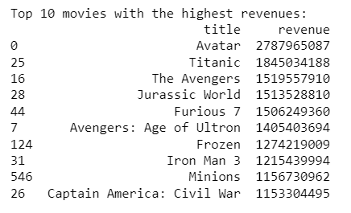
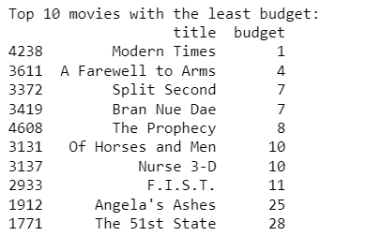
List the top 10 movies with the highest revenues and the top 10 movies with the least budget.
Output:
Conclusion:
Avatar movie has generated the highest revenue of all time whereas Civil War has been able to made its place in the top 10 revenues Movies.
Conclusion:
Modern Times is the movie with the least budget in the dataset, while the 51st state is on the tenth place with the budget of only $28.

Slide 11
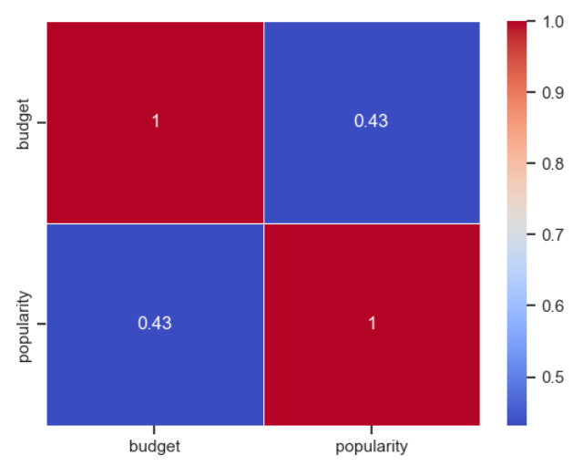
How are popularities of movies related with the movie budgets? Are they correlated or totally uncorrelated with each other? Write the interpretation of your analysis.
Output:
Conclusion:
Based on the correlation of 0.431 between the popularities of movies and their budgets, there is a moderate positive correlation. This correlation suggests that there is a tendency for movies with higher budgets to have higher levels of popularity, but the relationship is not extremely strong. It indicates that there is some degree of association between movie budgets and their popularity, but other factors also contribute to a movie's popularity.

Slide 12
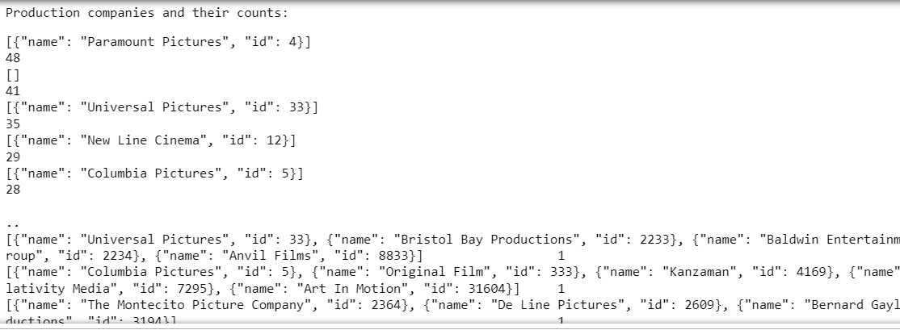
Identify and display the names of all production companies along with the number of times they appear in the dataset.
Output:
Conclusion:
There’re total of 2633 unique Production companies in the dataset, where Paramount Pictures has appeared most of the time i.e. 48 in count while Daniel Studios has only appeared once in the entire dataset.

Slide 13
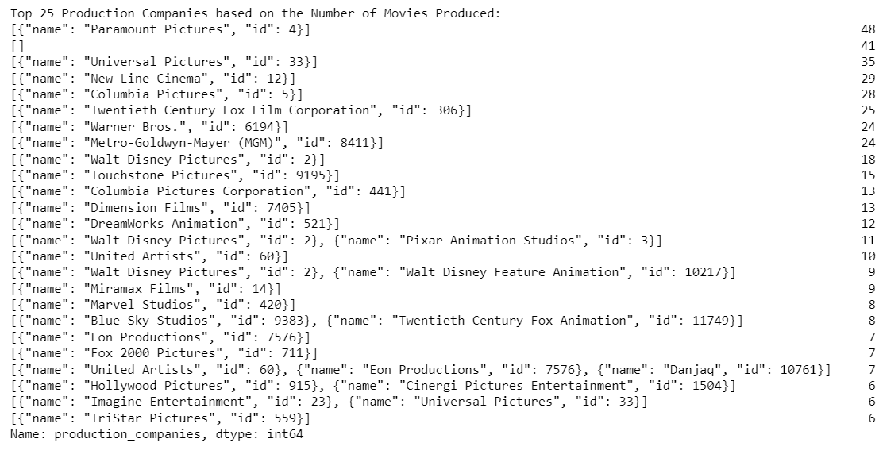
Display the names of the top 25 production companies based on the number of movies they have produced in descending order of the number of movies produced.
Output:
Conclusion:
The top 25 Production companies based on the number of movies they have produced are from Paramount Pictures to Working Title Films

Slide 14
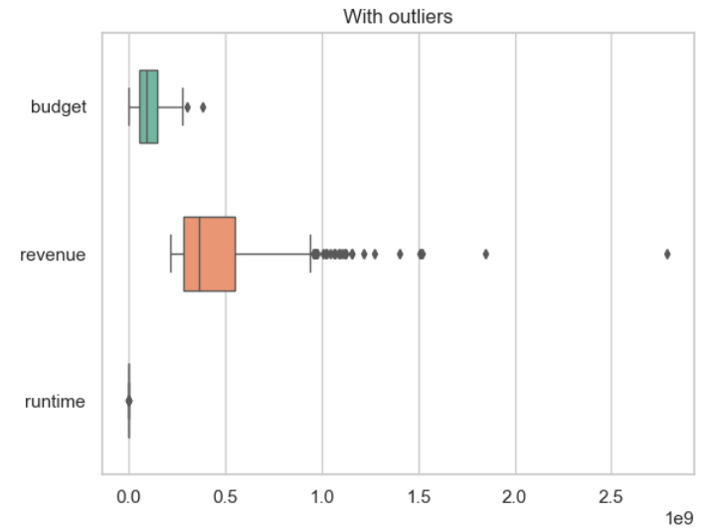
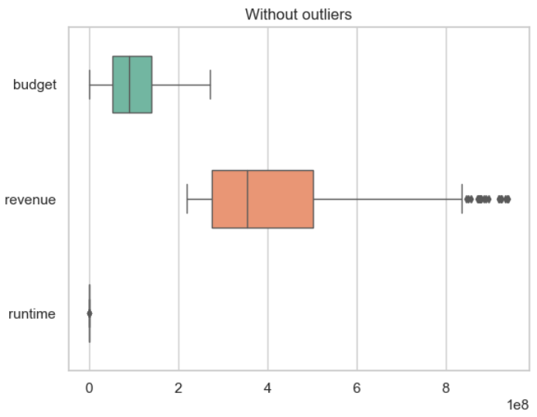
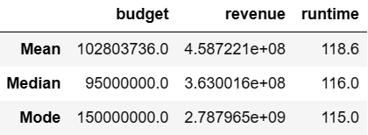
Sort the data in descending order based on revenue and filter the top 500 movies. Find the measures of central tendency for the following columns using the filtered data:
i. Budget ii. Revenue iii. Runtime
Output:
Conclusion:
Here, we can see the Revenue column has the highest measures of central tendency in the list of top 500 movies so it is obvious it’ll also have the most number of outliers. Even after performing the outlier analysis Revenue column is still containing some outliers in the output.

Slide 15
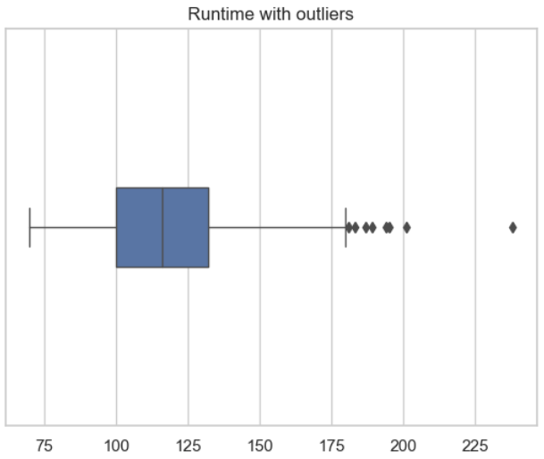
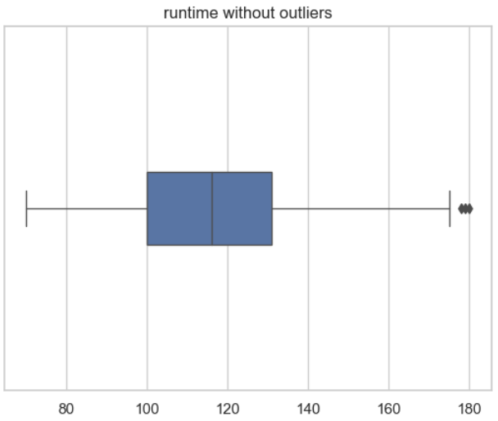
Sort the data in descending order based on revenue and filter the top 500 movies. Find the measures of central tendency for the following columns using the filtered data:
i. Budget ii. Revenue iii. Runtime
Output:
Conclusion:
In Runtime column the values were too smaller than the other two, therefore in this chart we can see a separated result only for the Runtime column. Here also after performing the outlier analysis there’re still some outliers left in the Runtime column.

Slide 16
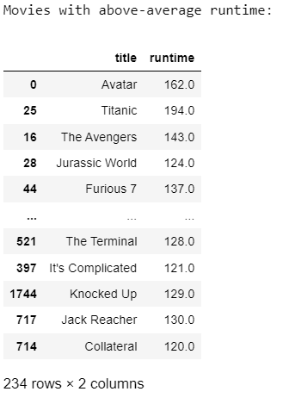
Identify and display the names of the movies along with their run times for those movies that have above average runtime, using the data from the previous task.
Output:
Conclusion:
The average Runtime is 129.0
So,
There’re total of 234 Movies in the dataset that have above average Runtime.
i.e. from 120 to 194 where the Highest Runtime of all time in the database is of movie ‘Titanic’.

Slide 17
Conclusion
Budget vs. Performance: High budgets don't guarantee movie success; audience preferences vary.
Revenue: "Avatar" generated the highest revenue, with "Civil War" in the top 10.
Budget-Popularity Correlation: Moderate positive correlation of 0.431 between budgets and popularity, this suggests that factors other than budget influence a movie's popularity.
Production Company Analysis: Paramount Pictures appeared most frequently (48 times).
Genre Analysis: Most genres had budgets exceeding $220,000, indicating audience preferences.
Revenue Outliers: Revenue column contains outliers despite performing the outlier analysis.
Movie Runtime Analysis: 234 movies had runtimes above average (129), “Titanic" had the highest runtime.

Slide 18
Thankyou
Presented by:
Aman Verma
Mentor
Sharayoo Dixit

