Slide 1
Group Project Title: Cancer Prediction Group: G 4 Team Members: Amandeep Singh Vohra (502004073), Babit Abrol (502004129) Submitted to: - Dr. Nitin Arvind Shelke
Artificial Intelligence
Project Presentation

Slide 2
Problem Statement
According to the world health organization (WHO) Breast cancer is the most frequent cancer among women, impacting 2.1 million women each year, and also causes the greatest number of cancer- related deaths among women.
Limited resource settings with weak health systems where the majority of women are diagnosed in late stages should prioritize early diagnosis programs based on awareness of early signs and symptoms and prompt referral to diagnosis and treatment.
The goal is to increase the proportion of breast cancers identified at an early stage, allowing for more effective treatment to be used and reducing the risks of death from breast cancer. Since early detection of cancer is key to effective treatment of breast cancer we use various machine learning algorithms to predict if a tumor is benign or malignant, based on the features provided by the data.

Slide 3
STAGE 1

Slide 4
Data Collection
Data Sources-
The data for our project has been collected by the Kaggle.com .
What is Kaggle?
Kaggle, a subsidiary of Google LLC, is an online community of data scientists and machine learning practitioners. Kaggle is the world's largest data science community with powerful tools and resources to help you achieve your data science goals.
Data Overview (Summary)
For our group project we chose Breast Cancer dataset. for cancer prediction among women. The data includes: -
Attribute Information:
1) ID number
2) Diagnosis (M = malignant, B = benign) -3 -32.

Slide 5
Required Libraries
NumPy
NumPy is a library for the Python programming language, adding support for large, multi-dimensional arrays and matrices, along with a large collection of high-level mathematical functions to operate on these arrays.
Pandas
Panda’s is a software library written for the Python programming language for data manipulation and analysis. In particular, it offers data structures and operations for manipulating numerical tables and time series.
SK- Learn
Scikit-learn is a free software machine learning library for the Python programming language. It features various classification, regression and clustering algorithms including support vector machines, random forests, gradient boosting, k-means and DBSCAN, and is designed to interoperate with the Python numerical and scientific libraries NumPy and SciPy.

Slide 6
Data Visualization

Slide 7
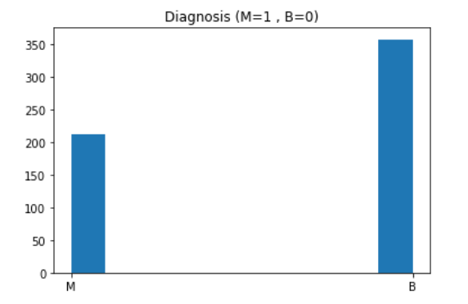
BAR CHART For M & B Diagnosis
M = Malignant (harmful)
B = Benign (less harmful)

Slide 8
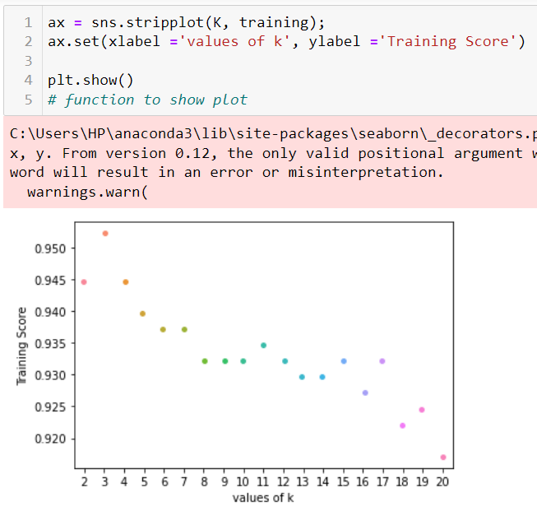
PLOT for K-values & Train Score

Slide 9
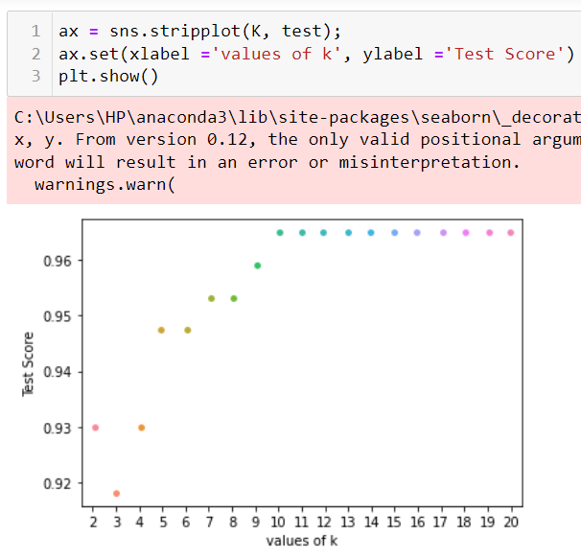
PLOT for K-values & Test Score

Slide 10
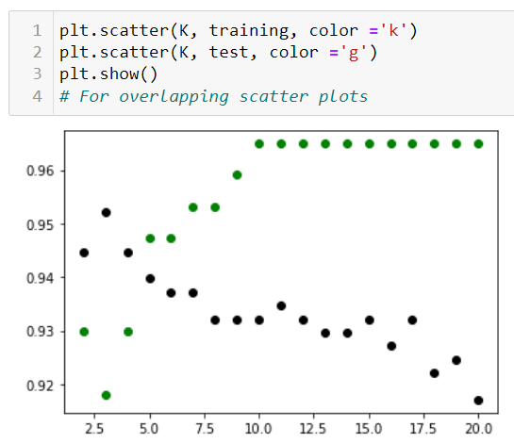
OVERLAPPING the Plots
The given scatter plot is a summarized view of the above created scatter plots.
From this plot we can see that there is a small cluster around the value 5, so we can take the value of k as 5

Slide 11
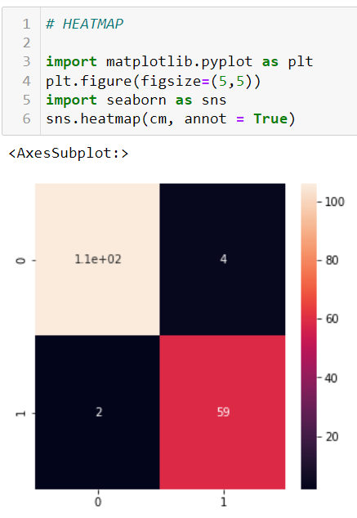
HEAT MAP

Slide 12
STAGE 2

Slide 13
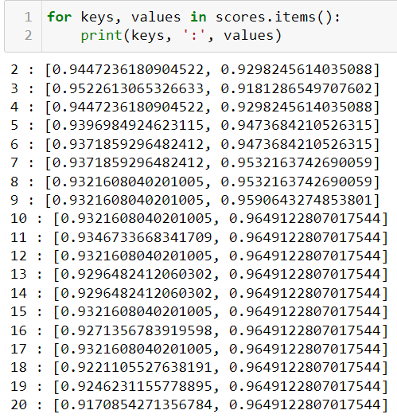
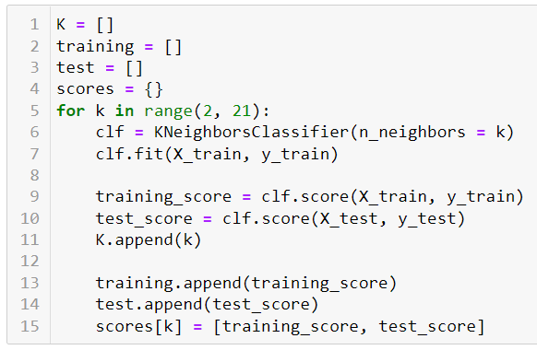
Model Building & Scoring

Slide 14
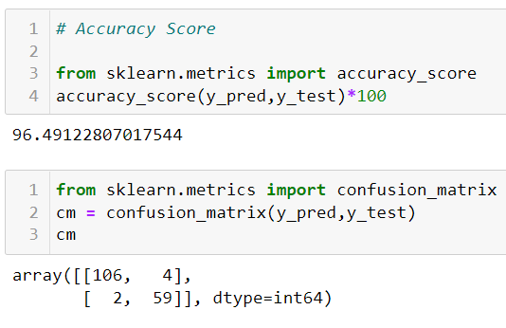
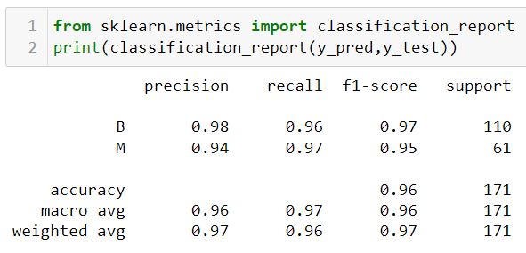
Accuracy
Report

Slide 15
STAGE 3

Slide 16
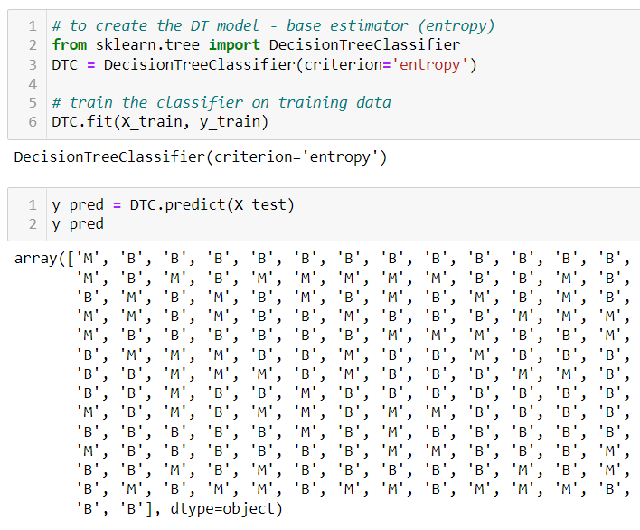
Implementation of Bagging and Boosting using Decision Tree Classifier as Base Estimator
Decision Tree Model and its Prediction…..

Slide 17
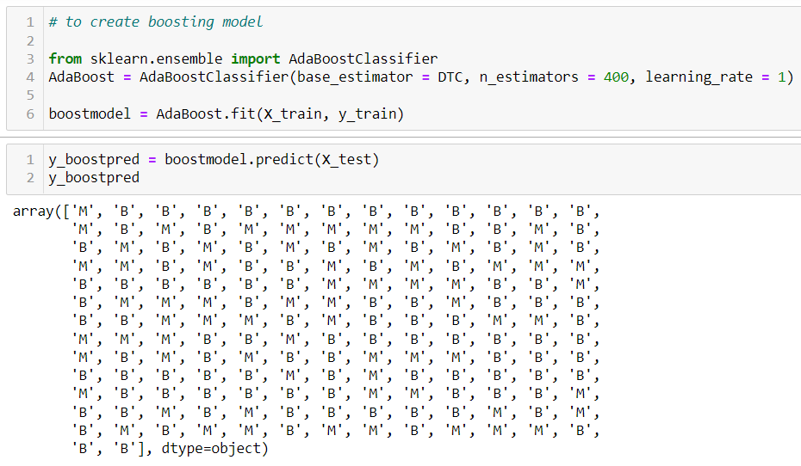
Boosting Model
Boosting Model and its Prediction…..

Slide 18
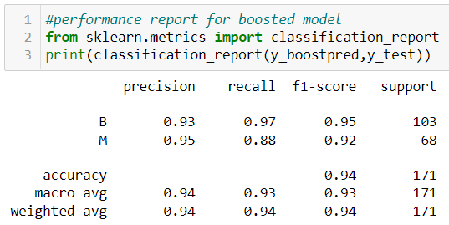
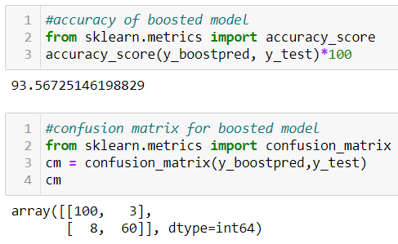
Accuracy
Report

Slide 19
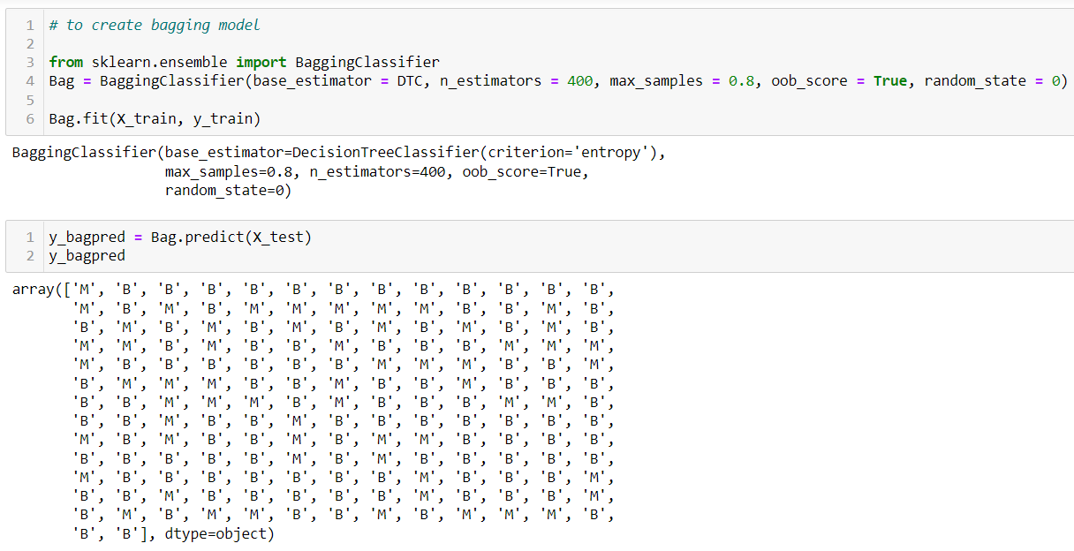
Bagging Model
Bagging Model and its Prediction…..

Slide 20
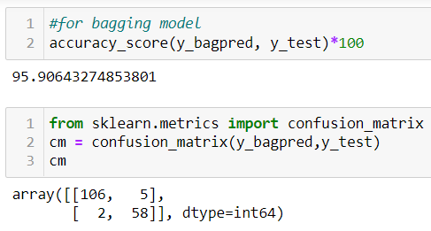
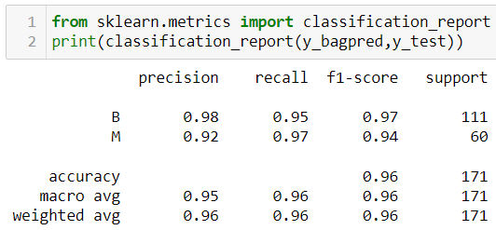
Accuracy
Report

Slide 21
Thank You

