Slide 1
ServiceDesk
SESSION 21 CAPSTONE
A help desk ticketing platform, shipped through a complete DevOps pipeline
Aman Yadav · 24bcs10183 · 2nd Year · Batch A
Notes:
Open on the running app. One sentence on what ServiceDesk is, then note the domain is my own and the DevOps architecture follows the course reference, which the brief allows.

Slide 2
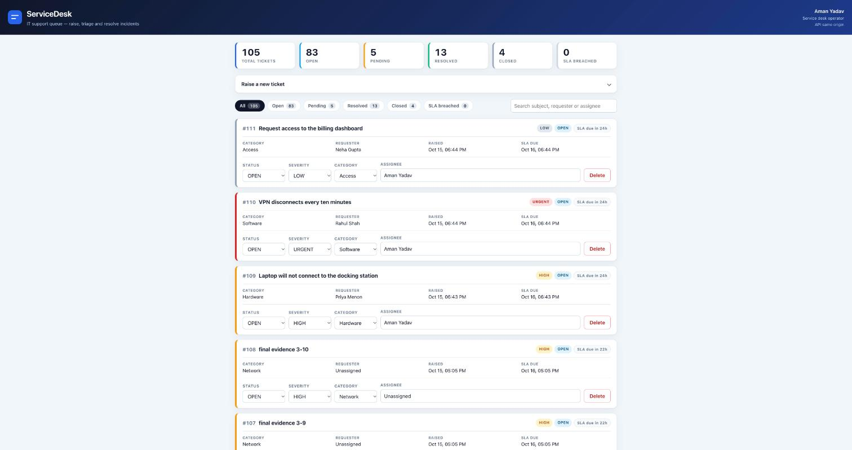
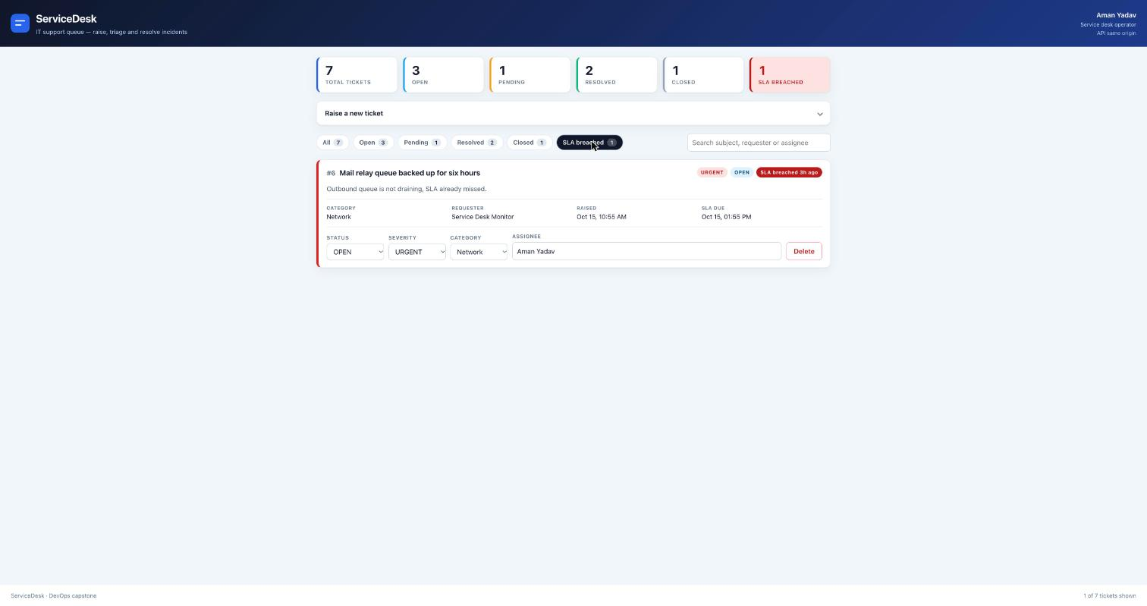
What the application does
A support team lives and dies by two questions.
What is open right now, and what is about to breach its SLA.
A ticket is raised against a category, given a severity and a requester
It is assigned to someone and moves through OPEN, PENDING, RESOLVED, CLOSED
From creation it carries an SLA deadline twenty-four hours out
The stats endpoint rolls the whole board into one response, which the console header and the Grafana dashboard both read
The operator console, served through the Kubernetes Ingress
11
2
40
API ENDPOINTS
TABLES + FK
TESTS
Filter chips carry live counts and narrow the queue without a reload
Notes:
Create a ticket live here, change its status, and point at the counters moving.

Slide 3
The data model, and why it has two tables
Ticket
Category
id · subject · description · severity · status · requester
assignee · category_id → categories.id · created_at · sla_due_at
id · name (unique) · description
Seeded with Hardware, Software, Access and Network by the second Alembic revision, so a fresh database is usable immediately.
severity LOW · MEDIUM · HIGH · URGENT
status OPEN · PENDING · RESOLVED · CLOSED
The foreign key is the point, not decoration
A single flat table would have needed one trivial migration. Two related tables forced a real one, with a constraint the database actually enforces — an insert naming a category that does not exist is rejected by PostgreSQL, not by application code.
Proven by running the downgrade with a ticket already referencing a seeded category: the first version threw ForeignKeyViolation, which is exactly the bug a migration written without data would hide.
Notes:
If asked why two tables: a flat table makes Alembic trivial and proves nothing. The FK gives a real constraint and a real migration.

Slide 4
The API surface
GET
/health
liveness, no database touched
2xx
GET
/ready
readiness, runs a query
2xx
GET
/metrics
Prometheus exposition format
2xx
GET
/api/tickets
list, newest first
200
POST
/api/tickets
create
201
GET
/api/tickets/{id}
read one
200 / 404
PUT
/api/tickets/{id}
partial update
200 / 404 / 422
DELETE
/api/tickets/{id}
remove
204 / 404
GET
/api/tickets/stats
counts by status plus SLA breaches
200
GET
/api/categories
list
200
POST
/api/categories
create, rejects duplicates
201 / 409
Every status code listed is exercised by the test suite and verified by curl against the running cluster
Notes:
Do not read the table out. Point at stats and at the 409 on duplicate categories, which is the one people ask about.

Slide 5
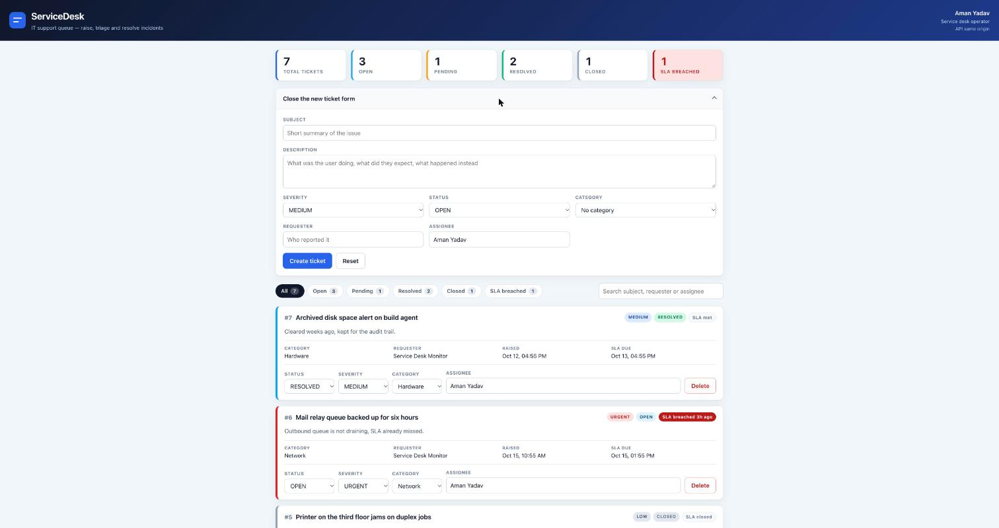
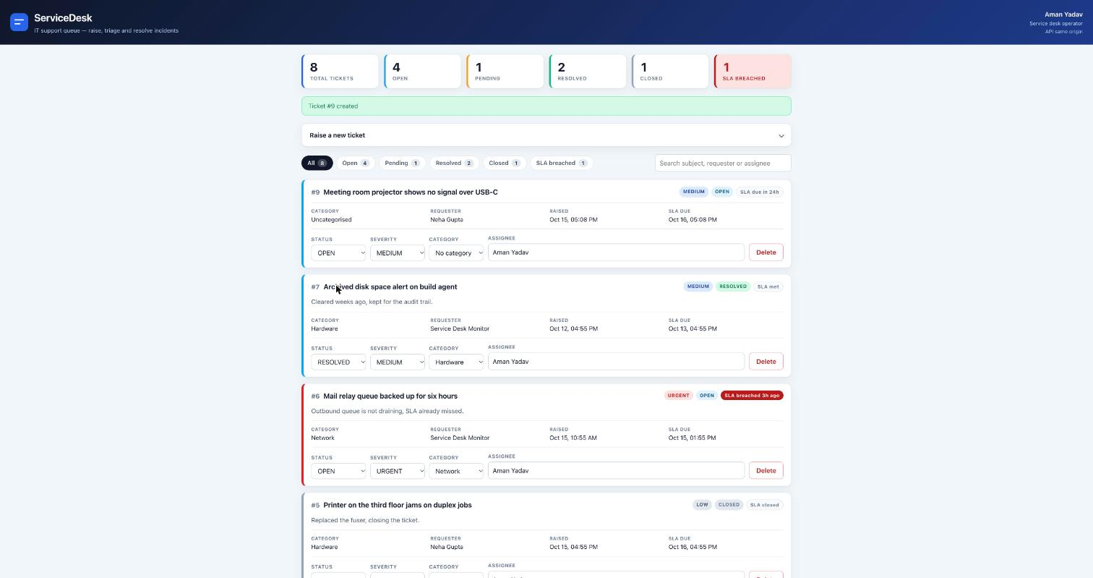
The console in use
Raising a ticket
It lands in the queue
Filtering the board
Category and severity come from the API, not a hardcoded list
Written to PostgreSQL and read back, with the SLA clock already running
Chips carry live counts so a breach is one click away
React 19 with TypeScript, built by Vite
Inline editing on every row — status, severity, category and assignee each PUT straight to the API and the stats bar recomputes from the response. Error and success banners cover the failure paths rather than failing silently.
Notes:
These are real browser captures of the running application, not mockups.

Slide 6
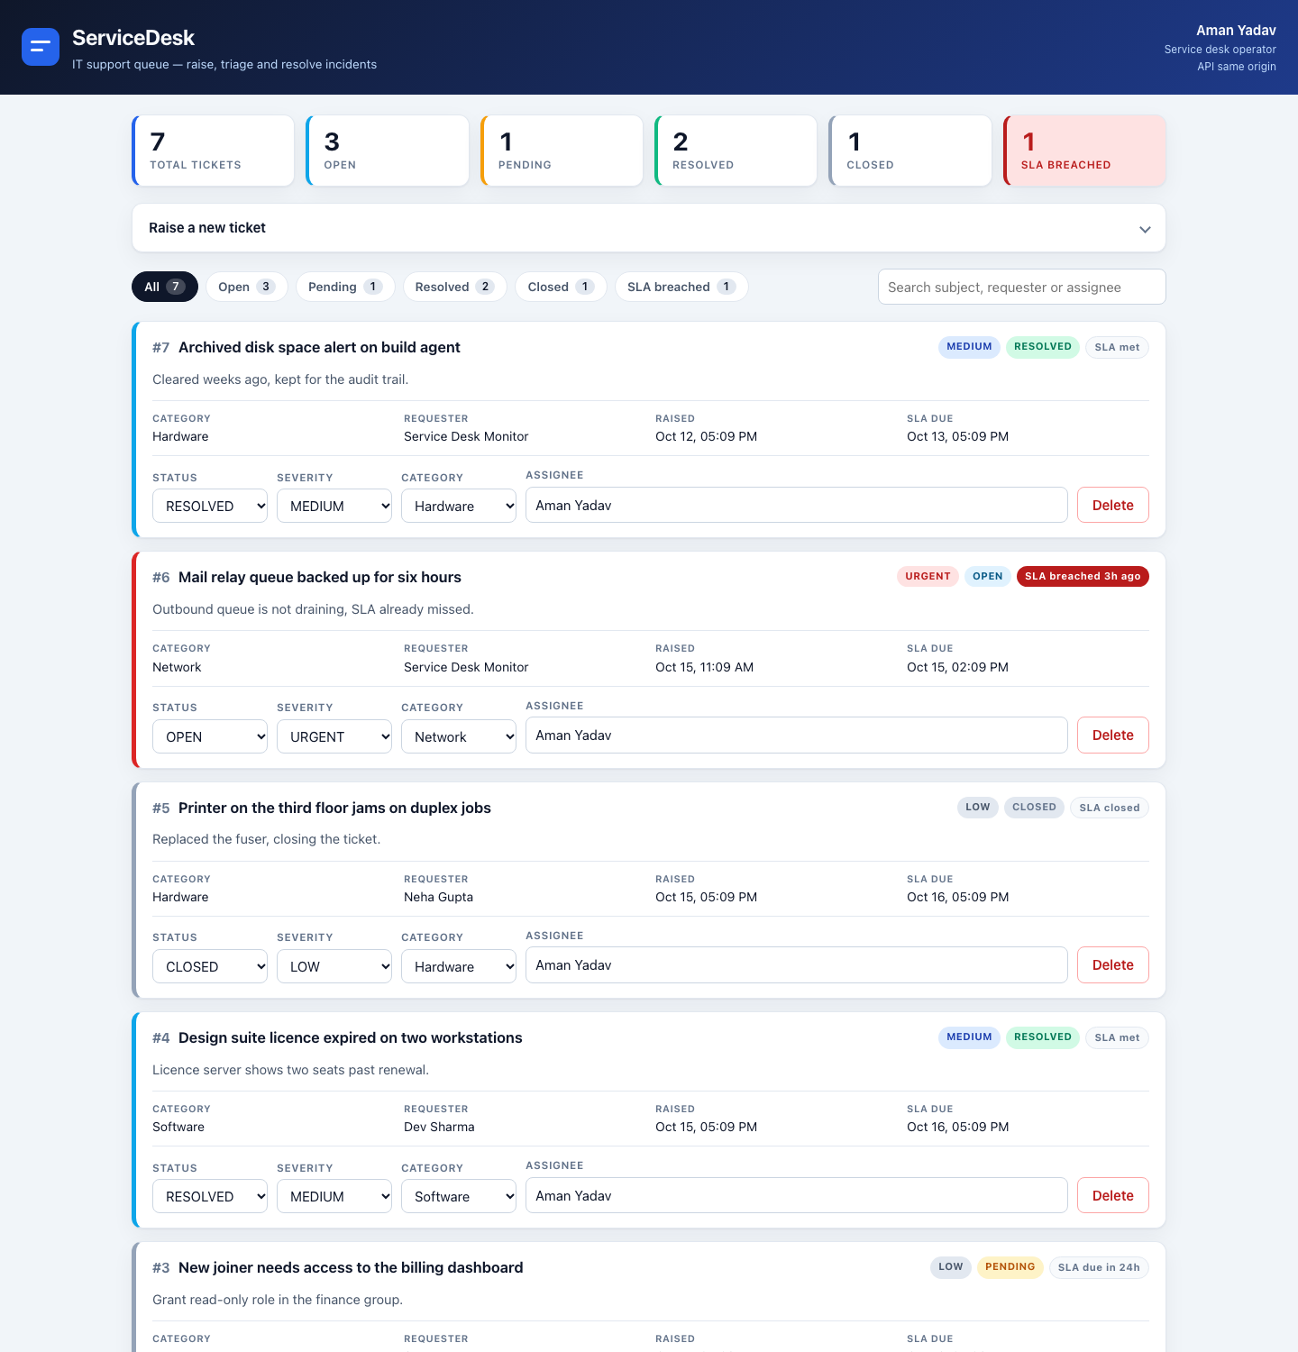
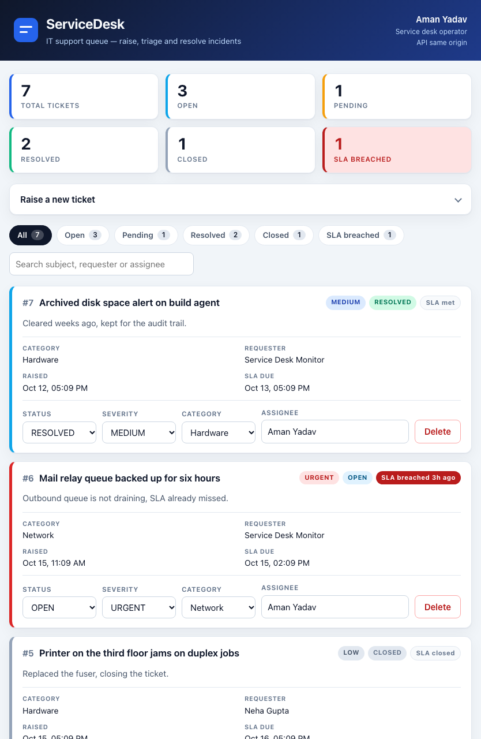
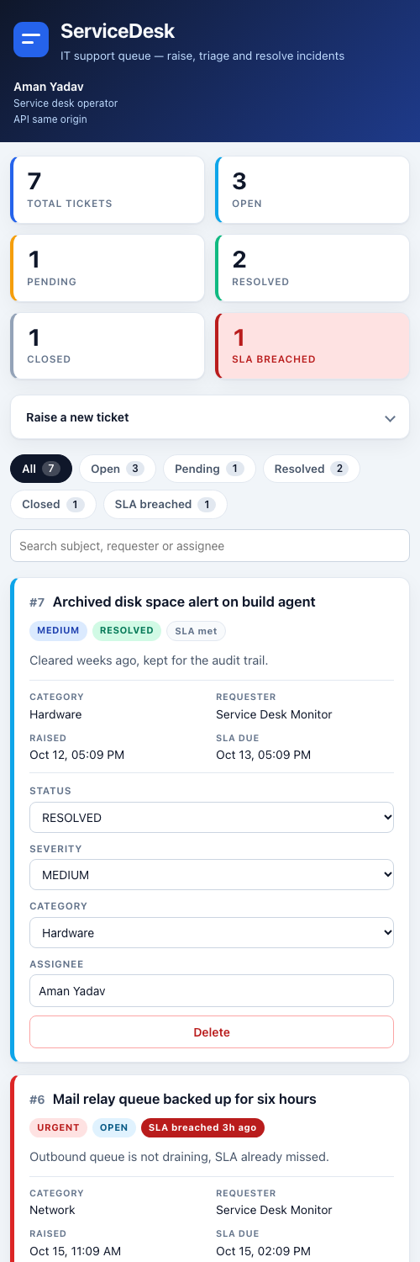
Responsive at three widths
Breakpoints
1000px and 640px.
Below 640 the row grid collapses to stacked fields so nothing overflows horizontally.
The narrow capture is 500px because Chrome on macOS will not render a window narrower than that.
Tablet · 834px
Desktop · 1440px
Phone · 500px
The rubric asks for a responsive, usable UI — these are the same page at three viewport widths
Notes:
The 500px caveat is honest and worth saying: Chrome clamps window width, so there is no true 390px capture.

Slide 7
How a change reaches the cluster
1
2
3
4
5
6
Commit
→
Test
→
Build
→
Scan
→
Publish
→
Deploy
push to main
pytest gates all
two images
Trivy, HIGH fails
GHCR, SHA tag
helm upgrade
Nothing in that chain is manual except the final upgrade, and nothing skips a step
Infrastructure
Orchestration
Observability
Terraform describes a VPC, four subnets across two availability zones, security groups and an EKS cluster. Applied against an emulator, never real AWS — stated plainly on its own slide.
One Helm chart with three environment overlays. Thirteen revisions covering install, scale, a failed upgrade, rollback and image swaps.
Prometheus scrapes the backend every fifteen seconds through a ServiceMonitor the chart ships. Grafana reads those series into twenty-three panels.
Notes:
A map so the grader knows what is coming. Detail lands on the slides after this.

Slide 8
Tests, and why they cannot touch real data
40
98%
5
0.21s
TESTS, ALL PASSING
COVERAGE
REQUIRED BY RUBRIC
FULL SUITE
What is covered
Isolation, proven not claimed
Health and readiness, including the database round trip
Full ticket CRUD and every 404 path
409 on a duplicate category name
422 on an unknown category_id and on bad enum values
The stats aggregate, including SLA breach counting
conftest.py resolves the test database before the application is imported.
If that URL ever resolves to the production DATABASE_URL it raises at import rather than running. I verified that refusal path fires.
Every production row was md5-checksummed before and after a full run and came back identical.
Notes:
Run pytest live, then open conftest.py and explain the refusal path.

Slide 9
Containers
Backend
Frontend
python:3.12-slim
node build → nginx:1.31-alpine
A builder stage compiles wheels; the runtime copies only the virtualenv. pip, setuptools and wheel are then deleted, which removed four fixable high-severity findings on its own.
Node compiles the bundle and only the built assets reach the final image. The compiler, node_modules and source never ship.
Both run as non-root — checked on the published artefact, not the local build
$ docker run --rm --entrypoint id ghcr.io/amanyadav7015/servicedesk-backend:5041ecb
uid=10001(servicedesk) gid=10001(servicedesk) groups=10001(servicedesk)
docker compose up --build starts frontend, backend and PostgreSQL together, and the pipeline smoke-tests that same stack on every push — so the compose file cannot silently rot.
Notes:
Run docker compose ps, then the id command against the published image.

Slide 10
The gate is real
A failing test did not just colour a badge red. It prevented an artefact from existing.
Notes:
Slow down here. This is the strongest single piece of evidence in the project.

Slide 11
Proving the pipeline blocks a bad commit
I pushed a deliberately failing test on commit 759989a
Frontend build (Vite)
success
The registry settles it
Backend tests (pytest)
FAILURE
red commit 759989a → 404
green commit d142944 → 200
14 tags, every one a commit SHA
no "latest" tag anywhere
Build, scan and publish
skipped
Docker Compose stack
skipped
I queried the registry directly rather than reading the pipeline log. The red commit produced no artefact at all.
Skipped, not failed — the needs: graph stopped them before they took a runner
Any running container traces back to the exact source commit that produced it.
Notes:
Open the red run, show the skipped jobs, then switch to the registry and show nothing exists for that SHA.

Slide 12
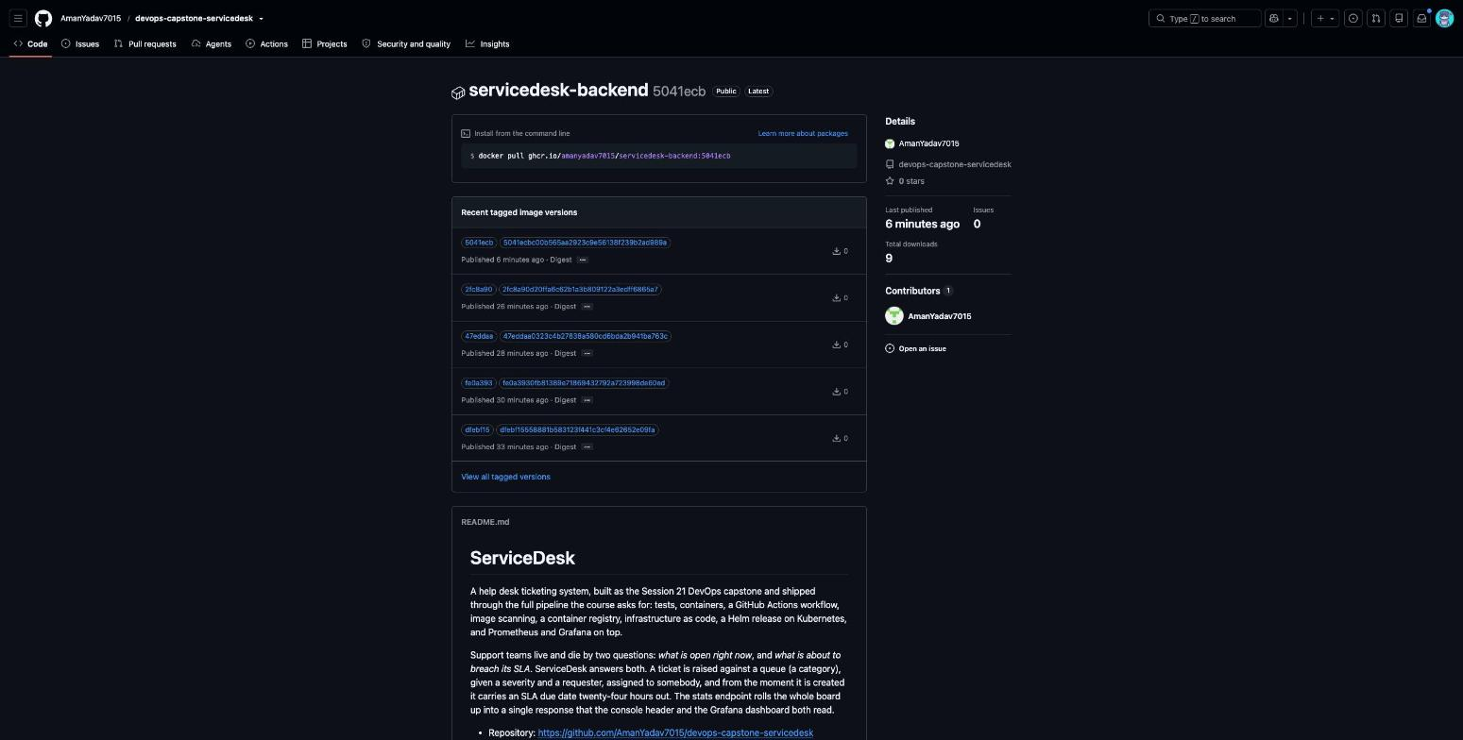
Every image traceable to a commit
Public
Anyone can pull it; no imagePullSecret is needed in the chart
SHA tags only
Both the full forty-character hash and the short form, never latest
Linked to the repo
The package page carries the README, so provenance is one click away
The published package: public, SHA-tagged, pullable without authentication
Notes:
Point at the tag list. The absence of latest is the detail worth naming.

Slide 13
Security scanning, fixed at source
nginx:1.27-alpine
nginx:1.31-alpine + apk upgrade
43
findings
41 high · 2 critical · every one fixable
0
findings
one minor version, zero suppressions
.trivyignore.yaml is empty — and that was a choice, not a default
The file I inherited suppressed three findings in a web framework. One was already stale.
The other two were real: the framework was pinned below its fixed release by a second dependency that declared an upper bound.
Rather than suppress them, I traced the constraint and upgraded the package holding the version down.
The entire Python section of the report disappeared. Removed at the source, not filtered out of view.
The gate itself runs with --exit-code 1 --severity HIGH,CRITICAL, and an informational pass alongside it hides nothing.
Notes:
Show the empty ignore file. A suppression would have scored the same and been worse engineering.

Slide 14
Kubernetes and Helm
5/5
2+2
13
1
4
PODS RUNNING
APP REPLICAS
HELM REVISIONS
INGRESS HOST
CLUSTERIP SVC
Proven end to end
POST a ticket through the Ingress → 201
delete BOTH backend pods
read the same ticket back → still there
confirmed as a row via psql
One Ingress host routes / to the frontend and /api to the backend. maxUnavailable: 0 means two image swaps never dropped a request.
Reached at the Ingress hostname, not a port-forward
Notes:
Delete a pod live, watch it return, then refresh the console to show the data survived.

Slide 15
What the chart got wrong, and how I found it
helm lint passed with zero failures. Every defect below was semantic — lint validates syntax, not wiring.
1
Ingress pointed at a Service that did not exist, on a port nothing listened to
— would have failed at runtime
every /api request would have 503
2
The frontend could never have started
— would have failed at runtime
its nginx proxies to a host named backend that no Service provided
3
ServiceMonitor aborted the install where the Prometheus CRDs were absent
— would have failed on a clean install
guarded now with .Capabilities.APIVersions.Has
4
The database password sat in the Deployment in plain text
— would have failed on a clean install
moved into a Secret and injected by secretKeyRef
5
Postgres used a rolling strategy on a single read-write volume
— would have failed on a clean install
switched to Recreate so two pods never contend
6
A startup race between the backend and the database
— would have failed on a clean install
a wait-for-postgres init container closes it
Notes:
The lesson is the headline: a chart can lint clean and still be wired to nothing.

Slide 16
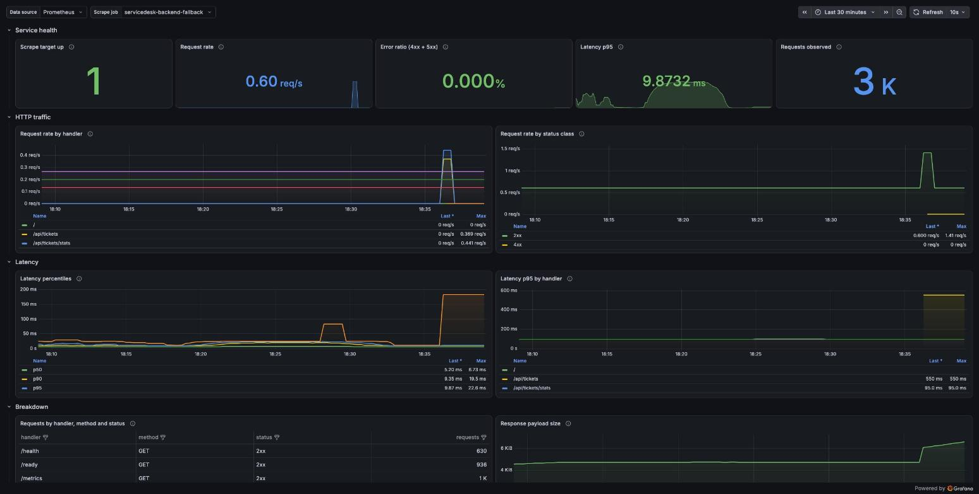
Observability
2/2
targets up, no scrape errors
9.87 ms
p95 latency under load
8 + 3
recording rules and alerts
Twenty-three panels on the application's own instrumentation, not node statistics
Two bugs in my own queries
A fallback scrape job double-counted every series, and an SLO rule read a histogram bucket that does not exist, so it silently returned nothing.
Notes:
Have the dashboard open and send traffic so the request-rate panel moves while you talk.

Slide 17
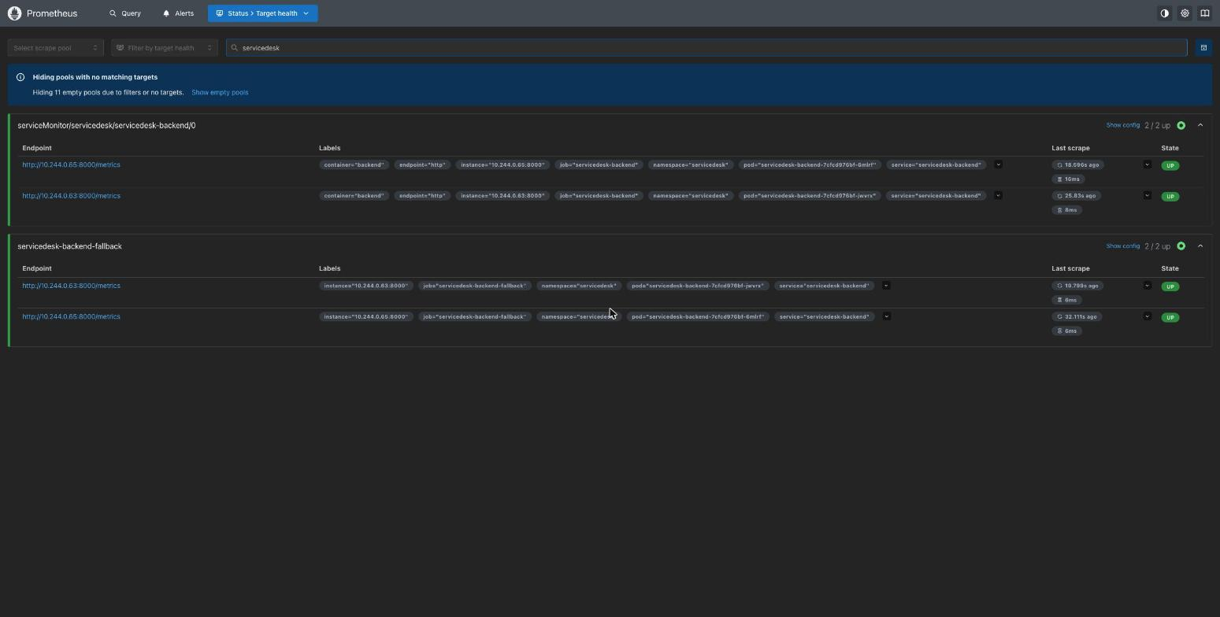
Where the metrics come from
The chart ships a ServiceMonitor, so the operator discovers pods automatically
A second fallback job scrapes the same pods by label, which is why each appears twice
Every query pins job=servicedesk-backend, so nothing double-counts
The instrumentation
/metrics is exposed by the application itself, not an exporter bolted on beside it.
Proven by sending exactly twenty-five requests and watching the counter move by exactly twenty-five.
Both backend pods scraped and up, with an empty last-error on every target
Notes:
The moving-counter proof is the one worth saying out loud: a static scrape proves nothing.

Slide 18
Infrastructure as code — and what I could not do
Really applied, and really destroyed
Planned only, never created
Twenty resources — VPC, two public subnets across two availability zones, private subnets, internet gateway, NAT, route tables and security groups. Verified afterwards with the AWS CLI, then destroyed and verified empty.
The EKS cluster and its managed node group. A genuine thirty-five resource plan with no errors — but the emulator does not implement the EKS API at all, and there is no AWS account behind this.
I would rather lose the points than imply a cluster exists
The README states this in its first paragraph. No AWS console screenshot exists and none is claimed.
I also captured the control: with the skip flags off the plan fails with "No valid credential sources found", ~/.aws does not exist, and sts get-caller-identity cannot locate credentials. That is proof the plan was not quietly run against a hidden account.
Three separate probes record the emulator refusing EKS, including Terraform creating the IAM roles successfully and failing only on the cluster call — which shows the HCL is sound and the gap is the emulator.
Realistic score on this module: nine to twelve of fifteen. The four EKS points are unreachable without an account.
Notes:
Do not rush or apologise. Stating the limit precisely, with the control evidence, is worth more than hand-waving.

Slide 19
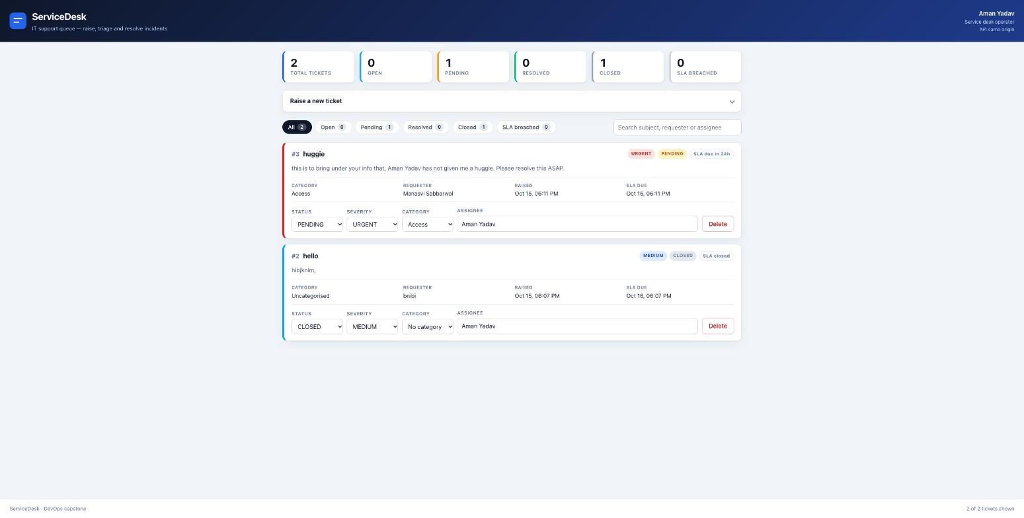
Also running on hosted infrastructure
A managed PostgreSQL instance, with Alembic running on first boot
Backend and frontend as container services, built from the repository
Defined in render.yaml so the whole stack is reproducible
Stated plainly in the README
Free tier: the services sleep after fifteen minutes and the managed database is removed after thirty days. The README gives the exact dates and says the Kubernetes deployment is the real deliverable.
The same images, deployed to a managed platform from the same Dockerfiles
Notes:
Optional slide. Skip it if time is short — the rubric never asked for public hosting.

Slide 20
Passing your own tests is not the same as being portable
Three bugs that passed CI, passed the security scan, and ran fine in Kubernetes
Notes:
This is the part that shows judgement rather than box-ticking. Take your time.

Slide 21
Three bugs only a stricter host revealed
1
Container up, nothing listening
FIX
The stock nginx entrypoint derives a checksum by shelling out to the package manager, which blocks when run as a non-root user. The process stayed alive, so Docker reported it healthy. No HTTP ever answered.
Removed the script this image replaces anyway
2
exec: Operation not permitted
FIX
The binary carried a capability so an unprivileged user could bind port 80. A host setting no_new_privileges refuses to execute a file carrying capabilities. Kubernetes allowed it; the stricter host did not.
Dropped the capability and moved to port 8080
3
502 with a perfectly healthy backend
FIX
The proxy forwarded the browser's Host header upstream, and a variable proxy_pass sends no SNI. A platform routing by Host and terminating TLS could do neither.
Host $proxy_host and proxy_ssl_server_name on
None is visible when the backend is plain HTTP on the same network — which is exactly why the cluster never surfaced them, and why every fix made the Kubernetes image better too.
Notes:
Say plainly that the stricter environment acted as a free audit.

Slide 22
Thank you
github.com/AmanYadav7015/devops-capstone-servicedesk
Notes:
Close on what I would do differently: an advisory lock around the migration so two replicas cannot race on a cold database, and a real AWS account to finish the EKS module.

