Slide 1
Analyzing the Relationship Between Diet Patterns and Fitness Outcomes
A Data Analytics Mini Project
By: Amana Ismail
Tools Used: Python | Pandas | Matplotlib | Seaborn
Dataset Source: Kaggle

Slide 2
Introduction
• Nutrition and exercise together shape overall fitness and health.
• This study explores how dietary choices impact workout performance and body metrics.
• The goal is to find patterns that help design effective, personalized health plans.

Slide 3
Problem Statement
-> People often face difficulty maintaining consistent fitness progress because the impact of dietary choices on exercise performance is not well understood. This study aims to investigate how food composition and nutrient intake affect energy expenditure, body metrics, and overall workout outcomes.

Slide 4
Proposed Solution
Integrate nutrition and gym datasets.
Clean, preprocess, and merge both data sources.
Perform Exploratory data analysis (EDA) to find relationships between dietary habits and exercise outcomes.
Visualize trends and correlations to guide health optimization.

Slide 5
Dataset Overview
• Dataset 1: Daily Food Nutrition Dataset
- Attributes: Calories, Protein, Carbs, Fat, Sugars, Cholesterol, etc.
• Dataset 2: Gym Members Exercise Tracking
- Attributes: Workout Frequency, Duration, Calories Burned, BMI, Fat Percentage, Age.
• Source: Kaggle
• Users matched via User_ID.

Slide 6
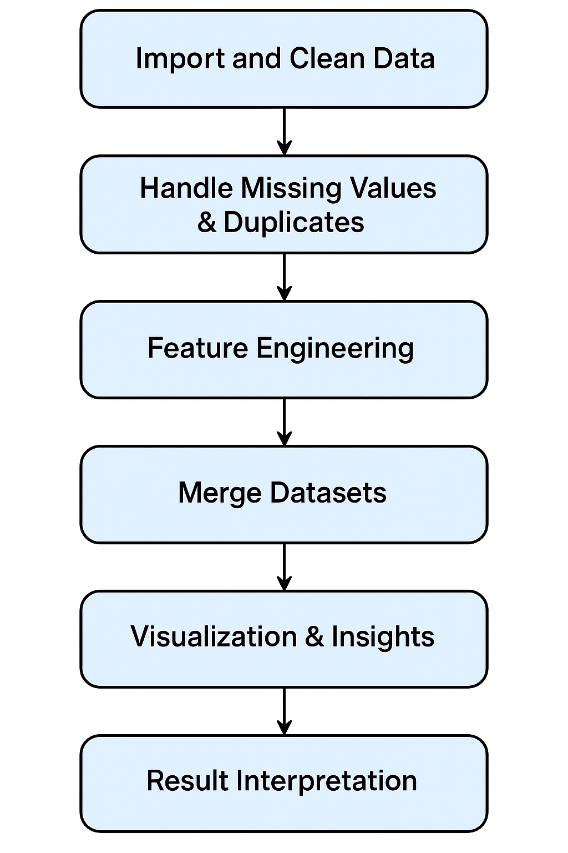
Workflow Diagram

Slide 7
Tools Used
• Python Libraries: Pandas, NumPy, Matplotlib, Seaborn
• Environment: Google Colab
• Used for: Cleaning, analyzing, and visualizing data relationships.

Slide 8
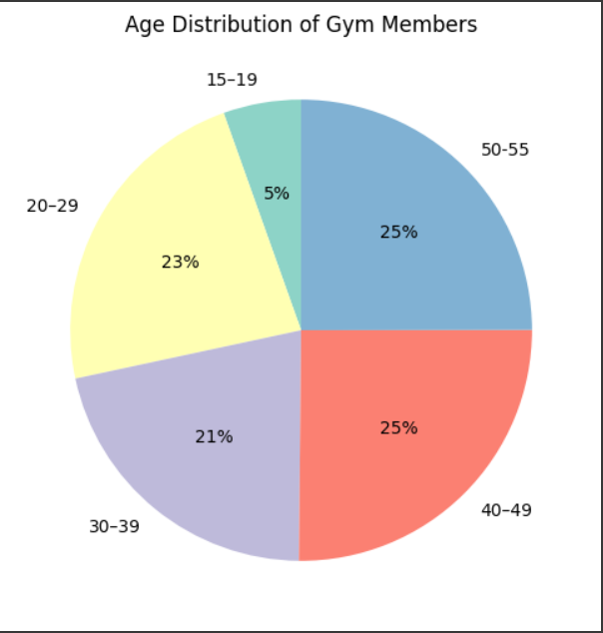
Age Distribution of Gym Members
• Majority of gym members belong to the 40–55 age group, indicating higher fitness engagement among middle-aged adults.
• Participation among younger individuals (15–19) is relatively low, suggesting lower involvement in structured fitness routines at younger ages.
• The 20–39 age group also represents a significant portion, showing steady participation among working-age adults.

Slide 9
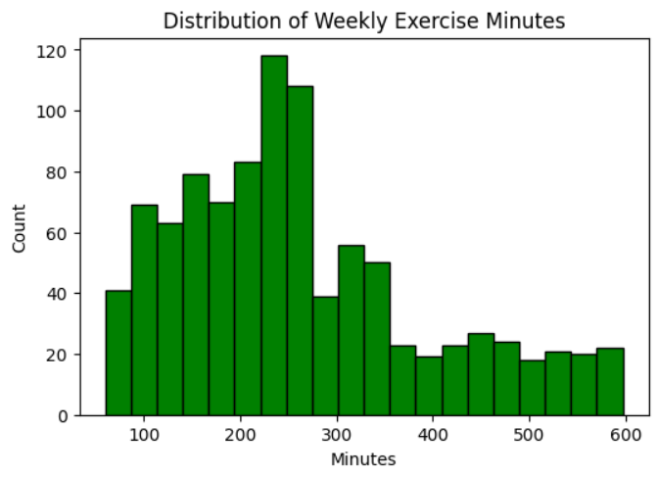
Distribution of Weekly Exercise Minutes
• Majority exercise 200–300 minutes per week (3–5 days/week).
• Shows consistent habits among most users.
• A few outliers indicate varied fitness commitment levels.

Slide 10
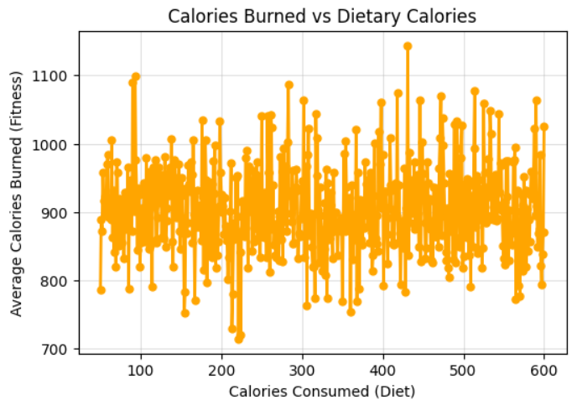
Calories Burned vs Dietary Calories
•There is no strong correlation between dietary calories and calories burned — the data points are widely spread.
• Calorie burn likely depends on exercise intensity and duration, rather than just dietary calorie intake. .
• This suggests that higher food intake does not always lead to more calories burned during workouts.

Slide 11
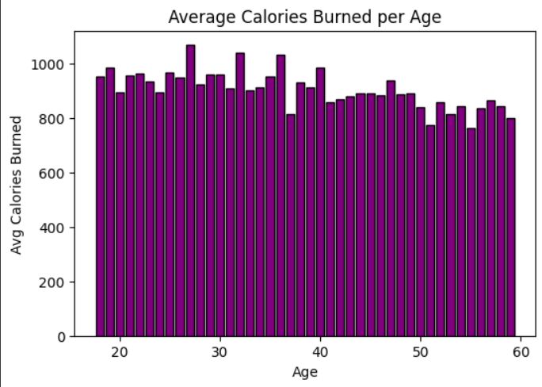
Average Calories Burned per Age
• Peak calorie burn seen in users aged 25–40 years.
• Decline after 45, possibly due to lower metabolism.
• Younger users show moderate activity levels.

Slide 12
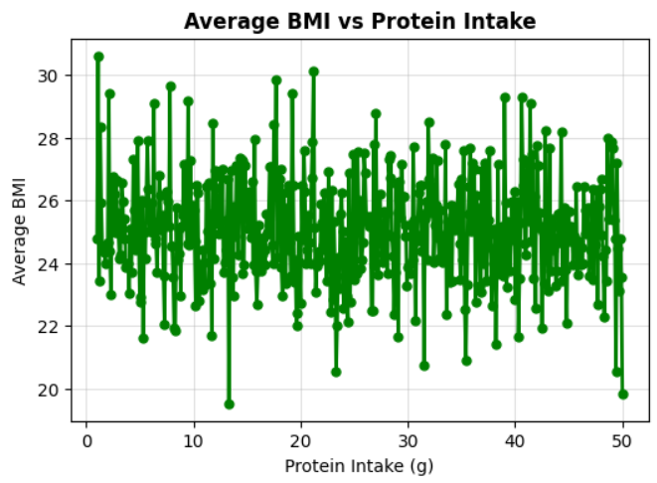
Average BMI vs Protein Intake
• There is no strong correlation between protein intake and BMI , values remain relatively stable across protein levels.
•BMI stays mostly stable, regardless of protein levels.
•Other factors, like exercise and total calories, likely affect BMI more.

Slide 13
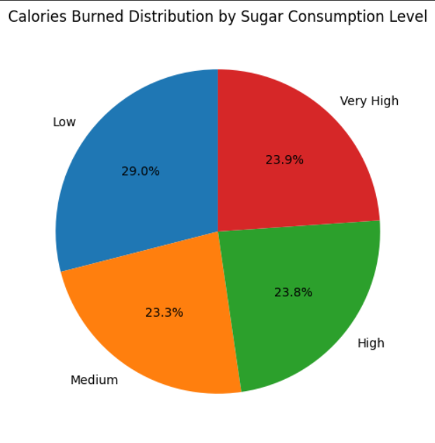
Calories Burned by Sugar Consumption Level
• Low sugar consumers burn the most calories (29%), showing better fitness outcomes..
• Medium, high, and very high sugar groups have similar but slightly lower calorie burn levels.
• Controlled sugar intake supports better energy utilization and supports improved workout performance..

Slide 14
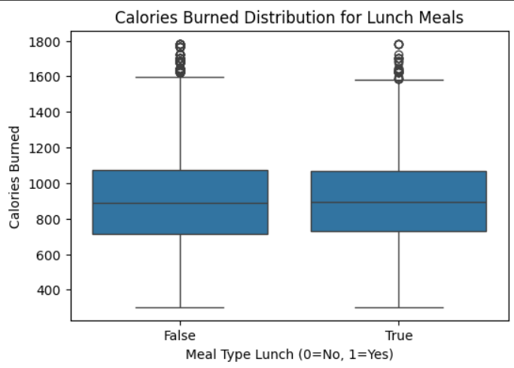
Calories Burned Distribution for Lunch Meals
• Calories burned are almost the same for people who eat lunch and those who don’t.
• No major difference in workout performance based on having lunch.
• Suggests that meal timing (lunch) doesn’t strongly affect calories burned.

Slide 15
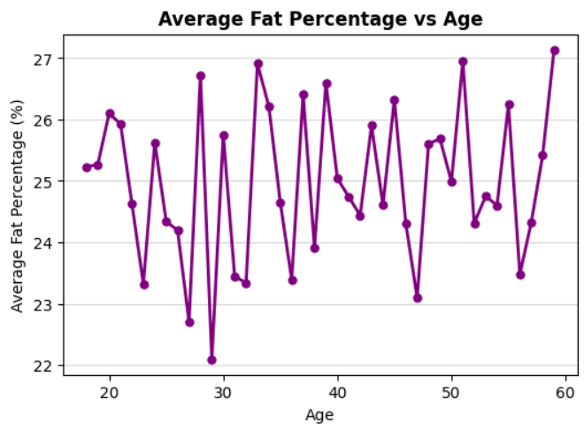
Average Fat Percentage vs Age
• The average fat percentage fluctuates across different ages without a clear trend.
• Slight increase in fat percentage is seen around older ages (50–60).
• Indicates that fat levels vary individually rather than consistently with age.

Slide 16
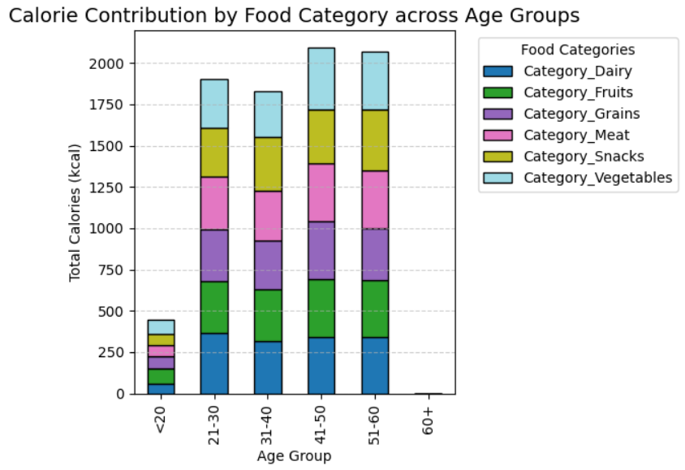
Calorie Contribution by Food Category across Age Groups
• Calorie intake increases with age, peaking between 41–60 years.
• Grains,meat, and dairy are the major calorie contributors across all age groups.
• The under-20 group consumes the least calories, while older adult (51-60) consumes a balanced diet.

Slide 17
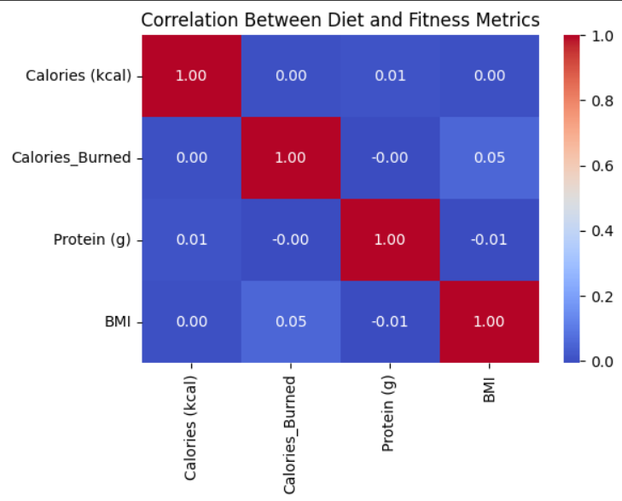
Correlation Heatmap (Diet vs Fitness Metrics)
•The correlation between dietary factors (calories, protein) and fitness metrics (BMI, calories burned) appears to be very weak.
• This indicates that dietary intake alone may not strongly influence BMI or calorie expenditure - exercise habits and individual metabolism likely have a greater impact.

Slide 18
Results
•Weak correlations found between diet metrics and fitness outcomes, suggesting limited direct impact of macronutrients on calorie burn or BMI
•Exercise consistency (frequency & duration) has a strong positive impact on overall fitness.
•Moderate sugar intake still appears beneficial for calorie control.
•Overall, workout behavior plays a more significant role than diet composition in this dataset.

Slide 19
Conclusion
•Diet factors show minimal direct influence on fitness outcomes in this dataset.
•Exercise habits (frequency and duration) are the key drivers of improved performance.
•Balanced diet with controlled sugar intake supports overall calorie management.
• Future work: Include sleep, hydration, and stress data for deeper insights.
•Regular exercise impacts fitness more than diet balance.

Slide 20
References
• Kaggle Datasets:
- Daily Food Nutrition Dataset
- Gym Members Exercise Tracking
• Python Libraries: pandas, matplotlib, seaborn, numpy, python

Slide 21
THANK YOU

