Slide 1



Task- To find out Intrinsic Value of Tata Motors using Discounted Cash Flow and Comparable Company Analysis
Name- Aman Agrawal Roll no.- 240098

Slide 2

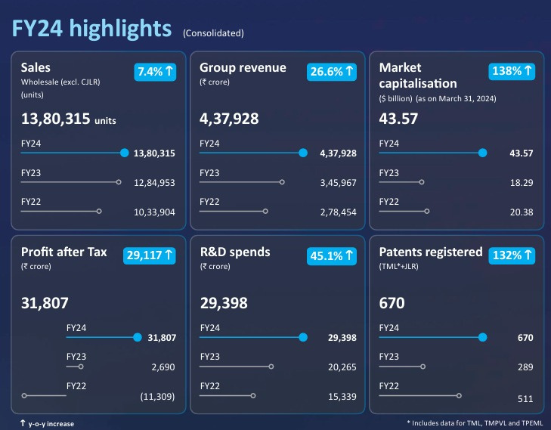
COMPANY OVERVIEW
Wardiere Inc.
Tata Motors, a part ofthe TataGroup, is a
leading global automobile manufacturer, In India it holds a significant market share in both the commercial vehicle industry and passenger vehicle industry
Annual Report of Tata Motors of FY 25 has not been released yet (as of 18 May 2025) Therefore, all financial data used if from FY24 and before

Slide 3


DISCOUNTED CASH FLOW ANALYSIS
Thereare2types of DCFanalysis:
usingFree Cash Flowto Firm(FCFF)
STEP 1: Calculate Free Cash Flows of last 3 years (FY22,FY23,FY24):
usesdiscountingrate= costofequity
known as unlevered FreeCashFlow
doesn’t deductinterest anddebt repayments FCFF= EBIT*(1-tax)+ depreciation & amortization - Capex - increment in noncash working capital
FCFF= EBIT (1- Tax Rate)+ Depreciation + Amortization-capital expenditure-increasein non-cash workingcapital
Increase in non-cash workingcapital= current assets- cash - current liabilities
Calculate the average Free Cash Flow and use it to project Future Free Cash Flows in step 2.
using Free Cash Flow to Equity (FCFE)
discounting rate= WACC
known as levered Free Cash Flow
deducts interest and debt repayments FCFE=Cash from operating activities- Capex
*We will be using Free Cash flow to firm (FCFF) to do the analysis

Slide 4

Step 2: Calculate the Future Free Cash Flows:
Select a suitable growth rate and growth period to project the future free cash flow of the company
In our case, Tata Motors is a well-established company so we will project for 5 years instead of the standard 10 years projection and a growth rate of 15% in the first 2 years and 10 % for the remaining period as the it is not normal for a well-established company to maintain a high growth rate for a long period of time
Future Free Cash Flow (of year n) = Average Cash flow * (1+ growth rate) ^ n
Step 3:- Calculate WACC:
Weighted Average Cost of Capital
WACC= (E/(E+D)) * Cost of Equity + (D/(D+E))* Cost of Debt*(1-tax) E=Equity, D= Debt, tax= corporate tax rate
Cost of Equity=Risk Free Rate + Beta * (market return rate-risk free rate) Cost of Debt- effective interest rate a company pays on its borrowed funds, such as loans and bonds.
WACC is used as the discount rate in the further steps

Slide 5


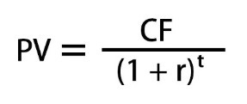
STEP 4:- Calculate the terminal value:
terminal value represents the total Free Cash Flow of the company beyond the explicit forecast period, up till infinity
Terminal Value= (Last Future Free Cash Flow) * (1+ terminal growth rate) / (WACC - terminal growth rate) terminal growth rate is generally below 5%
The formula which we have used above is called the Perpetuity Growth Terminal Value
STEP 5:- Calculate Present Value (PV) of all Future Free Cash Flows:
we will calculate the present value of the Future Free Cash Flows (FFCF of a forecast period + terminal value) according to the principle of Time Value Of Money.
r is the discount rate, which will be equal to the WACC, we calculated earlier. finally add up the total value of all present values of future free cash flows., this total is called the Enterprise Value.

Slide 6

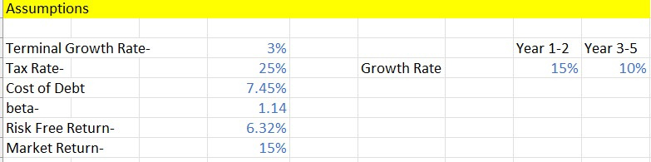

STEP 6:- Calculate the intrinsic Share Price of the company:
after getting the Enterprise Value(EV) , we calculate the Equity value by
subtracting the Net Debt (total debt- cash and cash equivalents)from the EV
thisequity value is divided by thetotal number ofoutstandingshares, to gettheIntrinsic Shareprice
ASSUMPTIONS MADE
RESULTS
Intrinsic Share Price= Rs. 1975.60

Slide 7

COMPARABLE COMPANY ANALYSIS
STEP 1
Select comparable companies
STEP 2
Gather financials
and calculate
multiples
STEP 4 Determine a valuation range
STEP 3 Benchmark the multiples

Slide 8


SELECTING COMPARABLE COMPANIES
Tata Motors is associatedwith both thecommercial vehicle(CV)andpassengervehicle(PV)
industry with an operatingmargin of 13.5%
it has 13% sharein domestic PV market and 53% shareinEVmarket
it boasts the largestdomestic CV market share of 37.7%
While Tata Motors owns the luxury car brand JLR, no comparableIndia-listedluxuryautomaker exists. The CCA includes Indian peers in CV and PV segments,thereforethismightaffectthe Comparable Company Analysis.
The following peers are selected based on geographical factors, industry specific, operating profit margin, etc. ->
Mahindra & Mahindra
Hyundai Motors India
Force Motors
Ashok Leyland
Maruti Suzuki
Operating profit margin
13.13%
17.9%
13.08%
12.8%
17.8%
Industry
CV+PV
CV+PV
PV
CV
CV

Slide 9


GATHER FINANCIALS AND
CALCULATE THE MULTIPLES
Financial data required-
MUTIPLES TO CALCULATE-
Total Outstanding Shares Share Price(used as of 18 may 2025)
Net Debt
Revenue
EBITDA
Net Income
ENTERPRISE VALUE/REVENUE ENTERPRISE VALUE/EBITDA P/E RATIO
Formulae Required-
Equity Value= Total outstanding shares x Share price Enterprise Value (EV)= Equity Value + Net Debt

Slide 10

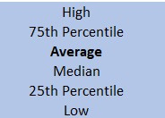

BENCHMARK THE MULTIPLES
After calculating these benchmarks, check if
the data contains any outliers which affect the average,
if not then take average value
otherwise feel free to take median value of ratio
DETERMINE A VALUATION RANGE
Calculate the implied value ofEnterprisevaluein case of an EV ratio
Calculate the implied value ofEquityValuefirstin case of an Equityratio
Calculate the implied share priceusing theimplied Equity and Enterprise value
You will get 3 values corresponding to 3 ratios
Implied Share Price of Tata Motors after CCA (in Rs.) ->

Slide 11

FINAL VALUATION SUMMARY
After doing both thevaluation analysesonTataMotors,itcanbeinferred
that the stock currently at Rs 726.5 (asof21may2025)ishighly undervalued in comparison to theintrinsicsharevalue,thereforemakingit the right time to invest in, if one has confidenceoveritsfundamentals
Resources-
79th Annual Report
Stock Screener Yahoo Finance

