Slide 1
MANZIL
Sarthak Nivesh
सार्थक निवेश
AI-Powered Indian Stock Market Investment Intelligence Platform
Aman Jain · Rohit Fogla · Vanshita Mehta · Disita Tirthani
Python · Streamlit · Groq AI

Slide 2
AGENDA
01
Problem Statement & Market Facts
06
Technology Stack
02
Project Objectives
07
Data Sources
03
Sarthak Nivesh (One step Solution)
08
Competitive Advantage
04
Features & Functionality
09
Future Scope & Roadmap
05
Workflow & Methodology
10
Team & Impact

Slide 3
PROBLEM STATEMENT
95%
₹2L
6+
0
of retail investors
lose money
Bloomberg Terminal
cost per year
websites needed for
one investment decision
Free AI tools
for Indian markets
No Guidance
Expensive Tools
Scattered Data
No Free AI
Retail investors rely on unverified tips and YouTube videos.
Professional platforms cost ₹1,500–₹2,00,000/year — unaffordable.
NSE, Moneycontrol, Screener, TradingView, AMFI — 6 sites for 1 trade.
ChatGPT lacks Indian stock data; Bloomberg AI costs lakhs.

Slide 4
OBJECTIVES
01
Democratize Access
02
One Unified Platform
03
AI-Driven Decisions
Give every Indian retail investor the same analysis-quality as institutional traders — completely free.
Replace 6+ fragmented websites with a single app covering stocks, IPOs, MFs, and smart money.
Use Groq's Llama 3.3 70B to deliver BUY/SELL/HOLD with confidence score, entry, target and stop-loss.
04
Real-Time Intelligence
05
Reduce Losses
06
Financial Literacy
Zero hardcoded data — every piece of information is fetched live from official and reliable sources.
Cut the 95% retail loss rate by providing structured, evidence-backed investment decisions.
Explain the WHY behind every recommendation so users learn while they invest.

Slide 5
Sarthak Nivesh (One Step Solution )
BEGINNER-FRIENDLY — Explains things in plain language, even in Hindi
100% REAL DATA — Every number is fetched live from official sources. No dummy data anywhere.
AI-POWERED — Uses Groq Llama 3.3 70B for analysis, not just simple calculations
COMPLETELY FREE — No subscription, no hidden charges
COMPREHENSIVE — 13 features covering stocks, mutual funds, IPOs, FII/DII, portfolio, news, and AI analysis
MULTI-AGENT AI — 6 specialist agents working together is more accurate than one general AI
EMOTIONALLY INTELLIGENT — The AI Finance Coach understands that investors panic and explains things in a calm, reassuring way
PROFIT-FOCUSED — The IPO AI gives specific exit strategies to maximise profit, not just "apply or avoid"
.

Slide 6
COMPETITIVE ADVANTAGE
Platform
Stocks
IPO
Mut. Fund
Smart Money
AI
Price
Moneycontrol
✓
Basic
✓
✗
✗
Free
Zerodha Kite
✓
✗
✗
✗
✗
Free
Groww
✓
✓
✓
✗
✗
Free
Screener.in
Fundamental
✗
✗
✗
✗
Free
Bloomberg
✓
✓
✓
✓
✓
₹2L/yr
Sarthak Nivesh
✓
Advanced
✓
✓
✓
FREE ✦
✦ Only platform to combine ALL features — Stocks · IPO · Mutual Funds · Smart Money · AI — completely FREE for Indian retail investors

Slide 7
FEATURES & FUNCTIONALITY
1
2
3
Stock Intelligence Hub
Smart Money Tracker
IPO Intelligence Hub
120+ stocks · 50+ indicators · BUY/SELL/HOLD
FII/DII flow · Bulk/Block deals · Sector trend
Live GMP · Subscription · Apply/Avoid signal
4
5
6
Mutual Fund Center
Agentic AI Hub
Portfolio Management
50+ funds · SIP calculator · Returns comparison
6 AI agents · Groq LLM · 85% confidence score
Live P&L · Risk score · Rebalancing tips
7
8
9
News & Sentiment
Market Intelligence
Advanced Analytics
Google News RSS · TextBlob · Positive/Negative
NIFTY · SENSEX · Global markets overview
Candlestick · RSI · Bollinger Bands · Plotly

Slide 8
DATA SOURCES
⚡ ZERO HARDCODED DATA POLICY — Every value is fetched LIVE from official or verified sources
Yahoo Finance
NSE India API
ipowatch.in
Data Type: Stock Prices
Data Type: FII/DII + Deals
Data Type: IPO GMP + Subs
Update: Real-time (15 min)
Update: Daily after close
Update: Real-time
Google News RSS
AMFI India
SQLite3 DB
Data Type: Market Headlines
Data Type: MF NAV
Data Type: Portfolio / Alerts
Update: Real-time
Update: Daily 9 PM
Update: Per user session

Slide 9
TECHNOLOGY STACK
Python 3.12
Streamlit
Groq + Llama 3.3 70B
Core Language — Best ecosystem for AI & finance
Web Interface — Pure-Python, rapid development
AI Engine — 3–5 sec response, free, latest model
yfinance
NSE India API
Plotly
Stock Prices — Free real-time data, all NSE stocks
FII/DII + IPO — Official government source, reliable
Charts & Viz — Interactive candlestick & indicator charts
TextBlob
SQLite3
BeautifulSoup4
Sentiment Analysis — Simple, accurate for financial news
Database — Zero config, Python built-in, fast
Web Scraping — Scrapes live GMP from ipowatch.in
Pandas
Google News RSS
AMFI API
Data Processing — Industry standard for financial data
News Feed — Real-time, no API key needed
Mutual Fund NAV — Official daily NAV source

Slide 10
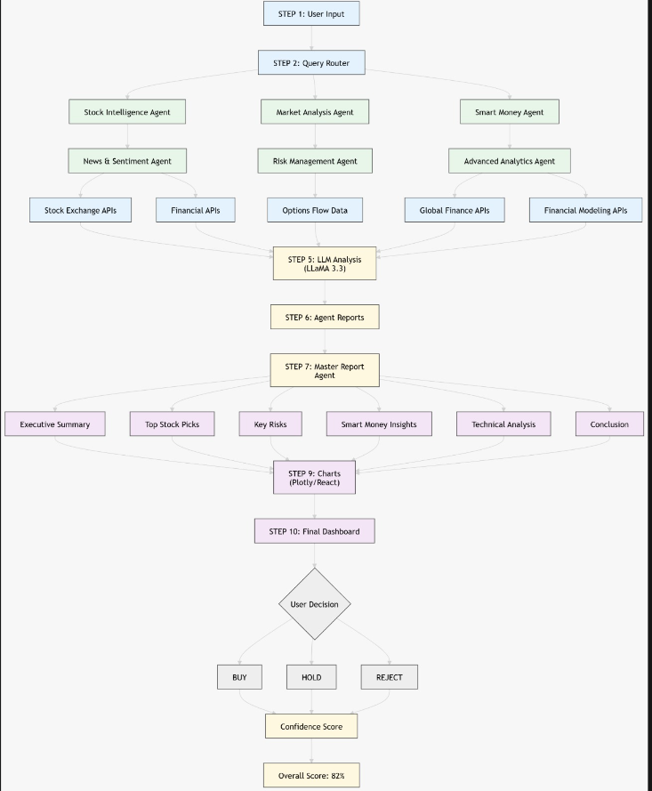
Methodology Flowchart

Slide 11
Literature Review
Year | Research Paper Title | Main Idea / Relation to Project | Key Technology / Method Used
2020 | “Stock Price Prediction Using Machine Learning and LSTM-Based Deep Learning Models” | This paper predicts Indian stock prices using NIFTY 50 data. It is useful for your Stock Intelligence Hub because it shows how AI and deep learning can generate stock recommendations. (arXiv) | LSTM, Machine Learning, NIFTY 50 data
2021 | “Effectiveness of Artificial Intelligence in Stock Market Prediction based on Machine Learning” | This paper studies how AI can combine technical analysis and sentiment analysis from news and Twitter for stock prediction. It supports your News Sentiment + AI recommendation module. (arXiv) | Machine Learning, Twitter Sentiment, Technical + Fundamental Analysis
2022 | “Stock Price Prediction using Sentiment Analysis and Deep Learning” | This research combines historical stock prices with sentiment analysis and deep learning to improve prediction accuracy. It is closely related to your News Sentiment Analysis feature. (arXiv) | Deep Learning, LSTM, Sentiment Analysis
2024 | “Indian Stock Market Prediction using Augmented Financial Intelligence ML” | This paper predicts Indian stock prices using ML models along with human intelligence and forecasting. It matches your Agentic AI and Smart Money Tracker concept. (arXiv) | Bidirectional LSTM, CNN-LSTM, GRU, Human Intelligence
2025 | “The Effectiveness of AI in Predicting Stock Market Trends: A Comparative Study of the Last Few Years of Indian Markets” | This paper compares different AI models used in the Indian stock market from 2018–2023. It is highly relevant because your project also compares and combines multiple AI methods for stock prediction. (ResearchGate) | AI Models, Comparative Study, Indian NSE/BSE Market
S.N | Research Gap
1 | No Unified Multi-Signal Intelligence System
2 | Lack of Explainable Decision Systems
3 | Fake News Impact is Ignored
4 | Missing Portfolio-Level Intelligence
5 | Over-Reliance on Historical Patterns
6 | No Smart Money Tracking
7 | User Personalization is Missing
8 | No Confidence Score in Predictions
9 | IPO Performance Prediction Research Gap

Slide 12
FUTURE SCOPE & ROADMAP
Phase 1
0–6 Months
Phase 2
6–12 Months
Phase 3
12–24 Months
Mobile App (Android/iOS)
Cryptocurrency tracking
Institutional multi-portfolio
Zerodha Kite API integration
Robo-Advisory & auto-rebalancing
Global markets (NASDAQ, NYSE)
Options & Derivatives analysis
Social Trading — copy portfolios
DeFi & blockchain assets
WhatsApp / SMS price alerts
LSTM neural network predictions
Voice Assistant — 'Hey Sarthak'
Monetization: Freemium (₹499/mo) · B2B API · Affiliate Revenue · Target: 1L users = ₹5 Cr/month

Slide 13
TEAM & SOCIETAL IMPACT
A
R
D
V
Aman Jain
Rohit Fogla
Disita Tirthani
Vanshita Mehta
Project Lead
AI & Data Engineer
Backend Dev
UI/UX & MF Dev
Architecture · Main platform · Stock Intelligence Hub · DB design
Smart Money Tracker · Agentic AI · Technical analysis engine · Volume analysis
IPO Intelligence · News Sentiment · Portfolio Management · Allotment checker
Mutual Fund Center · SIP Calculator · Dark theme · Plotly charts · Testing
SOCIETAL IMPACT
10 Cr+
95%
FREE
9
Demat accounts in India
Retail losses we aim to reduce
Cost for full AI analysis
Integrated modules in one platform

Slide 14
MANZIL
Sarthak Nivesh
"Making every investment meaningful"
Version 1.0 · Production Ready · March 2026
github.com/Amanarun2907/PRJ-3-6th-Semester-2026
Thank You

Slide 15
SYSTEM ARCHITECTURE
USER INTERFACE (Browser · Streamlit)
APPLICATION CORE · main_ultimate_final.py (5700+ lines)
agentic_ai_hub.py
ipo_intelligence.py
smart_money.py
portfolio_mgr.py
mutual_fund.py
DATA LAYER
Yahoo Finance
NSE India API
ipowatch.in
Google News RSS
SQLite DB
AMFI India

Slide 16
WORKFLOW & METHODOLOGY
01
User Opens
Platform
02
Selects
Module
03
Live Data
Fetched
04
Groq AI
Analyses
05
Decision
Delivered
Agentic AI Pipeline (4 Specialized Agents)
Agent 1
Technical Analysis
(50+ indicators)
Agent 2
Institutional Flow
(FII/DII scan)
Agent 3
Risk Assessment
(volatility, VIX)
Agent 4
Final Strategy
(entry · target · SL)

