Slide 1

Sales Presentation
AI-Enhanced Presentation | Solution Focus Prompt: Create a professional sales presentation for FinCore Solutions showcasing GetAli...
Generated with Advanced AI | Positive Tone

Slide 2

Market Opportunity
• Growing market demand
• Target customer analysis
• Competitive landscape overview
AI-Generated Content | People Slide

Slide 3
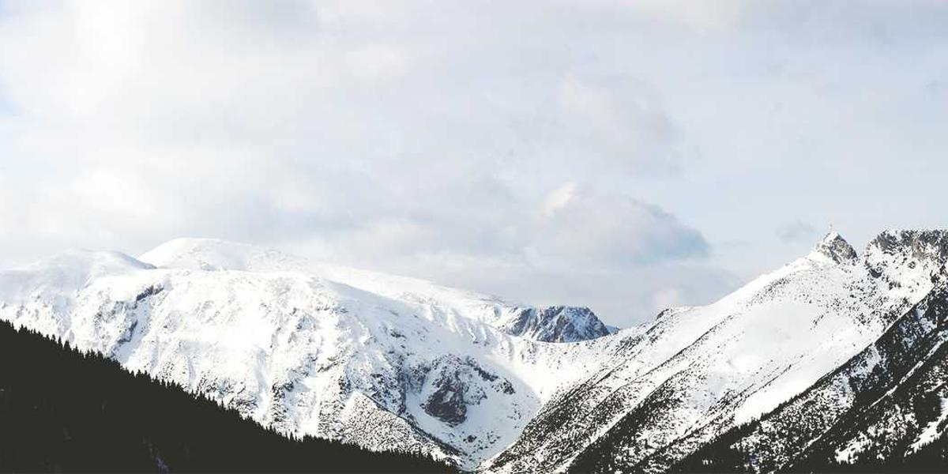
Our Solution
• Unique value proposition
• Key features and benefits
• Competitive advantages
AI-Generated Content | Solution Slide

Slide 4

Results & ROI
• Customer success stories
• Quantifiable benefits
• Return on investment
AI-Generated Content | Results Slide

Slide 5

Next Steps
Let's discuss next steps and how we can move forward together
Ready to Get Started | Take Action Today

