Slide 1

FinCore Solutions
AI-Enhanced Presentation | Solution Focus Prompt: Create a presentation for FinCore Solutions
Generated with Advanced AI | Positive Tone

Slide 2

Problem Statement
• Key information about Problem Statement
AI-Generated Content | Problem Slide

Slide 3

Our Solution
• Key information about Our Solution
AI-Generated Content | Solution Slide

Slide 4

Market Opportunity
• Key information about Market Opportunity
AI-Generated Content | General Slide

Slide 5
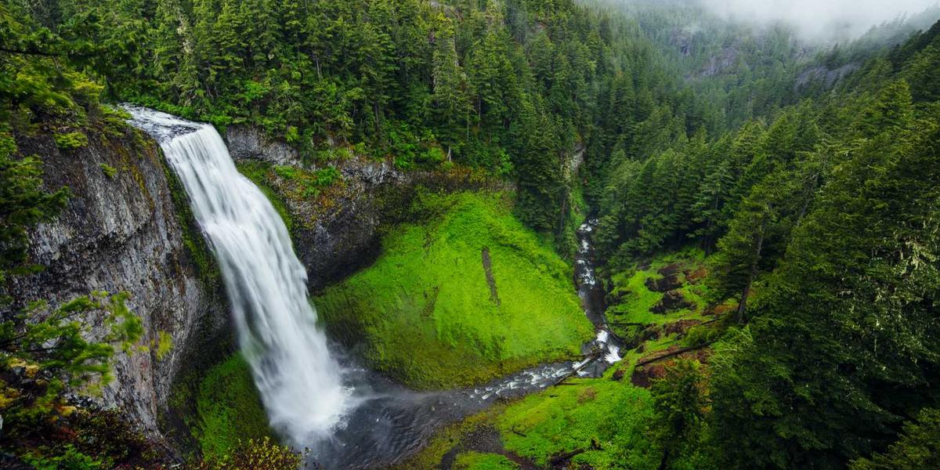
Next Steps
• Key information about Next Steps
AI-Generated Content | Process Slide

Slide 6

Next Steps
Contact us to learn more about our solution
Ready to Get Started | Take Action Today

