Slide 1
TEXT CLASSIFICATION AND CLASSIFIERS: A SURVEY
&
ROCCHIO CLASSIFICATION
Kezban Demirtas 1297704

Slide 2
Outline
Introduction
Text Classification Process
  Document Collection
  Preprocessing
  Indexing
  Feature Selection
  Classification
  Performance Measure
Rocchio Classification Algorithm

Slide 3
Introduction
Today, knowledge may be discovered from many sources of information but most information (over 80%) is stored as text.
It can be infeasible for a human to go through all available documents to find the document of interest.
Automatically categorizing documents could provide people a significant advantage in this subject.

Slide 4
Text Classification
Text classification (text categorization):
  assign documents to one or more predefined categories.
classes
Documents ? class1
class2
.
.
.
classn
NLP, Data Mining and Machine Learning techniques work together to automatically classify the different types of documents.

Slide 5
Introduction
Text classification (TC) is an important part of text mining.
An example classification;
  automatically labeling news stories with a topic like “sports”, “politics” or “art”
Classification task;
  Starts with a training set of documents labelled with a class.
  Then determines a classification model to assign the correct class to a new document of the domain.

Slide 6
Introduction
Text classification has two flavours;
  single label
  multi-label
Single label document is belongs to only one class.
Multi label document may be belong to more than one classes.
In this paper , only single label document classification is analysed.

Slide 7
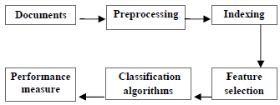
Text Classification Process
The stages of TC;
Documents Collection;
  First step of classification process.
  Different types (format) of document like html, .pdf, .doc, web content etc. are collected.

Slide 8
Pre-Processing
Documents are transformed into a suitable representation for classification task.
Tokenization: A document is partitioned into a list of tokens.
Removing stop words: Insignificant words such as “the”, “a”, “and”, etc are removed.
Stemming word:
  A stemming algorithm is used.
  This step is the process of conflating tokens to their root form.
  e.g. connection to connect, computing to compute

Slide 9
Indexing
In this step, the document is transformed from the full text version to a document vector.
Most commonly used document representation is called vector space model (documents are represented by vectors of words).
VSM limitations:
  high dimensionality of the representation,
  loss of correlation with adjacent words,
  loss of semantic relationship that exist among the terms in a document.
To overcome these problems, term weighting methods are used to assign appropriate weights to the term as shown in following matrix.

Slide 10
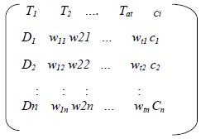
Indexing
wtn is the weight of word in the document.
Ways of determining the weight;
  boolean weighting
(1->if word exist in d, 0->otherwise)
  word frequency weighting
(number of times of a word in d)
  tf-idf, entropy etc.
  The major drawback of this model is that it results in a huge sparse matrix, which raises a problem of high dimensionality.

Slide 11
Other Indexing Methods
Ontology representation
  Keeps the semantic relationship between the terms in a document.
  This ontology model preserves the domain knowledge of a term present in a document.
  However, automatic ontology construction is a difficult task due to the lack of structured knowledge base.
N-Grams
  A sequence of symbols (byte, a character or a word) called N-Grams, that are extracted from a long string in a document are used.
  In an N-Gram scheme, it is very difficult to decide the number of grams to be considered for effective document representation.

Slide 12
Other Indexing Methods
Multiword terms
  Uses multi-word terms as vector components to represent a document.
  But this method requires a sophisticated automatic term extraction algorithm to extract the terms automatically from a document.
Latent Semantic Indexing (LSI) preserves the representative features for a document.
Locality Preserving Indexing (LPI) discovers the local semantic structure of a document.
A new representation to model the web documents is proposed. HTML tags are used to build the web document representation.

Slide 13
Feature Selection
The main idea of FS is to select subset of features from the original documents.
FS is performed by keeping the words with highest score according to predetermined measure of the importance of the word.
Some notable feature evaluation metrics;
  Information gain (IG),
  Term frequency,
  Chi-square,
  Expected cross entropy,
  Odds Ratio,
  The weight of evidence of text,
  Mutual information,
  Gini index.

Slide 14
Some Feature Selection Methods
Information Gain
Mutual Information
Chi-square

Slide 15
Classification
Documents can be classified by three ways;
  Unsupervised (unlabelled)
  Supervised (labelled)
  Semi supervised
Automatic text classification have been extensively studied and rapid progress is seen in this area.
Some classification approaches;
  Bayesian classifier,
  Decision Tree,
  K-nearest neighbor(KNN),
  Support Vector Machines(SVMs),
  Neural Networks,
  Rocchio’s Algoritm

Slide 16
Performance Measure
This is the last stage of text classification.
Evaluates the effectiveness of a classifier, in other words, its capability of taking the right categorization decisions.
Many measures have been used for this reason;
  Precision and recall,
  Accuracy,
  Fallout,
  Error etc.

Slide 17
Performance Measure
 | truly YES | truly NO
system YES | a | b
system NO | c | d
Recall = a/(a+c)
  Did we find all of those that belonged in the class?
Precision = a/(a+b)
  Of the times we predicted it was “in class”, how often are we correct?

Slide 18
Performance Measure
TP - # of documents correctly assigned to this category
FN - # of documents incorrectly assigned to this category
FP - # of documents incorrectly rejected from this category
TN - # of documents correctly rejected from this category
Fallout = FN / FN + TN
Error = FN +FP / TP + FN +FP +TN
Accuracy = TP + TN

Slide 19
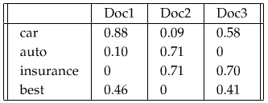
Rocchio Classification
    Rocchio classification uses Vector Space Model.
    In Vector Space Model, the documents are represented as vectors in a common vector space.
    We denote by V(d), the vector derived from document d, with one component in the vector for each dictionary term.
    The components are generally computed using the tf–idf weighting.

Slide 20
Tf–idf Weighting
Tf–idf
  term frequency–inverse document frequency,
  a numerical statistic which reflects how important a word is to a document in a collection or corpus.
It is often used as a weighting factor in information retrieval and text mining.
The tf-idf value,
  increases proportionally to the number of times a word appears in the document,
  but is offset by the frequency of the word in the corpus, which helps to control for the fact that some words are generally more common than others.

Slide 21
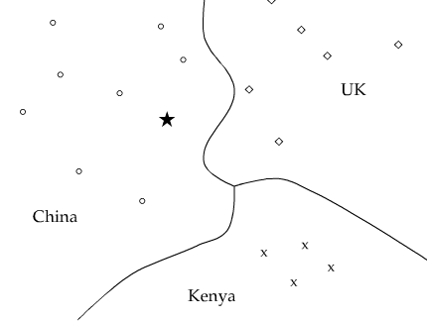
Vector Space Model
The document vectors are rendered as points in a plane.
This vector space is divided into 3 classes.
The boundaries are called decision boundaries.
To classify a new document, we determine the region it occurs in and assign it the class of that region.

Slide 22
Rocchio Classification
Rocchio classification uses centroids to define the boundaries.
The centroid of a class is computed as the center of mass of its members.
D_{c} is the set of all documents with class c.
v(d) is the vector space representation of d.

Slide 23
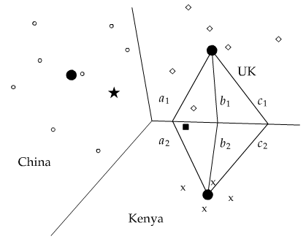
Rocchio Classification
Centroids of classes are shown as solid circles.
The boundary between two classes is the set of points with equal distance from the two centroids.

Slide 24
Rocchio Classification
The classification rule in Rocchio is to classify a point in accordance with the region it falls into.
We determine the centroid µ(c) that the point is closest to and then assign it to c.
In the example, the star is located in the China region of the space and therefore Rocchio assigns it to China.

Slide 25
Rocchio Classification
In other words;
  A prototype vector for each class is builded using a training set of documents
  This prototypevector is the average vector over all training document vectors that belong to class c.
  Then similarity between test document vector and each of prototype vectors are calculated.
  The class with maximum similarity is assigned to the document.
For calculating similarity;
  Euclidean distance
  Cosine similarity

Slide 26
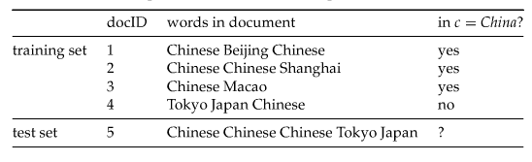
Example
We have 2 document classes: China and Japan and want to classify a new document.

Slide 27
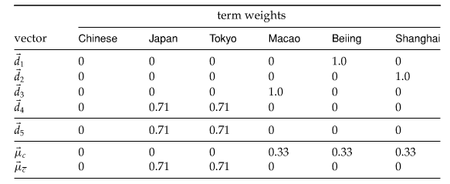
Example
First of all, we find the vector representations of documents by computing tf-idf values.

Slide 28
Example
Then two class centroids are computed with µc=1/3·(d1+d2+d3) and µc=1/1·(d4).
The distances of the test document from the centroids are |µc−d5|≈1.15and |µc−d5|=0.0.
Here, the distances are computed using the Euclidean distance.
Thus, Rocchio assigns d5 to Japan.

Slide 29
Analysis of Rocchio Algorithm
Rocchio forms a simple representation for each class: the centroid.
Classification is based on the distance from the centroid.
It is little used outside text classification;
  It has been used quite effectively for text classification.
  But in general worse than Naïve Bayes.
It is cheap to train and test documents.

Slide 30
Analysis of Rocchio Algorithm
Advantages
  Easy to implement
  Very fast learner
  Relevance feedback mechanism
    allow the user to progressively refine the system's response
Disadvantages
  Low classification accuracy

Slide 31
Conclusion
The growing use of the textual data needs text mining, machine learning and NLP techniques and methodologies to organize and extract pattern and knowledge from the documents.
In this presentation, I tried to give the general steps of classification algorithms and the details of Rocchio classification algortihm.
In text classification, there are several classfiers but no classifier can be mentioned as a general model for any application.
Different algorithms perform differently depending on data collection.

Slide 32
Thank you!
Any questions?

