Slide 1
Prescriptive and Predictive Analytical Models
Predictive Analytical Models
Purpose: Predictive analytics’ purpose focuses on forecasting future outcomes based on historical data. It helps answer the question: "What is likely to happen?". This practice has become essential in today's world, enabling organizations to anticipate trends, reduce risks, and make informed decisions (GeeksforGeeks, 2018).
Methodology: These models use statistical techniques, machine learning algorithms, and data mining to uncover patterns. Common techniques include (Halton, 2025):
    Classification: They are designed to classify input data into predefined categories or classes based on training datasets (e.g. random forest, neural network, decision trees, logistic regression, and support vector machines).
    Clustering: Groups data points based on their similarities without requiring predefined labels (e.g. k-means clustering, hierarchical clustering).
    Time Series Modelling: Analysis of sequential data points that are collected over time (e.g. ARIMA, SARIMA, Prophet, and XGBoost).

Slide 2
Examples of Predictive Analytical Models
Shark Attacks - Predicting Outcomes with Machine Learning
PriceRunner – Optimizing Product Categorization
In my shark attack analysis notebook, I used predictive modelling by training machine learning algorithms such as Logistic Regression, SVM, Decision Tree, and Random Forest to forecast the type or severity of shark attacks. I based these predictions on variables like age, activity, species, and gender. My goal was to uncover patterns in historical data that could help anticipate whether a shark attack would be fatal or non-fatal. I evaluated the accuracy of these models using metrics like ROC AUC and PR AUC to ensure their reliability in making predictions.
In my PriceRunner notebook, I used predictive modeling to classify products into their correct categories based on features like product titles, merchant IDs, and clusters. By training classification models such as K-Nearest Neighbors and Random Forest, I was able to accurately predict the category of new product entries, automating the classification process and improving product organization for better price comparisons.

Slide 3
Prescriptive Analytical Models
Purpose: Prescriptive analytics’ recommends course of action/s that can optimize outcomes based on predicted scenarios. It goes one step further by answering: "What should we do?" and "How can we mitigate risks or capitalize on opportunities?" (Stryker, 2024).
Methodology: These models often use optimization algorithms, simulations, and rule-based systems. Common techniques include (Hassan, 2024):
    Optimization Models: Uses mathematical equations to find the best solution under given constraints (e.g. linear and nonlinear programming, stochastic optimization).
    Simulation: Creates virtual models to test different scenarios and their outcomes.
    Machine Learning: Uses algorithms to analyse data and generate recommendations based on patterns and trends.
    Decision Analysis: Evaluates and compares multiple strategies to select the most effective one (decision trees).
    Heuristic Algorithms: Provides approximate solutions for complex problems that may not have a precise answer.

Slide 4
Examples of Prescriptive Analytical Models
Shark Attacks – Recommending Actions Through Model Optimization
Price Runner - Data-Driven Strategies for Product Optimization
I applied aspects of prescriptive modeling by comparing the effectiveness of different resampling techniques (like SMOTE and undersampling) and analyzing how each modeling approach performed. This allowed me to determine the best combination of methods to achieve balanced and accurate predictions. By identifying the most effective model setups, I was able to make informed recommendations on which strategies could be used to guide real-world decisions—for example, advising authorities on how to allocate safety resources based on predicted high-risk factors.
I applied clustering techniques, specifically K-Means, to identify patterns in product offerings and merchant behavior. This allowed me to prescribe strategies such as optimizing inventory management and creating targeted marketing campaigns. For example, when I discovered Canon cameras frequently clustered together, I suggested bundling similar products to boost sales and enhance customer engagement.

Slide 5
Prescriptive and Predictive Analytical Model
Aspect | Predictive Analytics | Prescriptive Analytics
Definition | Forecasts future trends, outcomes, or behaviors based on historical data and pattern recognition. | Recommends specific actions or strategies based on data analysis and predictive models.
Purpose | To answer "What is likely to happen?" | To answer "What should we do about it?"
Focus | Identifying patterns and forecasting trends | Recommending optimal decisions and actions
Output | Forecasts, probabilities, and risk scores | Action recommendations and optimization strategies
Typical Methods | Regression analysis, time series forecasting, machine learning classification | Optimization algorithms, simulation modeling, decision analysis

Slide 6
Advantages and Disadvantages of Predictive and Prescriptive Analytics
Model Type | Advantages | Disadvantages
Predictive Analytics | Identifies trends and potential future risks early, enabling proactive responses to challenges. Continuously improves its accuracy and effectiveness as more data is gathered and analyzed. | Forecasts may be unreliable if they rely on biased or incomplete data, leading to skewed insights. Additionally, false predictions can result in poor decision-making and misguided strategies.
Prescriptive Analytics | Optimizes outcomes by recommending the best actions under given constraints while uncovering untapped revenue opportunities. It also helps organizations focus resources effectively, avoiding waste on non-impactful data or initiatives. | Relies heavily on correct assumptions, as inaccuracies can lead to unreliable results or suggestions. Misinterpretation of data or models may yield misleading recommendations, and implementing these systems requires advanced tools and skilled analysts.
(Edwards and Thor Olavsrud, 2019; Chabrier, 2021)

Slide 7
Analytical Methods
FUNCTION
Regression Analysis
Decision Tree
Clustering
Regression analysis predicts a continuous outcome based on one or more independent variables. It identifies trends or relationships in data, usually through a line of best fit or more complex models in other regression types. Common methods include OLS (Ordinary Least Squares), Ridge/Lasso Regression, Bayesian Regression and MLE (Maximum Likelihood Estimation).
A decision tree uses a tree structure to model decisions and outcomes. It splits data into branches based on feature values, making it easy to interpret for both classification and regression problems. Key components include root node, internal node, branches, and leaf nodes. Some metrics for splitting are Gini Impurity, Entropy, and Information Gain.
Clustering groups unlabelled data based on similarity. Unlike classification, clustering is unsupervised, meaning it finds natural groupings without prior labels. It measures distances (e.g., Euclidean) between points. Common algorithms used are K-Means, DBSCAN, and Hierarchical Clustering.
(Mehta, 2023; IBM, 2021; GeeksforGeeks, 2018)

Slide 8
SCENARIO/USE CASE
Regression Analysis
Decision Tree
Clustering
Healthcare
  Goal: Identify key factors influencing patient recovery time.
  Method: Use multiple regression with variables like age, treatment type, and diet.
  Outcome: Younger patients with a specific treatment plan recover faster.
Loan Approval
  Goal: Automate the loan decision process.
  Method: Decision tree analyses inputs like credit score, employment status, and income.
  Outcome: Applicants with strong credit scores and stable jobs are approved faster, while others require deeper checks.
Retail Marketing
  Goal: Segment customers based on behaviour and preferences.
  Method: Use clustering (e.g., K-Means) on data like spending habits, age, location.
  Outcome: Identify groups such as: (1) High spenders on premium goods, (2) Budget-conscious deal seekers and (3) Occasional buyers.
(Hassan, 2024; Fenjiro, 2018; Quilty, 2022)

Slide 9
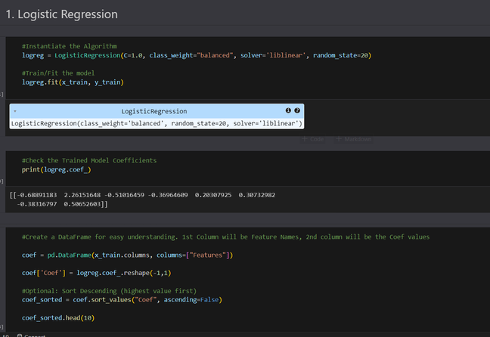
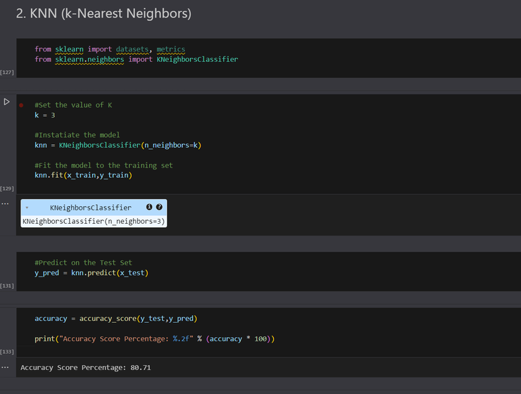
EVALUATION OF MODELS BASED ON CASE STUDY
Evaluating Predictive Analytics Using the Titanic Case Study
Application: The models can inform real-world scenarios such as emergency preparedness plans, transportation safety protocols, and disaster response strategies by identifying which groups are at higher risk and need prioritization.
Insights Gained:
  Analysis revealed that females, children, and first-class passengers had significantly higher survival rates, indicating how social structure and demographics influenced survival outcomes.
Benefits:
  Using multiple classification algorithms (Logistic Regression, KNN, Naive Bayes, Decision Tree) allowed for comparison of predictive performance and identification of influential features. This highlights how structured data and machine learning can aid in decision-making and risk assessment.
  Models can simulate various "what-if" scenarios, helping planners anticipate the impact of changes (e.g., increasing lifeboat capacity or altering boarding strategies).
(Analytiks, 2020)

Slide 10
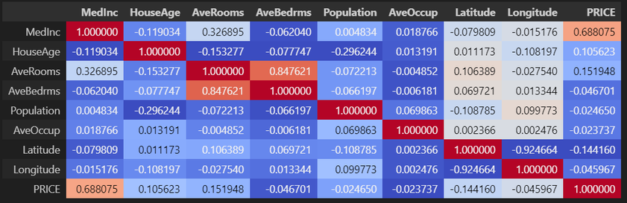
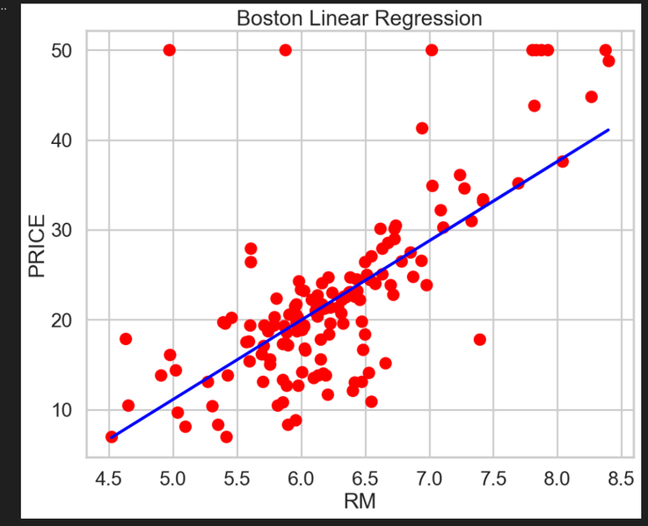
EVALUATION OF MODELS BASED ON CASE STUDY
Evaluating Predictive Analytics Using the Boston Housing Dataset
Application: The linear regression model applied to the Boston housing dataset provides actionable insights into how the number of rooms (RM) affects housing prices. This kind of analysis can be extended to:
  Real estate valuation and property appraisal tools
  Urban planning for identifying high-value residential zones
  Policy-making regarding housing affordability and zoning regulations
Insights Gained:
  A positive linear relationship between number of rooms and median home value: as RM increases, so does MEDV.
  Feature importance is evident through strong correlation scores, especially RM, which directly influence the price.
  Scatter plots and correlation matrices provide visual confirmation of relationships, aiding intuitive understanding of data patterns.
Benefits:
  Linear regression yields a clear equation (y = β0 + β1x) that is easy to interpret and explain to stakeholders.
  It serves as a starting point for more complex models while still offering reasonable predictive capability.
  Correlation heatmaps and scatter plots enhance understanding of inter-variable relationships.
  Performance metrics like R², MAE, and MSE offer measurable insights into model accuracy and error, supporting continuous improvement.
  Linear models are fast to train and ideal for high interpretability with low computational cost.
(Analytiks, 2020)

Slide 11
What is Big Data?
Big data refers to the immense volumes of structured and unstructured data generated every second, which can be analysed for insights to enhance decision-making in organizations. It is defined by five key characteristics known as the 5 V’s: Volume, Velocity, Variety, Veracity, and Value.
Companies Actively Using Big Data
  Netflix: Suggests shows/movies based on watch history.
  Uber: Uses real-time traffic and user data to optimize routes and pricing.
  Google: Analyzes search history, location, and behavior to deliver personalized results and ads.
Value of Big Data on Decision-Making
Organisations
End Users
  Analytics optimize supply chains, production, staffing, and resource allocation, reducing waste and costs.
  Identify trends, forecast demands, and make evidence-based plans rather than relying solely on intuition.
  To explore new markets, test product ideas, and enhance research capabilities.
  Helps users monitor spending, invest wisely, and avoid fraud through alerts and trends.
  Streaming platforms and online retailers use big data to suggest content or products tailored to user preferences.
  Health and fitness apps leverage personal data to guide users in improving lifestyle, diet, and exercise routines.
(Kumari, 2021; Badman and Kosinski, 2024; The Data Scientist, 2025)

Slide 12
Characteristics of Big Data
  Volume – Refers to the enormous amount of data generated from diverse sources every second. Examples include social media uploads, mobile data, e-commerce transactions, IoT sensor data, and biomedical records.
  Velocity – Describes the speed at which new data is created, collected, and processed. However, it demands real-time data processing, fast decision-making, continuous model updates, and anomaly detection.
  Variety – Represents the wide range of data types and formats such as structured, semi-structured, and unstructured. Examples include text, images, videos, audio, and metadata.
  Veracity – Indicates the accuracy, quality, and trustworthiness of data. Examples of issues include incomplete records, data inconsistencies, errors, and ambiguities.
  Value – Refers to the actionable insights and business benefits gained from big data analytics. This could be the impact of big data to the organisation, such as increased revenue and operational efficiency.
Data-driven Decisions
(DatabaseTown, 2024)
Notes:
Identify the 5 Vs of Big Data. Explain using this section.
‹#›

Slide 13
Data-Driven Decision Making (DDDM)
  Data-driven decision-making (DDDM) is the practice of using data analysis to guide business decisions rather than relying on intuition or gut feeling.
  It involves collecting and analyzing data from various sources such as customer feedback, market trends, financial data, and operational metrics.
  The approach helps organizations make informed, objective decisions aligned with their business goals
Benefits of DDDM:
  Improves decision accuracy and reduces uncertainty.
  Enhances customer engagement and satisfaction through personalized experiences.
  Optimizes performance and business strategies.
  Increases operational efficiency.
Examples:
  E-commerce companies use customer data to personalize marketing and optimize pricing.
  Streaming services use viewing history to recommend content, reducing churn.
  Retailers analyze sales patterns to manage inventory and predict demand.
(Mucci, 2024)

Slide 14
Process in Data-Driven Decision Making
  Define Objectives: Establish clear business goals and the specific problems or decisions that require a data-driven approach.
  Identify and Collect Data: Gather relevant data from internal and external sources. This may involve surveys, existing records, market trends, or customer feedback.
  Organize and Explore Data: Structure and prepare data for analysis. Ensuring the data is clean and accessible is crucial for accurate insights.
  Data Analysis: Utilize statistical methods and analysis tools to uncover patterns, trends, and correlations within the data.
  Draw Conclusions: Interpret the results of the analysis and translate them into actionable insights. This step often includes visualizing data to communicate findings clearly.
  Implement and Evaluate: Make data-driven decisions based on the insights gained and monitor the outcomes to assess effectiveness. Adjust strategies continuously based on new data and feedback.
(Ticong, 2024; Buijsse, Willemsen, and Snijders, 2023)

Slide 15
Impact of Using Complex Data Sets
Impact on Users
  Users benefit from more personalized experiences, whether through product recommendations, targeted advertisements, or tailored services.
  Users can make decisions more quickly and with greater confidence, as data analysis provides immediate insights into trends and patterns.
  While data-driven decisions are more accurate, users may become overly reliant on data, potentially sidelining creativity and intuition.
Impact on Organisations
  Complex data sets allow organisations to monitor their operations in real-time, identifying bottlenecks in production, customer service, or supply chains.
  Organisations can use big data to uncover insights that help in long-term strategic planning.
  Big data provides deep insights into customer behaviour, preferences, and purchasing patterns.
(Ohaba, 2023)

Slide 16
Evaluation of complex datasets in decision-making
Benefits
Constraints
  Complex datasets improve decision accuracy.
  They reveal hidden patterns not visible in simple data.
  Data-driven decisions reduce human cognitive biases.
  Multiple variables enable better risk assessment.
  Advanced data analysis creates competitive advantages.
  Complex data supports detailed customer personalization.
  Data quality problems multiply with complexity.
  Complex datasets require expensive computing infrastructure.
  Organizations often lack specialized analytical expertise.
  Complex models become difficult to interpret and explain.
  Integrating diverse data sources creates technical challenges.
  Too many variables can cause analysis paralysis.
(Ganesh, 2023; Cristofaro, 2024)
(Intone, 2025; GeeksforGeeks, 2024)
Notes:
Discuss the advantages and challenges to an organisation of using complex data sets for decision making.
‹#›

Slide 17
Statistical Tools
  R is well-suited for big data due to its extensive statistical packages and ability to integrate with distributed computing tools like Hadoop and Spark.
  Python supports big data through scalable libraries like Pandas and Dask and seamless integration with machine learning and big data frameworks.
  Apache Spark efficiently handles big data by enabling fast, in-memory, distributed processing across large clusters.
  SAS is ideal for big data analysis with its powerful, scalable analytics and enterprise-level data management capabilities.
  SSPSS manages and analyzes large datasets easily through a user-friendly interface and integration with big data platforms.
(Hillier, 2025)

Slide 18
Statistical Techniques Used for Big Data Manipulation
  Regression analysis models relationships between variables, making it essential for predicting outcomes from complex, high-volume datasets.
  Monte Carlo simulation efficiently handles uncertainty and variability in large datasets through repeated random sampling.
  Sampling techniques like subsampling and leveraging reduce computational load while preserving analytical accuracy in big data.
  Principal Component Analysis (PCA) reduces dimensionality in large datasets, making analysis faster and more interpretable without major loss of information.
  Time series analysis uncovers patterns and forecasts trends in massive time-based datasets commonly found in big data environments.
  Machine learning algorithms extract insights and make accurate predictions from vast, complex datasets without manual rule-setting.
(Indeed, 2020)

Slide 19
Graphical Tools
Graphical Tools Used for Big Data Visualisation
  Tableau handles big data effectively by connecting to diverse data sources and enabling users to create interactive, scalable visualizations with ease.
  Power BI is ideal for big data as it provides dynamic dashboards, strong data integration, and seamless compatibility with cloud-based and Microsoft ecosystems.
  Looker supports big data through real-time analytics, secure data exploration, and compatibility with multiple SQL-based big data platforms.
  Qlik Sense excels in big data analysis with its associative engine and scalable cloud architecture for rapid, intuitive insights.
  Google Data Studio is suitable for big data by offering real-time, collaborative reporting with seamless integration across Google platforms, making it accessible for users handling large-scale web and marketing data.
(GeeksforGeeks, 2020)

Slide 20
Graphical Techniques Used for Big Data Visualisation
  Line charts are widely used in big data for visualizing trends over time, helping identify patterns and changes in metrics across long periods.
  Bar charts effectively compare categorical data, making it easy to spot differences and rank variables in large datasets.
  Scatter plots reveal relationships and correlations between two continuous variables, essential for identifying patterns in big data analysis.
  Heat maps display data intensity through color, making them ideal for identifying clusters, outliers, or regional variations in large datasets.
  Box plots summarize distribution, variability, and outliers, offering a compact view of data spread in high-volume datasets.
  Treemaps help visualize hierarchical data and part-to-whole relationships, especially useful for exploring proportions in complex big data structures.
(Writer, 2020)

Slide 21
Analysis and Visualisation Tools
Python
Suitability: Python is perfect for more complex analysis and handling both structured and unstructured data. Libraries like Pandas for data manipulation, Matplotlib/ Seaborn for visualizations, and Folium for mapping make it highly customizable for deep dives into the Shark Attacks Dataset.
Pros:
  Extremely flexible for custom analyses and visualizations.
  Can handle large datasets efficiently and perform advanced statistical analysis.
  Open-source, which makes it free to use.
Cons:
  Requires programming knowledge, making it less user-friendly for non-technical users.
  Takes more time to create visualizations compared to drag-and-drop tools like Tableau or Power BI.
Microsoft Excel
Suitability: Excel is widely accessible and can be useful for basic analysis of the Shark Attacks Dataset, especially when it comes to filtering, sorting, and creating basic charts. However, for larger datasets, its capabilities are limited compared to more specialized tools.
Pros:
  Easy to use and widely available.
  Good for small datasets and basic analysis like pivot tables, bar charts, and line graphs.
  Familiar to most users, requiring minimal learning curve.
Cons:
  Not suitable for handling large datasets efficiently.
  Limited visualization options for complex or interactive data exploration.
  Not ideal for advanced statistical analysis or geographic mapping.
(Pavlovych, 2025; Mattoo, 2023)
(Barraza, 2024; esProc, 2025)

Slide 22
Analysis and Visualisation Tools
Tableau
Suitability: Tableau is excellent for visualizing large datasets with geographical and temporal data. It can create interactive dashboards, heat maps, and time-series visualizations, which are ideal for understanding patterns in shark attack incidents across locations, species, and time.
Pros:
  Advanced geographical mapping for visualizing shark attack locations.
  Intuitive drag-and-drop interface for creating complex visualizations.
  Strong temporal visualizations to analyse trends over time.
Cons:
  Can be expensive for smaller organizations or individual users.
  Might have a learning curve for beginners, especially when dealing with complex datasets.
Microsoft Power BI
Suitability: Power BI is highly suitable for analyzing and visualizing structured datasets like the Shark Attacks Dataset. It supports geospatial visualizations, time series analysis, and detailed filtering, making it easy to explore patterns across different attributes such as location, species, activity, and more.
Pros:
  Seamless integration with various data sources (e.g., Excel, SQL).
  Affordable, especially for organizations already using Microsoft products.
  Powerful filtering and drill-down features for in-depth analysis.
Cons:
  Limited advanced visualization options compared to Tableau.
  May require more customization to handle unstructured data or complex analysis.
(Dixon, 2010; Shaptunova, 2025)
(Pavlenko, 2022; DataFlair Team, 2018)

Slide 23
Introduction to the Dataset
This dataset hosted on Kaggle (Global Shark Attack Dataset) contains records of shark attacks, including various attributes such as the date of the attack, location, species of shark, and the nature of the incident. The dataset is compiled from various sources and includes forensic examinations of incidents, interviews with victims and witnesses, and evaluations of environmental conditions.
Purpose of the Program:
  To analyze trends and patterns in shark attack incidents
  To predict shark attack types based on contextual factors like geography, activity, species, and demographics.
  To provide assistance in risk management, awareness campaigns, or marine safety planning.

Slide 24
This dataset contains 39,098 rows and 255 columns, amounting to over 9.97 million data points, which significantly increases its complexity and demands for storage, processing, and analysis. Big data is not solely defined by volume but also by variety (numerous features and mixed data types), velocity (how data is collected or updated), and veracity (inconsistencies and unstructured elements, which this dataset contains, such as mixed data types and incomplete entries).
Furthermore, this dataset is part of a larger global data initiative, namely the Global Shark Attack File (GSAF), an expanding international database of shark attacks maintained by researchers and institutions. The file represents a subset of the broader dataset, which includes historical data dating back centuries (1800s to date) and is constantly growing through ongoing reports and data integration from researchers, governments, and public submissions.

Slide 25
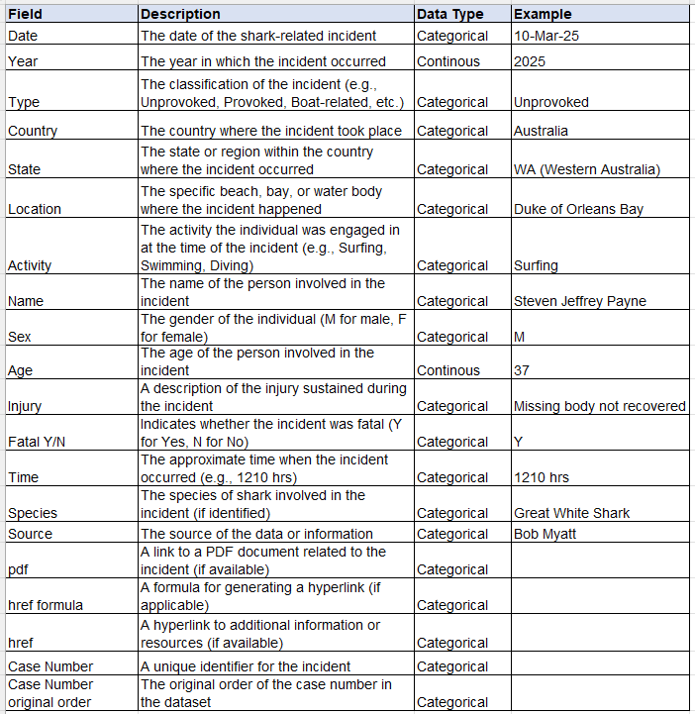
Data Dictionary
  The dataset has a total of 20 fields.

Slide 26
Data Preparation
Data Cleaning: This involves identifying and correcting errors, inconsistencies, or inaccuracies in the dataset to ensure its accuracy, complete, and usable for analysis or modelling:
  Missing values: Rows with null values in key columns such as Type, Sex, Age, or Fatal were either removed, imputed, and replaced as “Unknown”, if possible.
  Standardizing values: Ensure consistent categories such as in Sex column (“MALE”⟶ “M”, “FEMALE”⟶ “F”) and Fatal column (“YES”⟶ “Y”, “NO”⟶ “N”, Unknown).
  Noise reduction: Irregular entries like "?" or “Unknown” in Species or Activity were either categorized under "Other" or excluded, depending on relevance.
  Outliers: Extreme age values or inconsistent date entries were either corrected or dropped.
  Eliminating duplicates: Duplicate entries were identified and removed.
  Fixing inconsistent country names: Applied mappings to unify country representations (e.g., "Usa"→ "United States of America", “Sudan?”⟶ “Sudan”).
Data Discretization: This is the process of converting continuous data into discrete categories or intervals for better modelling performance:
    Temporal features like Years or Date were used to create periods or decades for trend analysis and to reduce dimensionality.
Notes:
Detail the process of preparing data for analytical modeling, starting with data cleaning, where erroneous or missing values are identified and corrected to ensure data quality. Then, discuss discretization, the process of converting continuous variables into categorical ones, which can simplify analysis and improve interpretability. Move on to aggregation, where data is combined into summary statistics or categories to reduce complexity and facilitate analysis. Finally, explain data reduction, which involves techniques such as principal component analysis or feature selection to reduce the dimensionality of the dataset while retaining relevant information, thereby improving computational efficiency and model performance.
Identify three potential issues that may arise during the preparation of data for an applied analytical model. First, discuss data quality issues, such as missing values, outliers, or inconsistencies, which can skew analysis results and undermine the reliability of the model. Second, highlight the challenge of feature selection, where selecting the most relevant variables from a large pool of potential predictors can be subjective and may lead to model overfitting or underfitting. Lastly, address the issue of data imbalance, particularly in classification tasks, where one class may be significantly underrepresented, leading to biased model performance and inaccurate predictions.
‹#›

Slide 27
Data Aggregation: It combines multiple data points into a summary form, such as calculating the average, sum, or count of values:
    Aggregated shark data by year, species, country, and fatality to identify top countries with the most incidents for temporal and geographical insights.
    Grouped fatality rates by gender (M and F) to calculate fatal and non-fatal rates as percentages.
    Grouped shark data by cluster (clustering technique) to compute means per group.
Data Reduction: This technique reduces the size or complexity of the dataset while preserving key information.
    Dropped irrelevant or high-missing columns like pdf, href, Name, Source, and other metadata.
    Dimensionality Reduction using PCA (Principal Component Analysis) was applied prior to clustering, ensuring that only the most informative features were used.
    Used feature selection to retain variables that are most relevant to classification (e.g., Activity, Species, Age, Fatal) and dropped unnecessary or noisy columns.
    Applied SMOTE to reduce class imbalance before training classification models
Notes:
Detail the process of preparing data for analytical modeling, starting with data cleaning, where erroneous or missing values are identified and corrected to ensure data quality. Then, discuss discretization, the process of converting continuous variables into categorical ones, which can simplify analysis and improve interpretability. Move on to aggregation, where data is combined into summary statistics or categories to reduce complexity and facilitate analysis. Finally, explain data reduction, which involves techniques such as principal component analysis or feature selection to reduce the dimensionality of the dataset while retaining relevant information, thereby improving computational efficiency and model performance.
Identify three potential issues that may arise during the preparation of data for an applied analytical model. First, discuss data quality issues, such as missing values, outliers, or inconsistencies, which can skew analysis results and undermine the reliability of the model. Second, highlight the challenge of feature selection, where selecting the most relevant variables from a large pool of potential predictors can be subjective and may lead to model overfitting or underfitting. Lastly, address the issue of data imbalance, particularly in classification tasks, where one class may be significantly underrepresented, leading to biased model performance and inaccurate predictions.
‹#›

Slide 28
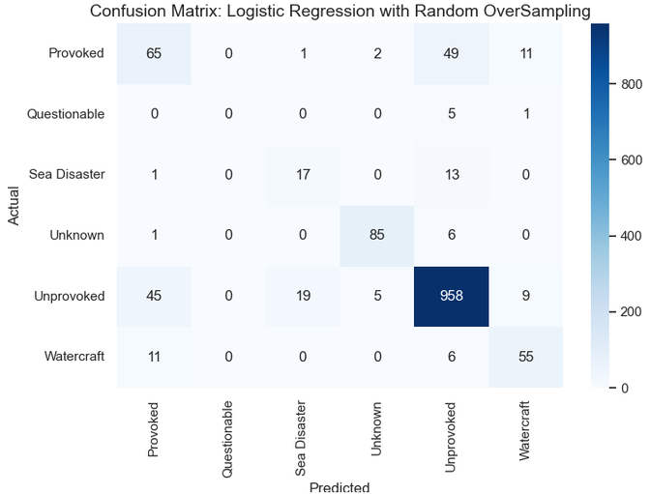
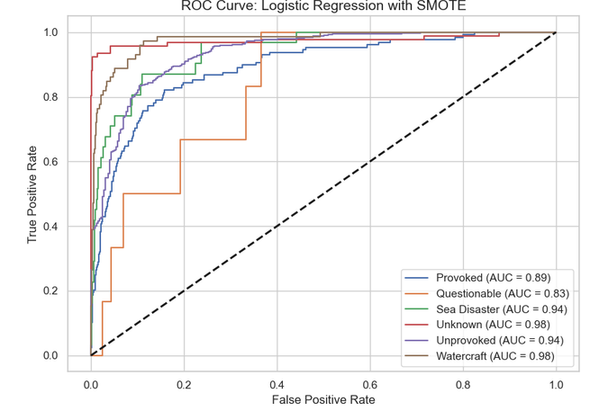
Methods to Visualize Analytical Model Output
The confusion matrix helps illustrate how well the models predicted the type of shark attack (e.g., Unprovoked, Provoked, Watercraft, etc.) by showing the number of correct and incorrect classifications for each category. This is useful in spotting which types of attacks the model struggles to identify.
The ROC curve provides a visual representation of how well the model distinguishes between different attack types. For this multiclass dataset, the ROC curve shows the true positive rate versus the false positive rate for each attack class, helping to assess the model’s ability to separate categories like "Unprovoked" and "Sea Disaster" effectively.
Notes:
Detail the process of preparing data for analytical modeling, starting with data cleaning, where erroneous or missing values are identified and corrected to ensure data quality. Then, discuss discretization, the process of converting continuous variables into categorical ones, which can simplify analysis and improve interpretability. Move on to aggregation, where data is combined into summary statistics or categories to reduce complexity and facilitate analysis. Finally, explain data reduction, which involves techniques such as principal component analysis or feature selection to reduce the dimensionality of the dataset while retaining relevant information, thereby improving computational efficiency and model performance.
Identify three potential issues that may arise during the preparation of data for an applied analytical model. First, discuss data quality issues, such as missing values, outliers, or inconsistencies, which can skew analysis results and undermine the reliability of the model. Second, highlight the challenge of feature selection, where selecting the most relevant variables from a large pool of potential predictors can be subjective and may lead to model overfitting or underfitting. Lastly, address the issue of data imbalance, particularly in classification tasks, where one class may be significantly underrepresented, leading to biased model performance and inaccurate predictions.
‹#›

Slide 29
Potential Issues in Data Preparation
Missing Values: Many real-world fields (like ‘Age’ or ‘Injury’) have missing or inconsistent entries. Many rows contain NaNs or vague descriptions (e.g., “Unknown” activity or species).
Imbalanced Data: Some attack types or regions are overrepresented, requiring resampling techniques. Most entries may belong to one class (e.g., non-fatal), leading to biased model predictions.
Textual Ambiguity: Descriptions like “surfing” vs. “surfing near shore” can make feature engineering challenging unless NLP techniques are used.
Inconsistent or Noisy Entries: Features like "Activity" or "Species" have many unique values; improper encoding may hurt model performance.
Notes:
Detail the process of preparing data for analytical modeling, starting with data cleaning, where erroneous or missing values are identified and corrected to ensure data quality. Then, discuss discretization, the process of converting continuous variables into categorical ones, which can simplify analysis and improve interpretability. Move on to aggregation, where data is combined into summary statistics or categories to reduce complexity and facilitate analysis. Finally, explain data reduction, which involves techniques such as principal component analysis or feature selection to reduce the dimensionality of the dataset while retaining relevant information, thereby improving computational efficiency and model performance.
Identify three potential issues that may arise during the preparation of data for an applied analytical model. First, discuss data quality issues, such as missing values, outliers, or inconsistencies, which can skew analysis results and undermine the reliability of the model. Second, highlight the challenge of feature selection, where selecting the most relevant variables from a large pool of potential predictors can be subjective and may lead to model overfitting or underfitting. Lastly, address the issue of data imbalance, particularly in classification tasks, where one class may be significantly underrepresented, leading to biased model performance and inaccurate predictions.
‹#›

Slide 30
Proposed Dataset Preparation for Analytical Model
  Selected key variables relevant to classification: Sex, Age, Type, Activity, Country, Fatal, etc. Removed unnecessary or identifier fields like Name, Location, PDF.
  Imputing missing values in features like Age or Species using statistical methods (e.g., median age).
  Used SMOTE to address class imbalance in the Fatal column.
  Created new features such as Is_Adult, High_Risk_Activity, or Decade to capture meaningful patterns (feature engineering).
  Applied PCA before KMeans clustering to reduce dimensionality and noise.
  Data was split into training and testing sets with stratification to maintain class proportions, ensuring model generalizability.
  Applied Label Encoding for binary and ordinal variables (e.g., Sex, Fatal). Applied One-Hot Encoding for nominal multi-class variables like Activity, Species, Country where necessary.
  Standardized and scaled continuous features such as Age (especially for models sensitive to scale like SVM or KMeans).
Notes:
Detail the process of preparing data for analytical modeling, starting with data cleaning, where erroneous or missing values are identified and corrected to ensure data quality. Then, discuss discretization, the process of converting continuous variables into categorical ones, which can simplify analysis and improve interpretability. Move on to aggregation, where data is combined into summary statistics or categories to reduce complexity and facilitate analysis. Finally, explain data reduction, which involves techniques such as principal component analysis or feature selection to reduce the dimensionality of the dataset while retaining relevant information, thereby improving computational efficiency and model performance.
Identify three potential issues that may arise during the preparation of data for an applied analytical model. First, discuss data quality issues, such as missing values, outliers, or inconsistencies, which can skew analysis results and undermine the reliability of the model. Second, highlight the challenge of feature selection, where selecting the most relevant variables from a large pool of potential predictors can be subjective and may lead to model overfitting or underfitting. Lastly, address the issue of data imbalance, particularly in classification tasks, where one class may be significantly underrepresented, leading to biased model performance and inaccurate predictions.
‹#›

Slide 31
Data Transformation
Data transformation is a crucial preprocessing step that helps ensure the analytical model can learn effectively, produce accurate predictions, and generalize well.
Data transformation improves model compatibility, since most machine learning algorithms require data in a specific format. Numerical-only models like Logistic Regression, SVM, and KMeans cannot handle raw categorical text, such as Sex, Type, or Country.
  Transformation applied: The categorical features are converted into numerical format using label encoding and one-hot encoding, allowing models to process them properly.
It also handles data imbalance for better learning. In the dataset, there is a class imbalance between fatal and non-fatal shark attacks. Without transformation, models tend to favour the majority class, resulting in poor predictive performance for the minority class.
  Transformation applied: SMOTE was used to balance the dataset, helping the model learn both classes more equally.
It normalizes feature scales. Features like Age have a different range compared to binary variables like Sex or Fatal. Models like KMeans or SVM are sensitive to feature scale. Large-valued features can dominate others, skewing results.
  Transformation applied: Standardization or normalization was used to bring all numerical features to the same scale, improving model performance and fairness.
Notes:
Emphasize the primary reasons for performing data transformation before inputting it into an applied analytical model. Firstly, discuss the need to normalize or standardize data to ensure that variables are on a comparable scale, preventing certain features from dominating the analysis due to their larger magnitude. Secondly, highlight the importance of handling skewed distributions through techniques like log transformation or power transformation, which can improve the performance of certain models by making the data more symmetric and reducing the impact of outliers. Lastly, mention the necessity of encoding categorical variables into numerical representations to enable their inclusion in mathematical models, ensuring that all relevant information is captured for analysis.
‹#›

Slide 32
Data Transformation
It reduces complexity and dimensionality. High-dimensional data can cause the "curse of dimensionality," where too many irrelevant or redundant features reduce model performance:
  Transformation applied: Principal Component Analysis (PCA) was used to reduce the number of features before clustering, keeping only the most informative components.
It increases predictive power through feature engineering. Raw data may not capture all the patterns or context needed:
  Transformation applied: Derived variables were created (like age groups or activity risk levels), which helped models capture more meaningful patterns. This boosts interpretability and can improve classification accuracy.
It ensures clean, consistent input for modelling. Many columns had inconsistent formats or entries — like text variations ("M", "Male", "male") or unknowns ("?", "Unknown"):
  Transformation applied: The entries were cleaned and unified before modelling, reducing noise and inconsistencies.
Notes:
Emphasize the primary reasons for performing data transformation before inputting it into an applied analytical model. Firstly, discuss the need to normalize or standardize data to ensure that variables are on a comparable scale, preventing certain features from dominating the analysis due to their larger magnitude. Secondly, highlight the importance of handling skewed distributions through techniques like log transformation or power transformation, which can improve the performance of certain models by making the data more symmetric and reducing the impact of outliers. Lastly, mention the necessity of encoding categorical variables into numerical representations to enable their inclusion in mathematical models, ensuring that all relevant information is captured for analysis.
‹#›

Slide 33
Project Goals
Identify patterns in shark attacks across different dimensions (e.g., location, time, activity, and demographics) to support public safety initiatives.
Classify the type of shark attacks using machine learning algorithms to assist in incident reporting and response planning.
Cluster shark attacks to discover hidden groupings that can guide targeted interventions or policies.
Forecast future fatal shark attack trends using time series analysis to improve readiness and resource allocation.
Notes:
Emphasize the primary reasons for performing data transformation before inputting it into an applied analytical model. Firstly, discuss the need to normalize or standardize data to ensure that variables are on a comparable scale, preventing certain features from dominating the analysis due to their larger magnitude. Secondly, highlight the importance of handling skewed distributions through techniques like log transformation or power transformation, which can improve the performance of certain models by making the data more symmetric and reducing the impact of outliers. Lastly, mention the necessity of encoding categorical variables into numerical representations to enable their inclusion in mathematical models, ensuring that all relevant information is captured for analysis.
‹#›

Slide 34
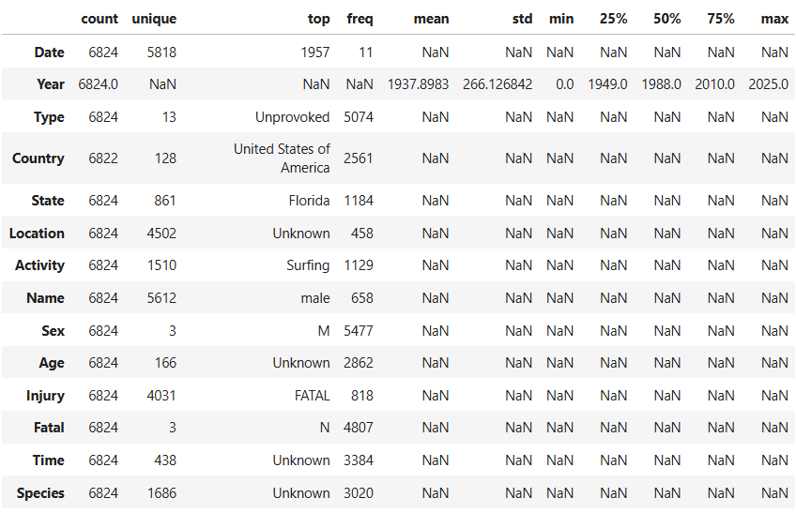
Data Analysis and Data Visualisation
Based on the summary statistics:
  The dataset spans across multiple years, with a mean year of 1937 and extending up to 2025.
  "Type" shows 13 unique values, with "Unprovoked" being the most frequent type (5,074 instances). This might indicate that most incidents happen without human provocation.
  The United States of America tops the list as the most frequent country of occurrence (2,561 instances), with Florida being the most common state (1,184 cases).
  "Surfing" is the most frequent activity (1,129 occurrences), which is not surprising, given its close interaction with ocean environments.
  The majority of incidents involve males (with 5,477 occurrences).

Slide 35
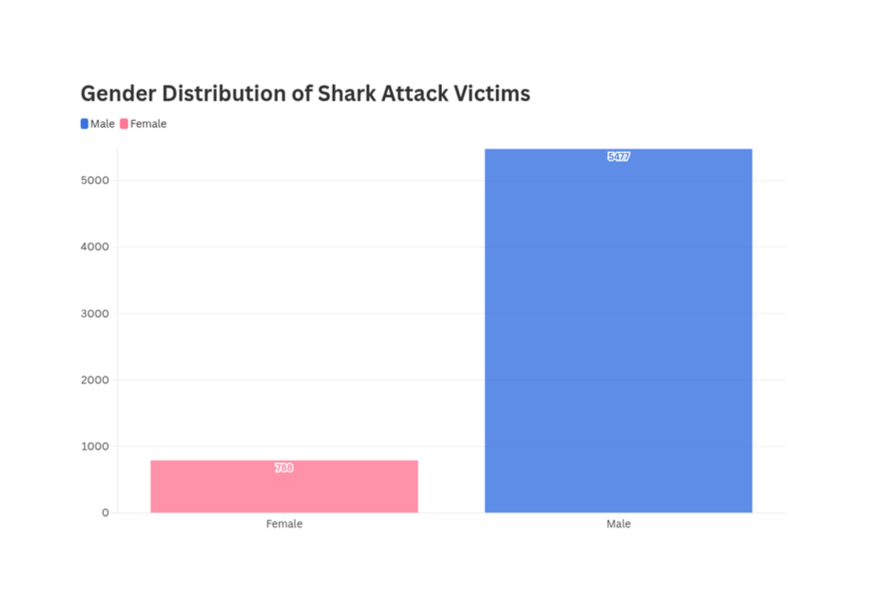
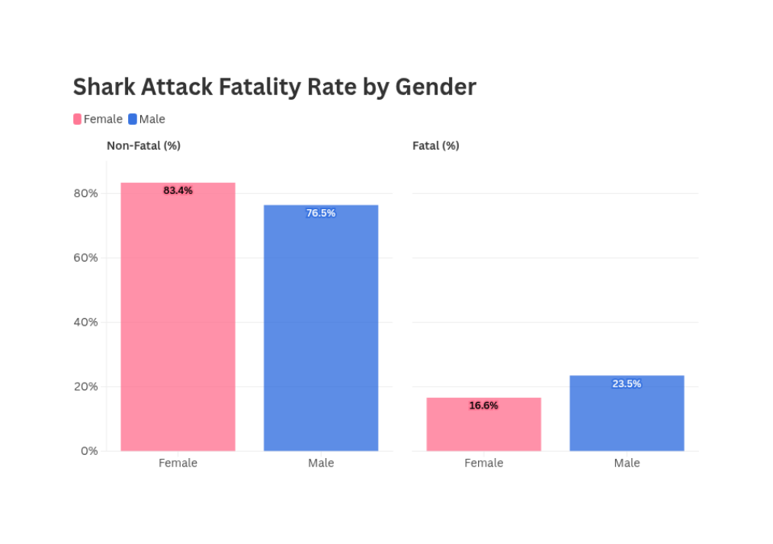
Which gender is most frequently involved in shark attacks? Are fatal shark attacks more likely to happen to one gender over the other?
87.4%
12.6%
Among females, 83.4% of attacks are non-fatal, with a low fatality rate of 16.5%. In contrast, males face a higher fatality rate of 23.5%, with 76.5% of incidents being non-fatal. This difference might be attributed to behavioural factors, such as male engaging in riskier activities or venturing closer to sharks.
The overwhelming majority of shark attack victims are male (87.4%), while females account for only 12.6%. This disparity suggests that the water activities (e.g., surfing, diving) are typically undertaken by males.

Slide 36
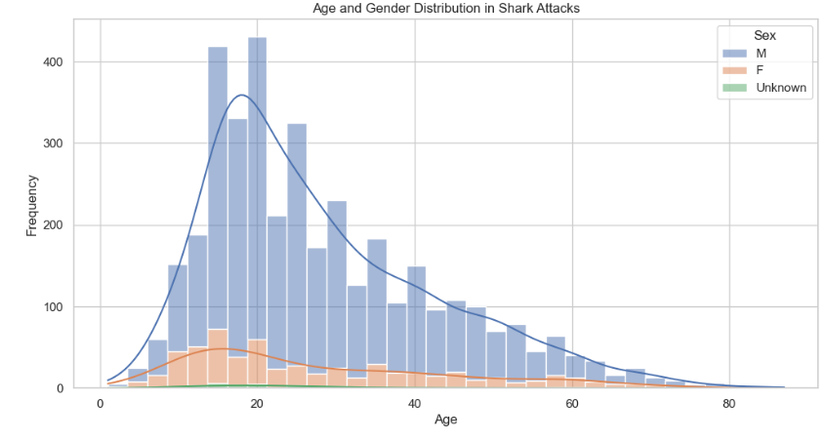
Which age groups are most at risk of shark attacks, and are there gender-based trends in these distributions?
  It shows that males are significantly more frequent victims compared to females.
  The highest frequency of shark attacks occurs among males aged 15 to 25 years, with a peak around age 20. Females also exhibit a slight peak in the same age range, but with a much lower frequency compared to males.
  Young males are likely engaging in activities that place them at higher risk in shark-prone environments.

Slide 37
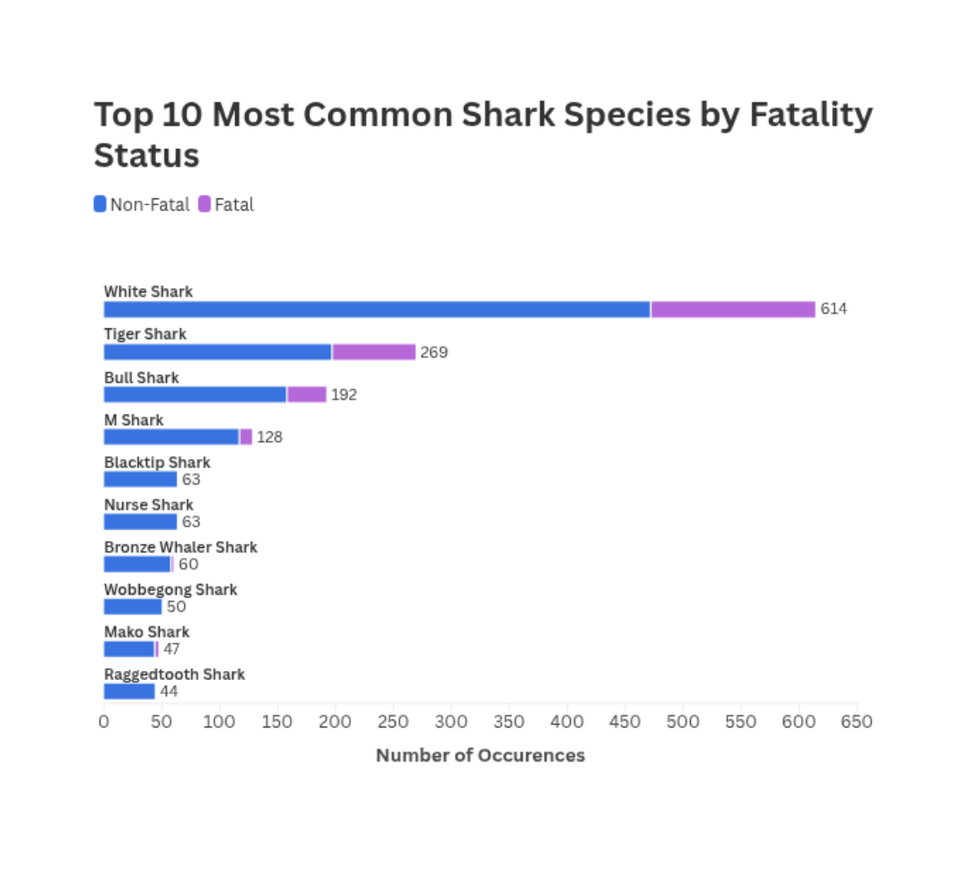
Which shark species are most frequently involved in incidents, and which are more likely to cause fatalities?
  It illustrates that the White Shark is the most frequently involved in shark incidents, with a total of 614 occurrences. Among these, a significant portion is fatal, making it the species most associated with fatalities. The prominence of White Shark poses the greatest risk to human life during interactions
  Tiger Sharks (269 occurrences) and Bull Sharks (192 occurrences) follow in frequency, and both species also have notable fatality rates, although lower than the White Shark.
  Other species such as the Mako Shark, Black tip Shark, Nurse Shark, and others have fewer occurrences (each under 130) and the proportion of fatal incidents for these species is relatively lower.

Slide 38
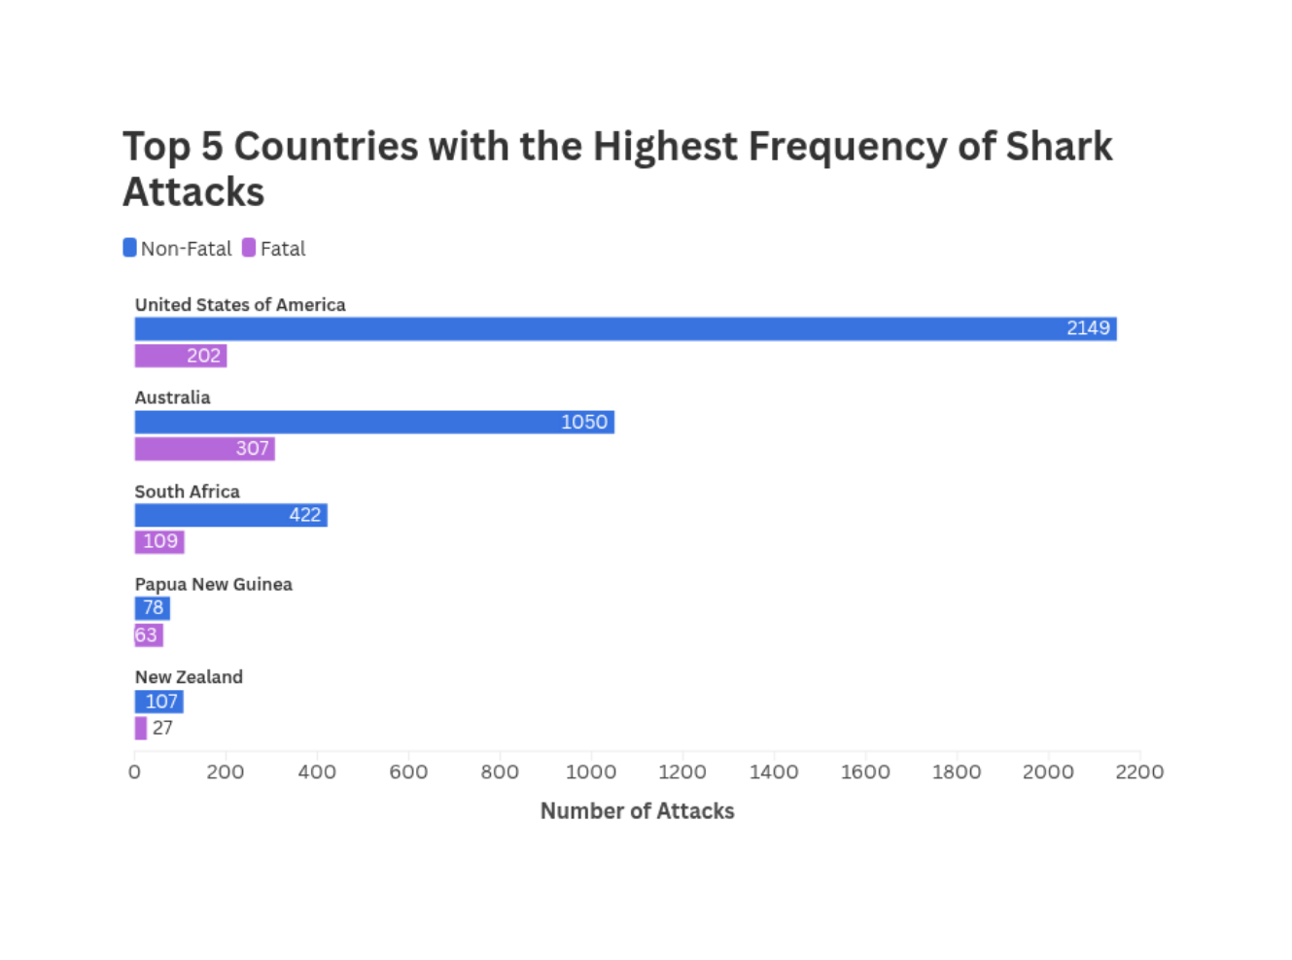
Where do shark attacks occur most frequently, and how do the fatality rates compare among the top countries?
  Shark attacks are most frequent in the United States (2,351 incidents), where fatality rates are relatively low compared to non-fatal attacks. This suggests that while shark encounters are common, they are less likely to be deadly.
  Australia follows with 1,357 attacks, showing a higher proportion of fatal incidents compared to U.S.
  South Africa has 531 attacks with a notable fatality rate, indicating greater risk in its waters.
  Smaller totals are seen in Papua New Guinea (141) and New Zealand (134), but these also have significant fatality rates relative to their occurrence.

Slide 39
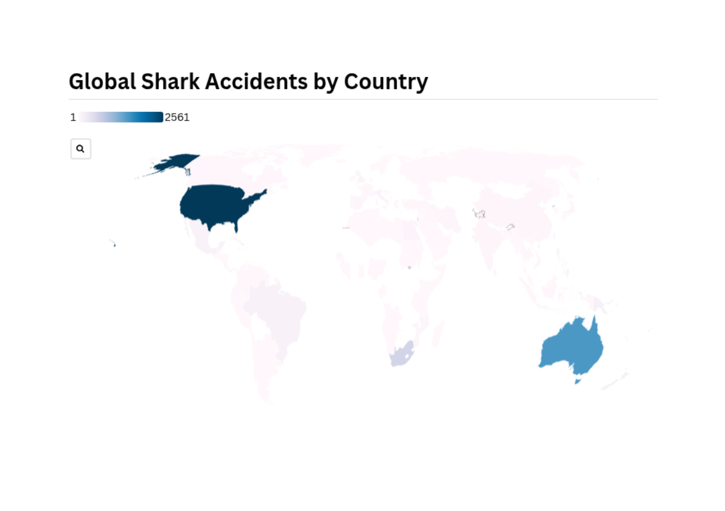
What is the global distribution of shark attacks?

Slide 40
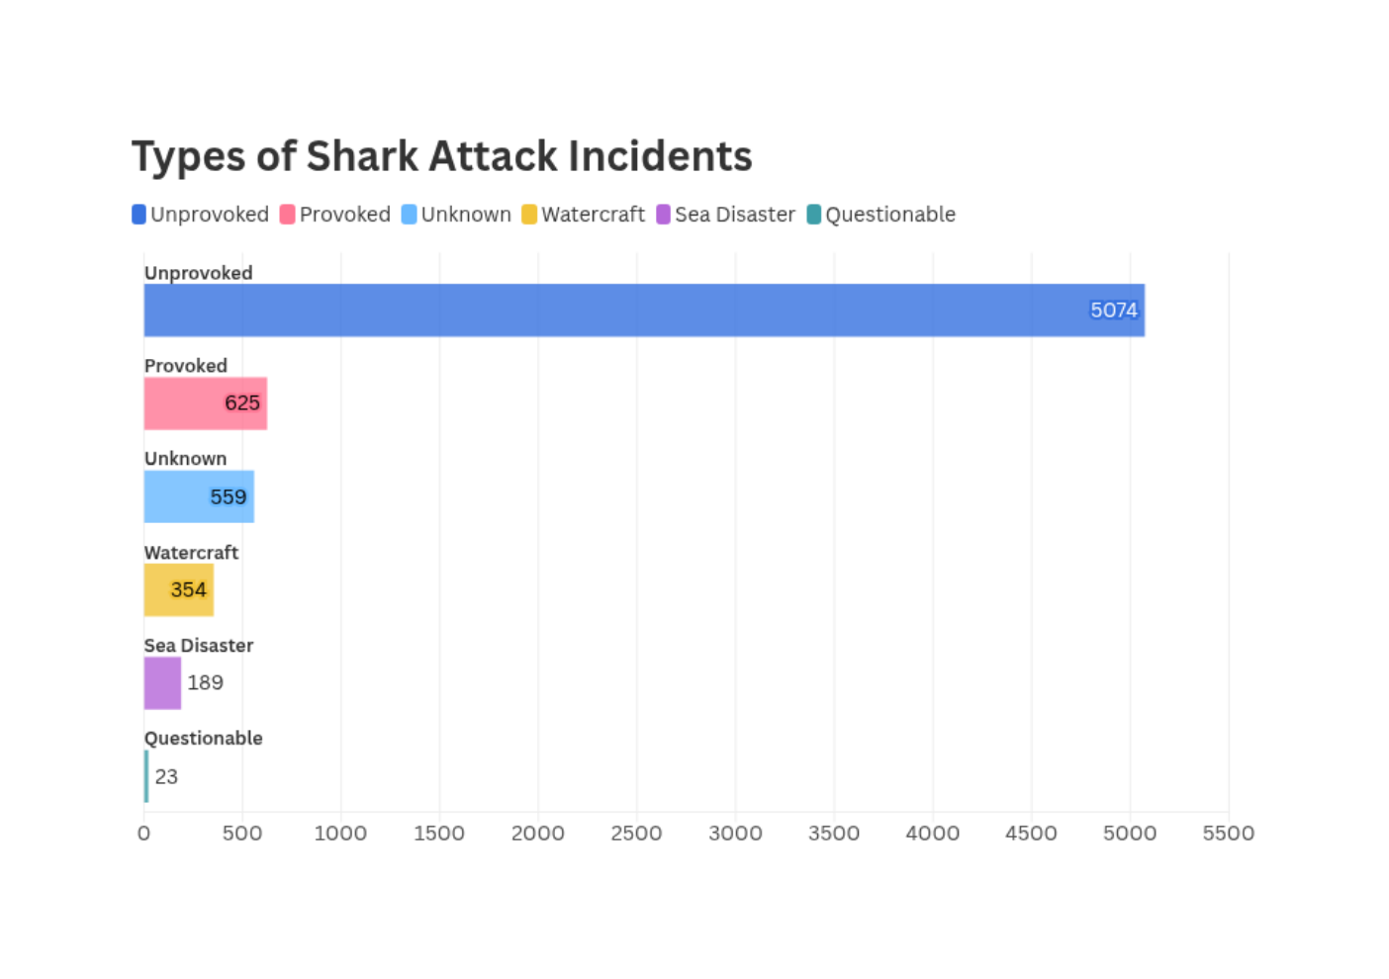
What are the most common types of shark attacks, and how might that influence safety awareness efforts?
  The data shows that Unprovoked shark attacks are overwhelmingly the most common type, with 5,074 incidents, far surpassing other categories such as Provoked attacks, Unknown incidents, and smaller numbers for Watercraft, Sea Disasters, and Questionable cases.
  Since unprovoked attacks dominate, public education could prioritize informing people about actions that inadvertently attract sharks, such as wearing shiny jewellery, splashing excessively, or entering the water with open wounds.

Slide 41
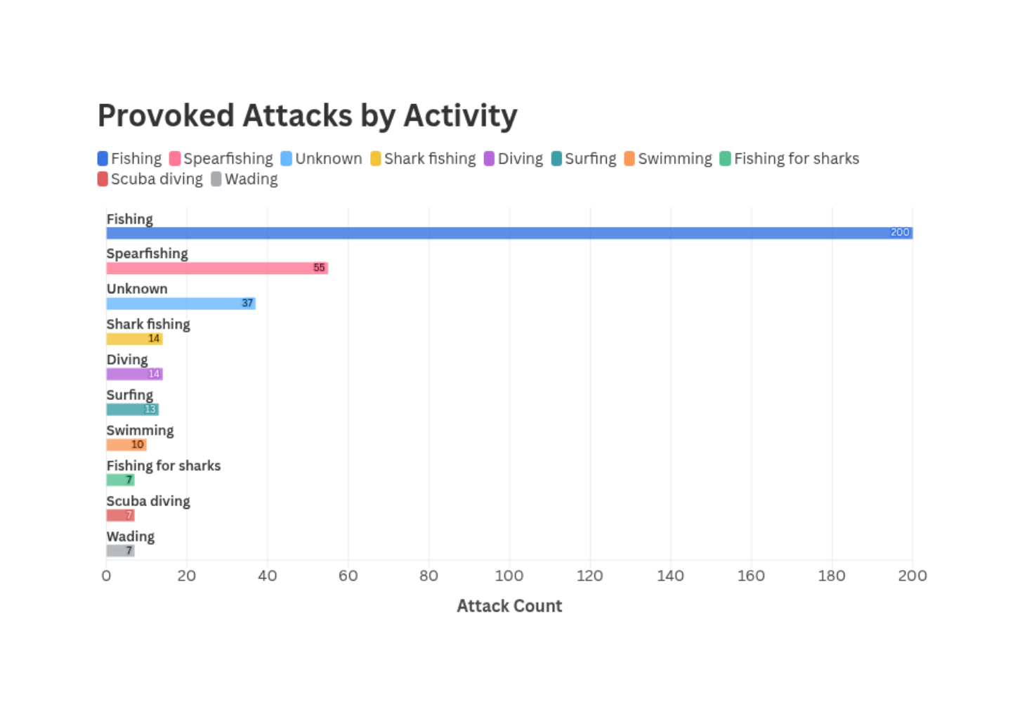
Which human activities are most associated with provoked shark attacks?
  The human activities most associated with provoked shark attacks often involve direct interactions with sharks or their environments. Fishing tops the list with 200 incidents, followed by Spearfishing with 55 incidents, and Shark fishing with 14 incidents. These activities can provoke sharks, as they may feel threatened or attracted by bait or caught fish.
  Other activities like Diving, Surfing, and Swimming also contribute to provoked attacks, though to a lesser extent.

Slide 42
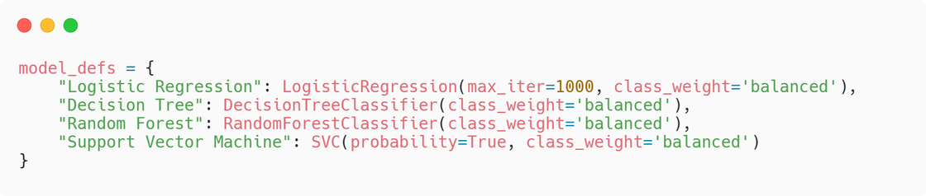
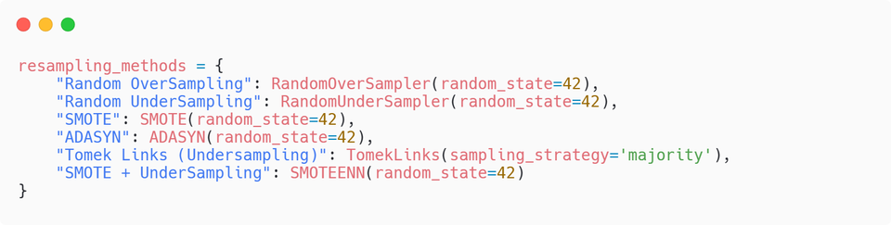
Classification Modelling
Goal: Predict the type of shark attack (e.g., Unprovoked, Provoked, Unknown, Watercraft, Sea Disaster, Questionable) based on features such as location, activity, fatality, gender, and more. This supports lifeguard preparedness, safety communication, and data-driven policy making by helping authorities understand what kind of incidents are likely under given conditions.
Preparation:
  Calculates the area under the Precision-Recall curve to assess model performance on imbalanced data.
  Applies feature scaling to numerical features and one-hot encoding to categorical ones.
  Divides the data into training and testing sets (80/20) to evaluate model performance.
  Defines four base classifiers: Logistic Regression, Decision Tree, Random Forest, and SVM, with built-in class balancing.
  Includes resampling techniques like SMOTE, ADASYN, Oversampling, Undersampling, and Tomek Links to address class imbalance.
  For each resampling method, resamples the training data, trains all models, and makes predictions on the test set.
  Prints confusion matrices, classification reports, accuracy, ROC AUC, and PR AUC scores for comprehensive model comparison.
# Defining Models
# Defining resampling methods

Slide 43
Classification Modelling
After reviewing the classification results across all resampling methods, the best and most appropriate resampling method overall is: SMOTE or Synthetic Minority Over-sampling Technique
Why SMOTE?
  Consistently high performance across all models.
  SMOTE achieves high precision and recall on both majority and minority classes.
    Unlike undersampling methods, it does not discard valuable majority data.
    Unlike SMOTE+Undersampling, it avoids extreme class distortions.
  Provoked, Sea Disaster, and Watercraft types, which are underrepresented, were more accurately predicted using SMOTE.
  All models under SMOTE maintained above 0.82 accuracy and strong PR AUC/ROC AUC scores, which suggests good generalization.
Why Not Other Resampling Methods?
  Random Undersampling significantly reduced overall accuracy (as low as 36%–47%) by dropping too much majority data.
  SMOTE + Undersampling caused extreme overfitting to minority classes and collapsed overall performance (e.g., Unprovoked recall dropped to 31%).
  Tomek Links showed improvement over raw undersampling, but still lagged behind SMOTE in macro/micro F1 and ROC AUC.
  ADASYN was close to SMOTE in many metrics but less stable across models and had slightly lower recall on minority classes.
  Random Oversampling inflated performance metrics artificially and increased risk of overfitting.

Slide 44
Table 1: Model Performance Before and After Applying SMOTE
Model | Accuracy | Precision (Macro) | Recall (Macro) | F1-score (Macro) | ROC AUC | PR AUC
Logistic Regression | 0.87 | 0.59 | 0.61 | 0.60 | 0.92 | -0.94
Decision Tree | 0.83 | 0.57 | 0.60 | 0.57 | 0.76 | -0.84
Random Forest | 0.86 | 0.67 | 0.46 | 0.49 | 0.87 | -0.92
Support Vector Machine (SVM) | 0.79 | 0.55 | 0.61 | 0.56 | 0.89 | -0.86

Slide 45
Model Performance Insights with SMOTE
Logistic Regression
Decision Tree
  Achieved the highest accuracy (86.81%) and strong macro F1-score (0.60), indicating well-rounded performance across classes.
  Recorded excellent ROC AUC (0.9248) and PR AUC (-0.9354), showing strong discrimination even in an imbalanced multi-class setting.
  Balanced precision and recall, especially effective at distinguishing between Unprovoked, Unknown, and Watercraft incidents.
  Reached an accuracy of 82.86%, slightly behind Logistic Regression, but with lower precision on minority classes.
  Performed well on majority classes but showed moderate overfitting risks, as evidenced by lower macro F1-score (0.57).
  AUC metrics (ROC AUC: 0.7646; PR AUC: -0.8429) indicate it was less stable for generalization on rare incident types.
Support Vector Machine (SVM)
Random Forest
  Had the lowest accuracy (78.68%) among the four, but compensated with a strong PR AUC (-0.8559) and ROC AUC (0.8901).
  Showed improved recall on minority classes after SMOTE, including better recognition of Sea Disaster and Provoked attacks.
  Best used when minimizing false negatives is critical, though slightly less reliable in overall probability calibration.
  Delivered strong accuracy (85.57%) and good PR AUC (-0.9216), proving to be robust in classification, especially for Unprovoked attacks.
  Underperformed in recall for Provoked and Sea Disaster classes, suggesting bias toward majority classes despite SMOTE.
  Slight drop in macro F1-score (0.49) due to its conservative treatment of minority class predictions.

Slide 46
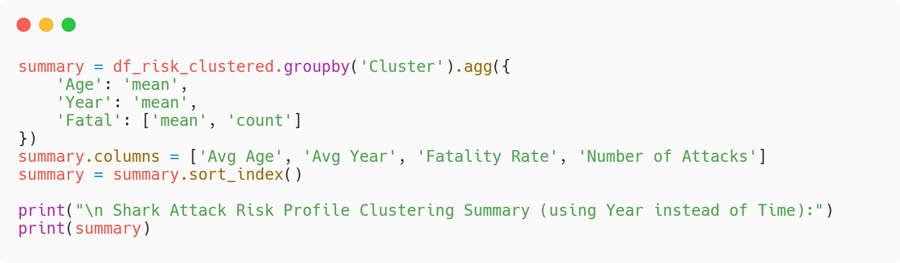
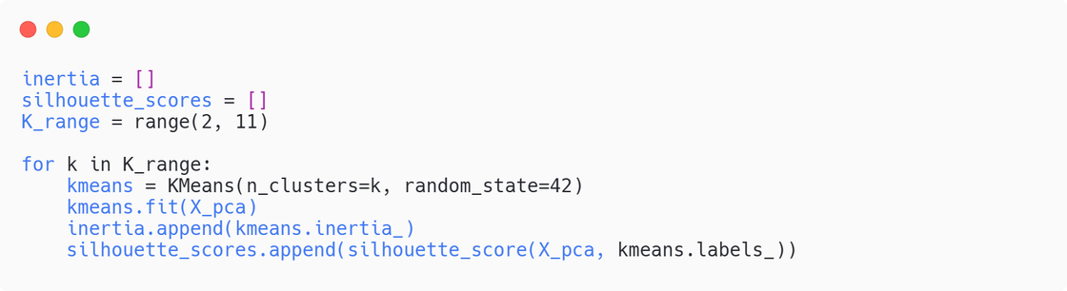
Clustering Modelling
Goal:
The goal of this clustering model is to group shark attack incidents based on victim risk profiles by using attributes like age, gender, activity, and year. This is to uncover distinct patterns in how, when, and to whom shark attacks occur.
Preparation:
  Cleaned and standardized the dataset by converting Age, Year, and Fatal into numeric formats through mapping and imputation.
  Selected key risk-related features: Sex, Age, Activity, and Year to represent victim demographics and context.
  Defined preprocessing pipelines for numeric features (imputation + scaling) and categorical features (imputation + one-hot encoding).
  Used ColumnTransformer to combine preprocessing steps into one unified transformation process.
  Transformed the dataset into a numerical matrix ready for modeling using the defined preprocessing pipeline.
  Reduced dimensionality with PCA to 2 principal components to simplify the dataset for clustering and visualization.
  Applied KMeans clustering and evaluated cluster quality using Elbow and Silhouette methods to determine the optimal number of clusters.
# Creating Clustering Summary
# Applying KMeans and PCA

Slide 47
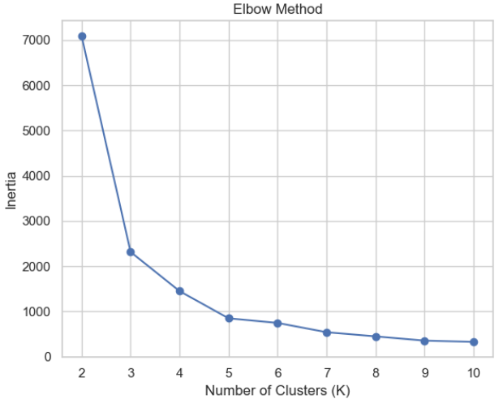
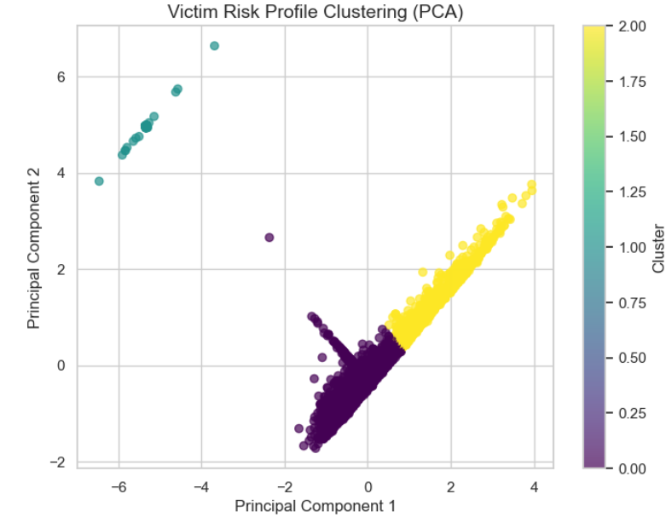
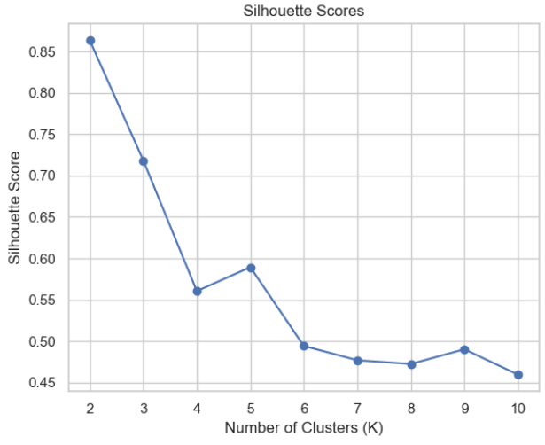
Clustering: Elbow Method, PCA, and Silhoutte Method
Shows how inertia decreases as clusters increase, suggesting that around 3 clusters might be ideal.
Displays data points in a transformed space where colors indicate different clusters, which helps visualize separation.
Evaluates clustering quality, which indicates that 2 clusters might be optimal based on the highest silhouette score.

Slide 48
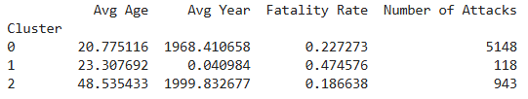
Insights from the Clustering Model
  The Elbow Method graph shows a distinct bend at K=3, with the Silhouette Scores indicating strong separation at K=2 but a reasonable balance at K=3.
  The PCA visualization confirms three clearly distinct groupings in the data (purple, yellow, and teal clusters), suggesting 3 clusters optimally balances separation quality and model simplicity.
  The clusters show a clear separation by victim age.
    The majority of cases (5,148 incidents) fall into Cluster 0 (averaging 20.8 years old), representing younger victims from earlier decades with moderate fatality rates (22.7%).
    Cluster 2 (943 incidents, averaging 48.5 years old) represents a newer pattern of attacks involving middle-aged victims with the lowest fatality rates (18.7%), possibly reflecting changes in recreational water activities or improved medical responses in recent decades.
    The small but concerning Cluster 1 (118 incidents, averaging 23.3 years old) shows anomalous characteristics with its extremely low year values (0.04) and nearly 50% fatality rate (47.5%).

Slide 49
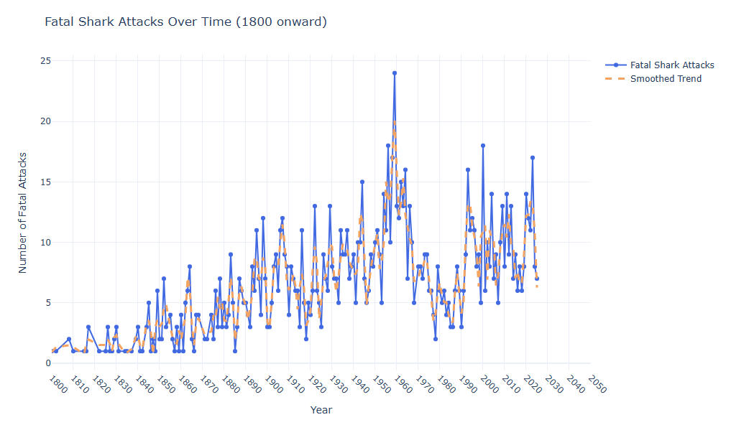
Time Series Analysis: Are fatal shark attacks increasing or decreasing over time, and what to expect in the succeeding years?
  There is evidence that fatal shark attacks have generally increased over the long term, particularly from the early 1800s to the mid-20th century. This could be due to growing human activity in marine environments, and environmental factors.
  However, in the more recent decades, the smoothed trend suggests a relative stabilization rather than a continuous increase.
  Peaks do occur in certain years (e.g., 1959 and 2023), but they don't represent a consistent upward trend year after year.

Slide 50
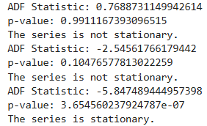
Data Preparation for Shark Attack Forecasting
  Data was filtered to include only records from the year 2015 onward, narrowing the analysis to recent trends. Grouping by Year allowed for counting the number of shark attacks per year.
  To assess if the time series is stationary, the Augmented Dickey-Fuller (ADF) test was applied to the data. Non-stationary data were differenced (first and second differencing) until stationarity was achieved.
  After achieving stationarity, the ARIMA model was fitted to the differenced series. This model used historical patterns to forecast shark attack numbers for the next five years, complete with confidence intervals.
  Initially, the series is not stationary, indicated by the high p-value (>0.05). This required differencing.
  However, the first differencing reduced variability, but still not stationary.
  At second differencing, it achieved stationary. This is confirmed by a significantly low p-value (~0.00000365). This indicates the transformed series is suitable for modeling

Slide 51
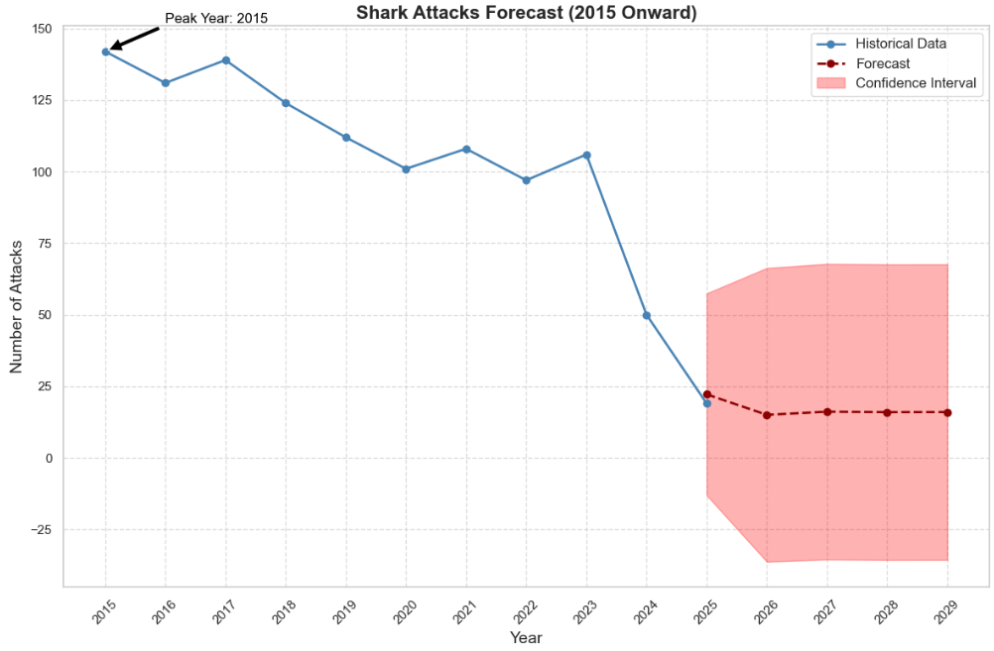
Shark Attack Trends and Forecast for Future Years
  The year 2015 stands out with the highest number of shark attacks, approximately 150.
  From 2015 onward, there is a visible downward trend in shark attack incidents. By 2024, the number of attacks appears to stabilize at a significantly lower level (around 25 attacks per year), showing a consistent reduction over the decade.
  The forecast predicts shark attacks to stay stable at around 25 annually, with no immediate trend change. However, widening confidence intervals suggest future numbers could range from 25 to 75 attacks per year, indicating growing uncertainty.

Slide 52
Overall Review of the Investigation
The investigation provided a comprehensive analysis of shark attack incidents using the Global Shark Attack datset, starting with thorough data cleaning and exploration to uncover key patterns in victim demographics, attack types, and geographical distribution. Visualizations such as bar charts, heatmaps, and maps effectively highlighted trends and supported understanding. In the modeling phase, various machine learning classifiers such as Logistic Regression, Decision Tree, Random Forest, and SVM, were applied alongside resampling techniques like SMOTE and ADASYN to address class imbalance. While the models performed well in predicting common attack types like "Unprovoked," they struggled with underrepresented classes such as "Questionable" and "Sea Disaster," limiting overall generalizability. Nonetheless, the use of metrics like confusion matrices, ROC curves, and PR AUC scores ensured a detailed evaluation of model performance, and the knowledge gained is valuable for improving safety awareness, marine risk analysis, and data-driven conservation efforts.

Slide 53
Evaluation
Data Preparation and Manipulation Methods
Strengths
Weaknesses
One of the main strengths of data preparation is the removal of unnecessary columns, which reduces clutter and highlights relevant information (Kumar, 2025). Filling missing values in categorical columns with "Unknown" keeps the dataset complete for analysis and maintains its integrity.
Standardizing columns ensures consistent formats for variables like 'Sex' and 'Fatal' (e.g., 'M', 'F', 'Y', 'N'), which enhances data uniformity. Additionally, data type conversion boosts processing efficiency.
In terms of transformation, using categorical encoding methods like OneHotEncoder effectively represents non-numeric data, which is vital for machine learning (Pykes, 2025). Feature engineering, such as creating new columns for shark species, adds specific information for deeper analysis.
The use of visualization techniques, including bar charts, scatter plots, and choropleth maps, provides clear insights, making it easier to spot trends and patterns.
For machine learning, achieving a balanced class distribution through techniques like SMOTE is essential for improving model performance. Moreover, integrating preprocessing steps into a pipeline streamlines the workflow, which facilitates easier management and reproducibility.
Despite the strengths, there are notable weaknesses in data preparation and manipulation methods. A major concern is the loss of information when filling missing values with "Unknown," which can obscure valuable insights, especially if the missing data is not random, potentially skewing results. Additionally, there is a risk of bias in standardization, as this process may overlook cultural differences in naming conventions, which affects analysis accuracy.
While removing non-standard values improves data quality, it can also exclude relevant cases that might provide insights into rare incidents. The complexity of transformation processes can lead to errors if not managed carefully, particularly when using regular expressions to extract information (DataCalculus, 2025). Finally, reliance on resampling techniques can introduce noise or artifacts, making models less generalizable (Wang et al., 2024)

Slide 54
Tools Selection
Strengths
Weaknesses
Python libraries like pandas, numpy, matplotlib, seaborn, and plotly provide strong functionalities for data manipulation and visualization. Machine learning libraries like Sklearn, xgboost, and imblearn help build effective predictive models while addressing class imbalances through techniques like SMOTE for oversampling (Brownlee, 2020). Geospatial tools like geopandas and folium are well-suited for mapping and visualizing shark attack locations, with folium's HeatMap plugin effectively showing clustered data (Papareddy and Gotsman, 2025).
For data preprocessing, tools like SimpleImputer, StandardScaler, and OneHotEncoder ensure data consistency and readiness for analysis. The cleaning methods applied to both categorical and numeric features effectively manage missing values and standardize formats (Stack Overflow, 2020; Solanki, 2020).
The combination of KMeans clustering and PCA provides valuable insights into risk profiles based on factors like age and activity. The elbow and silhouette methods help determine the best number of clusters (GeeksforGeeks, 2019). Additionally, time-series analysis using ARIMA and the Savitzky-Golay filter aids in identifying trends and forecasting shark attack patterns.
Custom and interactive visualizations are designed to be engaging and informative, such as bar charts for gender distribution and fatality rates, along with choropleth maps showing incidents by country.
The complexity in setup for certain tools, such as ARIMA, requires meticulous tuning and a deep understanding of parameters, which can pose challenges in optimizing accuracy and interpretability (Hayes, 2024). Additionally, the integration of geospatial tools like geopandas and folium with non-spatial data may have limited compatibility or necessitated additional preprocessing steps.
Classification models lies in their struggle to consistently perform well on minority classes like Questionable and Sea Disaster, even with SMOTE applied. While models like Logistic Regression and Random Forest showed strong overall accuracy and AUC scores, they tended to favor majority classes, leading to lower recall for rare incidents. Decision Trees risk overfitting and instability (GeeksforGeeks, 2024), while SVMs, despite improved recall for minority classes, had lower overall accuracy and longer training times.
While the visualizations are informative, some may appear overly technical to non-technical audiences. For example, PCA clustering or ARIMA forecasts may require clearer explanations, particularly regarding confidence intervals and annotations, to ensure comprehension among those unfamiliar with statistical concepts (DataScienceBase, 2025).

Slide 55
Impact of Data Derived on Decision-Making
Shark Attack Analysis
  This data isn’t just about sharks it’s about who gets attacked, where, why, and how to stop it. These insights empower public education, improve emergency response, influence policy, and ultimately save lives without demonizing sharks.
  The majority of victims are young males, particularly those aged 15 to 25, most commonly involved in high-risk activities. This trend highlights that young males are the most vulnerable group (Florida Museum, 2025). Safety campaigns should specifically target this demographic, particularly in high-risk water sports.
  Surf schools, beach resorts, and adventure sports centers should include risk-awareness education, especially around shark behavior and high-risk zones.
  Since unprovoked attacks dominate, people must learn (McGuire, 2024):
    Not to wear shiny objects.
    Avoid swimming at dawn/dusk (when sharks hunt).
    Stay out of the water with open wounds.
    Avoid erratic movements or excessive splashing.

Slide 56
Impact of Data Derived on Decision-Making
Shark Attack Analysis
  On geographic perspective, countries like Australia and South Africa need more aggressive shark safety strategies than the U.S., where fatality rates are lower despite more encounters. Governments could invest in (Queensland Goverment, 2022; Shark Smart, 2016):
    Shark detection technologies (e.g., drones, sonar buoys).
    Beach signage and flag systems.
    Lifeguard training specifically for shark emergencies.
  Fishing-related activities are a huge chunk of provoked attacks. Policies should:
    Regulate how and where fishing can occur (especially near popular beaches).
    Educate fishers about handling bait and caught fish safely.
  Understanding which shark species pose the most risk (e.g., White, Tiger, Bull) helps balance marine conservation with public safety.
  Conservation strategies can redirect human-shark interactions, like avoiding fishing in mating/birthing zones of high-risk species.

Slide 57
Impact of Data Derived on Decision-Making
Predictive Modelling
  Models like Logistic Regression and Random Forest help identify high-risk situations where shark attacks are more likely. Authorities can use these insights to issue targeted warnings for surfers, swimmers, or divers based on real-time inputs.
  Predictive accuracy from models like SVM and Decision Tree can inform which beaches need more patrols or first-aid stations during peak seasons or certain weather conditions.
  Identifying areas or species with higher fatality associations (like White Sharks) helps prioritize conservation zones and balance safety with ecological protection.
  Classifying attacks as Unprovoked, Provoked, or Sea Disaster helps craft tailored public awareness campaigns.
  Accurate classification helps standardize data in global shark attack databases, improving long-term studies and marine ecosystem tracking.
  Clustering & PCA help in profiling victims, and segmenting safety strategies by age and behavior.

Slide 58
Impact of Data Derived on Decision-Making
Time Series Analysis
  Time-series analysis shows a downward trend in shark attacks, which is encouraging. This data is supported by the International Shark Attack File (ISAF) wherein the shark bites worldwide have the lowest number in 30 years (Florida Museum, 2024).
  Authorities can de-prioritize large-scale emergency preparations unless future anomalies occur, 25 incidents/year might not justify excessive budgets unless the confidence interval spikes.
  However, since there's uncertainty, authorities should not become complacent. Agile risk-response systems should still be in place, especially for coastal tourism areas.
  Researchers might explore ecological reasons behind the drop, which can wider the implications for marine biodiversity, such as (Enviroliteracy, 2025; Megafauna, 2017; Kluger, 2023):
    Decline in shark population
    Habitat loss
    Climate change

Slide 59
Evaluation of Tools Used in Organisational Policy
The Shark Research Institute (SRI) is a global nonprofit organization dedicated to the protection, education, and conservation of sharks through rigorous, science-based research. Its mission emphasizes the use of credible data to guide public understanding, inform legislation, and support sustainable marine ecosystems. In alignment with this mission, the shark attack analysis project leverages data science tools to uncover patterns in shark-related incidents and predict potential risks based on demographic and environmental factors.
(Shark Research Institute, 2025)
SRI Business Need | Tool Used | How it Addresses the Need
Evidence-based policy and research for shark conservation | ML models (Logistic Regression, Random Forest), ARIMA, Clustering (KMeans) | ML models allow for the prediction of shark attack trends, identifying environmental and demographic risk factors. ARIMA and statistical time series can analyze seasonal patterns and impacts of climate change on shark populations (Valenti, 2023). Additionally, clustering have been utilized to identify regions with higher vulnerability to shark attacks. For instance, clustering analyses have revealed that coastal areas with high population densities and recreational activities are more prone to such incidents (elsayedibraheem, 2024).
Public education and myth-busting about sharks | Data visualization (Plotly, Folium), Demographic EDA (Pandas, Matplotlib) | Interactive visualizations break down complex shark data into simple graphics, dispelling myths and misconceptions. By using demographic analysis, the public can gain a deeper understanding of sharks’ role in the ecosystem and the necessity of their conservation.
Legislative advocacy for shark protections through factual, peer-reviewed data | Statistical modeling (e.g., Regression Analysis), Time series (ARIMA, SARIMA) | Statistical and time series models, particularly ARIMA, generate credible, data-driven insights that inform legislative bodies, helping to justify shark protection policies based on observed trends and patterns of shark decline, including the effects of illegal fishing and climate change (Dimri, Ahmad and Sharif, 2020).
Global conservation and field education outreach through data-driven profiling and regional analysis | Unsupervised learning (KMeans, PCA), Profiling (Cluster Analysis, Demographic Analysis), Choropleth map | Unsupervised learning methods and profiling reveal regional risk factors, victim demographics, and behavior patterns, assisting field teams in designing targeted educational campaigns. This data helps to highlight regions with the highest need for conservation efforts, based on real-world data.

Slide 60
Recommendation
Recommended Improvements for the Analytical Model
  Implement advanced imputation techniques such as KNN (K-Nearest Neighbors) imputation for numeric data, which considers the similarity between records, or use model-based imputations like regression for categorical values.
  Beyond traditional models like Logistic Regression and Random Forest, consider using more complex models such as Gradient Boosting Machines (GBM) or ensemble methods that combine multiple models to improve predictive performance.
  Introduce derived features such as "Distance from Coastline" (for geospatial clustering) or "Time of Day Categorization" (for improved temporal patterns). This could help reveal underlying trends or predictors of shark-related incidents.
Enhancing Performance and Addressing Model Limits
Performance Improvement:
  Implement k-fold cross-validation to ensure that the model's performance is robust and not overly fitted to the training data. This will provide a better estimate of the model's generalization to unseen data
  Use techniques like Recursive Feature Elimination (RFE) or Lasso regression to identify and retain only the most significant features, which can reduce model complexity and improve performance.
Addressing Model Limitations:
  Incorporate model interpretability tools like SHAP to understand the model's decision-making process better. This can help in identifying biases and improving the model's trustworthiness in real-world applications.
  For tree-based models, apply pruning techniques to reduce the size of the trees and prevent overfitting. This can help in simplifying the model while retaining its predictive power.

Slide 61
Comparison to Other Works
My Notebook
Enzer’s Notebook
In my analysis of shark attacks using the same dataset, I applied a more comprehensive and refined approach. I dropped irrelevant columns, thoroughly cleaned key variables like Country, Sex, Fatal, and Species, handled missing values systematically, removed invalid regions, and standardized species names. I properly addressed duplicates and created clear victim profiles by age and gender, identifying high-risk activities such as surfing and swimming. My species analysis included a detailed fatality breakdown, supported by clean, well-labeled visualizations, including a polished world map. I implemented four classification models (Logistic Regression, Decision Tree, Random Forest, SVM), tested six resampling techniques (e.g., SMOTE, ADASYN), and carefully interpreted ROC AUC, PR AUC, and confusion matrix results, highlighting the challenges of minority class performance and the limitations of PR AUC. I emphasized the real-world implications of the findings, particularly in safety and conservation. Additionally, I used PCA and KMeans clustering for victim profiling and conducted ARIMA forecasting on fatal attacks with clear visuals, connecting insights to practical prevention strategies.
In contrast, the other notebook also dropped unnecessary columns and cleaned variables like Sex, Fatal, and Country, but with less depth, particularly in filtering out vague regions and standardizing species names. While duplicates were addressed and victim profiling by age and gender was included, the species analysis lacked a detailed fatality breakdown. Their visualizations were less polished, with a less refined world map and occasional clarity issues. Although they used the same classification models and resampling techniques, their evaluation focused more on overall accuracy and ROC AUC, with limited attention to the PR AUC limitations and minority class challenges. The analysis placed less emphasis on real-world application, and while they performed PCA with KMeans and basic ARIMA forecasting, the visuals were less developed and lacked strong connections to public safety or conservation strategies.

Slide 62

Data Specialist Roles
  Data Analyst: A data specialist is responsible for thoroughly analysing clients' data to identify trends, issues, or opportunities.
  Data Conversion Specialist: They manage the conversion of hard copy data into digital formats, ensuring the accuracy and validity of this transfer.
  Data Storage and Systems Expert: Data specialists design and maintain secure data storage systems, ensuring they are capable of handling large amounts of data efficiently.
  Data Trainer: They are responsible for training staff on how to use data storage and retrieval systems.
(Peters, 2020)

Slide 63
Data Specialist Responsibilities
  Collecting and verifying data from multiple sources to ensure accuracy and reliability.
  They manage the transfer of data from one system to another or from physical formats to digital databases.
  Overseeing the development and performance monitoring of databases.
  They regularly perform audits to assess the quality of data in the system.
  When there are issues related to data storage or retrieval, data specialists troubleshoot and resolve these problems.
  Data specialists create reports based on data analysis, presenting the findings to senior management or board meetings.
(Peters, 2020)

Slide 64

Common Issues
  Cleaning and preparing data for analysis can be time-consuming and mundane, as they must ensure data accuracy and consistency.
  Difficulty in communicating complex technical data issues to non-technical stakeholders, such as business executives or clients.
  As organizations move to cloud-based data systems, data specialists must ensure data security amidst increasing cyber threats.
  They have to manage and extract data from multiple sources and formats. Integrating these sources into a cohesive and unified data platform can be a complicated and tedious process.
(Sheriff, 2020)

Slide 65
Impact of Key Issues on Data-Driven Culture
  Reduced productivity since data preparation, handling multiple data sources, and dealing with security concerns consume a large portion of a data specialist’s time.
  Inconsistent and inaccurate data resulting from fragmented sources leads to poor insights and misguided business decisions.
  Data specialists facing unclear roles and excessive responsibilities, like data preparation and model building, are prone to burnout and job dissatisfaction.
  Undefined KPIs and unclear business objectives cause data specialists to work on tasks that do not contribute to organizational goals, wasting valuable resources.
(Sheriff, 2020)

Slide 66
Data Compliance
  Creating a Compliance Framework: Data specialists establish a structured framework that outlines how to address compliance regulations, evaluate internal privacy controls, and ensure data security, particularly for sensitive data.
  Defining Data Collection Policies: It’s essential to document what data is being collected and the purpose behind its collection. This step ensures transparency and helps meet regulatory requirements, especially if the data involves personal or consumer information.
  Developing Privacy Policies: Clear privacy policies are created to inform customers about what data is being collected, how it will be used, stored, and for how long.
  Commitment to Disclosures: Data specialists ensure that privacy policies are publicly available and easily accessible to customers, maintaining transparency and fostering trust.
  Staying Updated with Regulations: Data specialists monitor and adapt to the constantly evolving data protection regulations, ensuring the organization’s compliance practices are up-to-date and aligned with the latest legal requirements.
(Stone, 2022)

Slide 67
References
Felipe_Esc (2021) Shark attack dataset. [Online] Kaggle.com. Available from : https://www.kaggle.com/datasets/felipeesc/shark-attack-dataset/data [Accessed 08/04/25].
‌GeeksforGeeks (2018) Clustering in Machine Learning. [Online] GeeksforGeeks. Available from : https://www.geeksforgeeks.org/clustering-in-machine-learning/ [Accessed 09/04/25].
Cote, K., (2021) What Is Prescriptive Analytics? 6 Examples | HBS Online. [Online] Business Insights Blog. Available from : https://online.hbs.edu/blog/post/prescriptive-analytics [Accessed 09/04/25].
Cote, K., (2021)What Is Predictive Analytics? 5 Examples | HBS Online. [Online] Business Insights Blog. Available from : https://online.hbs.edu/blog/post/predictive-analytics [Accessed 09/04/25].
Hassan, M. (2024) Prescriptive Analytics - Techniques, Tools and Examples. [Online] Research Method. Available from : https://researchmethod.net/prescriptive-analytics/ [Accessed 09/04/25].
Halton, C. (2025) Predictive Analytics: Definition, Model Types, and Uses. [Online] Investopedia. Available from : https://www.investopedia.com/terms/p/predictive-analytics.asp [Accessed 09/04/25].
IBM (2024) Prescriptive analytics. [Online] Ibm.com. Available from : https://www.ibm.com/think/topics/prescriptive-analytics[Accessed 09/04/25].
Edwards, J. and Thor Olavsrud (2019) What is predictive analytics? Transforming data into future insights. [Online] CIO. Available from : https://www.cio.com/article/228901/what-is-predictive-analytics-transforming-data-into-future-insights.html [Accessed 09/04/25].
Chabrier (2021) Pros and Cons of different Prescriptive Analytics technologies. [Onlin
Gajjar, J. and Jacques, M. (2016) [Online] SlideShare. vailable from : https://www.slideshare.net/slideshow/ceo-regression-analysis/58334028 [Accessed 09/04/25].
‌mljourney (2024) Decision Tree Real Life Examples - ML Journey. [Online] ML Journey. Available from : https://mljourney.com/decision-tree-real-life-examples/ [Accessed 09/04/25].
IBM (2021) Decision tree. [Online] Ibm.com. Available from : https://www.ibm.com/think/topics/decision-trees [Accessed 09/04/25].
What Is Regression Analysis? Types, Importance, and Benefits. (2023) [Online] G2. Available from : https://www.g2.com/articles/regression-analysis [Accessed 09/04/25].
GeeksforGeeks (2018) Clustering in Machine Learning. [Online] GeeksforGeeks. Availa
ble from : https://www.geeksforgeeks.org/clustering-in-machine-learning/ [Accessed 09/04/25].
Hassan, M. (2024) Regression Analysis - Methods, Types and Examples. [Online] Research Method. Available from : https://researchmethod.net/regression-analysis/ [Accessed 09/04/25].
Youssef Fenjiro (2018) Machine learning for Banking: Loan approval use case. [Online] Medium. Available from : https://medium.com/@fenjiro/data-mining-for-banking-loan-approval-use-case-e7c2bc3ece3 [Accessed 09/04/25].
Quilty, F. (2022) Clustering: The New World Of Retail Product Segmentation. [Online] Forbes. Available from : https://www.forbes.com/councils/forbestechcouncil/2022/04/20/clustering-the-new-world-of-retail-product-segmentation/ [Accessed 09/04/25].
Naveen Kumar K (2019) Case Study : Customer Segmentation of E-Commerce data using Clustering Algorithms : Step by Step explanation for Beginners. [Online] Medium. Available from : https://medium.com/@naveeen.kumar.k/case-study-customer-segmentation-of-e-commerce-data-using-clustering-algorithms-step-by-step-1098ef49424b [Accessed 09/04/25].
e] Medium. Available from : https://medium.com/ibm-data-ai/pros-and-cons-of-different-prescriptive-analytics-technologies-10514098399a [Accessed 09/04/25]
Peters, P. (2020) Data Specialist Job Description. [Online] Betterteam. Available from : https://www.betterteam.com/data-specialist-job-description [Accessed 09/04/25].
Sheriff, S. (2024) 8 Data Scientist Challenges in 2025: Expert Tips to Overcome. [Online] Acuvate software. Available from : https://acuvate.com/blog/challenges-faced-by-data-scientists [Accessed 09/04/25]
.Stone, A. (2022) Data Compliance Strategies: 10 Best Practices to Consider. [Online] Best Enterprise Data Storage Software, Solutions, Vendors and Platforms. Available from : https://solutionsreview.com/data-storage/data-compliance-strategies/ [Accessed 09/04/25].
‌

Slide 68
References
Kumari, R. (2021) Top 10 Companies that Uses Big Data | Analytics Steps. [Online] AnalyticsSteps. Available from : https://www.analyticssteps.com/blogs/companies-uses-big-data [Accessed 09/04/25].
‌The Role of Big Data in Business Decision-Making. (2025) [Online] The Data Scientist. Available from : https://thedatascientist.com/the-role-of-big-data-in-business-decision-making [Accessed 09/04/25].
Mucci, T. (2024) Data Driven Decision Making. [Online] Ibm.com. Available from : https://www.ibm.com/think/topics/data-driven-decision-making [Accessed 09/04/25].
Ticong, L. (2024) Data-Driven Decision-Making: 6 Key Steps (+ Examples). [Online] Datamation. Available from : https://www.datamation.com/big-data/data-driven-decision-making/ [Accessed 09/04/25].
Buijsse, R., Willemsen, M. and Snijders, C. (2023) Data-Driven Decision-Making. Classroom Companion: Business, pp. 239–277.
Ohaba, E. (2023) The Impact Of Big Data Analytics On Business Decision-Making. [Online] eLearning Industry. Available from : https://elearningindustry.com/the-impact-of-big-data-analytics-on-business-decision-making [Accessed 09/04/25].
Hillier, W. (2025) [Online] CareerFoundry. Available from : https://careerfoundry.com/en/blog/data-analytics/data-analytics-tools/ [Accessed 09/04/25].
7 Types of Statistical Analysis Techniques (And Process Steps). (2025) [Online] Indeed Career Guide. Available from : https://www.indeed.com/career-advice/career-development/types-of-statistical-analysis [Accessed 09/04/25].
GeeksforGeeks (2020) Best Data Visualization Tools for 2025. [Online] GeeksforGeeks. Available from : https://www.geeksforgeeks.org/data-visualization-tools/ [Accessed 09/04/25].
Writer, R.C. (2020) Big data visualization: what it is, techniques and best tools. [Online] Rock Content. Available from : https://rockcontent.com/blog/big-data-visualization/ [Accessed 09/04/25].
5 V’s of Big Data: Definition and Explanation. (2024) [Online] DatabaseTown. Available from : https://databasetown.com/5-vs-of-big-data-definition-and-explanation/#google_vignette [Accessed 18/04/25].
Mission (2025) Shark Research Institute. [Online] Shark Research Institute. Available from : https://www.sharks.org/mission-work [Accessed 20/04/25].
Ganesh, S. (2023) 5 Ways Big Data Can Enhance Decision-Making. [Online] Analytics Insight. Available from : https://www.analyticsinsight.net/insights/5-ways-big-data-can-enhance-decision-making [Accessed 24/04/25].
Cristofaro, D. (2024) The Power of Data-Driven Decisions: How Leveraging Data Leads to More Informed and Effective Business Choices. [Online] Proof Insights. Available from : https://proof-insights.com/the-power-of-data-driven-decisions-how-leveraging-data-leads-to-more-informed-and-effective-business-choices/ [Accessed 24/04/25].
20 Advantages and Disadvantages of Microsoft Excel. (2024) [Online] Carlos Barraza. Available from : https://barrazacarlos.com/advantages-and-disadvantages-of-microsoft-excel [Accessed 24/04/25].
Brownlee, J. (2020) How to Configure XGBoost for Imbalanced Classification - MachineLearningMastery.com. [Online] MachineLearningMastery.com. Available from : https://machinelearningmastery.com/xgboost-for-imbalanced-classification [Accessed 24/04/25].
Challenges in Data Analytics Implementation and How To Overcome Them. (2025a) [Online] Intone Networks. Available from : https://intone.com/challenges-in-data-analytics-implementation-and-how-to-overcome-them/.
‌

Slide 69
References
DataCalculus (2025) Using Regular Expressions for Efficient Data Cleaning. [Online] DataCalculus. Available from : https://datacalculus.com/en/knowledge-hub/data-analytics/data-cleaning-and-preprocessing/using-regular-expressions-for-data-cleaning [Accessed 24/04/25].
Dixon, D. (2010) The Quest To Make Web Data ‘Fun’. [Online] WIRED. Available from : https://www.wired.com/2010/02/the-quest-to-make-web-data-fun [Accessed 24/04/25].
Excel’s Advantages and Disadvantages in Data Analysis - esProc SPL Official Blog. (2025b) [Online] esProc SPL Official Blog. Available from : https://blog.esproc.com/excels-advantages-and-disadvantages-in-data-analysis [Accessed 24/04/25].
Florida Museum (2025) Victim Activity During Attacks. [Online] International Shark Attack File. Available from : https://www.floridamuseum.ufl.edu/shark-attacks/factors/victim-activity [Accessed 24/04/25].
Florida Museum (2024) Yearly Worldwide Shark Attack Summary. [Online] International Shark Attack File. Available from : https://www.floridamuseum.ufl.edu/shark-attacks/yearly-worldwide-summary
GeeksforGeeks (2019) Elbow Method for optimal value of k in KMeans. [Online] GeeksforGeeks. Available from : https://www.geeksforgeeks.org/elbow-method-for-optimal-value-of-k-in-kmeans [Accessed 24/04/25].
GeeksforGeeks (2024a) Overcoming Big Data Challenges: Strategies for Efficient Management and Analysis. [Online] GeeksforGeeks. Available from : https://www.geeksforgeeks.org/overcoming-big-data-challenges-strategies-for-efficient-management-and-analysis/.
GeeksforGeeks (2024b) Overfitting in Decision Tree Models. [Online] GeeksforGeeks. Available from : https://www.geeksforgeeks.org/overfitting-in-decision-tree-models/
Global Shark (2025) Shark Research Institute. [Online] Shark Research Institute. Available from : https://www.sharks.org/global-shark-attack-file [Accessed 24/04/25].
Hayes, A. (2024) Autoregressive Integrated Moving Average (ARIMA) Prediction Model. [Online] Investopedia. Available from : https://www.investopedia.com/terms/a/autoregressive-integrated-moving-average-arima.asp [Accessed 24/04/25].
Kluger, J. (2023) Are Shark Attacks Increasing? Here Are What the Data Say. [Online] TIME. Available from : https://time.com/6292696/shark-attack-data-2023 [Accessed 24/04/25].
Kumar, B. (2025) Data Preprocessing In Machine Learning. [Online] Python Guides. Available from : https://pythonguides.com/data-preprocessing-in-machine-learning [Accessed 24/04/25].
McGuire, D. (2024) Ten Tips to Avoid a Shark Attack – Shark Stewards. [Online] Shark Stewards. Available from : https://sharkstewards.org/ten-tips-to-avoid-a-shark-attack [Accessed 24/04/25].
Megafauna, M. (2017) Marine Megafauna Foundation. [Online] Marine Megafauna Foundation. Available from : https://marinemegafauna.org/human-threats-sharks-rays/habitat-loss[Accessed 24/04/25].
Papareddy , S. and Gotsman, T. (2025) Top 10 Python Data Visualization Libraries in 2025 · Reflex Blog. [Online] Reflex.dev. Available from : https://reflex.dev/blog/2025-10-27-top-10-data-visualization-libraries [Accessed 24/04/25].
Pavlenko, M. (2022) The Good and the Bad of Microsoft Power BI Data Visualization. [Online] AltexSoft. Available from : https://www.altexsoft.com/blog/power-bi-pros-cons/.

Slide 70
References
Pavlovych, A. (2025) Is Python Good for Data Visualization? [Online] PLANEKS. Available from : https://www.planeks.net/python-for-data-visualization/.
PCA for Clustering | DataScienceBase. (2025c) [Online] Datasciencebase.com. Available from : https://www.datasciencebase.com/unsupervised-ml/dimensionality-reduction-decomposition-techniques/pca-for-clustering [Accessed 24/04/25].
Pykes, K. (2025) Data Preprocessing: A Complete Guide with Python Examples. [Online] Datacamp.com. Available from : https://www.datacamp.com/blog/data-preprocessing.
Queensland Government (2022) Advance Queensland. Advance Queensland, [Online] Available from: doi.org/https://doi.org/10/1471807/sentry-6.16.1.
Sahil Mattoo (2023) A Complete Guide to Data Visualization in Python. [Online] Intellipaat. Available from : https://intellipaat.com/blog/what-is-data-visualization-in-python/ [Accessed 24/04/25].
Shaptunova, Y. (2025) Pros and Cons of Tableau Software for Data Visualization [Review] | SaM Solutions. [Online] SaM Solutions. Available from : https://sam-solutions.com/blog/tableau-software-review-pros-and-cons-of-a-bi-solution-for-data-visualization [Accessed 24/04/25].
Shark Smart (2016) Shark detection and deterrent technologies. [Online] SharkSmart. Available from : https://www.sharksmart.com.au/research/shark-detection-and-deterrent/ [Accessed 24/04/25].
Solanki, S. (2020) Scikit-Learn - Data Preprocessing [Scaling, Imputation & One-Hot Encoding]. [Online] Coderzcolumn.com. Available from : https://coderzcolumn.com/tutorials/machine-learning/scikit-learn-sklearn-data-preprocessing [Accessed 24/04/25].
South Africa’s second National Plan of Action for the Conservation and Management of Sharks (NPOA-Sharks II).
Stack Overflow (2020) Applying SimpleImputer and OneHotEncoder to multiple columns at once. [Online] Stack Overflow. Available from : https://stackoverflow.com/questions/62417617/applying-simpleimputer-and-onehotencoder-to-multiple-columns-at-once?
Team, D. (2018) Pros and Cons of Power BI - The Bright & the Dull side of visualization suite - DataFlair. [Online] DataFlair. Available from : https://data-flair.training/blogs/power-bi-advantages-and-disadvantages [Accessed 24/04/25].
Team, E. (2025) What would happen if sharks were extinct? - The Environmental Literacy Council. [Online] The Environmental Literacy Council. Available from : https://enviroliteracy.org/what-would-happen-if-sharks-were-extinct [Accessed 24/04/25].
Wang, L. et al. (2024) Novel resampling algorithms with maximal cliques for class-imbalance problems. Computers & Industrial Engineering, 199, p. 110754.
Dimri, T., Ahmad, S. and Sharif, M. (2020) Time series analysis of climate variables using seasonal ARIMA approach. Journal of Earth System Science, 129(1), [Online] Available from: doi.org/https://doi.org/10.1007/s12040-020-01408-x.
elsayedibraheem (2024) GitHub - elsayedibraheem/Shark-_Attack-_Data-_Analysis-_Project: A comprehensive report on global shark attack trends and patterns. [Online] GitHub. Available from : https://github.com/elsayedibraheem/Shark-_Attack-_Data-_Analysis-_Project [Accessed 24/04/25].
Valenti, E. (2023) Forecasting Shark Attack Risk Using AI: A Deep Learning Approach. Journal of Data Analysis and Information Processing, 11(04), pp. 360–370.
Felipe_Esc (2021) Shark attack dataset. [Online] Kaggle.com. Available from : https://www.kaggle.com/datasets/felipeesc/shark-attack-dataset/data [Accessed 29/03/25].
Why study shark attacks? (2025) [Online] Sharkattackfile.net. Available from : https://www.sharkattackfile.net/whystudy.htm [Accessed 29/03/25].
N-Enzer (2020) SharkAttackAnalysis/Shark Attacks.ipynb at main · N-Enzer/SharkAttackAnalysis. [Online] GitHub. Available from : https://github.com/N-Enzer/SharkAttackAnalysis/blob/main/Shark%20Attacks.ipynb [Accessed 29/04/25].

