Slide 1

Group meeting 17/01/25
Roman Sasik
Center for Computational Biology and Bioinformatics
UCSD

Slide 2
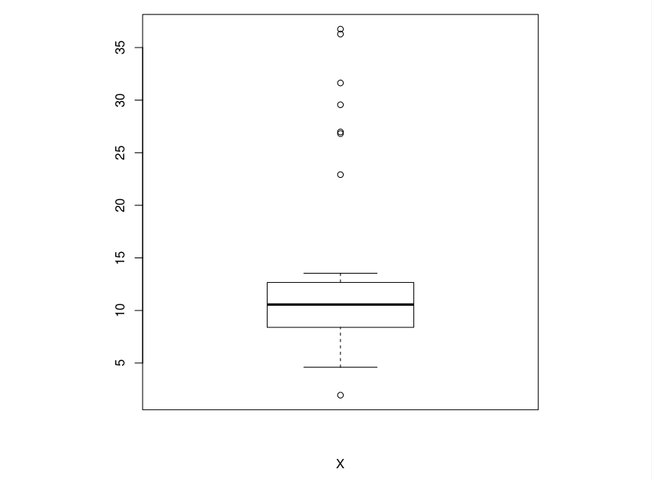
Boxplot

Slide 3
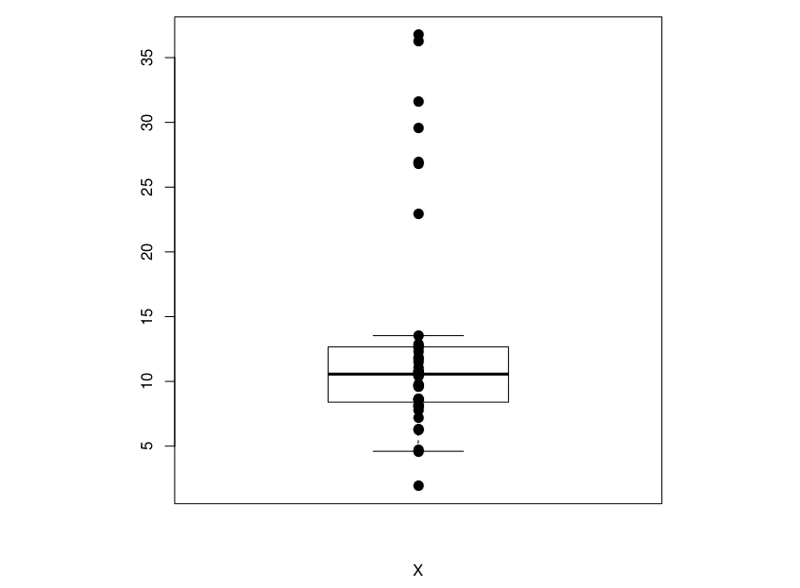
Boxplot with data points

Slide 4
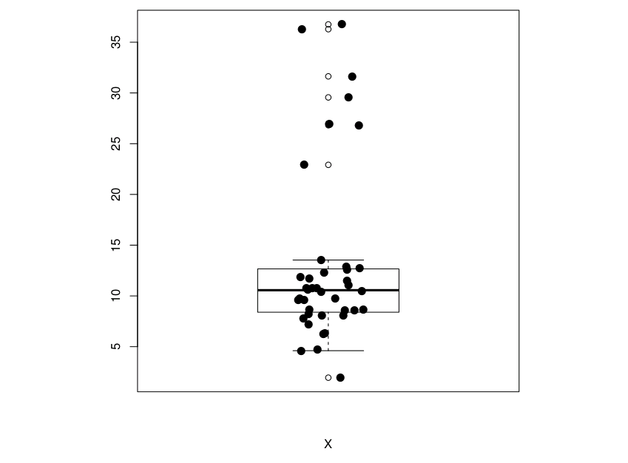
Boxplot with jitter

Slide 5

Boxplot with variable jitter

Slide 6
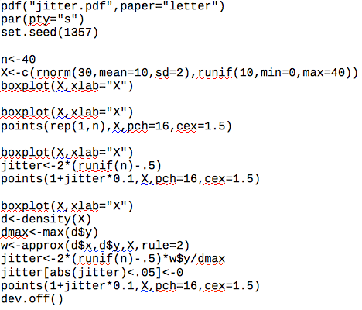

Slide 7
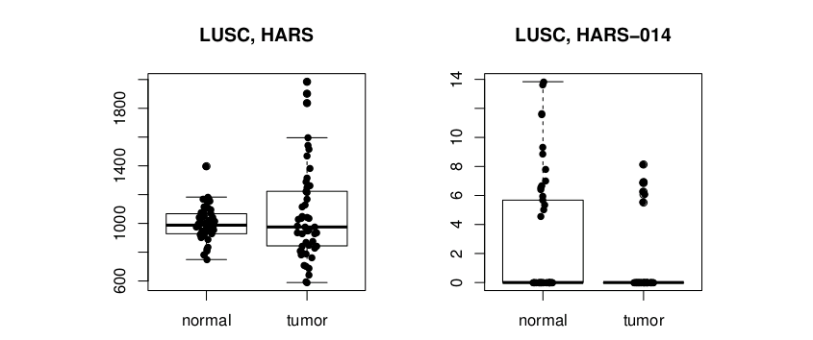

Slide 8
