Slide 1


Analysis of Service Requests Data
By Nashville Software School Data Analysis Team

Slide 2

Objectives
Based on discussions with hubNashville representatives, the NSS Data Analytics Team investigated the following:
Where resources might be allocated to encourage greater online engagement with the public by looking at current trends in phone/online requests
Current trends in service requests on a temporal basis to provide insight into appropriate staffing
Geospatial Analyses of Trash and Covid-19 service requests
Other interesting analyses:
Analysis on Property Inspector Violations reporting
Analysis of Dead Animal Pickups
Correlation to Police Dangerous Animal Reports
Notes:
After a brief discussion with hubNashville representatives, the Analytics team at Nashville Software School determined that the best course of action would be to focus primarily on developing analysis that would help the City of Nashville and Davidson County achieve greater efficiency - faster service with less manpower requirements. In order to highlight the current situation with regards to how service requests are received, we did in-depth analysis on requests made via phone and/or the Web in terms of type of request and geographically by zip code and by district.This allowed us to pinpoint areas that might benefit from further encouragement in the use of Web services to increase Davidson County productivity.
We also sought to look at service requests on a temporal basis to see when the call center receives the greatest number of requests in an effort to shed some light on personnel and manning issues.
To further spotlight where additional attention might be focused with regards to Trash-related service calls and Covid-19 related aid, we provided quantitative maps to indicate the hotspots of these service requests.
We had additional resources to allocate to some more specific analysis that may benefit the County including: A closer look at how incorporating Property Inspector Violations reporting could reduce that department’s need for redundant staffing;
A deeper dive into the statistics behind dead animal pickups and their relationship to police dangerous animal reporting.

Slide 3
Phone vs Online Request Comparison
Purpose
Identify areas of opportunity to reduce number of phone requests received by hubNashville
Methodology
Compare the distribution of phone request and online requests (website and mobile app) by request type
Removed other request origins as each accounts for 0.5% of data or less
Used data for 2020, focusing on current state
NSS Analysts: John, Diego, Amanda

Slide 4
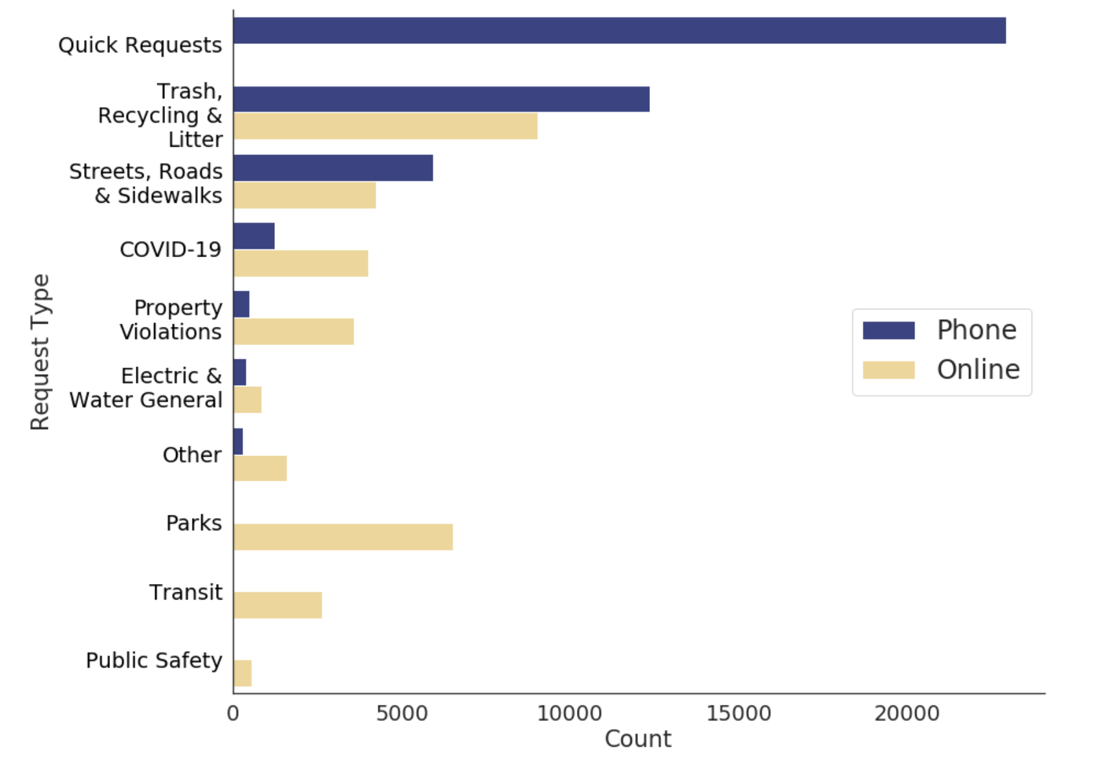
Online vs Phone Request Counts
Quick requests are exclusively by phone - manpower intensive
Trash, Recycling & Litter requests still largely by phone
NSS Analysts: John, Diego, Amanda

Slide 5
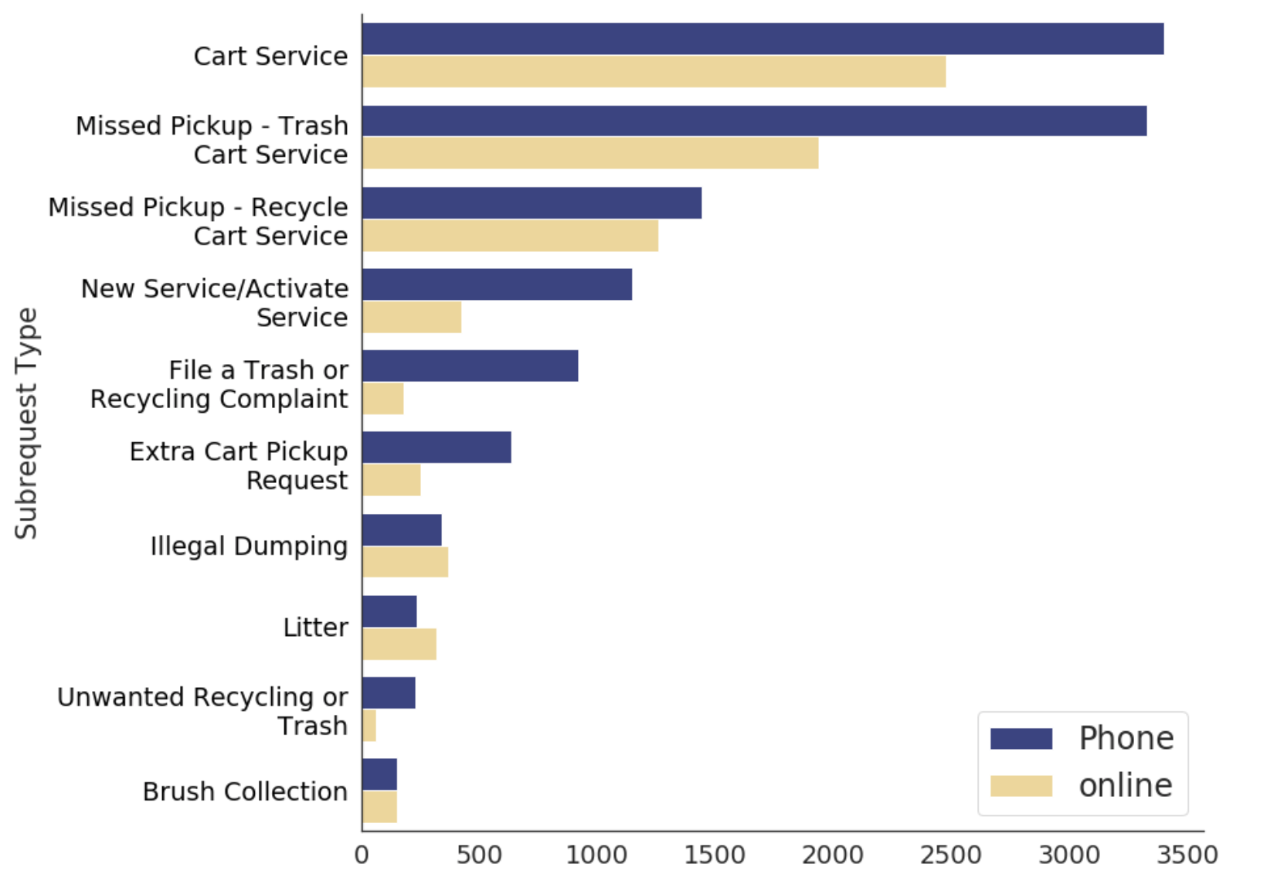
Trash, Recycling & Litter by Subrequest Type
66% of phone requests are related to Cart Service
NSS Analysts: John, Diego, Amanda

Slide 6
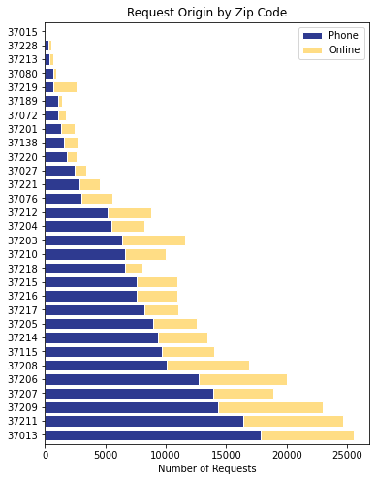
Phone vs Online Requests by Zip Code
Downtown Nashville
Included zip codes where requests are greater than 50
Zip codes in suburban areas lean towards phone requests
Urban Nashville zip codes request via online (37219)
Recommend marketing the online platform to zip codes 37013, 37211, 37209
NSS Analysts: Nicole, Ari
Notes:
We also looked at phone vs online requests by zip code. This analysis scope looks at all of the data, where we filtered the data by zip code for requests that were greater than 50. As you can see, there were more phone requests over online requests for all zip codes. The anomaly here was zip code 37219 (downtown/city) where online requests were more than phone requests. This could possibly be due to wifi access in this area and faster time submitting a request online vs the phone. It looks like zip codes in suburban areas lean towards phone requests. Overall, we recommend marketing the online platform to zip codes 37013, 37211, and 37209 since those zip codes have the largest number of phone requests. Next, we will hear from Pam regarding online requests by council district.

Slide 7
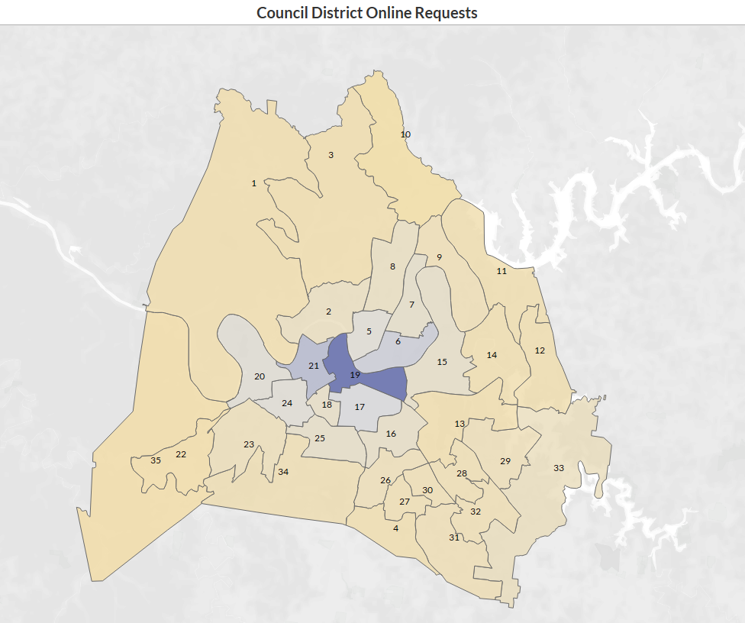

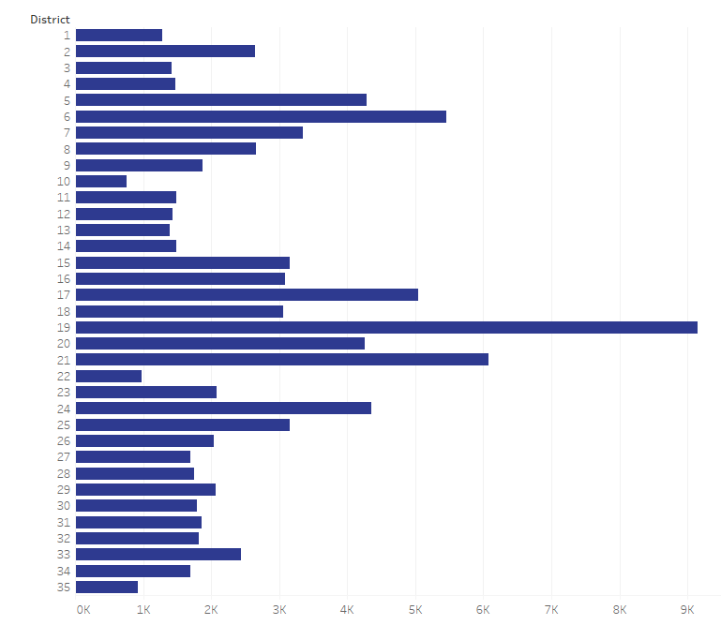
Online Requests by Council District
Council Districts
May want to promote use of app/website to lower-use
council districts via council leadership
10
35
NSS Analysts: Ben, Jacob, Pam
Notes:
Next, looking specifically at online requests from a council district perspective, you mentioned last week that some of you speak with council members and neighborhood groups about increasing their use of the website and app to resolve issues they’re having. We looked into the number of requests received online through the app and website, using the entire dataset timeframe, and created a visual to show per district usage of the online tools.
- Most of the hubNashville online requests come from the central district, Council District 19.
- The district that uses the online resources the least is Council District 10, on the north central edge of this map. - Efforts to increase usage of the website and app might be focused on the larger council districts showing the least usage, such as 35, 1, 3, and 10, found around the western edge of the Metro Nashville council district map. Next, Ness will discuss our findings about request types over time.

Slide 8
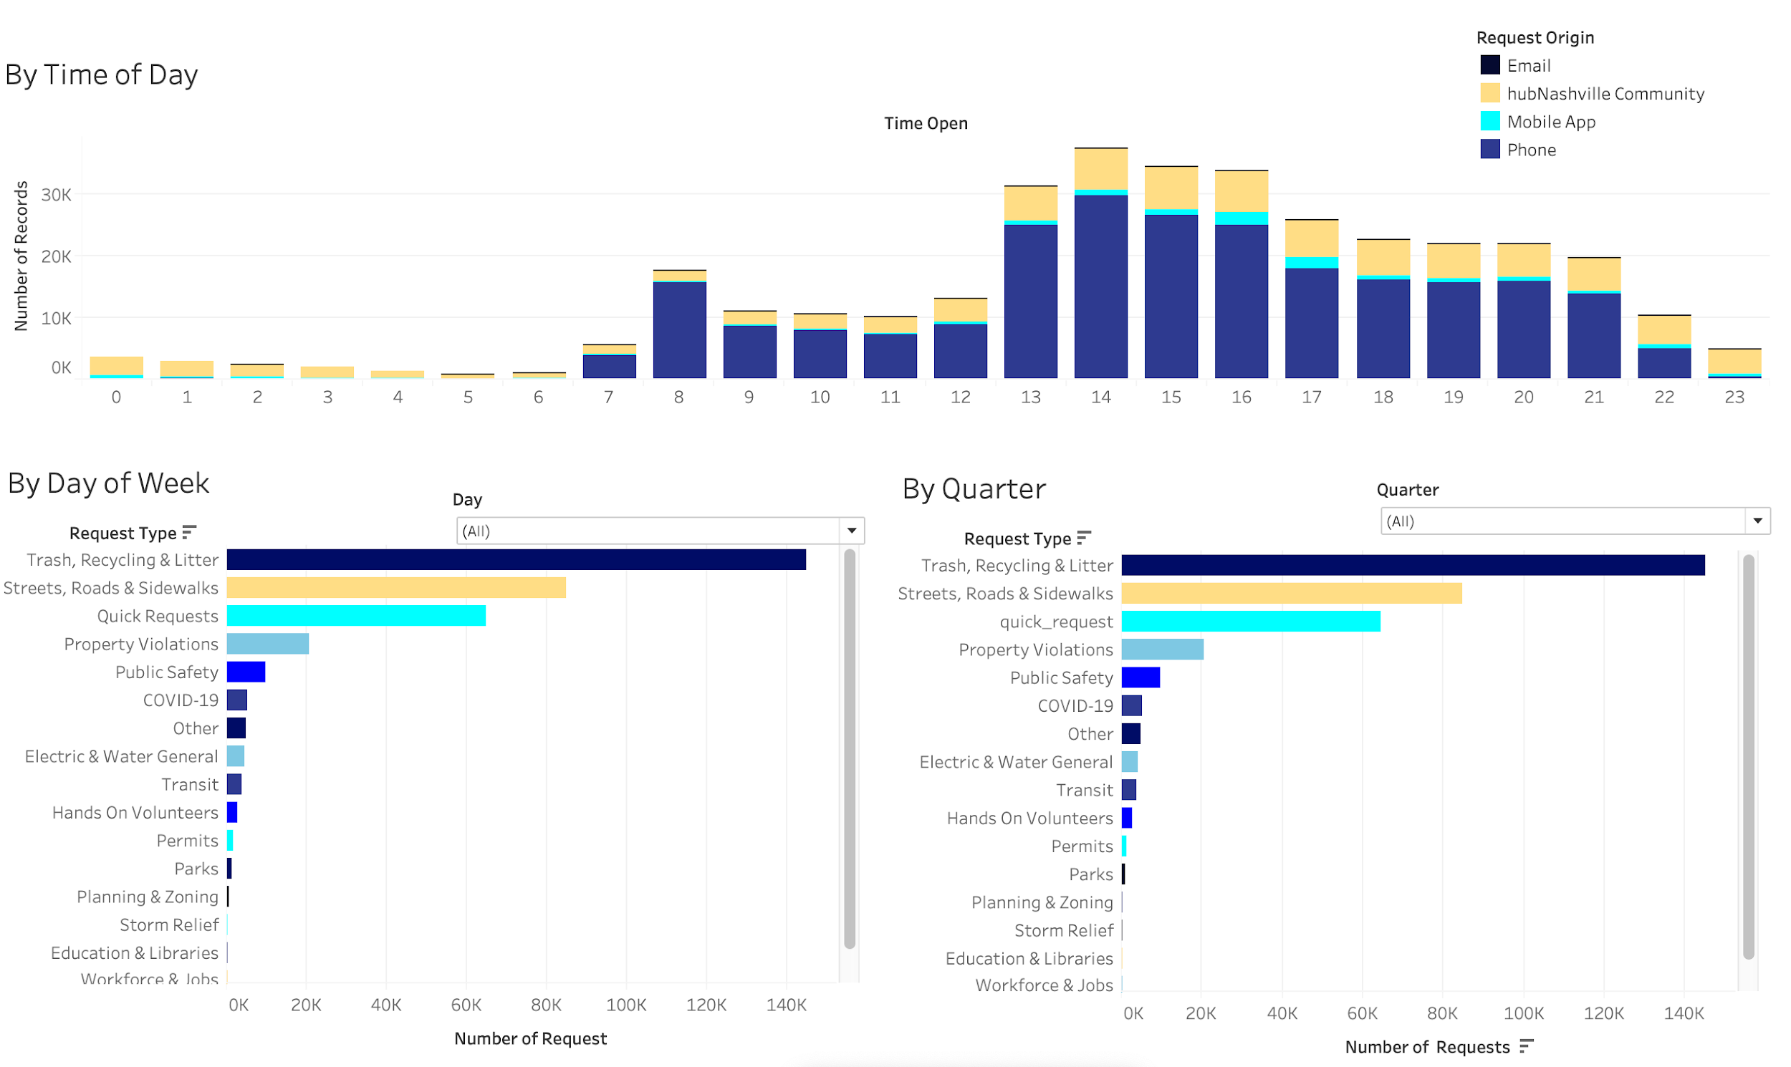
Request Types Over Time - Tableau
To View More of This Visualization: Click Here
NSS Analyst: Ness

Slide 9
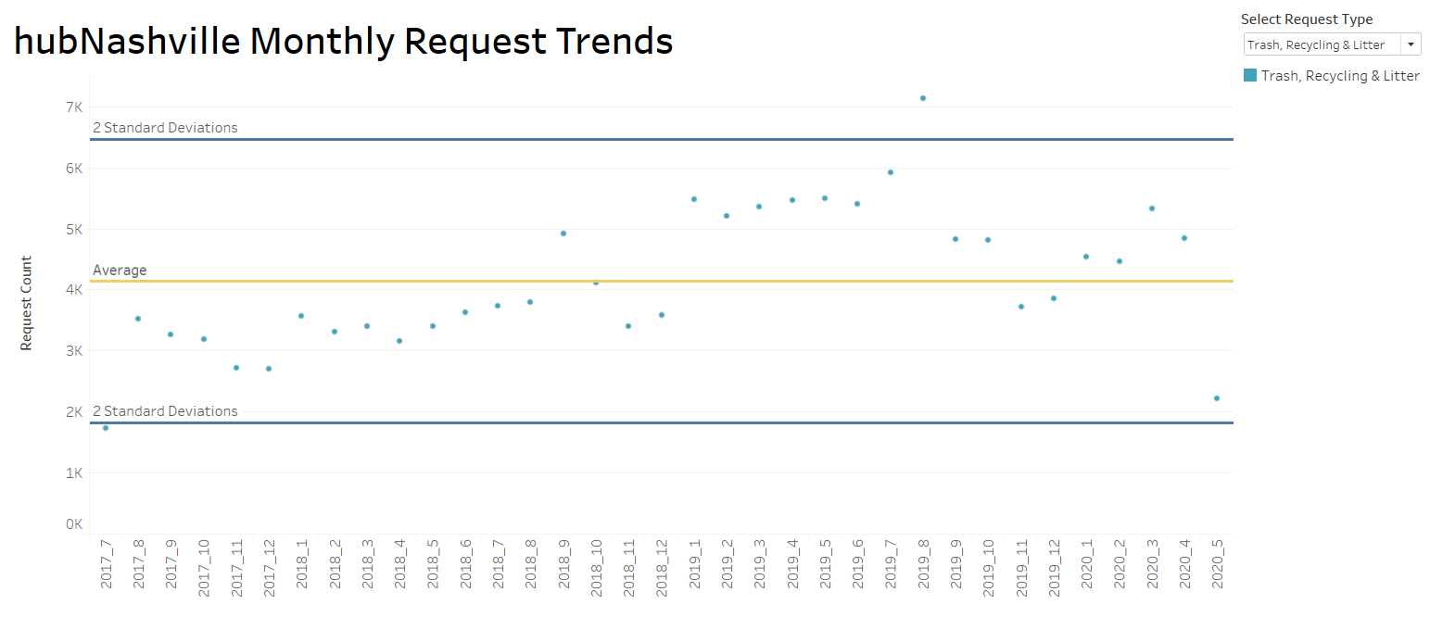
Request Types - Monthly Trends - Tableau
2019
2018
Similar shape in trash requests - peak in Aug/Sep and large drop Nov/Dec
To View More of This Visualization: Click Here
NSS Analyst: Media
Notes:
Created a dashboard to visualize the trends of the count of request types monthly since July 2017. This is a screenshot of looking at Trash, Recycling and Litter display the average count and its deviation of 95% confidence interval, which varies per request type. We noticed a similar pattern in 2018 and 2019. However, there was a higher count in 2019 may be due to the awareness of the services hubNashville offers. If you want to see the trends of the other request types, this dashboard is provided in the link below.

Slide 10
Geospatial Representations
Covid-19
Identify the Nashville area hotspots for Covid-19 requests
Trash, Recycling and Litter Requests
Identify high-volume request areas by zip code
Notes:
Looking at overall requests to shed some light on how we can increase productivity, the NSS team also created quantitative maps that allow you to see specifically where Covid-19 and trash service requests are heaviest. Over to Cat

Slide 11
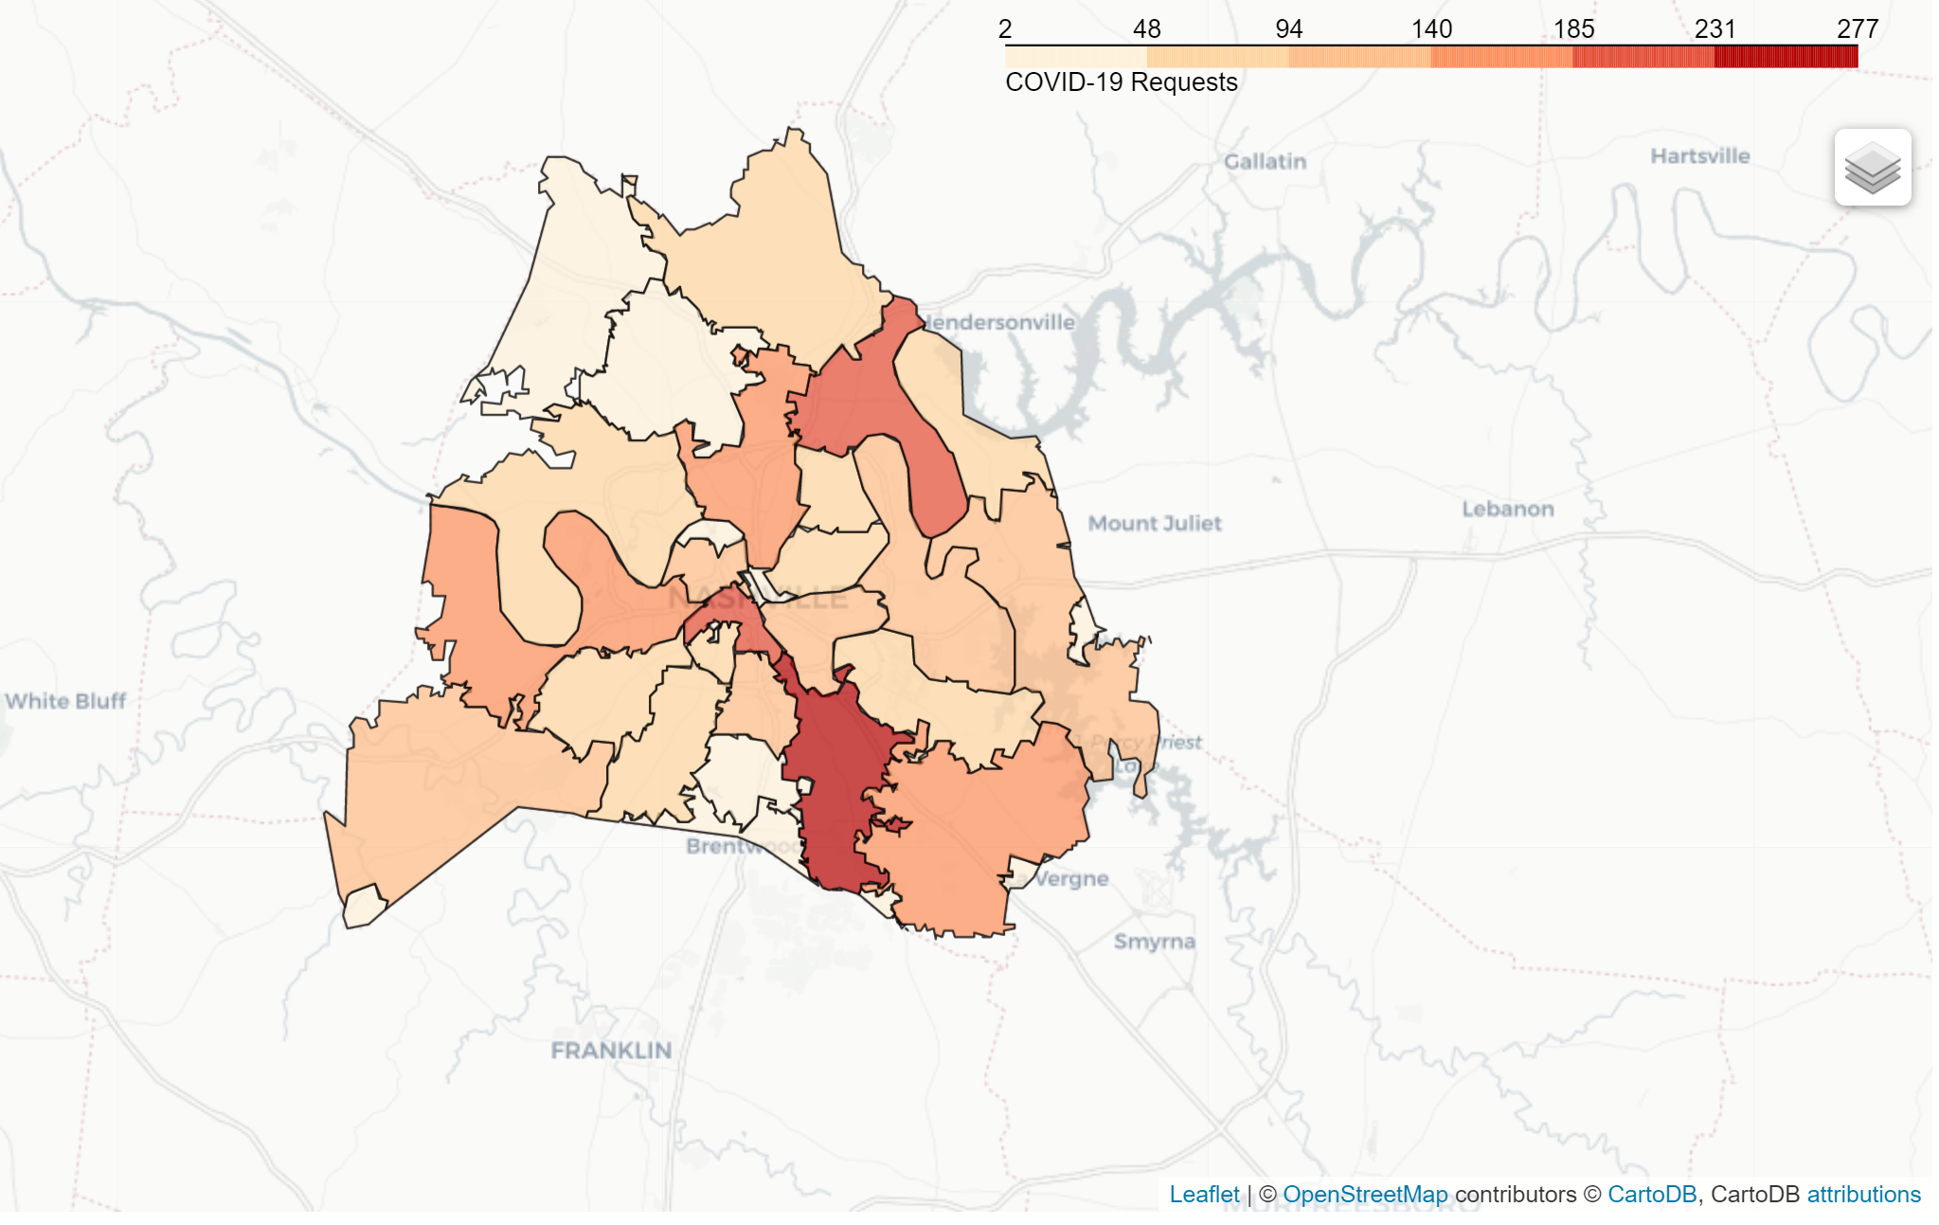
Covid-19 Geospatial Map
Highest concentration of COVID-19 requests in Antioch. More essential workers live here.
Source
Nashville Post Article
Covid-19 by Zipcode Map
NSS Analyst: Cat
Notes:
Metro Health Dept. connects cluster to essential workers.

Slide 12

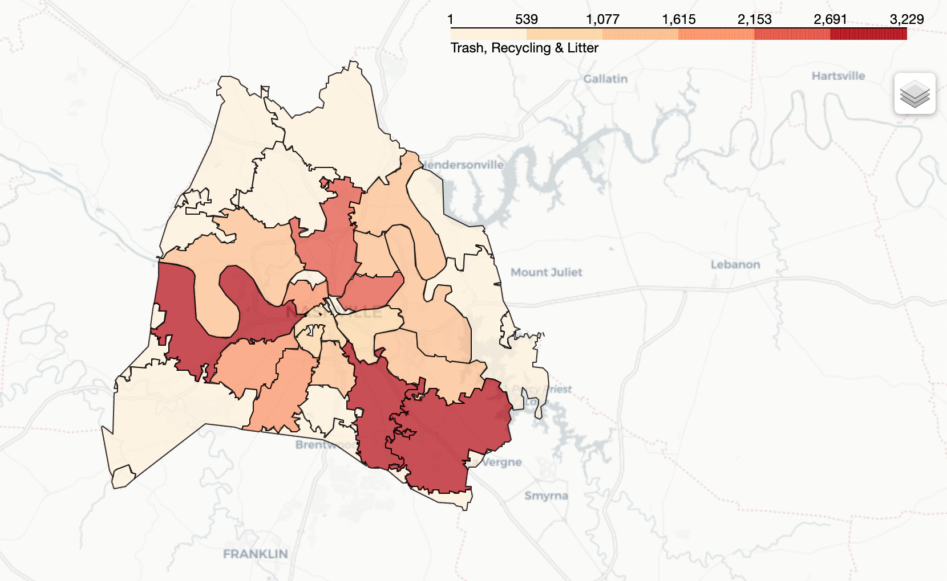
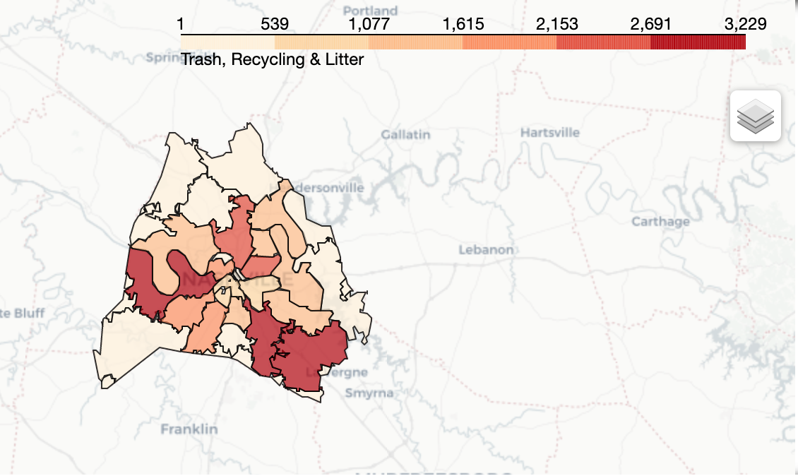
Trash, Recycling & Litter Geospatial Map
Zip Codes/ Neighborhoods with highest number of requests for Trash, Recycling & Litter:
37013 Antioch
37211 Berry Hill
37209 Bells Bend / Bordeaux-Whites Creek
Trash, Recycling & Litter by Zipcode Map
NSS Analyst: Cristina

Slide 13
Additional Analyses
Exploring further application of hubNashville to Property Violation Inspectors
Deeper analysis of Dead Animal Pickups over time and correlated with Police Dangerous/Injured Animal Reporting
Notes:
Some other explorations the NSS school team explored were the application of how property violation inspectors could utilize the tool in real time along with animal carcass request throughout the greater nashville area. Over to Teresa

Slide 14
Further Integration of Property Standards Reporting
Analyzed complaint sources from Property Standards Violation data to assess potential for further integration into hubNashville
Top 3 complaint source types accounted for 80% of property violation reports over the last 3 years
hubNashville has been effective in shifting complaint volume from phone calls to online reporting
Further integration could result in greater efficiency and utilization of the hubNashville system
Potential for unifying reporting system between hubNashville/Public Works and Codes Administration to reduce duplication of work
Potential for in-app solution to assist codes inspectors
Source:
Property Standards Violations

Slide 15
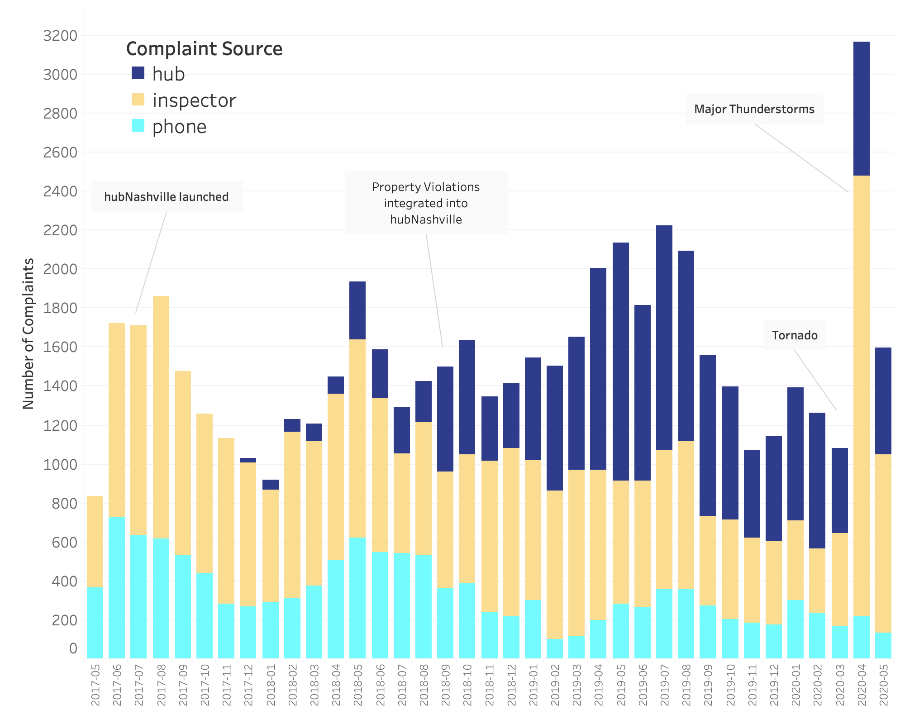
Property Standards Violations - Top 3 Complaint Sources
NSS Analyst: Teresa
Notes:
Looking at the trends for the top 3 complaint sources, Hub Nashville does appear to have displaced some portion of property violations reported by phone - inspector-sourced reports remain fairly steady. This began even before the official integration of codes/property violations in Sept 2018.
Looking at the datasets (hub Nashville and property violations), the systems do not appear to be fully integrated - different request number systems. Duplication of effort.
Opportunity for closer integration of codes administration into hub Nashville by streamlining property standards violations system.
Is there potential to implement an in-app solution for inspectors to submit reports along the same lines as Hands On Nashville volunteers after the tornado? Also see a parallel with the integration of data input by tow truck drivers as mentioned in the initial presentation.

Slide 16
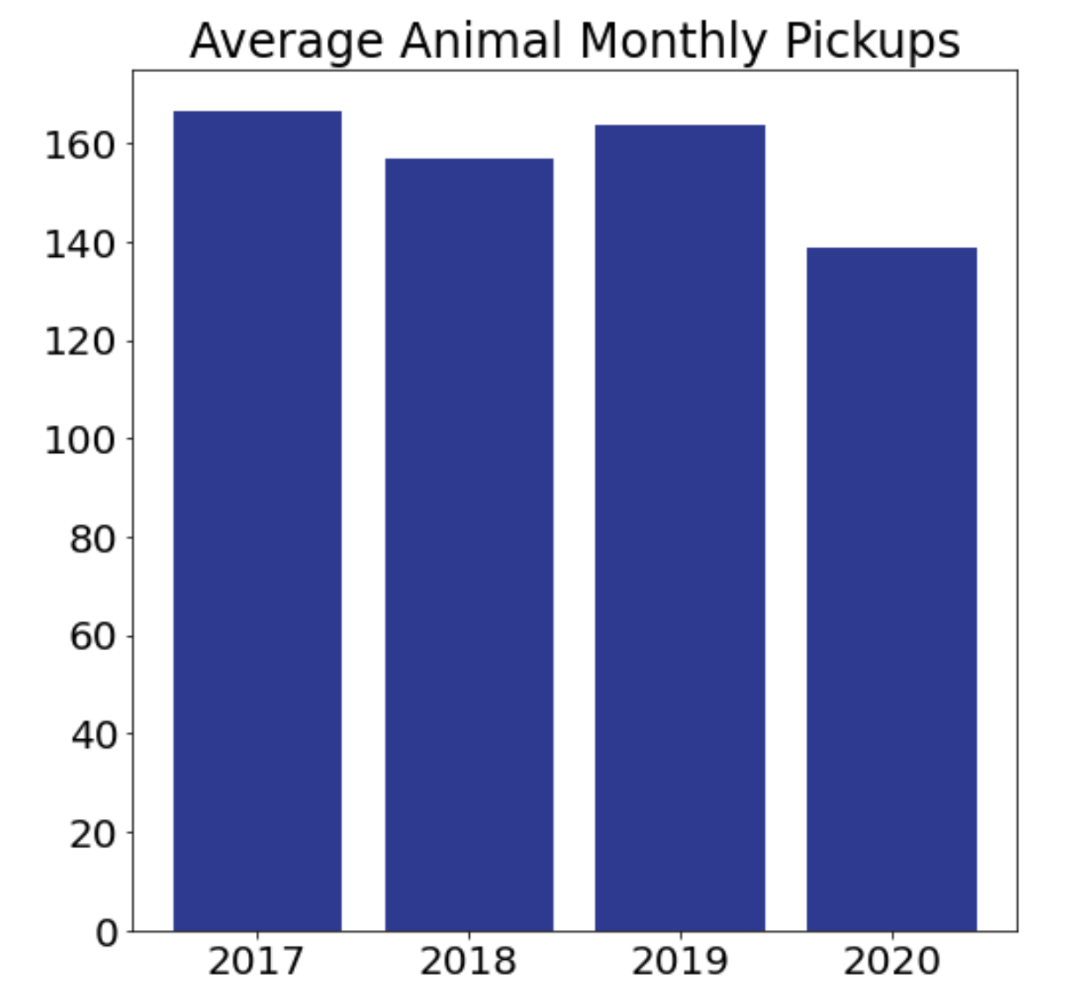
Animal Pickup Requests
167
164
2017 and 2020 were partial years of data, while 2018 and 2019 were full years.
Created a monthly average to keep comparison consistent.
We can see a noticeable drop in the monthly average for 2020.
157
139
NSS Analyst: Cat
Notes:
Lori and I looked at Dead Animal Pickup Requests, wondering if there was any change with the population growth and if the city-wide shut down may have made a difference. From this initial slide we can see that the average pickups per month has gone down noticeably in 2020. In the next two slides Lori will take a closer look.

Slide 17
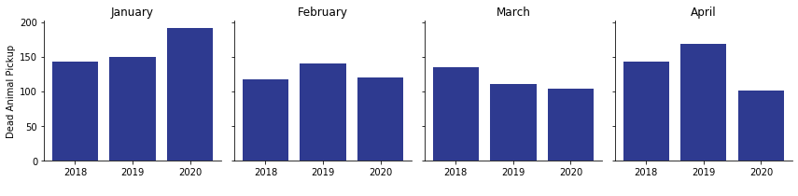
Did the city-wide shutdown impact
“Dead Animal Pickup” in 2020?
Unusual increase in 2020.
Maybe due to warmer weather?
~ 30% fewer dead animal
pickups in April in 2020
192
168
143
149
140
143
120
135
117
110
103
101
NSS Analyst: Lori
Notes:
This slide takes a deeper dive into the 2020 data. We saw from Cat’s chart that the average pickup requests per month were lower in 2020. This slide shows that the primary reason for that decrease was because of April, which had about 30% fewer calls than the same month in 2018 or 2019.

Slide 18
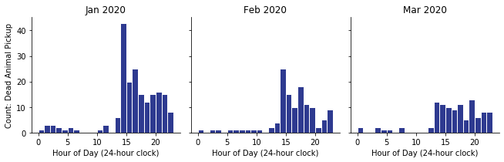
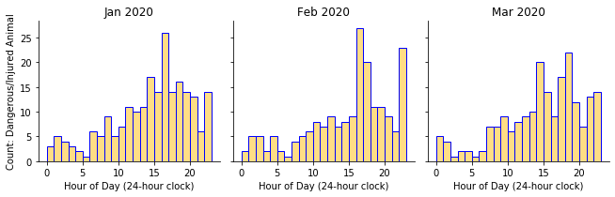
hubNashville Dead Animal Pickup
versus
Police Dept. Dangerous/Injured Animal
Is there a relationship between Dead Animal Pickups and Dangerous/Injured Animal reports to police?
Both have highest number of requests in mid-afternoon
Police data shows more late-night activity
Other interesting patterns?
High activity mid-day in Jan. & Feb in Dead Animal Pickups, but not March.
hubNashville: Dead Animal Pickup
Police: Dangerous / Injured Animal
2:00 p.m.
2:00 p.m.
NSS Analyst: Lori
Source Police Call Data
Notes:
---> I also looked at 2020 Police Calls data, to see if there might be correlation between the volume of calls coming in to police for Dangerous/Injured Animals and requests made to hubNashville for Dead Animal Pickup.
---> There does seem to be a mid-afternoon spike, but it’s a couple hours apart. Also, the police data shows a lot more activity late at night.
---> There doesn’t appear to be a connection on a high level based on hour of the day that the calls come in.
---> For the final part of this presentation, a summary will be provided by Antonio.

Slide 19
Summary of Observations
Funneling phone calls to the Web to provide information such as that provided by quick requests would be more efficient and reduce the need for manpower.
Assigning sub requests to Quick Requests in the future could lead to more in depth analysis
Trash and Litter Service Requests still account for the majority of the service requests (phone and online) - are there ways to more efficiently address these requests (specifically Cart Service Requests)?
Zip codes 37013, 37211, 37209 and Council District 10 have a higher proportion of phone requests vs. online requests and may benefit from some marketing regarding advantages of using hubNashville online
Notes:
Given the overall nature of the raw information we have narrowed our focus on a few promising observations. Since the data has only been collected over the course of a few years we are still early in the process of determining causation. As for now we can only see the start of trends and patterns to track in the years to follow.
If promoted more heavily in targeted areas we hope, the web platform in reduces strain on the call center, is more efficient, and possibility could address staffing forecast.
Trash and litter make up the majority of request but in many different ways. A push notification when entering the app may spotlight cart options for less navigation to address other common issues. We could look further into zipcode code 37219 to see if they are doing anything particularly persuasive since they are the single anomaly with more web request than phone service.

Slide 20
Summary of Observations
Statistical Process Chart provided unusual information regarding seasonal variations in trash related requests - spike in the fall and drop off near the winter
Could lead to a seasonal work schedule for additional manpower
Call center manpower based on forecast dashboard establishing the appropriate employee’s monitoring the most frequently requested correspondence types
Opportunities for further integration with Property Inspector Violations Team
Dead animal disposal requests experience higher reporting throughout the afternoon with a spike at 2pm.
COVID service requests heaviest in Antioch
Possible testing sites or additional resources could start with placement here
Notes:
As for the two years of identical seasonal trends with trash collection during the fall and summer. If the trend continues then this could to lead to a forecasted seasonal work cycle or projection of when waste could potentially be more of a problem.
Property inspection could be integrated for real time updates allowing for transparency and the possibility of quick correction or follow up.
A detailed look may highlight why carcass collection spikes in the evening or is correlated with injured animal calls.
And last but not least the very uncertain COVID has a focal point in Nashville. If there is a concentrated effort or an question of where to push reinforcement, then Antioch has been identified as having such a need.
Remember links for interactive dashboards are located at the bottom of each slide. At this time feel free to ask questions or give feedback for our findings.

